Slide 1

Mining for High Complexity Regions Using Entropy and Box Counting Dimension Quad-Trees
Rosanne Vetro, Wei Ding, Dan A. Simovici
Computer Science Department
University of Massachusetts Boston

Slide 2
Introduction
In science there are many approaches that characterize complexity.
The concept of complexity relates to the presence of variation.
A variety of scientific fields have dealt with complex mechanisms, simulations, systems, behavior and data complexity as those have always been a part of our environment.
In this work, we focus on the topic of data complexity which is studied in information theory. While randomness is not considered complexity in certain areas, information theory tends to assign high values of complexity to random noise.

Slide 3
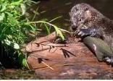
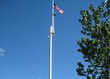
Introduction
Many fields benefit from the identification of content or noise related complex areas.
  In data-hiding adaptive steganography takes advantage of high concentration of self information on high complexity areas . Selective embedding can reduce perceptual degradation in transform domain steganographic techniques.
  Noisy or highly textured images will better mask changes than images with little content.

Slide 4
Scope of this work
An algorithm that identifies high complex domains of a 2-dimensional image domain is presented.
Two distinct methods are applied and later compared:
  Information-theoretic method which uses the entropy as indicative of complexity;
  Box counting dimension (BCD) Method which has its roots in fractal geometry.
High complexity areas of an image originated from both content and noise are targeted by the algorithm.

Slide 5
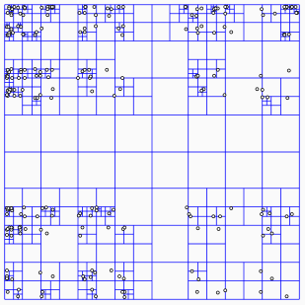
Algorithm Description
The algorithm constructs a full quad-tree related to the image entropy or box counting dimension to find high complexity areas.
It takes as input the gray scale version of an image, which corresponds to the root of the quad-tree.
It outputs an image file corresponding to a quad-tree that reflects the entropy or BCD concentration along the whole image area.

Slide 6
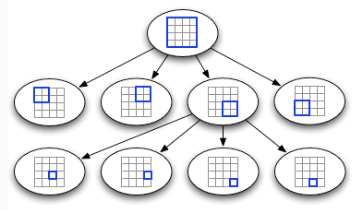
Algorithm Description: Construction the Quad-tree
Let H_{n} and bd_{n} denote the entropy and box counting dimension of the area corresponding to a node in the quad-tree and let A_{n} denote the node’s area.
During the quad-tree construction, a node is expanded if it satisfies the following splitting conditions:
  A_{n} > T_{a} , where T_{a} is a minimum pre-defined area size;
  H_{n} > T_{h} or bd_{n} > T_{bd} , where T_{h} and T_{bd} are pre-defined thresholds for the entropy and box counting dimension.

Slide 7

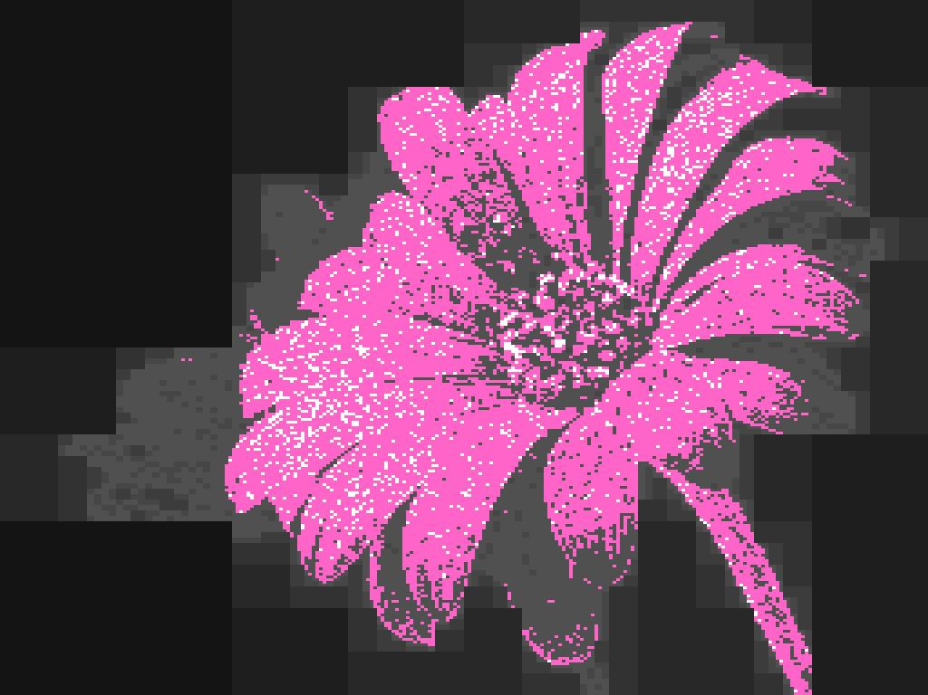
Algorithm Description
Quad-tree representation of an image feature¹ concentration
Leaves are assigned with a shade of gray, depending on their level on the tree.
Leaves located closer to the root correspond to areas of the image assigned with darker shades of gray.
The algorithm highlights the leaves at the highest tree level with highest feature¹ value (areas in pink or white).

Slide 8
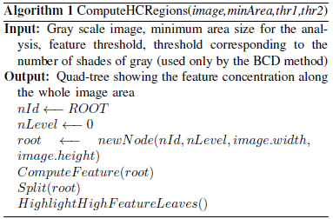
Algorithm: Computing high complexity regions

Slide 9
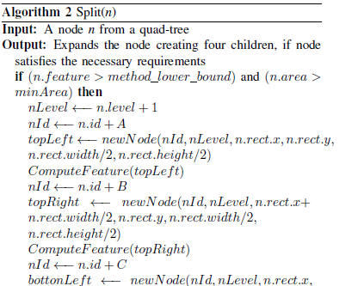
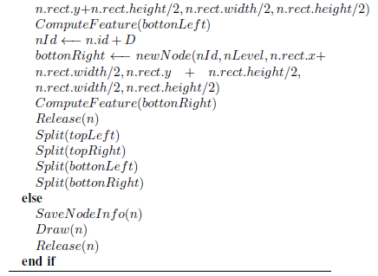
Algorithm : Splitting a node

Slide 10
Information-theoretic method
Let S be a finite set containing the possible values for the random variable X and let π= {B₁, ..., B_{n}} be a partition of S. The Shannon Entropy of π is the number:
The algorithm evaluates the Shannon Entropy of the local histograms of image sub-areas to find high complexity regions.
The partition blocks B_{i} _{(1 <= i} _{<=n)} of a node, used for the entropy analysis, consist of pixels with the same shade of gray.

Slide 11
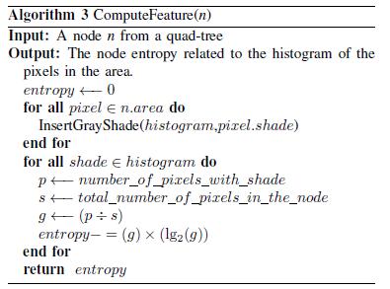
Information-theoretic method

Slide 12
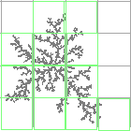
BCD method
Let (S, d) be a topological metric space and let n_{T}(r) be the minimum number of boxes of side length r required to cover a set T in metric space. The box-counting dimension of T is the number:
The algorithm evaluates the box-counting dimension of the local histograms of image sub-areas to find high complexity regions. The box-counting dimension of a sub-area is based on to the number of intercepting boxes in the sub-area.

Slide 13
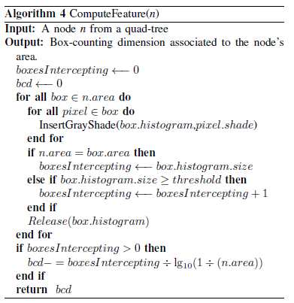
BCD method

Slide 14
Experimental Results
Experiments were performed over decompressed gray scale version of 9 JPEG images.
It was observed that the percentages of pixels in high complexity areas generated for each image file are very close in value for both methods.

Slide 15
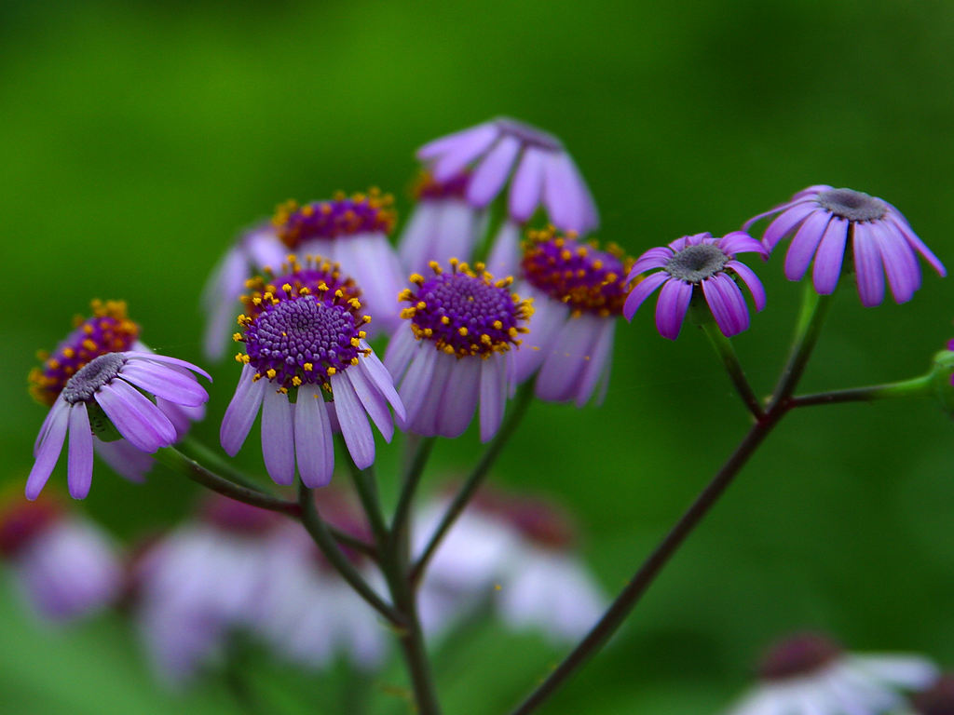
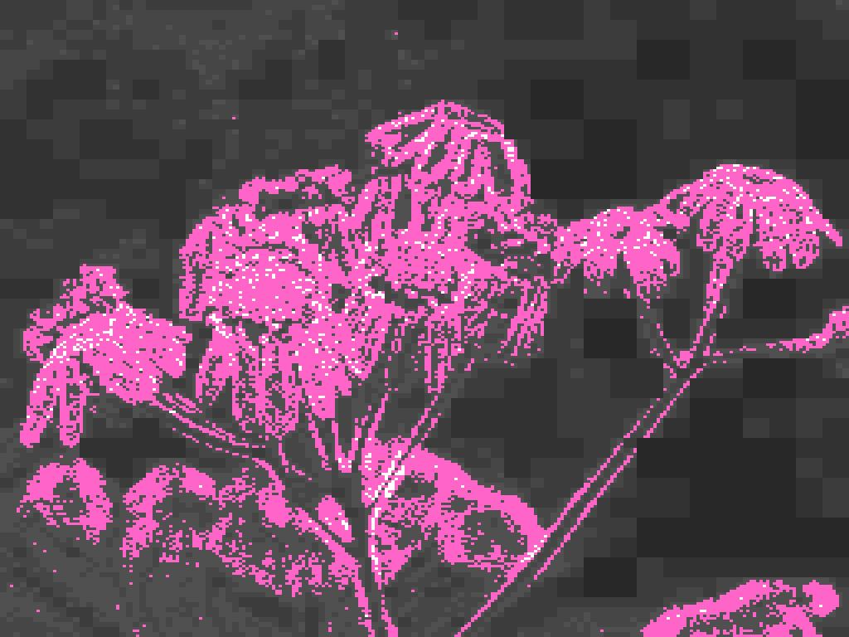
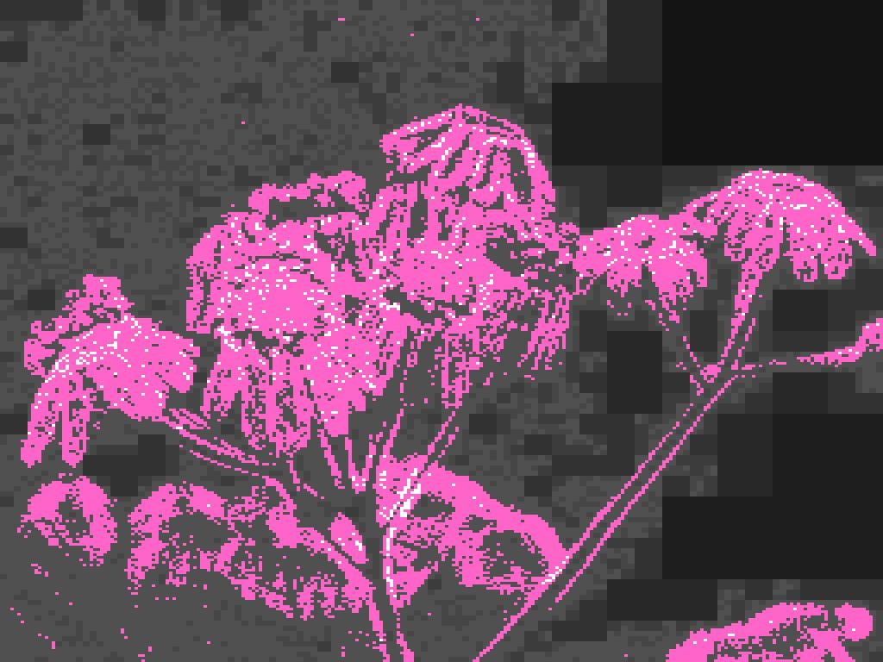

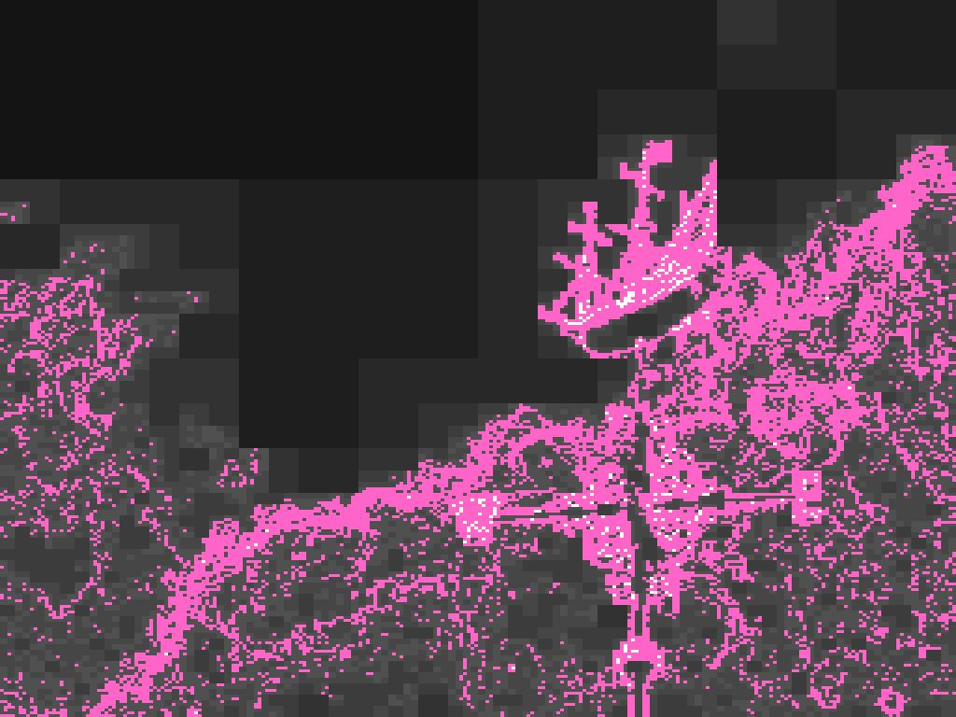
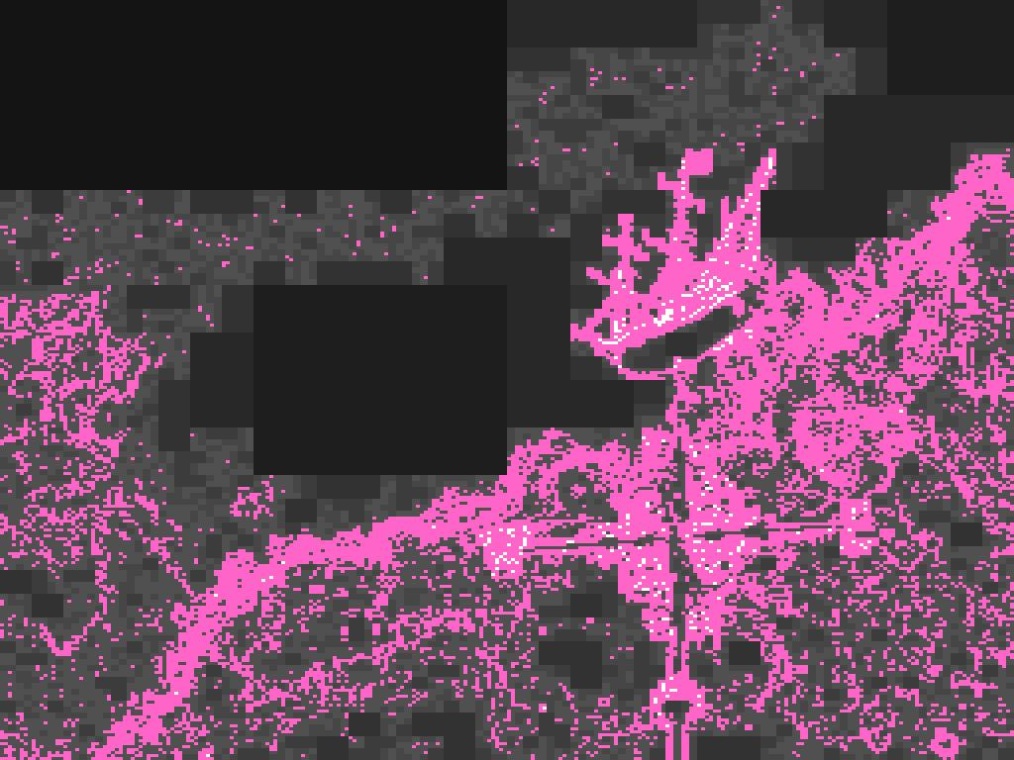
Experimental Results
Quad-trees generated for sample images
Original Image Entropy Quad-Tree BCD Quad-Tree

Slide 16
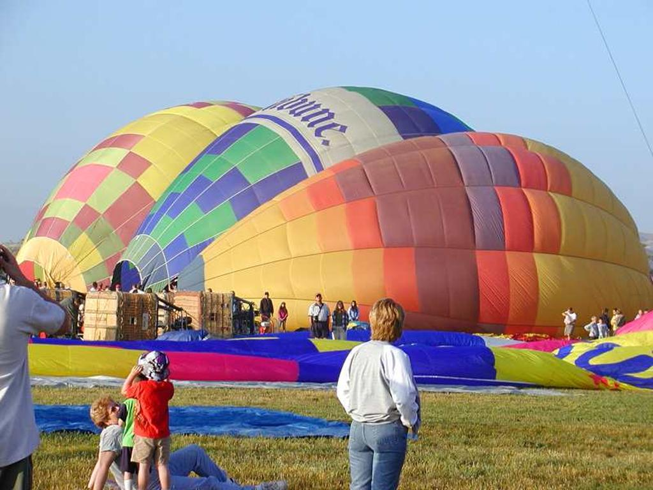
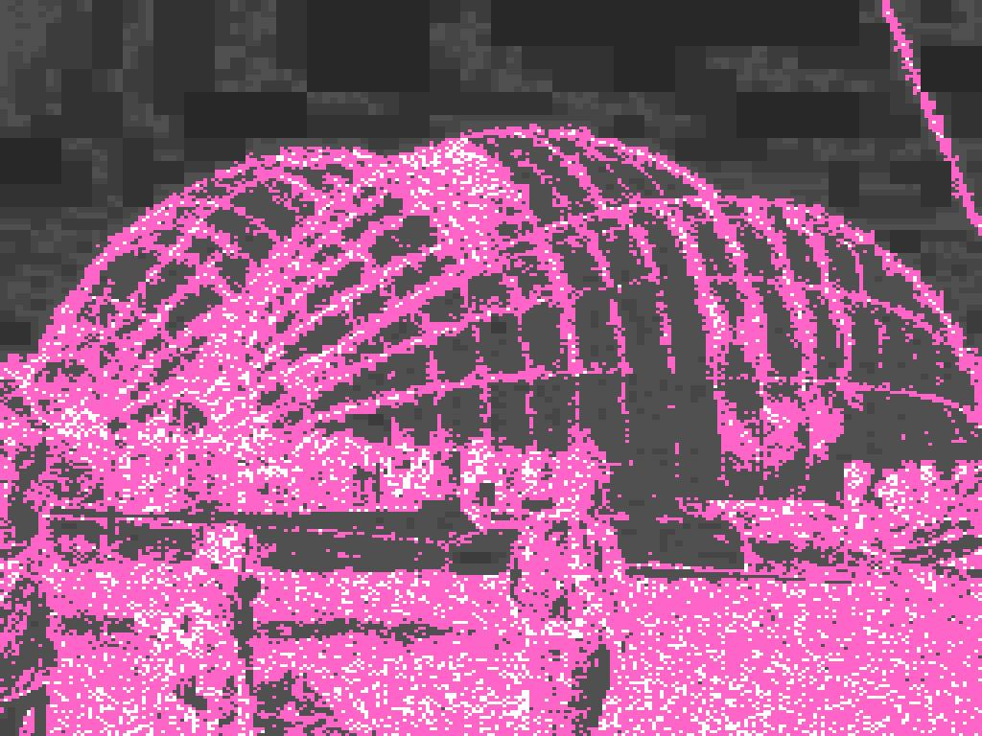
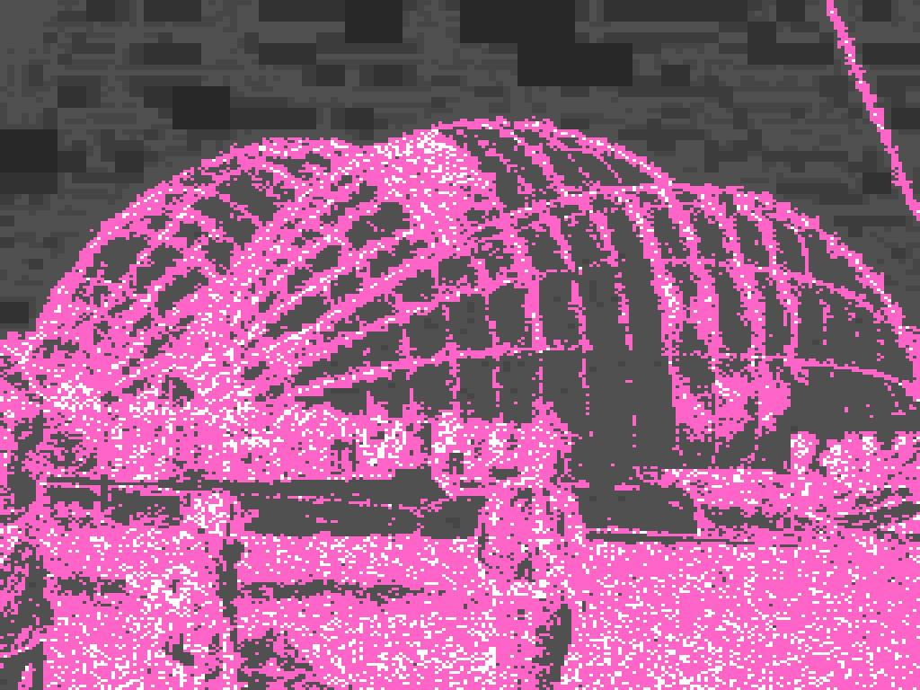
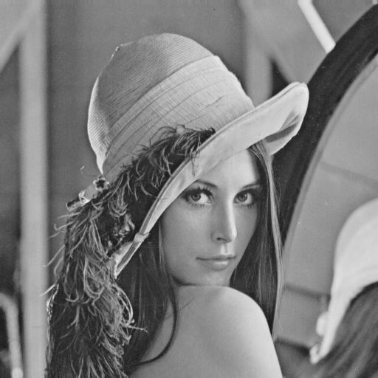
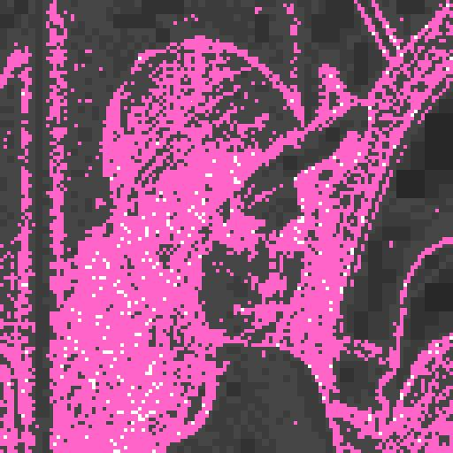
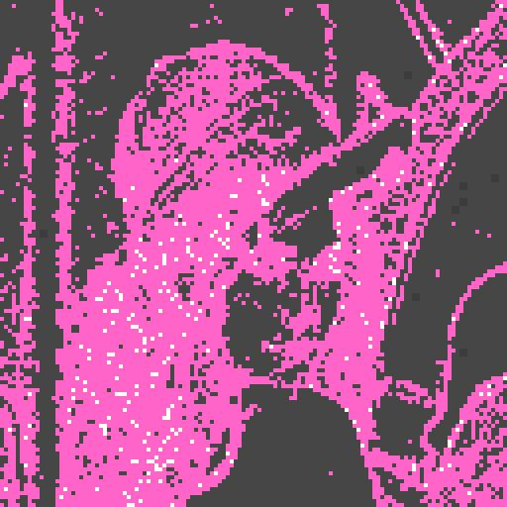
Experimental Results
Quad-trees generated for sample images
Original Image Entropy Quad-Tree BCD Quad-Tree

Slide 17
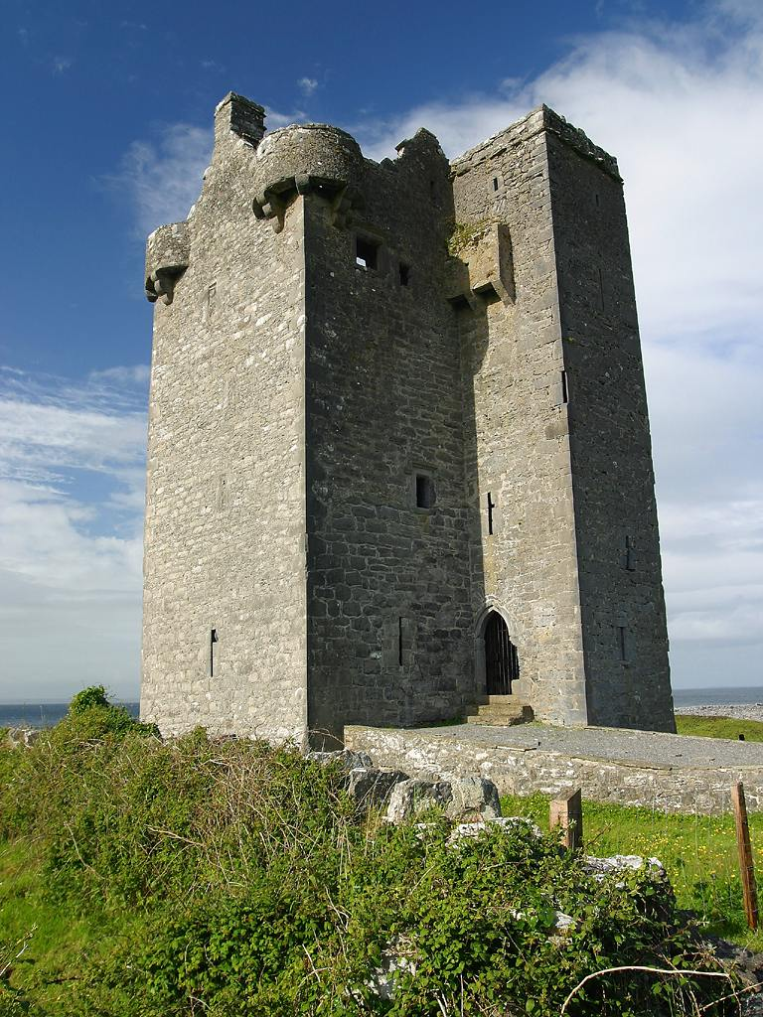
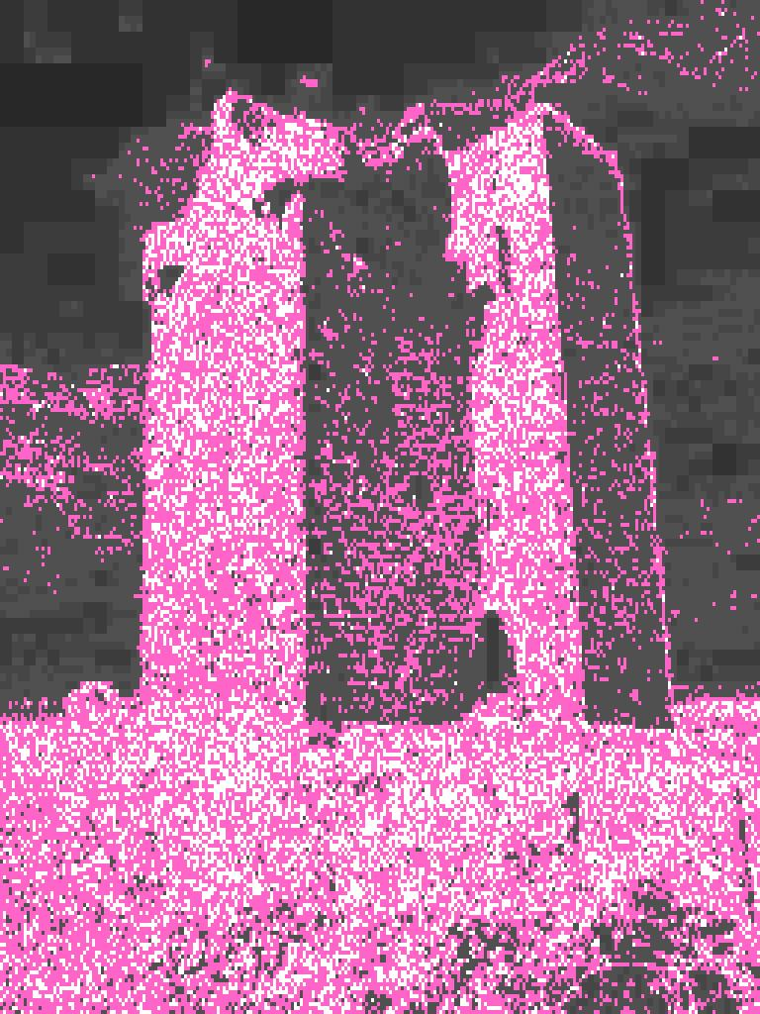
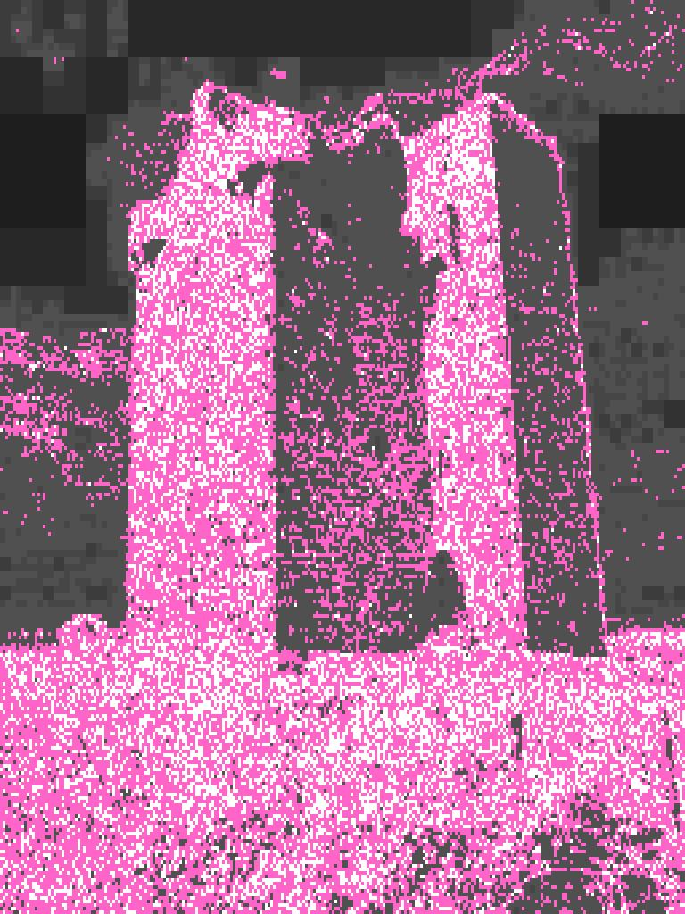
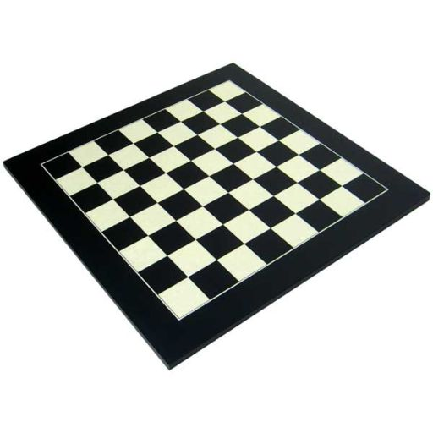
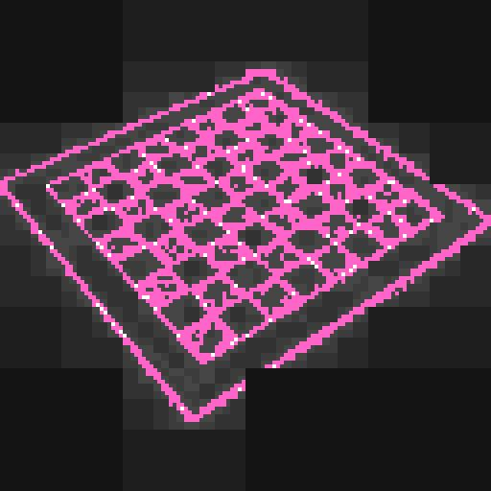
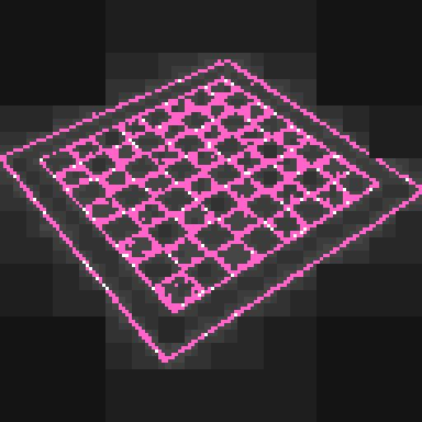
Experimental Results
Quad-trees generated for sample images
Original Image Entropy Quad-Tree BCD Quad-Tree

Slide 18
Experimental Results
In order to compare the results between different formats, experiments with Bmp image files were also performed. In this case, each Jpeg file was created from an original Bmp image.
Results for both formats regarding both methods were also quite similar and demonstrate that the algorithm can capture high complexity domains independent of a image format.
Results also show the relation between the characteristics of the images and the values used for the node splitting condition:
  Images corresponding to natural scenes or objects and faces with a textured background require a higher thresholds for both methods in order to capture well the complex regions.
  Images with objects and faces exposed over a more uniform background require lower values for those parameters.

Slide 19
To know more about it..
rvetro@cs.umb.edu
http://www.cs.umb.edu/~rvetro/research.htm

