Slide 1
Managing Data and Projects Across the Globe
University of Massachusetts Software Engineering
Donna Ferullo,
Director of
Research Programs, ASA
April 1, 2010

Slide 2
A Survey Of…
Clinical Data Management
Global Project Management Lessons Learned
Internationalizing a Product

Slide 3
Introduction to Clinical Data Management
What is it?
Who does it?
How does it affect me?
What does it look like to a software engineer?

Slide 4
Clinical Data Management (CDM)
“When new drugs or devices are tested in humans, the data generated by and related to these trials is known as clinical data. This data represents a huge investment by the biopharmaceutical or device company and is one of its greatest assets. It is the data that will eventually make a new product useful- and marketable- in disease therapy.”
-Suzanne Prokscha, Practical Guide to Clinical Data Management

Slide 5
Who Does It?
Drug companies
Medical device companies
Biotech companies
Hospitals
Research labs
Nonprofit disease organizations
University/corporate collaborations

Slide 6
CDM
“ The management of clinical data has become a critical element in the steps to prepare a regulatory submission and to obtain approval to market a treatment. As its importance has grown, clinical data management (CDM) has changed from essentially a clerical task in the late 1970s and early 1980s to the highly computerized specialty it is today”
-Suzanne Prokscha, Practical Guide to Clinical Data Management

Slide 7
How Does It Affect Me?
Affects your health, safety, and access to latest medical innovations:
-Clinical Data Management feeds FDA and regulatory approvals in the US
-Products of unapproved studies cannot reach the public

Slide 8
How Does It Affect Me?
Survey the field
Learn the terms
Be able to discuss in an interview
Increase your options
Appreciate the opportunities of the vast science and research institutions in an urban academic market

Slide 9
Position Examples
Regulatory Affairs
Clinical Software Engineering
Biotech Product Development
Medical Device Manufacturing
International Product Management
Clinical Data Manager
Disease State and Registries Software Engineering
Treatment Guided Research Software (ASA)
Hospital Clinical Systems Software (Phillips)
Electronic Medical Records (coordinated national effort)

Slide 10
The Organizational Entities
Sponsor – company that wants approval
CRO- clinical research organization
PI- Principal Investigator, research trained
Protocol/Study- the research project and the rules
Phase 1-IV Clinical Trials- the flow of research
Study sites- clinics participating, dispersed
Subjects- humans in the study
Data- recorded from the subjects

Slide 11
Clinical Trial Phases
Phase I: Researchers test a new drug or treatment in a small group of people for the first time to evaluate its safety, determine a safe dosage range, and identify side effects.
Phase II: The drug or treatment is given to a larger group of people to see if it is effective and to further evaluate its safety.

Slide 12
Clinical Trial Phases
Phase III: The drug or treatment is given to large groups of people to confirm its effectiveness, monitor side effects, compare it to commonly used treatments, and collect information that will allow the drug or treatment to be used safely.
Phase IV: Studies are done after the drug or treatment has been marketed to gather information on the drug's effect in various populations and any side effects associated with long-term use.

Slide 13
The Online Entities
Database
Case Report Form
Data Entry Fields
Rules and Validations
Electronic Data Capture
Remote Data Capture
Phone Data Capture

Slide 14
The Nuts and Bolts of a Data Management Project
Data management plan ->
Study setup ->
Tracking CRF data ->
Entering data ->
Managing lab data ->
Identifying and managing discrepancies ->
Collecting adverse event data ->

Slide 15
Nuts and Bolts, Continued
Coding reported terms ->
Creating reports and transferring data->
Closing studies .
Clinical Data Management by Suzanne Prokscha

Slide 16

Clinical Trial Visual
PI and Protocol
Case Report Form
Clinical Sites With Subjects :EDC, RDC, IRT
Subject Data
Sponsor’s Database
CDMS
FINAL DATA

Slide 17
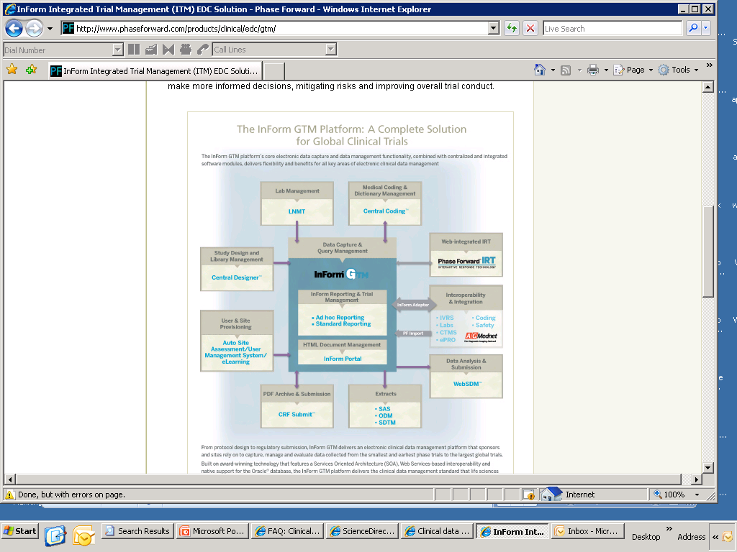

Slide 18
Data Management Plan
Project management document for a data management project
Written by the clinical data manager
Defines roles and responsibilities for each of the phases named:
- work performed
- who will perform
- which SOPs?
- what documentation or output?
QA and GCP compliance- both require a plan

Slide 19
Study SetUp
Definition and creation of a database using database design document
Preparation of manual data entry applications
Design and programming of transfer or loading programs
Must balance:
- clarity, ease, speed of data entry
- efficient creation of analysis data sets
- source data transfer formats

Slide 20
Common Data Management Entry Fields
“Hidden” text fields
Dates of all kinds
Text fields and annotations
Header information
Single check boxes
Calculated or derived values
Special integers

Slide 21
Preparing Data Entry Inputs:Screens and Systems
Heads up data entry
Heads down data entry
Data coordinators resolving discrepancies
Imaging systems and OCR
Entry databases
Electronic transfer programs
Standards and standards czars- CDISC
new fields, variations on fields, new codelists, additions to codelists, changes in groups of fields

Slide 22
Entering Data
Manual and OCR
Reducing transcription errors
Pre-entry review
Edits
QA
System tasks check manual tasks
Newer: digital imaging data, my field has electrical imaging data

Slide 23
Managing Lab Data
Blood chemistry, hematology, biomarkers, lipids, etc.
Largest percentage of study data by sheer
volume
Storing in tall skinny format
Normalizing units
Checking ranges- validation and rules
Central labs
Loading applications

Slide 24
Identifying and Managing Discrepancies
Discrepancies are inconsistencies in the data that require research
Discovered by manual or system review
internal and external system checks
Flag and notify investigator on a query form
Collect and record resolutions from all possible sources
Nifty ways to automate this process

Slide 25
Collecting Adverse Event Data
Uh oh “undesirable experience”
rash, death
Strict regulatory requirements: CFR21
Autocoding
Signs/symptoms events and serious adverse events are collected differently
Serious adverse events must go to a safety system and be reconciled with CDM before end of study

Slide 26
Coding Reported Terms
Coding takes free text and classifies it to like terms for analysis
ex. “sore head” “head pain” “headache”
Common coding dictionaries
COSTART= Coding Symbols for a Thesaurus of Adverse Reaction Terms
ICD-9-CM=International Classification of Diseases, 9th Revision
WHODRL- World Health Organization Drug Reference List

Slide 27
The Coding Algorithm (Heavy on Autocoder)
Collect and store the reported term
Run the autocoder
If code is found, autocoder stores the results
If code not found, autocoder stores the term for manual coding
Manual review of uncoded terms assigns a code in a separate table, or
Registers a discrepancy on the reported term
Reruns the autocoder, then finds a match

Slide 28
Creating Reports
Reports serve internal staff and management
Often guide interim analysis- “kill it?”
Name the selection criteria and construct the SQL or other query (“Of all males 40-44 who tried this statin, how many developed adverse reactions and how severe was the reaction, and what was their baseline BP before the study began?”)
Standard and Ad Hoc Reports
Validation

Slide 29
Transferring Data
Reports summarize data; transfers send the whole files
Used for external data review or satellite locations
Validated program or application
Use transfer metrics and transfer checklists to be sure the process is without error
- no. of files
- file sizes
- no. of patients per file
- no. of records per patient
- no. of variables or fields

Slide 30
Closing Studies
Last patient in
Data “lock” – time is competitively tracked
Before lock, all data, corrections from sites, calculated values, and codes for reported terms must be in- else discrepancies could result
Collect final data, resolve all queries, perform final QC(audit trail), complete documentation, sign off
Ready for data analysis

Slide 31
Now What
Data analysis, final reporting, regulatory approval process
Huge competitive pressures
-Time
- Isolated servers
- Security in data centers
- Contingency plans and disaster recovery

Slide 32

Competition to Final Data Analysis
Every day delayed to market is $1 M as of 2005

Slide 33
In the Regulatory World…
Compliance determines usability of data
Document, Document, Document
Auditing rules: mapping success
Your use cases must match your engineering plans, must match your QA plans, must match your test cases, must be signed, properly dated, properly filed in excruciating detail or you will not pass. If you don’t pass, you can’t use the data.

Slide 34
Validated Systems
Every new system implemented must be tested in accordance with a validation plan
Validation packages as a QA offering- often use every QA script- consulting gig too
FDA requirement
Validation in the pharmaceutical industry is defined as the establishment of evidence that the computer system does what it purports to do and will continue to do so in the future

Slide 35
Project Management Insurance: Lessons Learned
Archival
The verbal project manager
The art of bird dogging
Product management, marketing and watching the competition
Managing scope creep

Slide 36
Archival
Maintain an online, common record
- Sharepoint, Wiki pages, Google, in house
- Make that record the repository
- Lives beyond project
- Reference-able, auditable
- Central, accessible daily, the standard
Refer everyone to the repository
“Bible”- if not there, it is not part of project

Slide 37
The Verbal Project Manager
Hold in-person group meetings for requirements review, project plan review
You cannot overcommunicate
You cannot overestimate the misunderstandings that can occur on email
Pick up the phone
Maintain your working relationships

Slide 38
Hold Group Meetings of All Stakeholders
Promotes understanding
Efficient, minimal, but critical
Archive minutes
Review requirements and critical changes in live session with all stakeholders- communicate successes and delays in person
Check the project plan weekly and ask for deliverables
Authority and accountability

Slide 39
The Art of Bird Dogging
You must have and project authority
Use that authority to hold deliverables to time and make others accountable
Track your project plan
Send reminders and follow up by phone
Meet weekly to ensure deliverables met

Slide 40
Watching The Competition
Your scope must reflect market competition
Pay attention to product management, marketing, road map, competitive analyses
In long product development cycle, he who arrives with the best features wins
Example in autism software: reports feature and longitudinal graphing functionality

Slide 41
When Scope Creep Is Good
Cost/benefit, ROI analysis
Management decision then live group meeting
Controlled scope creep
Change control system
Stay in tune with marketing to maintain competitive edge

Slide 42
Project Management Education
Online:
http://www.gatlineducation.com/projectmanagement_overview.html
Free introductory:
http://www.suite101.com/course.cfm/17517/seminar
Most biotech or software professionals I know used PMP or Six Sigma certification

Slide 43
Internationalizing Software
Internationalizing (I18N) means the code:
designing applications so that they can be localized (adapted) to various languages and regions without engineering changes
Localization means translating the language

Slide 44
The Tech Side of I18N
Source code embedded with language strings are "internationalized" by extracting "hard coded" text strings and replacing them with references to a resource file external from the source code. This has the advantage of unicode compliance. This separation of logic and data also makes it easier to distribute the work of translating strings to other languages.
Alternatively, text strings in source code can simply be replaced with text of another language. This carries less risk than changing source code logic.
The logic for translating specific words and phrases can reside in an organization's Translation Memory database.

Slide 45
For More Introductory Information
http://www.wilsonmar.com/i18n.htm#UglyAm
http://www.gala-global.org/en/resources/CCapsArticleMoore_EN.pdf

Slide 46
Working With International Teams
Learn the culture and the accent
The Wine; Scotland, Japan, Germany, China, India, Switzerland, New York, The Midwest, Washington, D.C.
Kick off in person and milestone meet in person
Set regular meeting calls, late night or early morning
Find a reliable protocol for communications
Use your archived repository for all contributors, international and not
Archive your project emails

Slide 47
Worldwide Success
Virtual teams require more, not less communication
Do not make the less cost issue a less respect issue ex. my Swiss team
Be courteous about hours and deliver on their time ex. beta testing
Remote management can be a pain
Be the champion for the remote programmer- they do not have a voice. Loop them in.

Slide 48
Worldwide Success
Know your teams and your players: make the effort and they will reward you
Projects are about software; project management success is about people and follow-through

Slide 49
Changes I Have Seen
From installed database products to Web
From paper CRFs entered into large institutional databases to Electronic Data Capture
From in person teams to virtual teams, especially for family/work balance
national coalition example- 40%
From local tech teams to international programming teams, for cost savings

Slide 50
Changes I Have Seen
This means COMMUNICATION and REMOTE MANAGEMENT SKILLS are valuable
You will be leading the next wave. Keep your skills sharp, diversify and keep learning!

