Slide 1
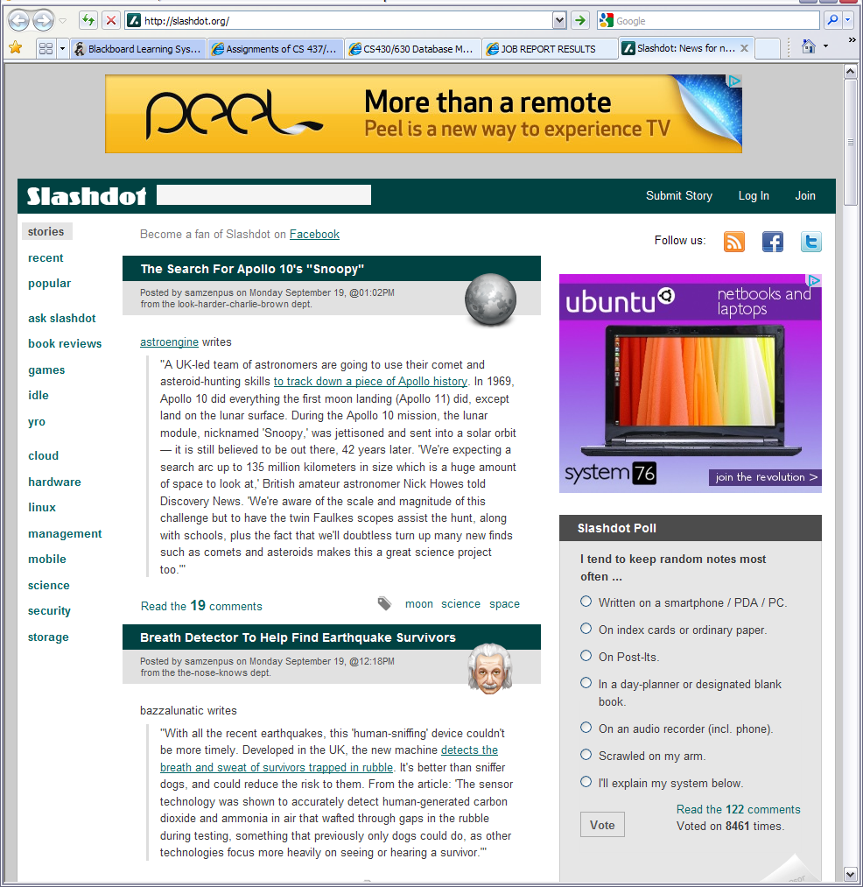
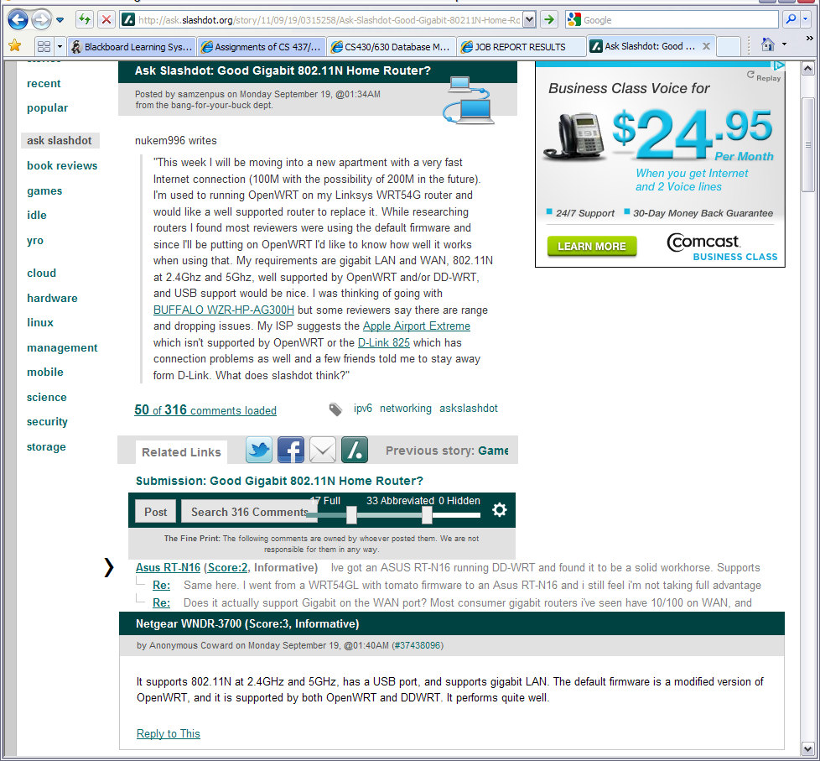
Making money
Search, Login, Logout – easy to find
Categories of stories – easy to find
Most of webpage is what I want to read
Right column is configurable tiles for desired content (not shown)
Content tags, awesome!
Story comments - Input from others
Lots of what I want to read, open and visible,
the rest of the material including comments, need to click to see.
CS637 - Homework #1 Timothy A. Carr September 19, 2011

Slide 2
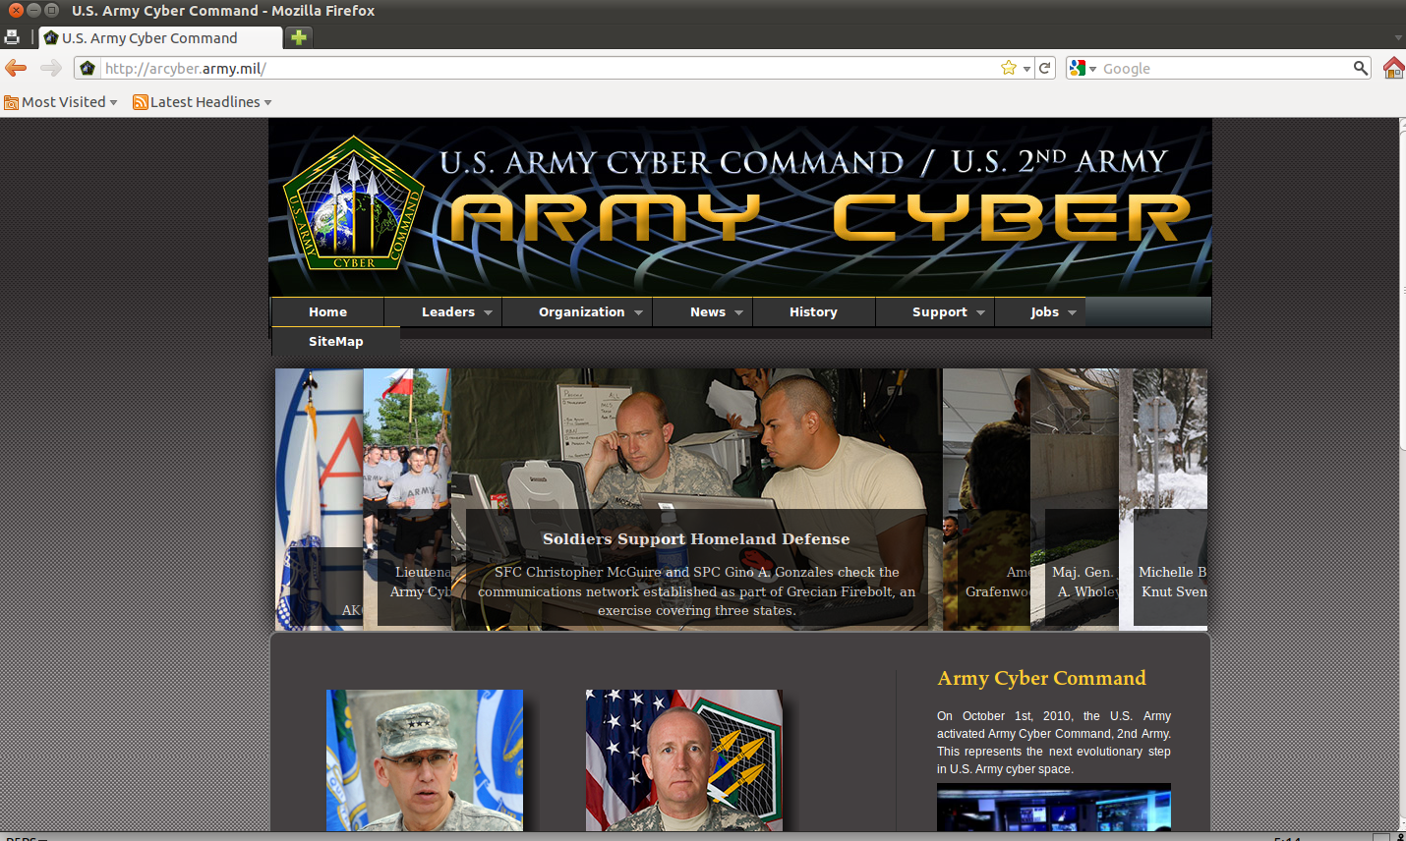
Evaluation of http://arcyber.army.mil/
Ronnie Sekamwa
The homepage has nice colors and background which reflects the organization of cyber war (spears)
Website navigation is easy and it contains slides of graphics.
Spelling and grammar are correct.
Website is connected to external social networks such as youtube, facebook and twitter where by one can follow all the website updates.
I like how the layers of the contents are arranged and all links are functional.
I like the horizontal menu as opposed to vertical.
I also like mouse over functionality

Slide 3

Babeu Alex
Like:
  Each page show exactly what website does:
    Allows ordering takeout online
  Has useable mobile version for smart phones
  Good use of symbols and pop-ups to show what pages mean
  No doubts about who to contact with problems.
Dislikes:
  No faceted browsing, so cannot search for a specific set of attributes.
  Some graphics on the page are small and
  Makes you fat.
How I would change:
  Would add a “wizard” to allow specifying options and seeing what the site recommends.
  Would make many of the graphics larger and to make them easier to read.

Slide 4
Craigslist.org
Pros:
1. mostly free service, not supported by adverts
2. easy to use
3. covers all 50 states, 450 cities all over the
world, and still growing
4. large number of users (easy to sell or find goods)
Cons:
1. limited search function
2. since it is free it attracts criminals for easy target
3. lots of scam and fraud
Alena Bertash

Slide 5
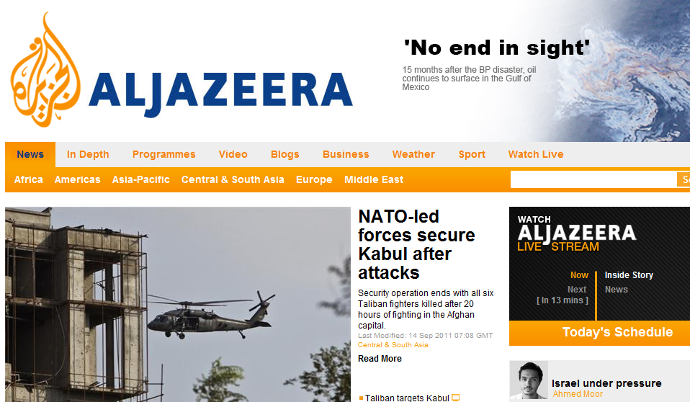
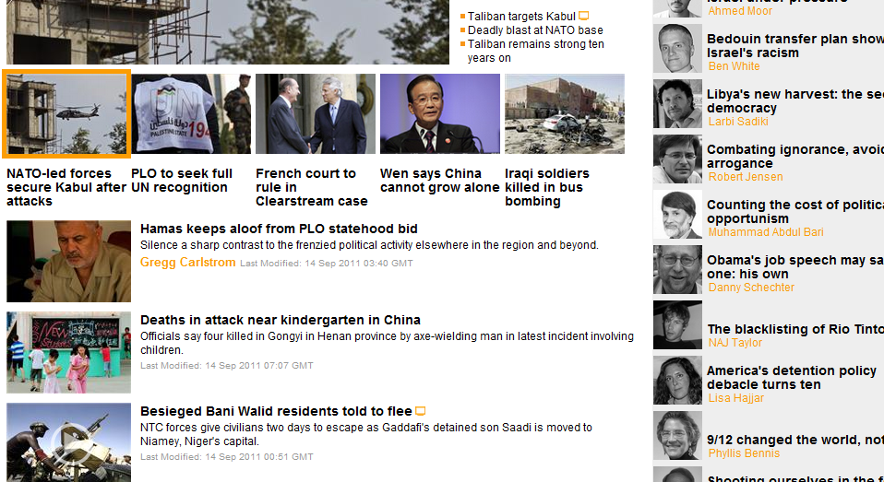
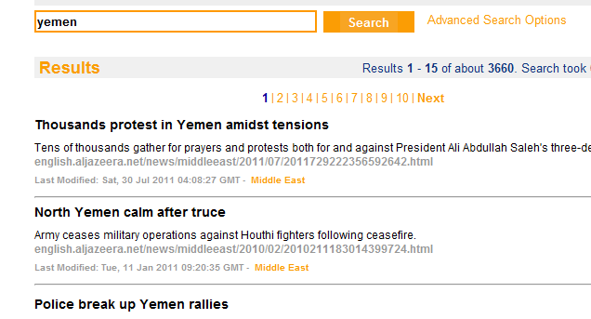
Al Jazeera English
Cordeiro Evan
http://english.aljazeera.net
Design Strengths:
Intuitive, Tiered, Accessible Navigation
Relevant, Well Formatted Search Results
Featured Interactive Content, Video
Simple, Bold Color Scheme
Prominent Logo/Branding
No Ads
Design Weaknesses:
Full Page Reloads
Unused Space in Header
Initial View Skewed
Non-Interactive Search

Slide 6

University of Massachusetts at Boston www.umb.edu
Das Priyanka
About the Website
Design reflects the brand of the university
Integrates with social media networks
Easier access to information
Information can be downloaded easily to different formats
Mobile application download capability
About the Design
Browser Compatibility
Easy Navigation
High Quality Content
Accessibility
Information Security/ Data Privacy
Technical Merit
  Quick Response/Load time
  Efficient Search Capability
  Database Integration
Wiser system functionalities should be improved
Career services should be more comprehensive and informative

Slide 7
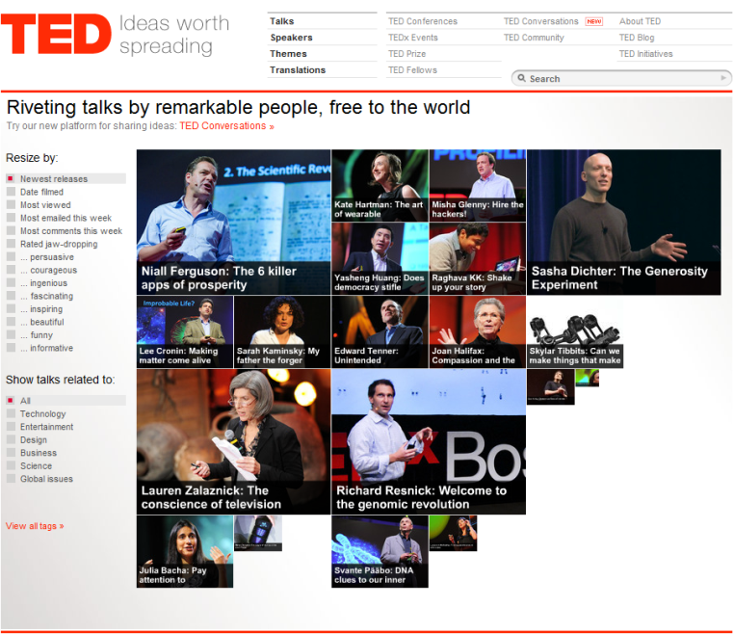


Fan Peihong
Ted.com offers many talk videos about different ideas from different people.
Home page design: simple and clean
Very informative
Interesting and educative
Usability:
Fast loading
Well organized
Intuitive
Supported by almost all browsers(with flash)
Fits in all size of windows
Easy to share
Accessibility:
All buttons have plain text
Subtitles are available for many languages
Powerful search engine
Improvement?
More colors.
Non-flash support
No fancy colors(Black and white)
Website url:
http://www.ted.com/

Slide 8
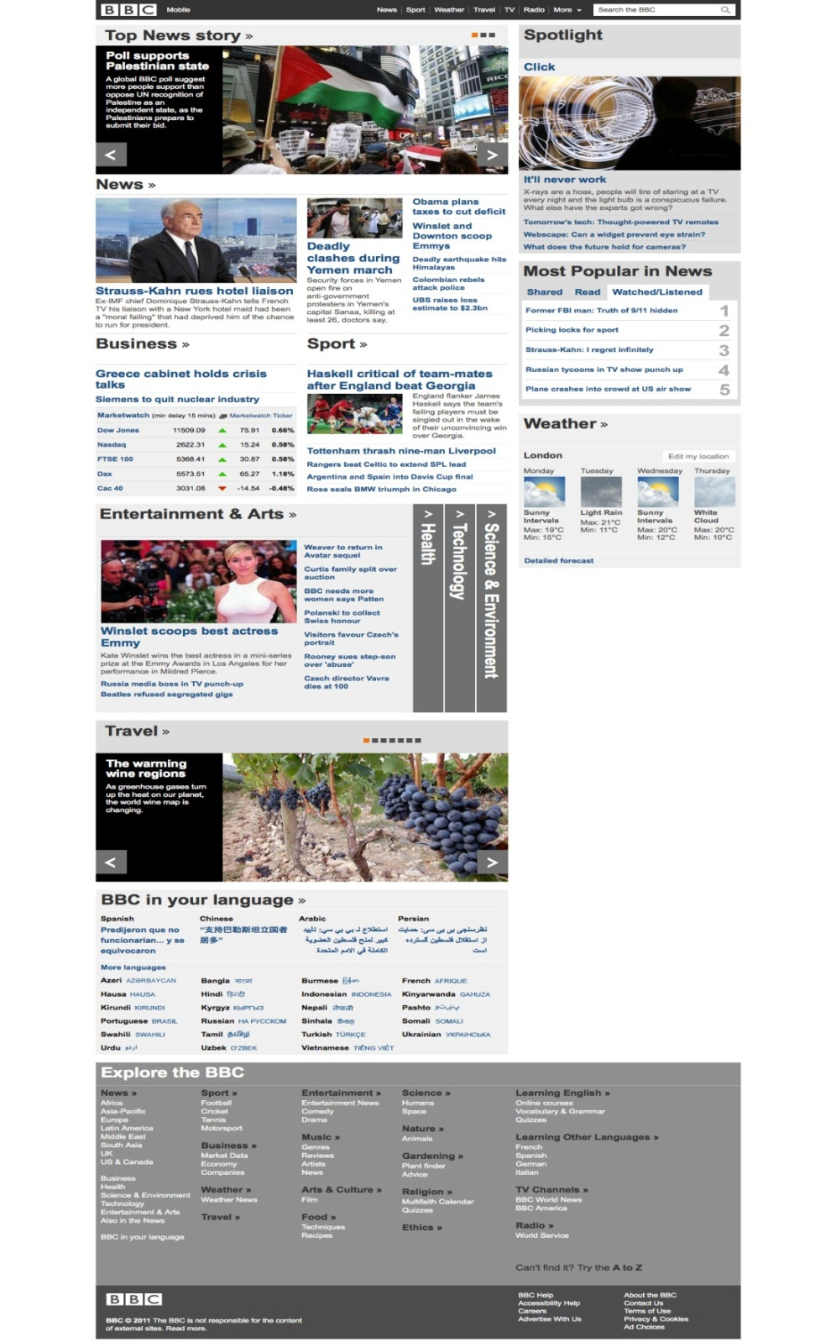
Website: www.bbc.co.uk
Jain Praerit
PROs:
Visually driven.
Lesser advertisements makes the website more secure.
Good database linkage.
Website layout is good.
Many language options caters to a larger audience hence, more web traffic.
CONs:
Less multimedia content on the homepage.
Lengthy page design which could be distracting.
Does not utilize full workspace.
Webpage design isn't very viewer-interactive, e.g a viewer would need to dig in for comments/subscription options.
I BELIEVE THIS WEBSITE IS A WELL DESIGNED WEBPAGE.
NEW ADDITIONS:
More multimedia content available on the homepage, e.g live streaming.
Continuous news ticker for people who just want to skim over the news.
Better utilization of free space, e.g push the language option and different sections on the side.

Slide 9
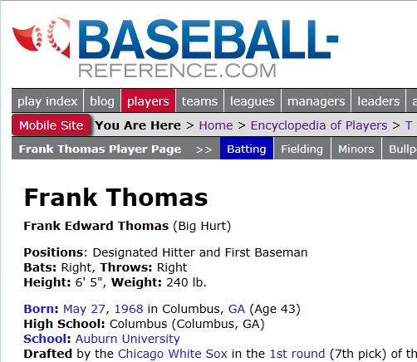
http://www.baseball-reference.com
Provides a vast database of baseball statistics.
  Individual player pages
    Batting, pitching, and fielding data
  Sortable player stats
  Teams, leagues, playoff records and individual awards
  Data from all major-league games in the last 50 years or so
It’s extremely fast and easy to use
  Easy to look up almost anything MLB related
  Targeted to people with a basic knowledge of the game
  Very simple, effective, table-based layout.
    Mimics box score data which is common in baseball records from newspapers
  Capable of settling bets rather quickly.
Other features:
  Wiki pages for different players and teams
  Daily Trivia
  Articles relating to current baseball topics
Areas to Improve
Not much. Sometimes on a player page it’s a little difficult to locate a certain dataset. It might be useful to reorganize the top of the page for navigation.
Although it’s pretty good as-is!
McGivney Kyle

Slide 10
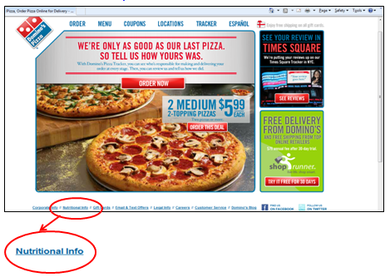
Evaluation: Domino’s website
Mangireddy Mayuri
Website URL: http://www.dominos.com/
Basic Web UI Design Principles:
Maintain Consistency across all the pages.
Provide effective feedback
Allow user to customize and control the interaction
Should minimize reliance on user memory
Error handling
I dislike Domino’s website because of the following factors:
Menu bar Navigation is not consistent
Calculating calories for the order placed is not user-friendly
This website is poorly designed considering the below listed reasons:
No feedback on user action
Inconsistent menu bar interface
User has no option of ordering a pizza without specifying the home address for a take away.
Nutritional Info functionality is provided at the bottom of the page in small font which appears out of glance to user. Even if noticed and used, the nutritional information cannot be related to a meal being ordered by user.
Improvements to the website:
Redesign the menu bar to maintain consistency throughout the website and to provide feedback on user action.
Existing: Proposal:
Embed Nutritional Info functionality and price details in the build order page, which gives intermediate feedback on price and calories at every step of the selection and helps the users to plan their meal within the allocated budget and not to exceed the calories advised as per their dietary recommendations.

Slide 11
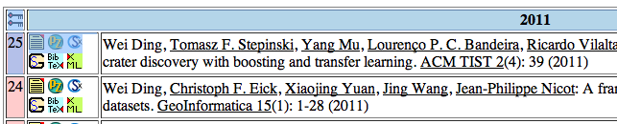
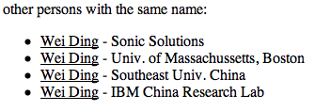
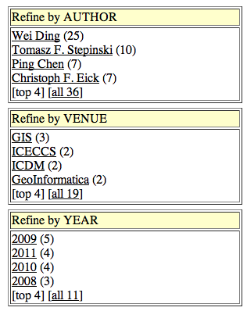
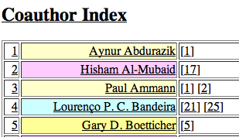
DBLP (Digital Bibliography & Library Project)
a computer science bibliography website
Main features
An open Problem
(1)
What is the best way
to correct error?
(2)
(3)
Yang Mu
Notes:
Play the slide show for this presentation to listen to the audio commentary by Peter Walsh and view slide timings. Or, click the sound icon on a slide for controls that you can use to hear the audio at your own pace.
A little organization will go a long way to enhancing your PowerPoint presentation.
Your title slide should be catching and relevant to your audience – offer something in the title that your audience wants.
Keep some basic principles in mind:
Your slides should complement what you have to say, not say it for you.
Keep slides direct and to the point - less is more!
Choose a background color or design that enhances and complements your presentation rather than competes with it.
Don’t get too fancy - a simple font, elegant color scheme and clear message is more important than lots of information (clutter!) on the slide.
Keep it simple! The purpose of the PowerPoint slide is to keep the mind of your audience focused – fewer words are better.
Note: You understand that Microsoft does not endorse or control the content provided in the following presentation.

Slide 12
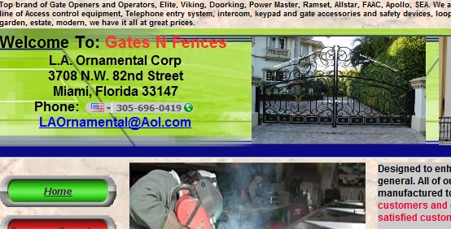
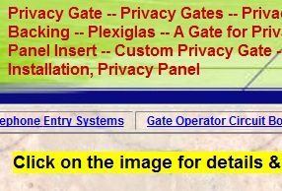
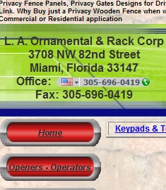
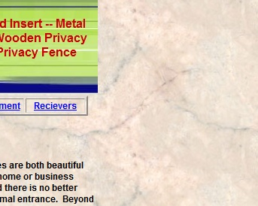
Gates n Fences – An Evaluation http://gatesnfences.com/
Why NO to Gates n Fences?
Very distracting
Not very eye-catching
Not at all neat and attractive
Design Flaws
Different font sizes and colors
Text above the heading on the page
Unattractive color combinations
Clustered text on the left side
Lots of empty space on the right side
Big buttons for links
Improvements
Standardize font size and color
Remove the paragraph above the heading
Change the color and background in the heading
Instead of buttons use some neat hyperlinks or reduce the size of buttons
Make some space in between the paragraphs by making use of the empty space on the right
Put some advertisements on the home page or links to some social networking sites like facebook
By Rinky Pandya
CS 437, Fall 2011

Slide 13
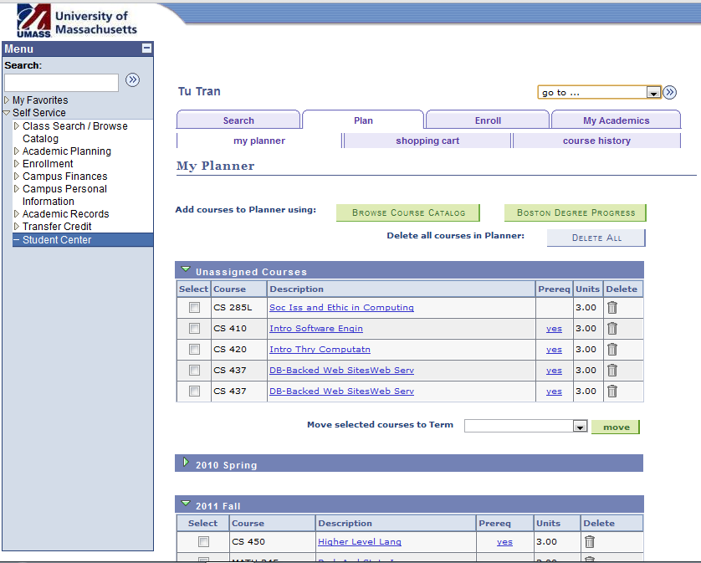
Let’s call Wiser 2.0 Smarter
Tran Tu
Notes:
Header will have drop down menu selecting major. Then it will generate list of required courses.
Courses taken by students will have different color.
Courses offered the next semester will be bold.
Next to each courses, there will be a drop down menu for sections.
Add/Drop/Remove courses is simply a click on the check button away.

Slide 14

“is almost certainly the best online photo management and sharing application in the world.”
Online
Management
Sharing
Is it perfect? Maybe not…
Wang Dawei

Slide 15
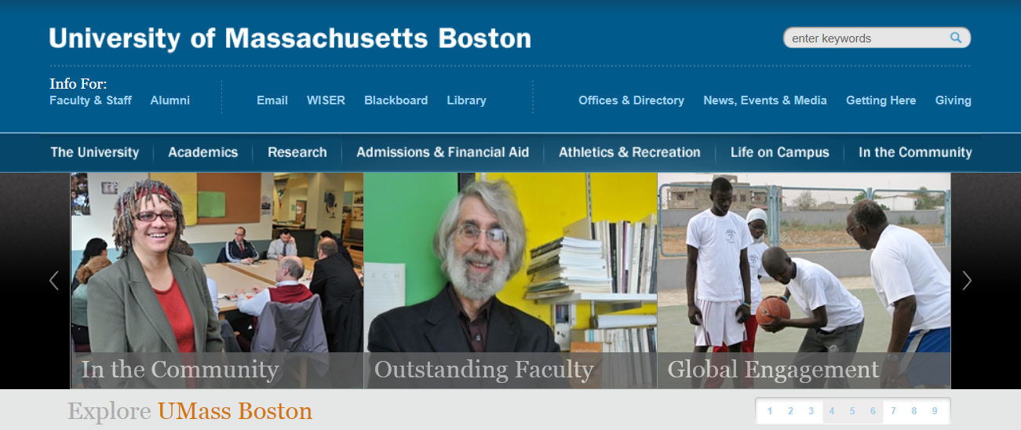
Neat, simple and clear
There are some big section at the top
Convenient
Can access some major section quick and easy
Some meaningful pictures show around, make this website lively
Clear categories
Well designed
Use a lot hyperlink to navigate you to where you want to visit
Each picture is a hyperlink, visually give you an idea about it
Search
Like its style and color
Xu Chao
From my point of view, this website looks good and also user friendly, I don’t have any better idea to improve it.

Slide 16
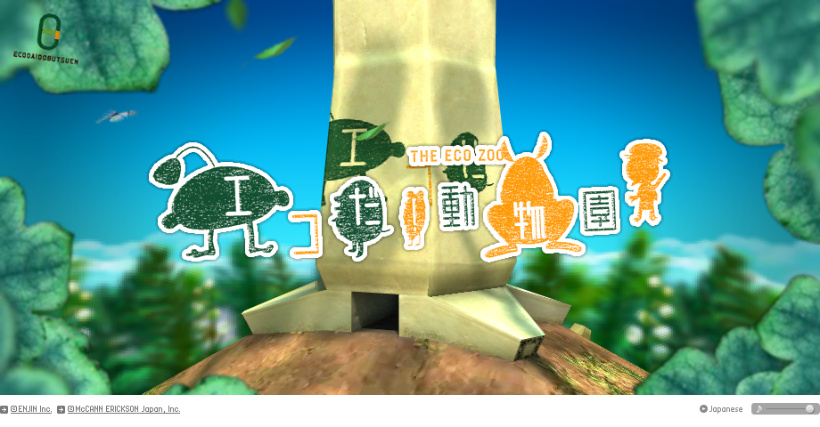
The Eco Zoo
Zhang yi
Innovative Design
Amazing Graphics
Rich and Vibrant Sound
Simple & Easy Browsing
Visual Demonstration
Shortcut Icons
Educational Contents
Protect Resources
Save Resources

