Slide 1
News
Griffith Christopher
And the automated generation thereof
0101010101011101010101010101000011111010011010101010101010100010101010101010101the recent earthquake in0101010101010000111110010 01010101010101111000Breaking news in Boston01 11101010101010100001111000011010And now VXT-4 With the sports…
Human-like writing generated by a program.
Attempting to mimic an action in a distinctly human manner; acting humanly.
Avoidance of repetition would demand non-deterministic use of vocabulary when multiple words may apply.
Generation of an article ‘spin’ by assessing past data and linking trends to vocabulary.
Full article link: http://www.nytimes.com/2011/09/11/business/computer-generated-articles-are-gaining-traction.html?ref=artificialintelligence

Slide 2
Pothanchand Yarra
Automated Online Assistant
Introduction
An automated online assistant is a program that uses artificial intelligence to provide customer service or other assistance on a website.
Components: Dialog System, Avatar, Expert System.
Category : Acting Rationally
Acting rationally means acting so as to achieve one's goals,
given one's beliefs.
The automated online assistant just perceives and acts.
What does this application do?
Automated online assistant have the ability to provide
customer service during 24 hours a day and 7 days a week.
It is estimated that automated online assistant produced 30% decrease in the work load for a human provided call center.
Algorithms used
Automated online assistant is an application where natural language processing is a major aspect.
Natural language processing uses pattern matching algorithms.A common example of a pattern-matching algorithm is regular expression matching, which looks for patterns of a given sort in textual data

Slide 3
Machine Translation (by Bielagus Michael)
Using computers to translate from one language to another, e.g., Japanese to English
Draws on all four definitions of AI; probabilistic/statistical approaches are currently most popular (acting rationally to simulate acting humanly)
Some problems:
Part-of-speech tagging
Word Sense Disambiguation
Resolving references of pronouns, prepositional phrases, etc.
Some algorithms:
Many machine learning algorithms (Decision Trees, Support Vector Machines, Hidden Markov Models, etc.)

Slide 4
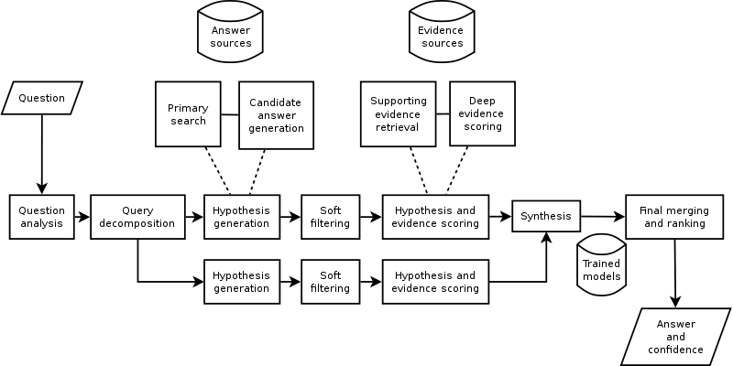
Brief Overview of IBM’s Watson
Watson is a A.I. computer system capable of answering questions posed in natural language
In 2011, as a test of its abilities, Watson competed on the quiz show Jeopardy!,
Watson belongs to the “acting rationally” category of A.I.
Watson is an application of advanced Natural Language Processing, Information Retrieval, Knowledge Representation and Reasoning, and Machine Learning technologies to the field of open-domain question answering
Watson is built on IBM's DeepQA technology for hypothesis generation, massive evidence gathering, analysis, and scoring
Uses algorithms that can analyze natural language and guess whether the results yielded by those algorithms stand a good chance of being correct.
Diagram of what watson’s algorithms most due (DeepQA)
Ceballos Jorge

Slide 5
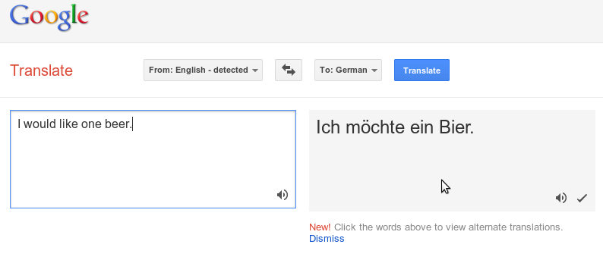
Mcgivney Kyle
Acting Humanly
Attempts to mimic the output of human translation.
Attempts to statistically infer language patterns.
Ideally, it would be indistinguishable from human translation.
In fact, language recognition is the first component of the Turing Test.
Translates text from one language to another.
The user chooses the two languages to translate, and enters text.
The user might also choose to let the system detect the language.
The program creates a translation, possibly accompanied by alternate translations, which the user can select from.
58 Supported languages.
The user may also choose to listen to generated audio output of either the input or output text.
How does it work?
Statistical Machine Learning.
Google pre-processes a corpus of translated sources, including UN documents and public domain books. They use a Bayesian algorithm to statistically identify patterns in the translations. This creates a model, which can be used to create output to the user. The user may help to improve the model by submitting alternate translations.
More information can be found at http://translate.google.com/about/index.html

Slide 6
A stealthy & Sensitive information-aware sound trojan for android smartphones presented by Binh Tran
Sensitive Info Extraction
Sound Processing
Sound Recording
What An AI Trojan targets sensitive info from sound sensor of Android smartphone
Which AI algorithm Sound learning and recognition based on frequencies and amplitudes
Category Rationally acting AI algorithm
MAIN AI COMPONENTS
Tran Binh

Slide 7
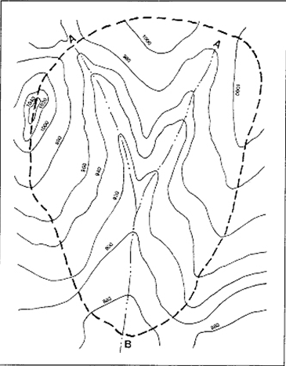
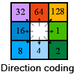
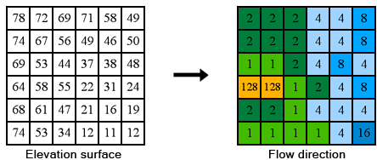
Finding Where The Water Goes
Traditional Elevation map
Do it in Digital Elevation Map By ArcGIS
“The direction of flow is determined by the direction of steepest descent, or maximum drop, from each cell.”
Contour Line
Watershed Boundary
Stream Flow
Dawei Wang Pictures are from ArcGIS 10 Help

Slide 8
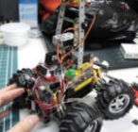
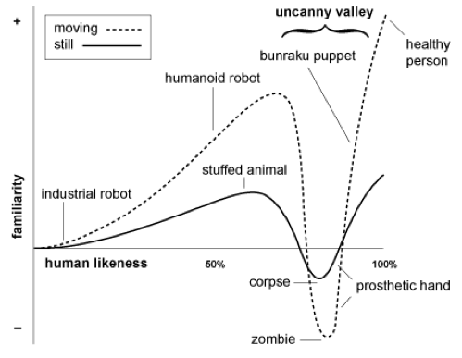
Donation Robot - Dona
Shun Guan
Shun Guan
Acting Rationally
The robot roams around in a public area.
acting when a passer comes within 50-cm rang.
robot shakes hands to attract passers’ attention
When person throws coins, robot nods head and look for another passer.
Acting Humanly
Blink eyes
Uncanny Valley

Slide 9
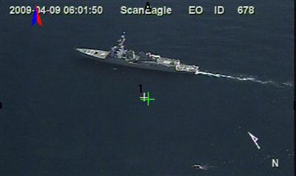
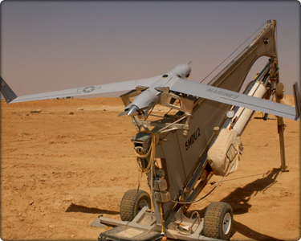
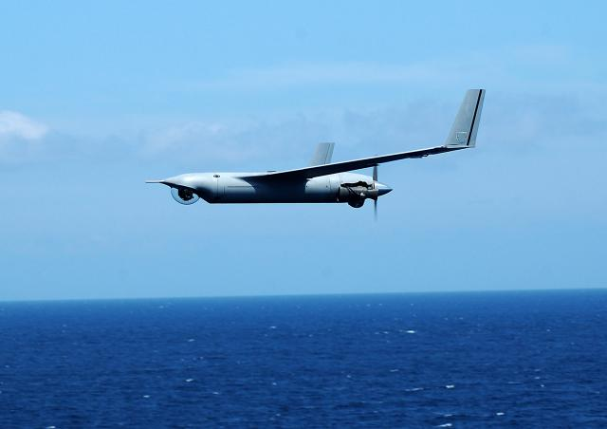
Thomas Norden

Slide 10
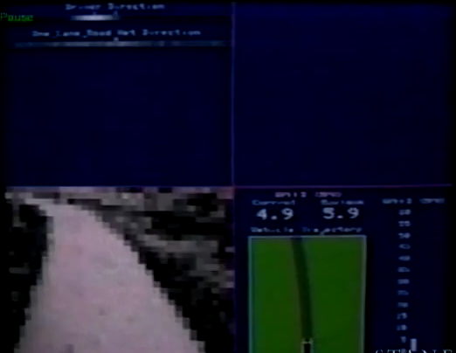
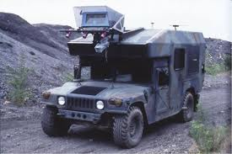
AI Application:
neural network based autonomous driving (1992)
Mingbo MA
http://www.youtube.com/watch?v=5u4G23_OohI

