Slide 1
CS 240 – Lecture 1
Intro to UNIX System and Homework 1

Slide 2
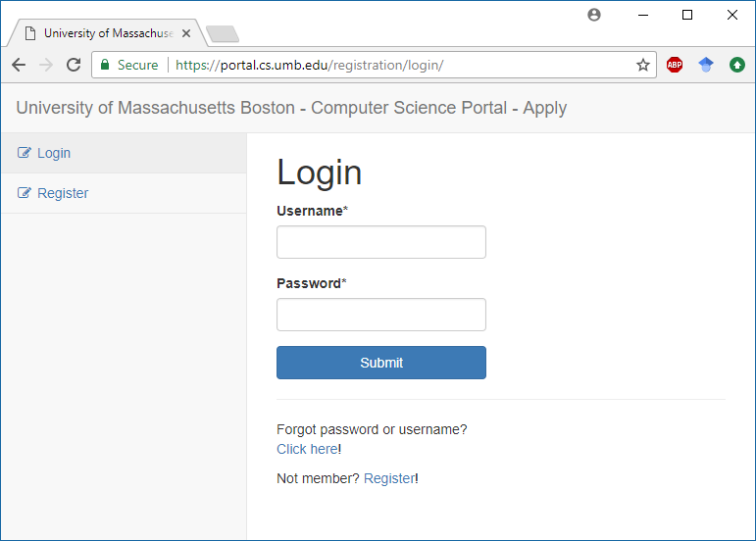
Getting Connected – Account
First, you need to request
an account.
  This is called the Apply
  process for our network.
You want to Register or
Login with previous creds.
You'll receive an email to
confirm your identity.
Follow the instructions.
  Don’t forget to select CS240!

Slide 3
Getting Connected – General
The CS department's Unix system is a collection of servers all running a UNIX or Linux operating system.
Students are expected to connect to it on the Users machine, but some classes may assign other machines for you to use (such as ulab for CS444).
The Users machine will always be at hostname
users.cs.umb.edu
It is an SSH host with port 22 open for connections.

Slide 4
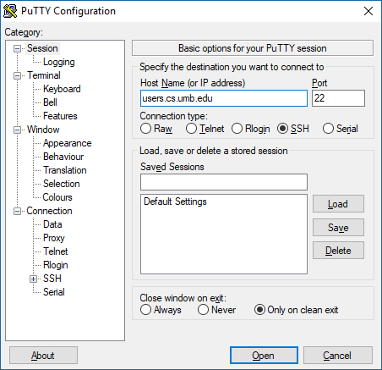
Getting Connected - Windows
The recommended SSH client for
Windows is PuTTY.
Input the hostname and port of the Users
machine (as seen here).
After hitting Open, you should be
prompted for a username, then password.
  These are the ones you picked in registration!
Afterwards, you should be at the
command line.
  If you get any warnings about keys,
  just accept the new ones.

Slide 5
Getting Connect – Mac and Linux
For Mac and Linux, these operating systems come built-in with terminal programs which offer a command line.
For these operating systems, use the built in ssh command.
Example:
  ssh <username>@<hostname>

Slide 6
Doing Work – Filesystem Navigation
When in a Command Line, you actually reside in one specific directory at a time.
  This is called the Working Directory of the command line.
  This is different from Graphical Desktop Environments, where you can cascade folder windows and be many places at once.
Each directory has an absolute path from the root of the filesystem.
  To view what the path of your Working Directory is, use the pwd command.
Each directory also has a relative path from the Working directory.
  This path depends on which directory is your Working Directory.
Many command line programs will perform their roles in the Working or current directory unless you specify a path to another.

Slide 7
Doing Work – Filesystem Navigation
Whenever you log in, you should be placed in your Home Folder.
  Absolute path (/home/<username>)
It's often more comfortable to change your working directory to the directory which has the files you're working on.
To do this, use the cd command to Change Directories.
Example:
  cd /home/<username>/cs240 absolute path
  cd ./cs240 relative path
Here, the period (.) indicates "the current Working Directory"

Slide 8
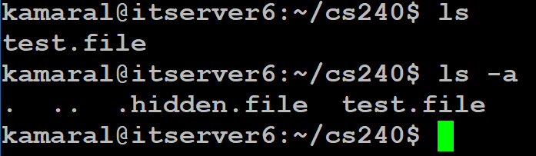
Doing Work – Filesystem Navigation
Often, users will find themselves having doubt that they're in the right folder and knowing the path isn't enough.
To get your bearings, it's often more useful to know which files are in the Working Directory.
For this, using the ls command will List the contents of the working directory.
  Some files will begin with a dot,
  making them hidden.
  To list those as well, use the
  ls -a command.
ls -l will show file details in a
nicer format.

Slide 9
Doing Work – File and Directory Manip.
For doing your homework, you'll be tasked with writing code, compiling programs, and executing programs, at the very least.
Another necessity of doing your homework will be submitting it.
  You will need to create files and folders so that your work makes it to me.
To create a new directory, you need to use the mkdir command, with either a relative path or absolute path.
Example (assuming Working Directory is ~/cs240):
  mkdir /home/<username>/cs240/hw1 absolute path
  mkdir ./hw1 relative path

Slide 10
Doing Work – File and Directory Manip.
Sometimes (often) users will need to move copies of files to a new location.
This is done with the cp command, for Copy.
To copy a file, use:
  cp <source-path> <destination-path>
To copy a folder, the Recursive flag (-r):
  cp -r <source-path> <destination-path>
To copy multiple files of a certain extension:
  cp /home/<username>/source/*.c destination/

Slide 11
Doing Work – File and Directory Manip.
Homework 1 asks you to create a Symbolic Link.
  This is very similar to the idea of a shortcut in Windows or other graphical desktop operating systems.
These are very useful tools as they allow you to shorten the relative paths to folders by using a nickname of sorts for that file.
Example:
  ln -s /courses/cs240/s18/kamaral/GROUP/hw1 cs240_hw1
This will create a "directory" in the current directory which can be cd'd to, just like you would a proper directory.
  This makes the shorted path for referencing that directory MUCH shorter.

Slide 12
Doing Work – File and Directory Manip.
Oh no! You've created a folder or file you didn't want to!
Don't fret, there's a delete command for files in the file system.
To delete files, use the rm command for Remove.
Example:
  rm hw1/hellp.c file path
  rm -r hw01/ directory path
  rm hw1/* all files in hw1
For directories, you need to use the -r for Recursive deletion.
Never use rm -rf /
  The equivalent of deleting system32 on Windows.

Slide 13
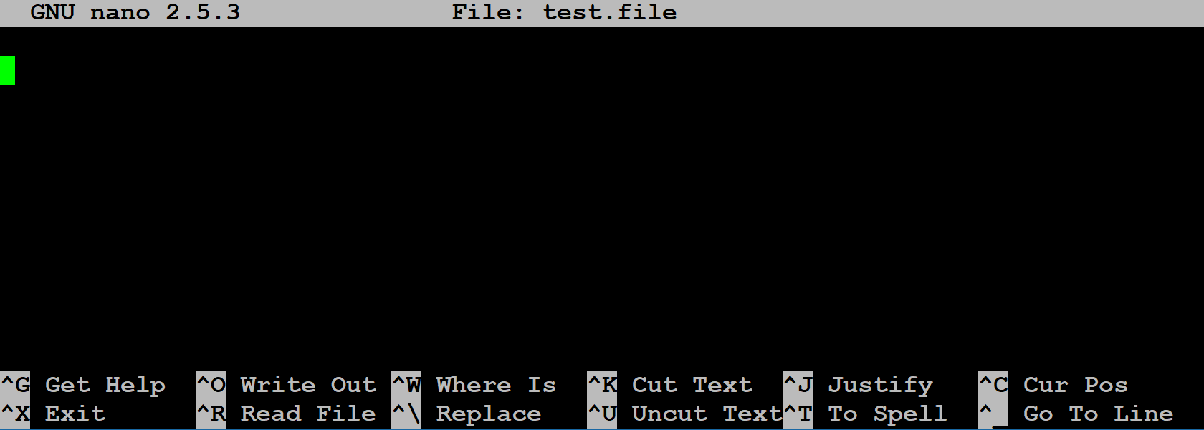
Doing Work – Editing Files (nano)
I'll only be showing one of the many command line editors for the sake of simplicity.
I recommend you pick your favorite after doing your own research on it.
Nano is an interactive
command line program
for editing files.
Commands are listed
below the typing area.
  The caret (^) indicates
  the Ctrl key.

Slide 14
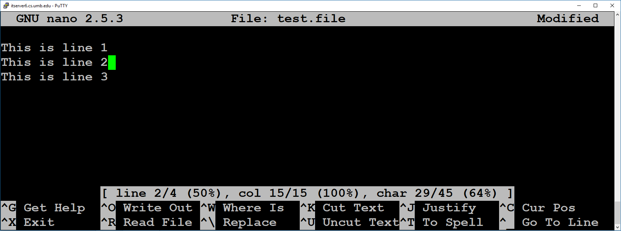
Doing Work – Editing Files (nano)
To save, use Ctrl+O (WriteOut) and confirm the filename.
To exit, use Ctrl+X.
  If you didn't save first, it'll ask you to confirm the filename.
To enable line number tracking, use Alt+C
  It should appear as follows:

Slide 15
Doing Work – Editing Files (Other)
Other command line editors include:
  Emacs
  Vim
These have different control schemes and offer very different initial experiences.
However, there's no difference in the output format across them.
  Each editor outputs raw text.
  As a result, you can't tell from just looking at a file which editor it was written in.
Familiarize yourself with your favorite soon, you'll be using one for another 3ish years at the very least.

Slide 16
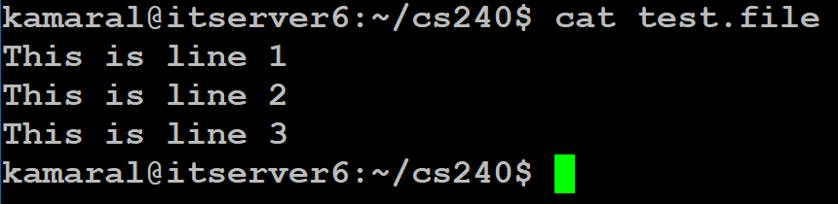
Doing Work – Viewing Files and Recording
An important part of having files is being able to display their contents.
However, command line editors are overkill with their interactivity and editing capabilities.
A non-interactive way to display the contents of files is to use the cat command, for Concatenate
Example:
  cat file1 file2 file3
  cat *.c
This command prints all contents of those files to the screen in order.

Slide 17
Doing Work – Viewing Files and Recording
An important part of our CS curriculum here is the "Show your work" aspect that is often hard to do with a long standing process like programming.
TypeScripts are a way of recording procedural use of the command line for later viewing.
  It records commands used, input given, and output received, just as it would appear on your console.
  It does NOT handle interactive command line programs like editors well at all.
To start a typescript, use the script command.
To complete a typescript, use the exit command to create typescript in the working directory.
  This is required because the script will not be fully saved until after exit is used.

Slide 18
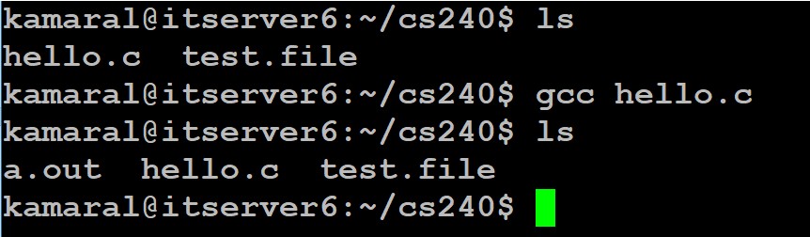
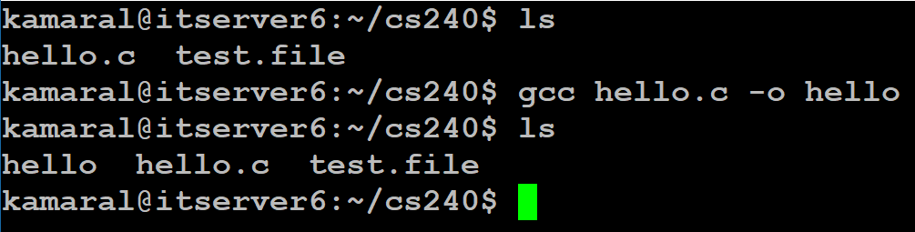
Doing Work – Compiling C Programs
To compile a C program, we use the GCC compiler.
This takes C source files, and produces executable binary files.
  Example:
By default, if not specified,
the compiler will produce the
binary as a.out
To specify a specific executable name, use the -o flag
  Immediately after -o should be
  the name of the executable.

Slide 19
Doing Work – Running Programs from W.D.
Most installed programs on the system are available for execution by name.
  Just as we have been with commands, these programs are run as the first part of any command string.
The way Unix and Linux identify which program to run by the single name you provide is by checking what's called the System Path Variable.
Your programs are NOT on the path by default.
To execute your programs, you must precede them with a ./ to indicate the location of your program to be run.
Example: ./hello

