Slide 1
CS 240 – Lecture 10
Common C Programming Errors, GDB Debugging

Slide 2
Troubleshooting Broken Code – In C
There are a number of differences between the Coding → Running cycle of C and languages like Python.
The a C program goes through the following stages before it is a proper executable.
Source Code
Preprocessor/Precompiler
Compilation
Linking
An error in your code can belong to any one of these stages in the process.

Slide 3
Preprocessor Errors – Syntax Errors
Often times, these will be self explanatory.
hello.c:1:2: error: invalid preprocessing directive #incdude
#incdude <stdio.h>
Above we have an example of error output from the compiler when we try to compile hello world.
As you can see #include is spelled incorrectly.
The compiler does its best to tell us where the error is and what is wrong, but it's not perfect.
"On line 1, starting at character 2, I found something invalid."
Compilers aren't smart enough to say "You spelled include wrong."

Slide 4
Preprocessor Errors – Syntax Errors
hello.c:1:20: warning: extra tokens at end of #include directive
#include <stdio.h> <string.h>
Above, we have extra things in the #include directive that aren't understood by the specification.
While this may make sense to us, the compiler only understands the C language specification.
The language "extra tokens", if found anywhere, means the line is wrong because you have written extra content where it doesn't belong.
Likewise, "expects" means something is missing when it shouldn't be.
hello.c:1:10: error: #include expects "FILENAME" or <FILENAME>
#include

Slide 5
Preprocessor Errors – Invisible Syntax Errors
There are some syntax mistakes in your code which do not raise any flags for the compiler.
#define MAXLINE 100;
Above, we have the symbolic constant MAXLINE which is a replacement for 100;
It's not until you try to use it in code where it would cause a crash that the compiler complains.
int a = MAXLINE; Compiler is actually fine with this.
printf("%d", MAXLINE); Compiler complains because of ;
prog.c:2:20: error: expected ‘)’ before ‘;’ token
#define MAXLINE 100;

Slide 6
Compilation Errors – Syntax Errors
More often than not, the Syntax Error you'll get is going to be of the form:
expected X before 'Y' token
X and Y are placeholders for other tokens like Parenthesis, Braces, Semicolons, or even entire expressions or variable names.
This type of error is often associated with a missing semicolon, which results in the C compiler reading parts of the next line of code.
int a = 1
a = 2;
prog.c:6:5: error: expected ',' or ';' before 'a'
It simply means "for this code to be compile-able, X must come before Y."

Slide 7
Compilation Errors – Semantic Errors
A semantic error is a type of error in which, for the most part, you've written correct pieces of C code, but the combination of them makes no sense.
a + b is a valid C expression
c + d is a valid C expression
a + b = c + d is not a valid C statement
For these types of errors, you'll get a number of cryptic responses from the compiler.
prog.c:6:11: error: lvalue required as left operand of assignment
a + b = c + d;
This one states that the left side of an assignment statement must be a location to store the value on the right.

Slide 8
Runtime Errors
Runtime errors are issues with the program which are not apparent to the compiler and won't be noticed until the program runs.
Runtime errors usually result in the entire program crashing because it is impossible to continue after reaching such an error.
"I was asked to divide by 0 and use the result for the rest of the program."
int a = 0, b = 1/a;
Floating point exception (core dumped)
These errors will not tell you where in the code they were encountered.
They may not even happen all the time.

Slide 9
Runtime Errors
The runtime error you're more likely to deal with is the Segmentation Fault.
Segmentation fault (core dumped)
Segmentation faults indicate memory access to addresses that do not belong to you.
Very likely, you've accessed the NULL address without checking for NULL
The solution to these is to make sure that any array code you've written receives an actual buffer and stays entirely within the length of that buffer.
Also, make sure that any file operations succeed by checking for the NULL address.

Slide 10
Logic Errors
Logic errors are the most prevalent of all errors.
Like runtime errors, they are not apparent to the compiler at compile time.
int average = a + b / 2; only divides b
Logic errors are a mistake in the program which leads it to produce incorrect results or behave otherwise incorrectly, but do not in-and-of themselves cause a crash.
The only solution to logic errors is to fix the mistake in your logical thinking and make sure that your code matches exactly what you want the program to do.
Finding them yourself requires patience and careful reading of your code.

Slide 11
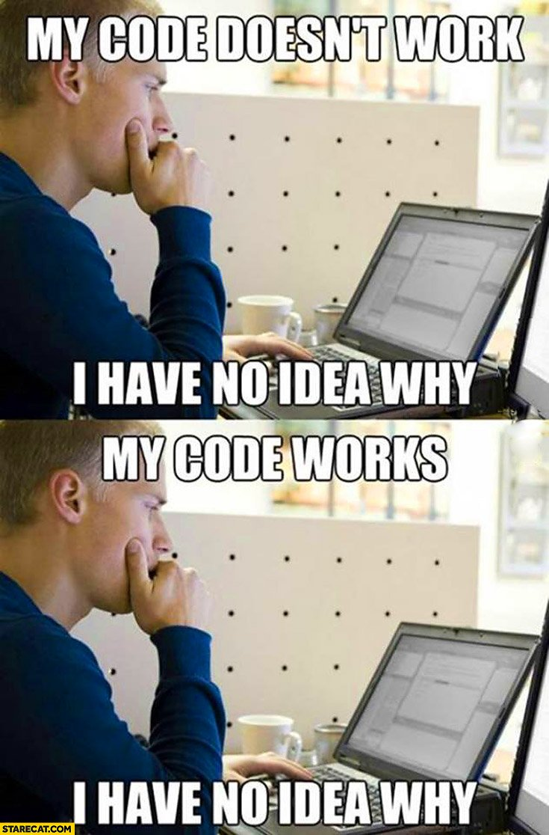
Debugging – My Code Won't Work and Now I Know Why
Debugging is the process of efficiently detecting errors, figuring out their effects on the program, and replacing those errors with working code.
On the right, a famous pair of quotes spreading across the internet programming communities.
There are tools which allow you to go step-by-step through the execution of a program called debuggers.
If you actually put in the effort to use one, you'll be able to say "I know why my code does/doesn't work."

Slide 12
Debugger – gdb utility
The gdb utility is a debugger for C programs available on the Unix system.
However, to use it with your program, it must specifically be compiled with debugging information included.
gcc –g –o program source.c
The –g flag indicates that the program should include in it's binary executable the names of functions, variables, and lines of code that constitute it.
Cheatsheet for gdb to have out while you're using it.
https://www.cs.umb.edu/~kamaral/cs240/gdb-refcard.pdf

Slide 13
Debugger – Attaching gdb to a Program
To use the debugger to go through the program, it needs to be attached to the program.
gdb prog
This will attach gdb to the program and it will be waiting for you to issue gdb commands.
To get the program to run normally at this point, you can type the following into the prompt.
(gdb) run "(gdb)" prompt should be there
You can also issue I/O redirections from here.
(gdb) run <input.file >output.file

Slide 14
Debugger – Setting Breakpoints in gdb
Breakpoints are places in the code where the gdb debugger is told to stop execution and wait for commands.
Without breakpoints, the gdb debugger would run without stopping until it hit all the errors you were trying to find.
To set a breakpoint at the beginning of a function, you can use break with the function's name:
(gdb) break main
With this, the debugger will run the program up to the beginning of the main function and wait for you to give additional commands.
You can also give breakpoints by line number and delete breakpoints by index (breakpoints are numbered starting from 1).
(gdb) break 4 (gdb) delete 1

Slide 15
Debugger – Stepping with gdb
Once you've reached a breakpoint, your screen should look something like this:
Breakpoint 1, main () at prog.c:4
4 int a = 0;
To execute this line of code and move to the next line, use the step command.
(gdb) step (gdb) step 2
5 a = a + 1; 6 a = a / (a - 1);
You can also step a number of lines by using step n
Also, at any point you can add more breakpoints with the break

Slide 16
Debugger – Listing lines of code around you
The list command will display the lines surrounding the current position in the execution.
(gdb) list
1 #include <stdio.h>
2
3 void main() {
4 int a, b, c, d = 10;
5 a = 1;
6 b = 4;
7 c = 7;
8 printf("%d", a);
9 }
10
This will always show 10 lines by default.

Slide 17
Debugger – Checking the variables in gdb
The print command allows us to check the value of variables at the current point in execution.
6 a = a / (a - 1);
(gdb) print a
$1 = 1
The print command may default to numeric printing.
To get character or hex output, use the following (respectively):
(gdb) print /c a (gdb) print /x a
$1 = '\001' $1 = 0x1

Slide 18
Debugger – Displaying local variables in gdb
To display all local variables, use the info locals command.
(gdb) info locals
a = 32767
b = 0
c = 0
d = 10
For all global and local variables, use the info variables command.
For larger projects, this will list too many variables you probably don't care about.

Slide 19
Debugger – Modifying Variables in gdb
Sometimes, you'll want to make minor changes once you've found an issue to test for another problem.
Without rerunning your code, you can change variables with the set variable command.
(gdb) set variable b = 10
(gdb) info locals
a = 32767
b = 10
c = 0
d = 10

Slide 20
Debugger – Continuing and Leaving
After you've solved a problem at a specific location, it's often worth letting the gdb debugger continue until it hits another breakpoint.
As opposed to hitting the step command until you're dizzy.
The continue command does just that and makes the program continue running until it hits another breakpoint.
(gdb) continue
To leave the debugger, use the quit command.
(gdb) quit

