Slide 1
CS 240 – Lecture 19
Serialization, Pointers to Arrays, Arrays of Arrays, Floating Point Numbers

Slide 2
Serialization
Serialization is the concept of turning any data structure or objects into a stream of bytes.
In C, we lack proper objects so most of our data structures are already bytes in memory.
The idea behind this is that if we can store the exact sequence of bytes that compose the data structure in a file, we can load the exact data structure back into memory as it was.
  Save files in video games, PowerPoint Files, etc.
However, this process isn’t always that simple.

Slide 3
Binary Formats
In C, we are privy to the binary format of data.
To the right, you'll see a struct rectangle in memory.
The act of serializing that value is the same as taking each of it's bytes and outputting them to a stream or file.
  This is not the same as printing each member as a number to a file!
In this case, it would serialize as
(Hex) 0078 5634
  This is Big-Endian byte order.
Address | Value | Variable
0x82ff6f80 | 0x00 | rect.p1.x
0x82ff6f81 | 0x78 | rect.p1.y
0x82ff6f82 | 0x56 | rect.p2.x
0x82ff6f83 | 0x34 | rect.p2.y
0x82ff6f84 | *junk*
0x82ff6f85 | *junk*
0x82ff6f86 | *junk*

Slide 4
Binary I/O – new options for fopen
When serializing data to a file in binary format, we should use the binary I/O mode when opening the file descriptor.
fopen("filename.dat", "rb");
Including a 'b' indicates that the file should be treated as a binary stream, instead of a text stream.
  Do so for both reading and writing of binary files.
Most Linux implementations ignore this option, however there is a distinct difference on operating systems which process text differently from binary data.
  Windows, for example, will curate text streams to make sure the carriage return character is present and absent at different times.

Slide 5
Binary I/O – fwrite
The fwrite function is defined as follows:
size_t fwrite(const void *ptr, size_t size,
size_t count, FILE *stream);
It's designed for writing a number of similarly sized objects to a stream.
The first argument ptr is the location in memory where it starts writing from.
It will then write the next size*count bytes to the stream.
Its return value is how many blocks of size size it successfully output, returning between 0 and count.

Slide 6
Binary I/O – fwrite Example
char buffer[100];
int n;
FILE * ofile = fopen("o.dat", "wb");
… // filling buffer with stuff
n = fwrite(buffer, 1, 100, ofile);
struct rectangle rect = {{0,0}, {1,2}};
int n;
FILE * ofile = fopen("o.dat", "wb");
n = fwrite(&rect,
sizeof(struct rectangle),
1,
ofile);

Slide 7
Binary I/O – fread
The fread function is defined as follows:
size_t fread(const void *ptr, size_t size,
size_t count, FILE *stream);
It's designed for reading a number of similarly sized objects from a stream.
The first argument ptr is the location in memory where it will store the data it reads from the stream.
It will then read the next size*count bytes from the stream and store them in memory starting at ptr.
Its return value is how many blocks of size size it successfully input, returning between 0 and count.

Slide 8
Binary I/O – fread Example
char buffer[100];
int n;
FILE * ifile = fopen("i.dat", "rb");
n = fread(buffer, 1, 100, ifile);
struct rectangle rect;
int n;
FILE * ifile = fopen("o.dat", "wb");
n = fread(&rect,
sizeof(struct rectangle),
1,
ifile);

Slide 9
Serialization – Transient Data
Transient or nonserializable data is any data that is only relevant in the current context.
Should the context change, that data loses semantic meaning.
For example,
char c;
char *cptr = &c;
The variable c is not transient data, as it retains it's meaning if stored in a file, printed to the screen, or sent over the network.
The variable cptr references a memory address in the current context and is meaningless to other contexts including subsequent runs of the same program.
  There is no guarantee that the address of c will be the same in every run of the program and there's no guarantee that another program loading that address will associate it with variable c.

Slide 10

Serialization – Storing a Linked List
Serializing more complicated data structures, like the Linked List require multiple stages.
struct link {
struct link *next;
type val;
}
As you can see, the link struct has a transient member next.
We cannot retain the connections between nodes in the serialized format.

Slide 11
Serialization – Storing a Linked List
To store a linked list, we need to store it's elements alone, without the addresses to the next element.
We can output the list in order like so:
struct link *c = root;
while (c != NULL) {
fwrite(&c->val, sizeof(type), 1, ofile);
c = c->next;
}
While this works, this method leads to some problems later on.

Slide 12
Serialization – Reading a Linked List
Recall that the Linked List is stored as a sequence of type variables where type is just a placeholder type for whatever the list holds.
To read in the linked list, we need to have an empty linked list to which we can add the elements.
struct link *root;
Next, we need to allocate space for each new link as we read.
struct link *newlink = (struct link*) malloc(sizeof(struct link));
fread(&newlink->val, sizeof(type), 1, ifile);
While we can set the value at that link, we can't set the next link because we haven't read it yet.
  In tonight's Homework, we will solve this problem.

Slide 13
Multi-Dimensional Arrays
Declare rectangular multi-dimensional array
  char array [2] [3]; /* array [row] [column] */
It is the same as a one dimensional array with each element being an array
NOTE THAT array [2, 3] IS INCORRECT!
The rightmost subscript varies fastest as one looks at how data lies in memory
  array [0] [0], array [0] [1], array [0] [2], array [1] [0],
  array [1] [1], array [1] [2]

Slide 14
Multi-Dimensional Arrays
Example of converting a month & day into a day of the year for either normal or leap years
  static char daytab[2] [13] = {
  {0, 31, 28, 31, 30, 31, 30, 31, 31, 30, 31, 30, 31},
  {0, 31, 29, 31, 30, 31, 30, 31, 31, 30, 31, 30, 31}
  };
Use a second row of day counts for leap year rather than perform a calculation for days in February
  daytab[1] [1] is 31 → same as daytab[0] [1]
  daytab[1] [2] is 29 → not same as daytab [0] [2]

Slide 15
Multi-Dimensional Arrays
The array declared as char daytab [2] [13] can be thought of as:
char (daytab [2]) [13]; /* see pg. 53 */
Each one dimensional array element (daytab[0], daytab[1]) is like array name - as if we declared:
char xx [13]; char yy [13]
Where xx is daytab[0] and yy is daytab[1]
daytab [0] is in memory first, and then daytab [1]

Slide 16
Multi-Dimensional Arrays
daytab[0] and daytab[1] are arrays of 13 chars
Now recall duality of pointers and arrays:
(daytab [0]) [13] → (*daytab) [13]
(daytab [1]) [13] → (*(daytab+1)) [13]
daytab is a pointer to an array of elements each of size=13 chars

Slide 17
Multi-Dimensional Arrays
But, these two declarations are not allocated in memory the same way:
char a [10] [20] → 200 char-sized locations
char (*b) [20] → 1 pointer to an array of elements
each is 20 chars
For the second declaration, code must set the pointer equal to an already defined array or use malloc to allocate new memory for an array. e.g.
char (*b) [20] = a; or
char (*b) [20] = (char (*) [ ]) malloc(200);

Slide 18
Multi-Dimensional Arrays
char a [10] [20];
a[0]
a[1]
a[2]
a[3]
a[4]
a[5]
a[6]
a[7]
a[8]
a[9]
20 chars
20 chars
20 chars
20 chars
20 chars
20 chars
20 chars
20 chars
20 chars
20 chars
char (*b) [20] = a;
char (*b) [20]
A pointer to unspecified number of 20 char arrays
char (*b) [20] = (char (*) [ ]) malloc(200);
20 chars
20 chars
20 chars
20 chars
20 chars
20 chars
20 chars
20 chars
20 chars
20 chars

Slide 19
Example of Pointer to a
Multi-Dimensional Array
int grid[320][240];
int (*grid_ptr)[240];
int doSomethingWithGrid(int (*array)[240]);
int main()
{
grid_ptr = grid; /* set grid_ptr to point at grid */
doSomethingWithGrid(grid_ptr);
}

Slide 20
Serialization – Storing Multi-D Array
From the definition of multidimensional array, it's easy:
int grid[320][240];
fwrite(grid, sizeof(int), 320*240, ofile);
The nature of the array is that each of the 320 arrays of 240 integers are contiguous.
Not only that, but within each of the arrays of 240 integers, the integers are all contiguous in memory.
As a result, the entire multidimensional array is a contiguous block of ints.

Slide 21
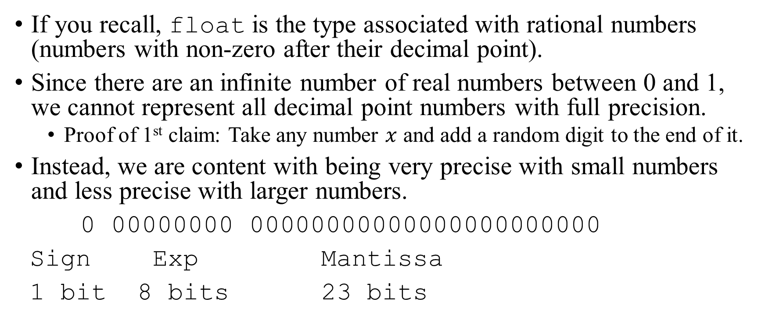
Types – float
If you recall, float is the type associated with rational numbers (numbers with non-zero after their decimal point).
Since there are an infinite number of real numbers between 0 and 1, we cannot represent all decimal point numbers with full precision.
  Proof of 1st claim: Take any number $x$ and add a random digit to the end of it.
Instead, we are content with being very precise with small numbers and less precise with larger numbers.
0 00000000 00000000000000000000000
Sign Exp Mantissa
1 bit 8 bits 23 bits

Slide 22
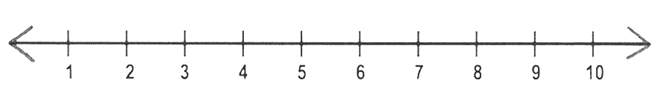
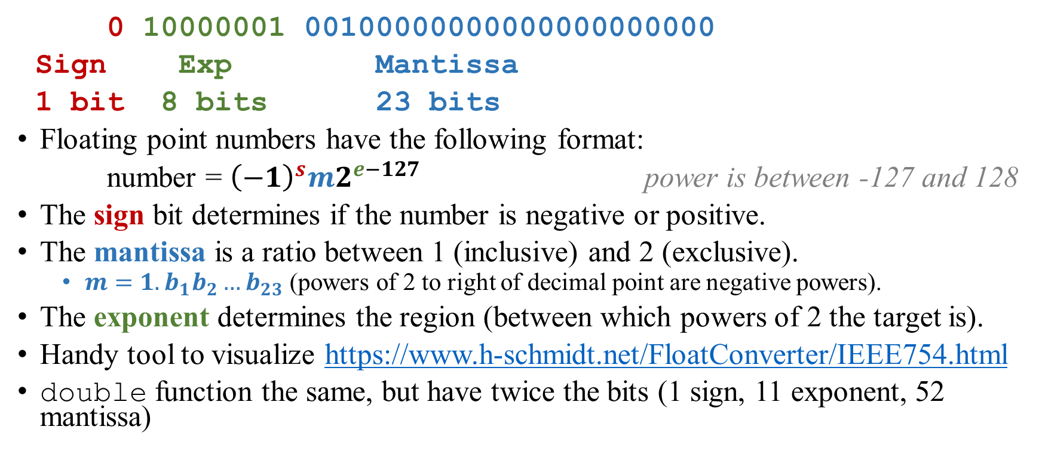
Types – float
4.5
0 10000001 00100000000000000000000
Sign Exp Mantissa
1 bit 8 bits 23 bits
Floating point numbers have the following format:
number = ${\left(−1\right)}^{s}m2^{e−127}$ power is between -127 and 128
The sign bit determines if the number is negative or positive.
The mantissa is a ratio between 1 (inclusive) and 2 (exclusive).
  $m=1.b_{1}b_{2}…b_{23}$ (powers of 2 to right of decimal point are negative powers).
The exponent determines the region (between which powers of 2 the target is).
Handy tool to visualize https://www.h-schmidt.net/FloatConverter/IEEE754.html
double function the same, but have twice the bits (1 sign, 11 exponent, 52 mantissa)

