Slide 1
Welcome to
CS220/MATH 320 –
Applied Discrete Mathematics
Summer 2020
Instructor: Ramin Dehghanpoor
I got help from and used Dr. Pomplun’s and Dr. Haspel’s slides

Slide 2
Instructor – Ramin Dehghanpoor
Office: M-201-35
Office Hours: Mondays 3:00-5:00 PM
Wednesdays 3:00-5:00 PM
E-Mail: ramin.dehghanpoor001@umb.edu
Website: http://www.cs.umb.edu/~ramin/cs220/

Slide 3
Textbook and Course Website
Discrete Mathematics and Its Applications Kenneth H. Rosen
We will study around 400 pages of this book.
Important! Course homepage:
http://www.cs.umb.edu/~ramin/cs220/
Contains all kinds of course information and also my slides

Slide 4
Your Evaluation
Homework assignments(4-5)
Midterm exam
Final exam
30%
30%
40%

Slide 5
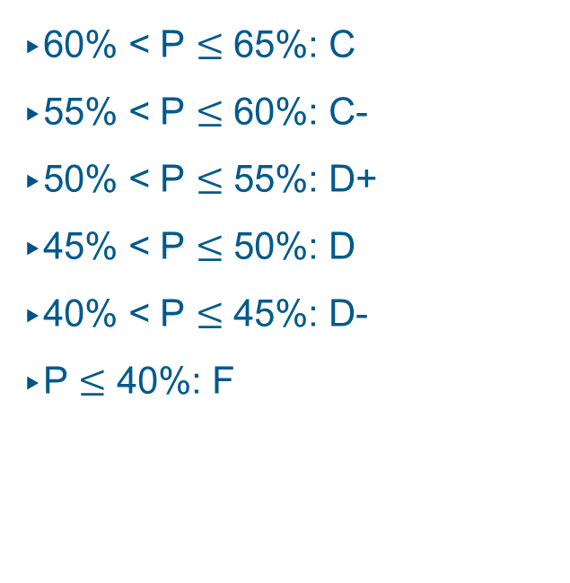
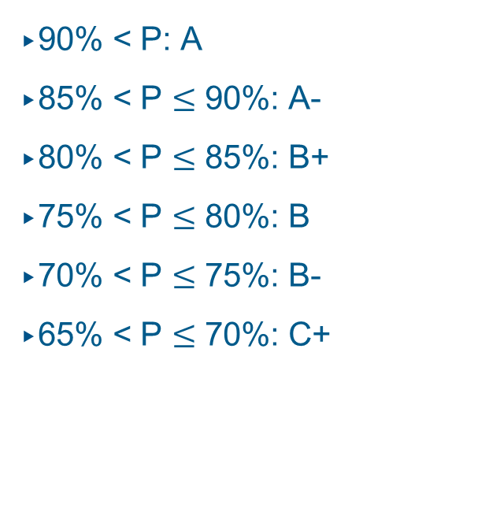
Grading
For the assignments, exams and your course grade, the following scheme will be used to convert percentages into letter grades:
90% < P: A
85% < P $≤$ 90%: A-
80% < P $≤$ 85%: B+
75% < P $≤$ 80%: B
70% < P $≤$ 75%: B-
65% < P $≤$ 70%: C+
60% < P $≤$ 65%: C
55% < P $≤$ 60%: C-
50% < P $≤$ 55%: D+
45% < P $≤$ 50%: D
40% < P $≤$ 45%: D-
P $≤$ 40%: F

Slide 6
Course Requirements
Enroll in the course on Gradescope with Entry code 9GBK2Z
Enroll in the course on Piazza with Access code 9GBK2Z or
the link: piazza.com/umb/summer2020/cs220math320
Your final grade should be at least 40% to pass.
You also have to pass the final exam.
Your TA will grade homework assignments
Your SI will work with you on a regular basis to answer your questions and do some practice.
Always ask your questions on Piazza please.

Slide 7
Academic Dishonesty
You are allowed to discuss problems regarding your homework with other students in the class.
However, you have to do the actual work (computing values, writing algorithms, drawing graphs, etc.) by yourself.
You cannot copy anything from other sources (Wikipedia, other students’ work, etc.)
The first violation will result in zero points for the entire homework or exam (and official notification).
The second violation will result in failing the course.

Slide 8
Complaints about Grading
If you think that the grading of your homework was unfair, please talk to the TA (to be announced).
If you are still unhappy afterwards, please talk to me.
If you think that the grading of your midterm exam was unfair, please talk to me

Slide 9
Why Care about Discrete Math?
Digital computers are based on discrete “atoms” (bits).
Therefore, both a computer’s
  structure (circuits) and
  operations (execution of algorithms)
  can be described by discrete math.
Most importantly, software engineers need to have a solid background in discrete mathematics in order to develop appropriate algorithms for given problems.

Slide 10
Syllabus
A discrete mathematics course has more than one purpose.
We will learn about five important themes:
Mathematical reasoning, Combinatorial analysis, Discrete structures, Algorithmic thinking, And Applications and Modeling
Let us just take a look at the syllabus on the course homepage…
http://www.cs.umb.edu/~ramin/cs220/sillabus.pdf

Slide 11
We will cover these parts of the book (8th edition):
1.1
1.3.1-1.3.4
1.4.1-1.4.10

Slide 12
Logic
Crucial for mathematical reasoning
Used for designing electronic circuitry
Logic is a system based on propositions.
A proposition is a statement (that declares a fact) that is either true or false (not both).
We say that the truth value of a proposition is either true (T) or false (F).
Corresponds to 1 and 0 in digital circuits
We use letters (p,q,r,…) to denote propositional variables

Slide 13
The Statement/Proposition Game
“Elephants are bigger than mice.”
Is this a statement?
yes
Is this a proposition?
yes
What is the truth value
of the proposition?
true

Slide 14
The Statement/Proposition Game
“520 < 111”
Is this a statement?
yes
Is this a proposition?
yes
What is the truth value
of the proposition?
false

Slide 15
The Statement/Proposition Game
“y > 5”
Is this a statement?
yes
Is this a proposition?
no
Its truth value depends on the value of y, but this value is not specified.
We call this type of statement a propositional function or open sentence.

Slide 16
The Statement/Proposition Game
“Today is January 23 and 99 < 5.”
Is this a statement?
yes
Is this a proposition?
yes
What is the truth value
of the proposition?
false

Slide 17
The Statement/Proposition Game
“Please do not fall asleep.”
Is this a statement?
no
It’s a request.
Is this a proposition?
no
Only statements can be
propositions.

Slide 18
The Statement/Proposition Game
“If elephants were red,
they could hide in cherry trees.”
Is this a statement?
yes
Is this a proposition?
yes
What is the truth value
of the proposition?
probably false

Slide 19
The Statement/Proposition Game
“x < y if and only if y > x.”
Is this a statement?
yes
Is this a proposition?
yes
… because its truth value does not depend on specific values of x and y.
What is the truth value
of the proposition?
true

Slide 20
Combining Propositions
As we have seen in the previous examples, one or more propositions can be combined to form a single compound proposition.
Propositions that cannot be expressed in terms of simpler propositions, are atomic.
When two compound propositions always have the same truth values, regardless of the truth values of its propositional variables, we call them equivalent
We formalize this by denoting propositions with letters such as p, q, r, s, and introducing several logical operators.

Slide 21
Logical Operators (Connectives)
We will examine the following logical operators:
Negation (NOT)
Conjunction (AND)
Disjunction (OR)
Exclusive or (XOR)
Implication (if – then)
Biconditional (if and only if)
Truth tables can be used to show how these operators can combine propositions to compound propositions.

Slide 22
Negation (NOT)
Unary Operator, Symbol: ¬
P | ¬P
true | false
false | true
“It is not the case that P”
Notes:
Examples

Slide 23
Conjunction (AND)
Binary Operator, Symbol: ∧
P | Q | P∧Q
true | true | true
true | false | false
false | true | false
false | false | false
Notes:
Examples

Slide 24
Disjunction (OR)
Binary Operator, Symbol: ∨
P | Q | P∨Q
true | true | true
true | false | true
false | true | true
false | false | false
Notes:
Examples

Slide 25
Exclusive Or (XOR)
Binary Operator, Symbol: ⊕
P | Q | P⊕Q
true | true | false
true | false | true
false | true | true
false | false | false
Notes:
Examples

Slide 26
Implication (if - then)
Binary Operator, Symbol: →
P | Q | P→Q
true | true | true
true | false | false
false | true | true
false | false | true
Notes:
Examples

Slide 27
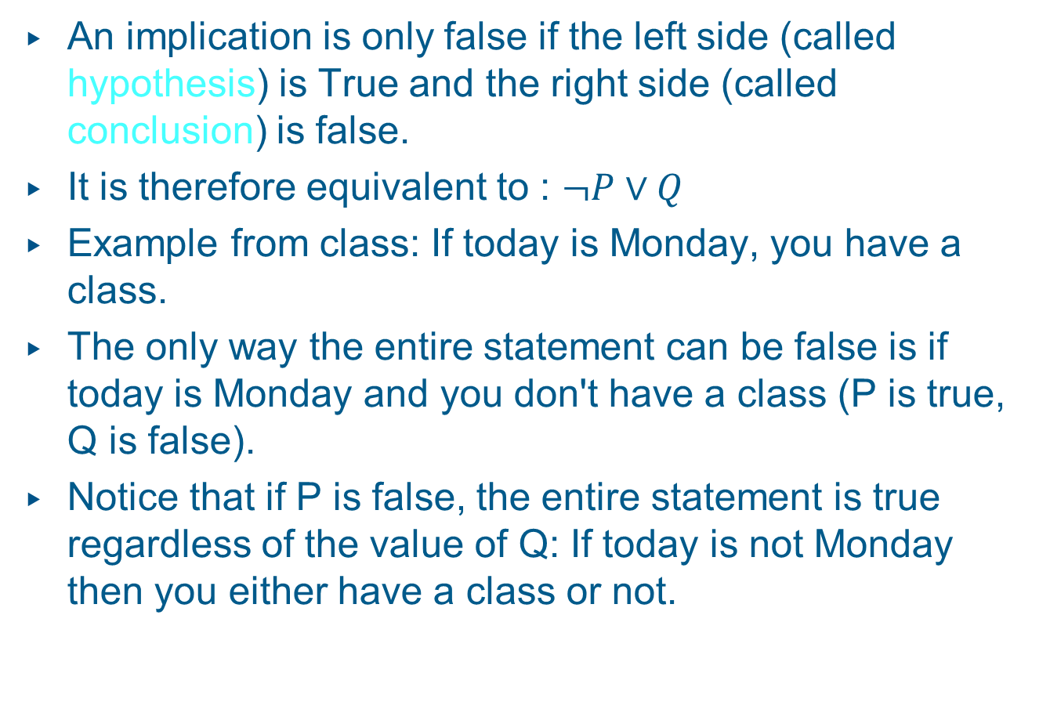
Implication (if - then)
An implication is only false if the left side (called hypothesis) is True and the right side (called conclusion) is false.
It is therefore equivalent to : $¬P∨Q$
Example from class: If today is Monday, you have a class.
The only way the entire statement can be false is if today is Monday and you don't have a class (P is true, Q is false).
Notice that if P is false, the entire statement is true regardless of the value of Q: If today is not Monday then you either have a class or not.
Notes:
Examples

Slide 28
P → Q terminologies
If P, then Q
If P, Q
P is sufficient for Q
Q if P
P implies Q
Q whenever P
Q follows from P
P only if Q
Q unless ¬P
Notes:
Examples

Slide 29
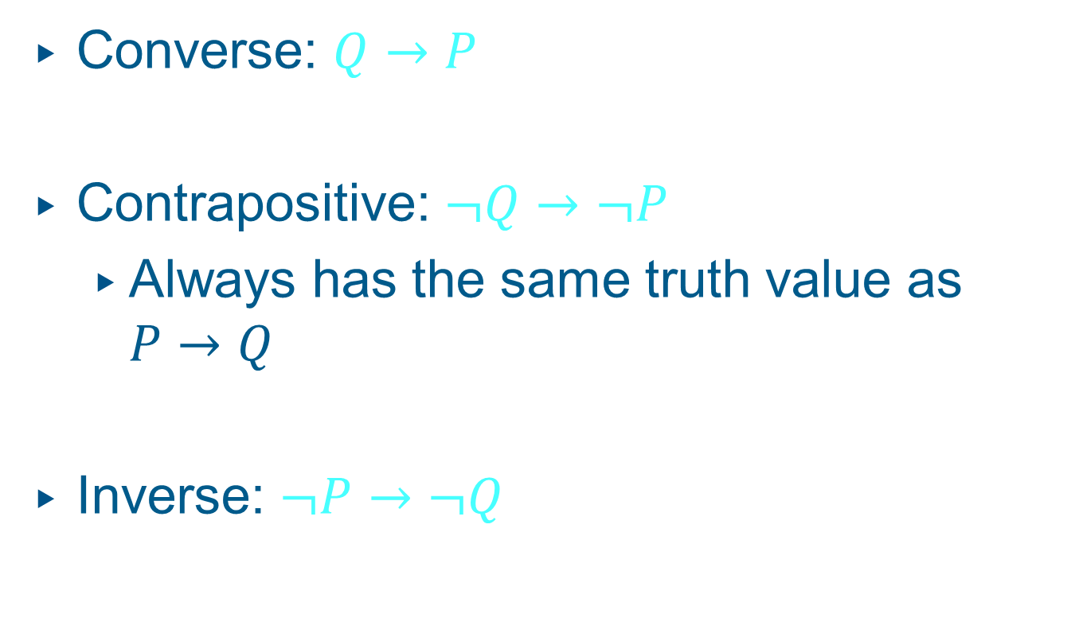
Converse, Contrapositive, and Inverse of P → Q
Converse: $Q→P$
Contrapositive: $¬Q→¬P$
  Always has the same truth value as $P→Q$
Inverse: $¬P→¬Q$
Notes:
Examples

Slide 30
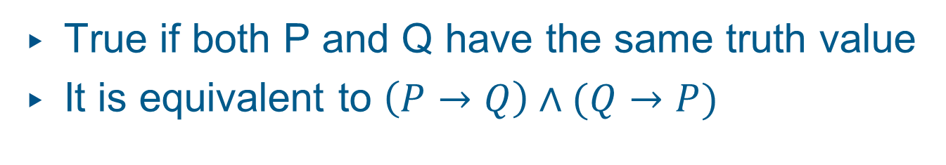
Biconditional (if and only if sometimes written as iff)
Binary Operator, Symbol: ↔
P | Q | P↔Q
true | true | true
true | false | false
false | true | false
false | false | true
True if both P and Q have the same truth value
It is equivalent to $\left(P→Q\right)∧(Q→P)$

Slide 31
Statements and Operators
Statements and operators can be combined in any way to form new statements.
P | Q | ¬P | ¬Q | (¬P)∨(¬Q)
true | true | false | false | false
true | false | false | true | true
false | true | true | false | true
false | false | true | true | true

Slide 32
Statements and Operations
Statements and operators can be combined in any way to form new statements.
P | Q | P∧Q | ¬ (P∧Q) | (¬P)∨(¬Q)
true | true | true | false | false
true | false | false | true | true
false | true | false | true | true
false | false | false | true | true

Slide 33
Equivalent Statements
P | Q | ¬(P∧Q) | (¬P)∨(¬Q) | ¬(P∧Q)↔(¬P)∨(¬Q)
true | true | false | false | true
true | false | true | true | true
false | true | true | true | true
false | false | true | true | true
The statements ¬(P∧Q) and (¬P)∨(¬Q) are logically equivalent, because ¬(P∧Q)↔(¬P)∨(¬Q) is always true.

Slide 34
Logic and Bit operations
Computers use bits. A bit is a symbol with two values 0 (F) and 1 (T)
Computer bit operations correspond to the logical connectives.
We have bitwise OR, bitwise AND, and bitwise XOR
Example for two bit strings 0110110110 and 1100011101
01 1011 0110
11 0001 1101
11 1011 1111
01 0001 0100
10 1010 1011
Bitwise OR
Bitwise AND
Bitwise XOR

Slide 35
Tautologies and Contradictions
A tautology is a statement that is always true.
Examples:
R∨(¬R)
¬(P∧Q)↔(¬P)∨(¬Q)
If S→T is a tautology, we write S⇒T.
If S↔T is a tautology, we write S⇔T.

Slide 36
Tautologies and Contradictions
A contradiction is a statement that is always false.
Examples:
R∧(¬R)
¬(¬(P∧Q)↔(¬P)∨(¬Q))
The negation of any tautology is a contradiction, and the negation of any contradiction is a tautology.

Slide 37
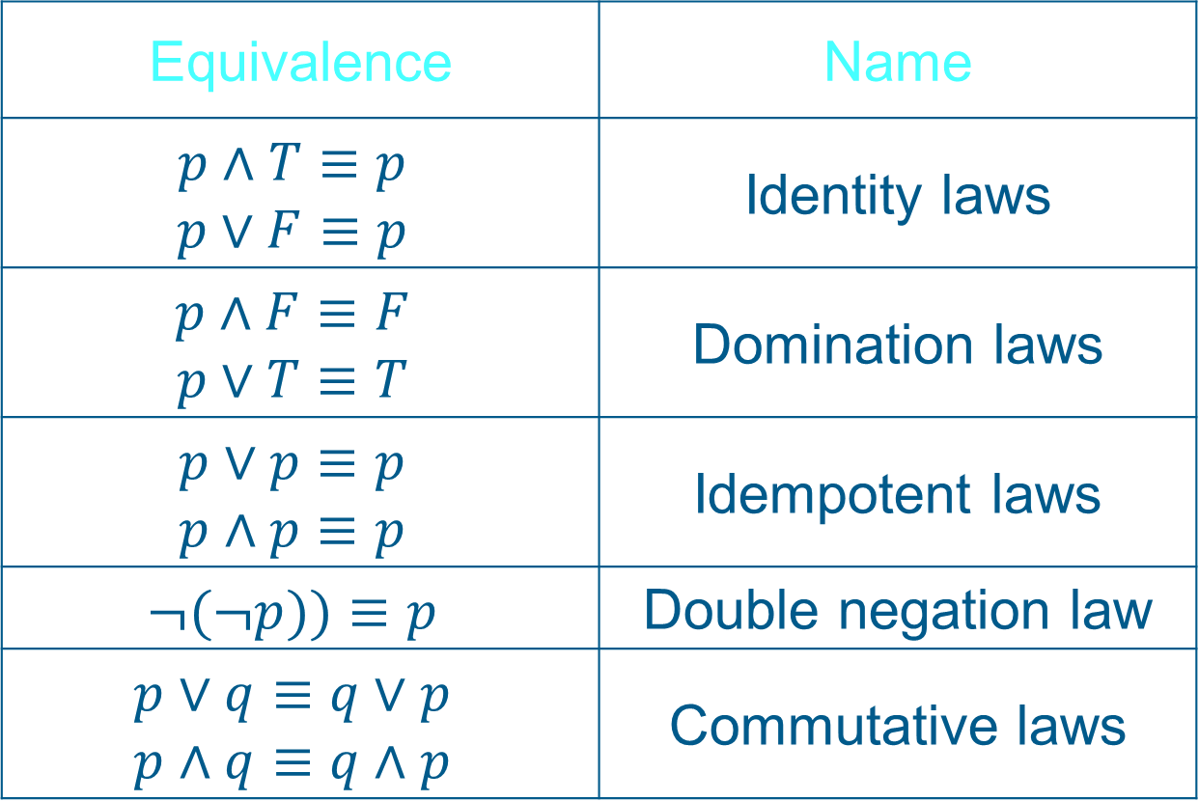
Some Logical Equivalences
Equivalence | Name
$$p∧T≡p$$ $$p∨F≡p$$ | Identity laws
$$p∧F≡F$$ $$p∨T≡T$$ | Domination laws
$$p∨p≡p$$ $$p∧p≡p$$ | Idempotent laws
$$¬(¬p))≡p$$ | Double negation law
$$p∨q≡q∨p$$ $$p∧q≡q∧p$$ | Commutative laws

Slide 38
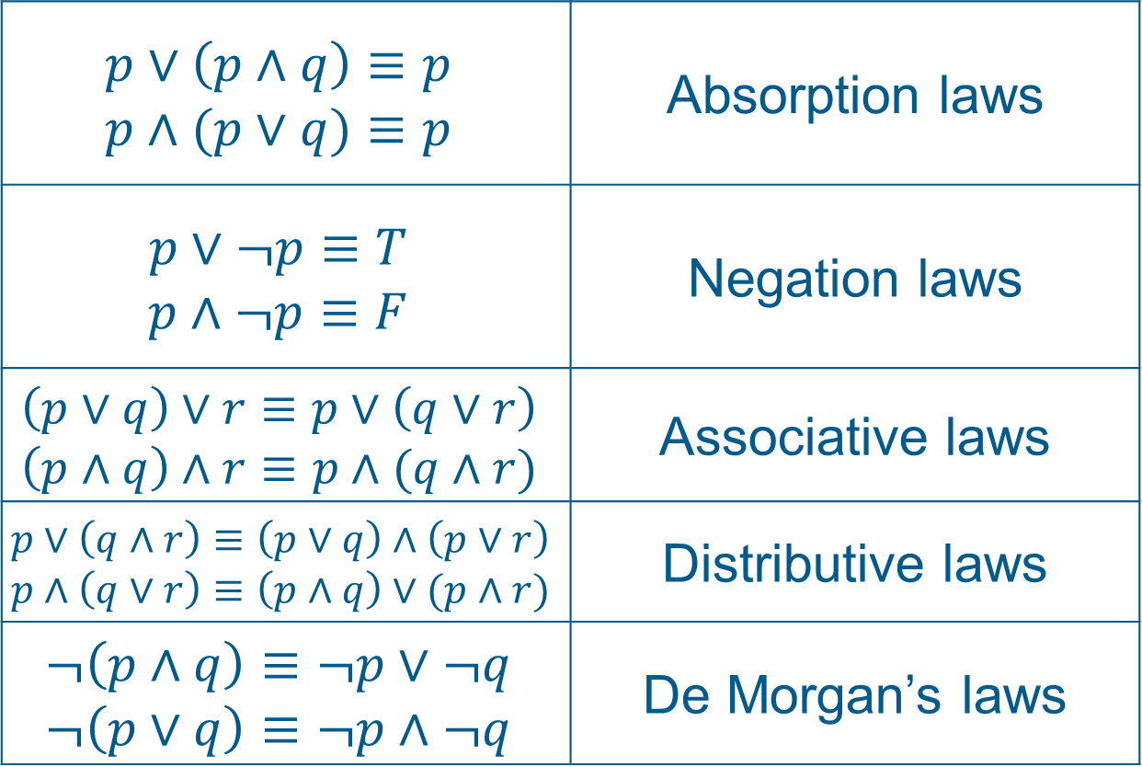
Some Logical Equivalences
$$p∨\left(p∧q\right)≡p$$ $$p∧(p∨q)≡p$$ | Absorption laws
$$p∨¬p≡T$$ $$p∧¬p≡F$$ | Negation laws
$$\left(p∨q\right)∨r≡p∨\left(q∨r\right)$$ $$\left(p∧q\right)∧r≡p∧(q∧r)$$ | Associative laws
$$p∨\left(q∧r\right)≡\left(p∨q\right)∧\left(p∨r\right)$$ $$p∧\left(q∨r\right)≡\left(p∧q\right)∨(p∧r)$$ | Distributive laws
$$¬\left(p∧q\right)≡¬p∨¬q$$ $$¬\left(p∨q\right)≡¬p∧¬q$$ | De Morgan’s laws

Slide 39
Predicates and Quantifiers
The statement P(x): “x is greater than 3” has two parts. The first part, the variable x, is the subject of the statement. The second part, (P) the predicate, “is greater than 3” refers to a property that the subject of the statement can have.
P(x) is the value of the propositional function P at x. Once a value has been assigned to the variable x, the statement P(x) becomes a proposition and has a truth value.
Quantification expresses the extent to which a predicate is true over a range of elements

Slide 40
Universal Quantification
Let P(x) be a propositional function.
Universally quantified sentence:
For all x in the universe of discourse (domain) P(x) is true.
Using the universal quantifier ∀:
∀x P(x) “for all x, P(x)” or “for every x, P(x)”
(Note: ∀x P(x) is either true or false, so it is a proposition, not a propositional function.)

Slide 41
Universal Quantification
Example:
S(x): x is a UMB student.
G(x): x is a genius.
What does ∀x (S(x) → G(x)) mean ?
“If x is a UMB student, then x is a genius.”
or
“All UMB students are geniuses.”

Slide 42
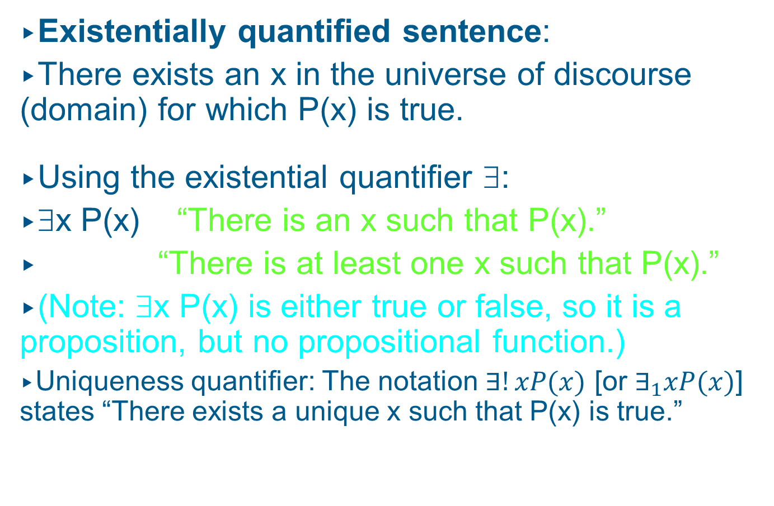
Existential Quantification
Existentially quantified sentence:
There exists an x in the universe of discourse (domain) for which P(x) is true.
Using the existential quantifier ∃:
∃x P(x) “There is an x such that P(x).”
“There is at least one x such that P(x).”
(Note: ∃x P(x) is either true or false, so it is a proposition, but no propositional function.)
Uniqueness quantifier: The notation $∃!xP(x)$ [or $∃_{1}xP(x)$] states “There exists a unique x such that P(x) is true.”

Slide 43
Existential Quantification
Example:
P(x): x is a UMB professor.
G(x): x is a genius.
What does ∃x (P(x) ∧ G(x)) mean ?
“There is an x such that x is a UMB professor and x is a genius.”
or
“At least one UMB professor is a genius.”

Slide 44
Quantification
Another example:
Let the universe of discourse be the real numbers.
What does ∀x∃y (x + y = 320) mean ?
“For every x there exists a y so that x + y = 320.”
Is it true?
yes
Is it true for the natural numbers?
no

Slide 45
Negation
¬(∀x P(x)) is logically equivalent to ∃x (¬P(x)).
¬(∃x P(x)) is logically equivalent to ∀x (¬P(x)).

Slide 46
Quantification
Introducing the universal quantifier ∀ and the existential quantifier ∃ facilitates the translation of world knowledge into predicate calculus.
Examples:
Paul beats up all professors who fail him.
∀x([Professor(x) ∧ Fails(x, Paul)] → BeatsUp(Paul, x))
All computer scientists are either rich or crazy, but not both.
∀x (CS(x) → [Rich(x) ∧ ¬Crazy(x)] ∨ [¬Rich(x) ∧ Crazy(x)] )
Or, using XOR:
∀x (CS(x) → [Rich(x) ⊕ Crazy(x)])

Slide 47
More Practice for Predicate Logic
Important points:
Define propositional functions in a useful and reusable manner, just like functions in a computer program.
Make sure your formalized statement evaluates to “true” in the context of the original statement and evaluates to “false” whenever the original statement is violated.

Slide 48
More Practice for Predicate Logic
More Examples:
Jenny likes all movies that Peter likes (and possibly more).
∀x [Movie(x) ∧ Likes(Peter, x) → Likes(Jenny, x)]
There is exactly one UMass professor who won a Nobel prize
∃x[UMBProf(x) ∧ Wins(x, NobelPrize)] ∧
¬∃y,z[y ≠ z ∧ UMBProf(y) ∧ UMBProf(z) ∧
Wins(y, NobelPrize) ∧ Wins(z, NobelPrize)]

