Slide 1
We will cover these parts of the book (8th edition): 10.3 10.4.1-10.4.3 10.4.5 11.1.1-11.1.3 (up to page 788) 11.2.1, 11.2.2 11.4.1 11.5 12.1 12.2.1 12.3.1

Slide 2
Representing Graphs (Adjacency list)
a
a
d
b
b
d
c
c
Vertex | Adjacent Vertices
a | b, c, d
b | a, d
c | a, d
d | a, b, c
Initial Vertex | Terminal Vertices
a | c
b | a
c
d | a, b, c

Slide 3
Representing Graphs
Definition: Let G = (V, E) be a simple graph with |V| = n. Suppose that the vertices of G are listed in arbitrary order as v₁, v₂, …, v_{n}.
The adjacency matrix A (or A_{G}) of G, with respect to this listing of the vertices, is the n×n zero-one matrix with 1 as its (i, j)th entry when v_{i} and v_{j} are adjacent, and 0 otherwise.
In other words, for an adjacency matrix A = [a_{ij}],
a_{ij} = 1 if {v_{i}, v_{j}} is an edge of G, a_{ij} = 0 otherwise.

Slide 4
Representing Graphs
Example: What is the adjacency matrix A_{G} for the following graph G based on the order of vertices a, b, c, d ?
a
b
d
c
Solution:
Note: Adjacency matrices of undirected graphs are always symmetric.

Slide 5
Representing Graphs
For the representation of graphs with multiple edges, we can no longer use zero-one matrices.
Instead, we use matrices of natural numbers.
The (i, j)th entry of such a matrix equals the number of edges that are associated with {v_{i}, v_{j}}.

Slide 6
Representing Graphs
Example: What is the adjacency matrix A_{G} for the following graph G based on the order of vertices a, b, c, d ?
a
b
d
c
Solution:
Note: For undirected graphs, adjacency matrices are symmetric.

Slide 7
Representing Graphs
Definition: Let G = (V, E) be a directed graph with |V| = n. Suppose that the vertices of G are listed in arbitrary order as v₁, v₂, …, v_{n}.
The adjacency matrix A (or A_{G}) of G, with respect to this listing of the vertices, is the n×n zero-one matrix with 1 as its (i, j)th entry when there is an edge from v_{i} to v_{j}, and 0 otherwise.
In other words, for an adjacency matrix A = [a_{ij}],
a_{ij} = 1 if (v_{i}, v_{j}) is an edge of G, a_{ij} = 0 otherwise.

Slide 8
Representing Graphs
Example: What is the adjacency matrix A_{G} for the following graph G based on the order of vertices a, b, c, d ?
a
b
d
c
Solution:

Slide 9
Representing Graphs
Definition: Let G = (V, E) be an undirected graph with |V| = n and |E| = m. Suppose that the vertices and edges of G are listed in arbitrary order as v₁, v₂, …, v_{n} and e₁, e₂, …, e_{m}, respectively.
The incidence matrix of G with respect to this listing of the vertices and edges is the n×m zero-one matrix with 1 as its (i, j)th entry when edge e_{j} is incident with vertex v_{i}, and 0 otherwise.
In other words, for an incidence matrix M = [m_{ij}],
m_{ij} = 1 if edge e_{j} is incident with v_{i} m_{ij} = 0 otherwise.

Slide 10
Representing Graphs
Example: What is the incidence matrix M for the following graph G based on the order of vertices a, b, c, d and edges 1, 2, 3, 4, 5, 6?
a
1
2
b
d
3
5
4
c
6
Solution:
Note: Incidence matrices of directed graphs contain two 1s per column for edges connecting two vertices and one 1 per column for loops.

Slide 11
Isomorphism of Graphs
Definition: The simple graphs G₁ = (V₁, E₁) and G₂ = (V₂, E₂) are isomorphic if there is a bijection (an one-to-one and onto function) f from V₁ to V₂ with the property that a and b are adjacent in G₁ if and only if f(a) and f(b) are adjacent in G₂, for all a and b in V₁.
Such a function f is called an isomorphism.
In other words, G₁ and G₂ are isomorphic if their vertices can be ordered in such a way that the adjacency matrices M_{G1} and M_{G2} are identical.

Slide 12
Isomorphism of Graphs
From a visual standpoint, G₁ and G₂ are isomorphic if they can be arranged in such a way that their displays are identical (of course without changing adjacency).
Unfortunately, for two simple graphs, each with n vertices, there are n! possible isomorphisms that we have to check in order to show that these graphs are isomorphic.
However, showing that two graphs are not isomorphic can be easy.

Slide 13
Isomorphism of Graphs
For this purpose we can check invariants, that is, properties that two isomorphic simple graphs must both have.
For example, they must have
the same number of vertices,
the same number of edges, and
the same degrees of vertices.
Note that two graphs that differ in any of these invariants are not isomorphic, but two graphs that match in all of them are not necessarily isomorphic.

Slide 14
Isomorphism of Graphs
Example I: Are the following two graphs isomorphic?
a
a
b
e
e
b
c
d
c
d
Solution: Yes, they are isomorphic, because they can be arranged to look identical. You can see this if in the right graph you move vertex b to the left of the edge {a, c}. Then the isomorphism f from the left to the right graph is: f(a) = e, f(b) = a, f(c) = b, f(d) = c, f(e) = d.

Slide 15
Isomorphism of Graphs
Example II: How about these two graphs?
a
a
b
e
e
b
c
c
d
d
Solution: No, they are not isomorphic, because they differ in the degrees of their vertices.
Vertex d in right graph is of degree one, but there is no such vertex in the left graph.

Slide 16
Connectivity
Definition: A path of length n from u to v, where n is a positive integer, in an undirected graph is a sequence of edges e₁, e₂, …, e_{n} of the graph such that f(e₁) = {x₀, x₁}, f(e₂) = {x₁, x₂}, …, f(e_{n}) = {x_{n-1}, x_{n}}, where x₀ = u and x_{n} = v.
When the graph is simple, we denote this path by its vertex sequence x₀, x₁, …, x_{n}, since it uniquely determines the path.
The path is a circuit if it begins and ends at the same vertex, that is, if u = v.

Slide 17
Connectivity
Definition (continued): The path or circuit is said to pass through or traverse x₁, x₂, …, x_{n-1}.
A path or circuit is simple if it does not contain the same edge more than once.

Slide 18
Connectivity
Definition: A path of length n from u to v, where n is a positive integer, in a directed multigraph is a sequence of edges e₁, e₂, …, e_{n} of the graph such that f(e₁) = (x₀, x₁), f(e₂) = (x₁, x₂), …, f(e_{n}) = (x_{n-1}, x_{n}), where x₀ = u and x_{n} = v.
When there are no multiple edges in the path, we denote this path by its vertex sequence x₀, x₁, …, x_{n}, since it uniquely determines the path.
The path is a circuit if it begins and ends at the same vertex, that is, if u = v.
A path or circuit is called simple if it does not contain the same edge more than once.

Slide 19
Connectivity
Let us now look at something new:
Definition: An undirected graph is called connected if there is a path between every pair of distinct vertices in the graph.
For example, any two computers in a network can communicate if and only if the graph of this network is connected.
Note: A graph consisting of only one vertex is always connected, because it does not contain any pair of distinct vertices.

Slide 20
Connectivity
Example: Are the following graphs connected?
a
b
a
b
e
e
d
d
c
c
Yes
No
a
b
a
b
e
e
d
c
d
f
c
No
Yes

Slide 21
Connectivity
Theorem: There is a simple path between every pair of distinct vertices of a connected undirected graph.
Definition: A graph that is not connected is the union of two or more connected subgraphs, each pair of which has no vertex in common. These disjoint connected subgraphs are called the connected components of the graph.

Slide 22
Connectivity
Example: What are the connected components in the following graph?
i
h
d
a
e
g
b
c
f
j
Solution: The connected components are the graphs with vertices {a, b, c, d}, {e}, {f}, {i, g, h, j}.

Slide 23
Connectivity
Definition: A directed graph is strongly connected if there is a path from a to b and from b to a whenever a and b are vertices in the graph.
Definition: A directed graph is weakly connected if there is a path between any two vertices in the underlying undirected graph.

Slide 24
Connectivity
Example: Are the following directed graphs strongly or weakly connected?
a
Weakly connected, because, for example, there is no path from b to d.
b
d
c
a
Strongly connected, because there are paths between all possible pairs of vertices.
b
d
c

Slide 25
Connectivity
Idea: The number and size of connected components and circuits are further invariants with respect to isomorphism of simple graphs.
Example: Are these two graphs isomorphic?
Solution: No, because the right graph contains circuits of length 3, while the left graph does not.

Slide 26
Trees

Slide 27
Trees
Definition: A tree is a connected undirected graph with no simple circuits.
Since a tree cannot have a simple circuit, a tree cannot contain multiple edges or loops.
Therefore, any tree must be a simple graph.
Theorem: An undirected graph is a tree if and only if there is a unique simple path between any of its vertices.

Slide 28
Trees
Example: Are the following graphs trees?
No.
Yes.
Yes.
No.

Slide 29
Trees
Definition: An undirected graph that does not contain simple circuits and is not necessarily connected is called a forest.
In general, we use trees to represent hierarchical structures.
We often designate a particular vertex of a tree as the root. Since there is a unique path from the root to each vertex of the graph, we direct each edge away from the root.
Thus, a tree together with its root produces a directed graph called a rooted tree.

Slide 30
Tree Terminology
If v is a vertex in a rooted tree other than the root, the parent of v is the unique vertex u such that there is a directed edge from u to v.
When u is the parent of v, v is called the child of u.
Vertices with the same parent are called siblings.
The ancestors of a vertex other than the root are the vertices in the path from the root to this vertex, excluding the vertex itself and including the root.

Slide 31
Tree Terminology
The descendants of a vertex v are those vertices that have v as an ancestor.
A vertex of a tree is called a leaf if it has no children.
Vertices that have children are called internal vertices.
If a is a vertex in a tree, then the subtree with a as its root is the subgraph of the tree consisting of a and its descendants and all edges incident to these descendants.

Slide 32
Tree Terminology
The level of a vertex v in a rooted tree is the length of the unique path from the root to this vertex.
The level of the root is defined to be zero.
The height of a rooted tree is the maximum of the levels of vertices.

Slide 33
Trees
Example I: Family tree
James
Christine
Bob
Frank
Joyce
Petra

Slide 34
Trees
Example II: File system
/
usr
bin
temp
bin
spool
ls

Slide 35
Trees
Example III: Arithmetic expressions
$$×$$
+
-
y
z
x
y
This tree represents the expression (y + z) $×$ (x - y).

Slide 36
Trees
Definition: A rooted tree is called an m-ary tree if every internal vertex has no more than m children.
The tree is called a full m-ary tree if every internal vertex has exactly m children.
An m-ary tree with m = 2 is called a binary tree.
Theorem: A tree with n vertices has (n – 1) edges.
Theorem: A full m-ary tree with i internal vertices contains n = mi + 1 vertices.

Slide 37
Binary Search Trees
If we want to perform a large number of searches in a particular list of items, it can be worthwhile to arrange these items in a binary search tree to facilitate the subsequent searches.
A binary search tree is a binary tree in which each child of a vertex is designated as a right or left child, and each vertex is labeled with a key, which is one of the items.
When we construct the tree, vertices are assigned keys so that the key of a vertex is both larger than the keys of all vertices in its left subtree and smaller than the keys of all vertices in its right subtree.

Slide 38
Binary Search Trees
Example: Construct a binary search tree for the strings math, computer, power, north, zoo, dentist, book.
math

Slide 39
Binary Search Trees
Example: Construct a binary search tree for the strings math, computer, power, north, zoo, dentist, book.
math
computer

Slide 40
Binary Search Trees
Example: Construct a binary search tree for the strings math, computer, power, north, zoo, dentist, book.
math
computer
power

Slide 41
Binary Search Trees
Example: Construct a binary search tree for the strings math, computer, power, north, zoo, dentist, book.
math
computer
power
north

Slide 42
Binary Search Trees
Example: Construct a binary search tree for the strings math, computer, power, north, zoo, dentist, book.
math
computer
power
north
zoo

Slide 43
Binary Search Trees
Example: Construct a binary search tree for the strings math, computer, power, north, zoo, dentist, book.
math
computer
power
dentist
north
zoo

Slide 44
Binary Search Trees
Example: Construct a binary search tree for the strings math, computer, power, north, zoo, dentist, book.
math
computer
power
book
dentist
north
zoo

Slide 45
Binary Search Trees
To perform a search in such a tree for an item x, we can start at the root and compare its key to x. If x is less than the key, we proceed to the left child of the current vertex, and if x is greater than the key, we proceed to the right one.
This procedure is repeated until we either found the item we were looking for, or we cannot proceed any further.
In a balanced tree representing a list of n items, search can be performed with a maximum of ⎡log(n + 1)⎤ steps (compare with binary search).

Slide 46
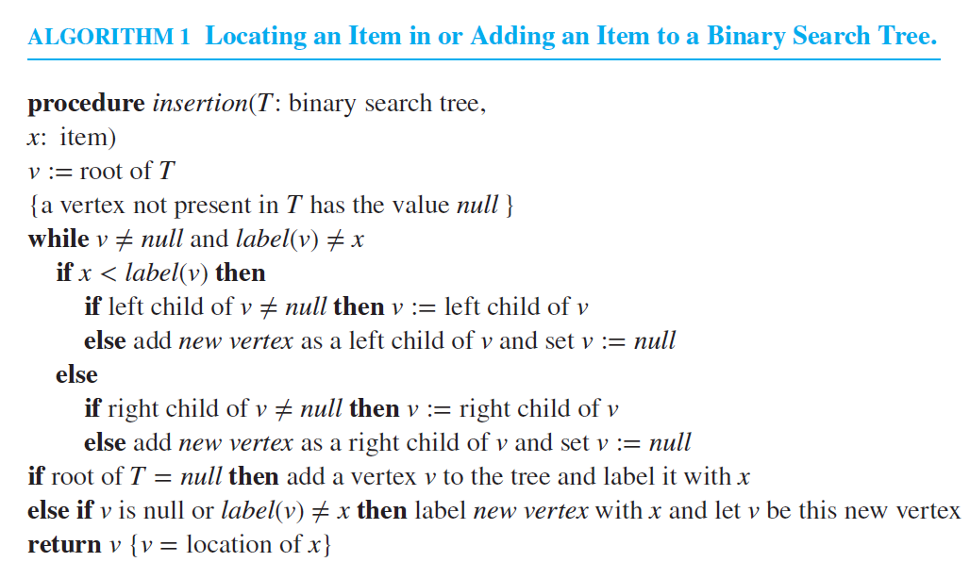
Binary Search Trees

Slide 47
Spanning Trees
Definition: Let G be a simple graph. A spanning tree of G is a subgraph of G that is a tree containing every vertex of G.
Note: A spanning tree of G = (V, E) is a connected graph on V with a minimum number of edges (|V| - 1).
Example: Since winters in Boston can be very cold, six universities in the Boston area decide to build a tunnel system that connects their libraries.

Slide 48
Spanning Trees
The complete graph including all possible tunnels:
Brandeis
Harvard
MIT
BU
Tufts
UMass
The spanning trees of this graph connect all libraries with a minimum number of tunnels.

Slide 49
Spanning Trees
Example for a spanning tree:
Brandeis
Harvard
MIT
BU
Tufts
UMass
Since there are 6 libraries, 5 tunnels are sufficient to connect all of them.

Slide 50
Spanning Trees
Theorem: A simple graph is connected if and only if it has a spanning tree.
Now imagine that you are in charge of the tunnel project. How can you determine a tunnel system of minimal cost that connects all libraries?
Definition: A minimum spanning tree in a connected weighted graph is a spanning tree that has the smallest possible sum of weights of its edges.
How can we find a minimum spanning tree?

Slide 51
Spanning Trees
The complete graph with cost labels (in billion $):
Brandeis
Harvard
7
8
5
MIT
2
9
5
4
9
6
4
Tufts
BU
4
4
6
5
3
UMass
The least expensive tunnel system costs $20 billion.

Slide 52
Spanning Trees
Prim’s Algorithm:
Begin by choosing any edge with smallest weight and putting it into the spanning tree,
successively add to the tree edges of minimum weight that are incident to a vertex already in the tree and not forming a simple circuit with those edges already in the tree,
stop when (n – 1) edges have been added.

Slide 53
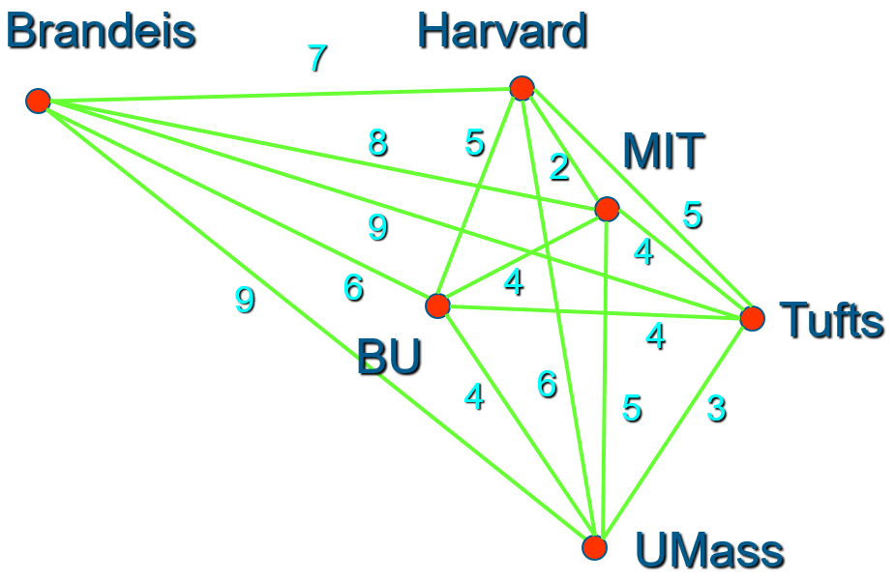
Spanning Trees
Example: Use Prim’s algorithm to design a minimum spanning tree for the libraries’ graph.
Brandeis
Harvard
2
MIT
6
4
4
Tufts
BU
3
Minimum cost: 19
UMass

Slide 54
Spanning Trees
Kruskal’s Algorithm:
Kruskal’s algorithm is identical to Prim’s algorithm, except that it does not demand new edges to be incident to a vertex already in the tree.
Both algorithms are guaranteed to produce a minimum spanning tree of a connected weighted graph.

Slide 55
Spanning Trees
Example: Use Kruskal’s algorithm to design a minimum spanning tree for the libraries’ graph.
Brandeis
Harvard
2
MIT
6
4
4
Tufts
BU
3
Minimum cost: 19
UMass

Slide 56
Spanning Trees
Prim vs. Kruskal:
The two algorithms differ in the way they can be implemented and their efficiency under different conditions.
As a rule of thumb, Prim’s algorithm is more efficient when initially there are many more edges than vertices.
For graphs with initially only few edges in comparison to the number of vertices, Kruskal’s algorithm typically performs more efficiently.

Slide 57
Boolean Algebra

Slide 58
Boolean Algebra
Boolean algebra provides the operations and the rules for working with the set {0, 1}.
These are the rules that underlie electronic circuits, and the methods we will discuss are fundamental to VLSI design.
We are going to focus on three operations:
Boolean complementation,
Boolean sum, and
Boolean product

Slide 59
Boolean Operations
The complement is denoted by a bar. It is defined by
$\overline{0}$ = 1 and $\overline{1}$ = 0.
The Boolean sum, denoted by + or by OR, has the following values:
1 + 1 = 1, 1 + 0 = 1, 0 + 1 = 1, 0 + 0 = 0
The Boolean product, denoted by ⋅ or by AND, has the following values:
1 ⋅ 1 = 1, 1 ⋅ 0 = 0, 0 ⋅ 1 = 0, 0 ⋅ 0 = 0

Slide 60
Boolean Functions and Expressions
Definition: Let B = {0, 1}. The variable x is called a Boolean variable if it assumes values only from B.
A function from B^{n}, the set {(x₁, x₂, …, x_{n}) |x_{i}∈B, 1 ≤ i ≤ n}, to B is called a Boolean function of degree n.
Boolean functions can be represented using expressions made up from Boolean variables and Boolean operations.

Slide 61
Boolean Functions and Expressions
Question: How many different Boolean functions of degree 1 are there?
Solution: There are four of them, F₁, F₂, F₃, and F₄:
x | F₁ | F₂ | F₃ | F₄
0 | 0 | 0 | 1 | 1
1 | 0 | 1 | 0 | 1

Slide 62
Boolean Functions and Expressions
Question: How many different Boolean functions of degree 2 are there?
Solution: There are 16 of them, F₁, F₂, …, F₁₆:
x
y
F₁
F₂
F₃
F₄
F₅
F₆
F₇
F₈
F₉
F₁₀
F₁₁
F₁₂
F₁₃
F₁₄
F₁₅
F₁₆
0
0
0
0
0
0
0
0
0
0
1
1
1
1
1
1
1
1
0
1
0
0
0
0
1
1
1
1
0
0
0
0
1
1
1
1
1
0
0
0
1
1
0
0
1
1
0
0
1
1
0
0
1
1
1
1
0
1
0
1
0
1
0
1
0
1
0
1
0
1
0
1

Slide 63
Boolean Functions and Expressions
Question: How many different Boolean functions of degree n are there?
Solution:
There are 2^{n} different n-tuples of 0s and 1s.
A Boolean function is an assignment of 0 or 1 to each of these 2^{n} different n-tuples.
Therefore, there are 2^{2n} different Boolean functions

Slide 64
Boolean Functions and Expressions
The Boolean expressions in the variables x₁, x₂, …, x_{n} are defined recursively as follows:
0, 1, x₁, x₂, …, x_{n} are Boolean expressions.
If E₁ and E₂ are Boolean expressions, then ($\overline{E_{1}}$), (E₁E₂), and (E₁ + E₂) are Boolean expressions.
Each Boolean expression represents a Boolean function. The values of this function are obtained by substituting 0 and 1 for the variables in the expression.

Slide 65
Boolean Functions and Expressions
For example, we can create Boolean expression in the variables x, y, and z using the “building blocks” 0, 1, x, y, and z, and the construction rules:
Since x and y are Boolean expressions, so is xy.
Since z is a Boolean expression, so is ($\overline{z}$).
Since xy and ($\overline{z}$) are Boolean expressions, so is xy + ($\overline{z}$).
… and so on…

Slide 66
Boolean Functions and Expressions
Example: Give a Boolean expression for the Boolean function F(x, y) as defined by the following table:
x | y | F(x, y)
0 | 0 | 0
0 | 1 | 1
1 | 0 | 0
1 | 1 | 0
Possible solution: F(x, y) = $\left(\overline{x }\right).y$

Slide 67
Boolean Functions and Expressions
Another Example:
Possible solution I:
F(x, y, z) = $\overline{(xz+y)}$
x
y
z
F(x, y, z)
0
0
0
1
0
0
1
1
Possible solution II:
F(x, y, z) = $\overline{(xz)} \overline{(y)}$
0
1
0
0
0
1
1
0
1
0
0
1
1
0
1
0
1
1
0
0
1
1
1
0

Slide 68
Boolean Functions and Expressions
Definition: The Boolean functions F and G of n variables are equal if and only if F(b₁, b₂, …, b_{n}) = G(b₁, b₂, …, b_{n}) whenever b₁, b₂, …, b_{n} belong to B.
Two different Boolean expressions that represent the same function are called equivalent.
For example, the Boolean expressions xy, xy + 0, and xy⋅1 are equivalent.

Slide 69
Boolean Functions and Expressions
The complement of the Boolean function F is the function$\overline{F}$, where $\overline{F}$(b₁, b₂, …, b_{n}) = $\overline{F(\text{b}\text{1}\text{, }\text{b}\text{2}\text{, }\text{…}\text{, }\text{bn})}$.
Let F and G be Boolean functions of degree n. The Boolean sum F+G and Boolean product FG are then defined by
(F + G)(b₁, b₂, …, b_{n}) = F(b₁, b₂, …, b_{n})+G(b₁, b₂, …, b_{n})
(FG)(b₁, b₂, …, b_{n}) = F(b₁, b₂, …, b_{n}) G(b₁, b₂, …, b_{n})

Slide 70
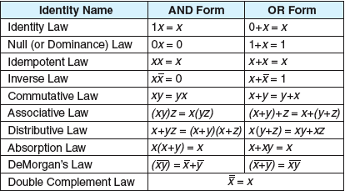
Identities
There are useful identities of Boolean expressions that can help us to transform an expression A into an equivalent expression B, e.g.:

Slide 71
Identities
These identities come in pairs. To explain the relationship between the two identities in each pair we use the concept of a dual.
The dual of a Boolean expression is obtained by interchanging Boolean sums and Boolean products and interchanging 0s and 1s.
The dual of a Boolean function F represented by a Boolean expression is the function represented by the dual of this expression.
This dual function, denoted by $F^{d}$, does not depend on the particular Boolean expression used to represent F.
An identity between functions represented by Boolean expressions remains valid when the duals of both sides of the identity are taken. This result, called the duality principle, is useful for obtaining new identities.

Slide 72
Definition of a Boolean Algebra
All the properties of Boolean functions and expressions that we have discovered also apply to other mathematical structures such as propositions and sets and the operations defined on them.
If we can show that a particular structure is a Boolean algebra, then we know that all results established about Boolean algebras apply to this structure.
For this purpose, we need an abstract definition of a Boolean algebra.

Slide 73
Definition of a Boolean Algebra
Definition: A Boolean algebra is a set B with two binary operations ∨ and ∧, elements 0 and 1, and a unary operation such that the following properties hold for all x, y, and z in B:
x ∨ 0 = x and x ∧ 1 = x (identity laws)
x ∨ ($\overline{x}$) = 1 and x ∧ ($\overline{x}$) = 0 (domination laws)
(x ∨ y) ∨ z = x ∨ (y ∨ z) and (x ∧ y) ∧ z = x ∧ (y ∧ z) (associative laws)
x ∨ y = y ∨ x and x ∧ y = y ∧ x (commutative laws)
x ∨ (y ∧ z) = (x ∨ y) ∧ (x ∨ z) and x ∧ (y ∨ z) = (x ∧ y) ∨ (x ∧ z) (distributive laws)

Slide 74
Representing Boolean Functions
There is a simple method for deriving a Boolean expression for a function that is defined by a table. This method is based on minterms.
Definition: A literal is a Boolean variable or its complement. A minterm of the Boolean variables x₁, x₂, …, x_{n} is a Boolean product y₁y₂…y_{n}, where y_{i} = x_{i} or y_{i} =$\overline{x_{i}}$.
Hence, a minterm is a product of n literals, with one literal for each variable.

Slide 75
Representing Boolean Functions
Consider F(x,y,z) again:
x
y
z
F(x, y, z)
F(x, y, z) = 1 if and only if:
x = y = z = 0 or
x = y = 0, z = 1 or
x = 1, y = z = 0
Therefore,
F(x, y, z) = ($\overline{ x }$)($\overline{ y }$)($\overline{ z }$) + ($\overline{ x }$)($\overline{ y }$)z + x($\overline{ y }$)($\overline{ z }$)
0
0
0
1
0
0
1
1
0
1
0
0
0
1
1
0
1
0
0
1
1
0
1
0
1
1
0
0
1
1
1
0

Slide 76
Logic Gates
Electronic circuits consist of so-called gates. There are three basic types of gates:
x
$$\overline{ x }$$
inverter
x
x+y
OR gate
y
x
xy
AND gate
y

