Slide 1
We will cover these parts of the book (8th edition):
1.5-1.7
1.8.1-1.8.4

Slide 2
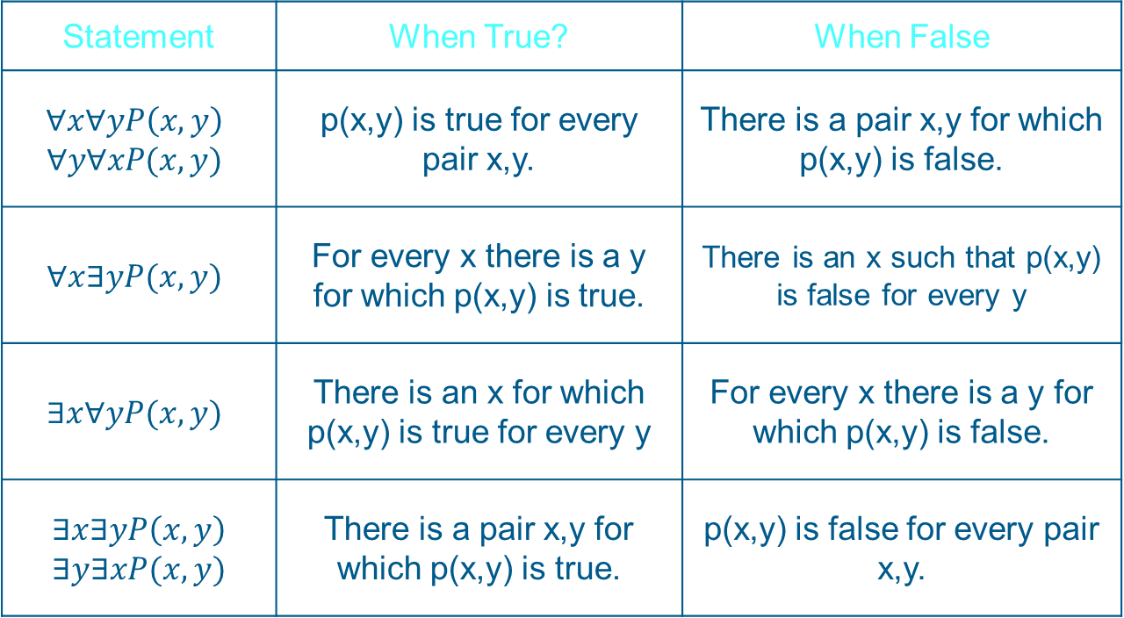

Nested Quantifiers
When one quantifier is within the scope of another. Such as
  $∀x∃y\left(x+y=0\right)$
Statement | When True? | When False
$$∀x∀yP\left(x,y\right)$$ $$∀y∀xP(x,y)$$ | p(x,y) is true for every pair x,y. | There is a pair x,y for which p(x,y) is false.
$$∀x∃yP(x,y)$$ | For every x there is a y for which p(x,y) is true. | There is an x such that p(x,y) is false for every y
$$∃x∀yP(x,y)$$ | There is an x for which p(x,y) is true for every y | For every x there is a y for which p(x,y) is false.
$$∃x∃yP\left(x,y\right)$$ $$∃y∃xP(x,y)$$ | There is a pair x,y for which p(x,y) is true. | p(x,y) is false for every pair x,y.

Slide 3
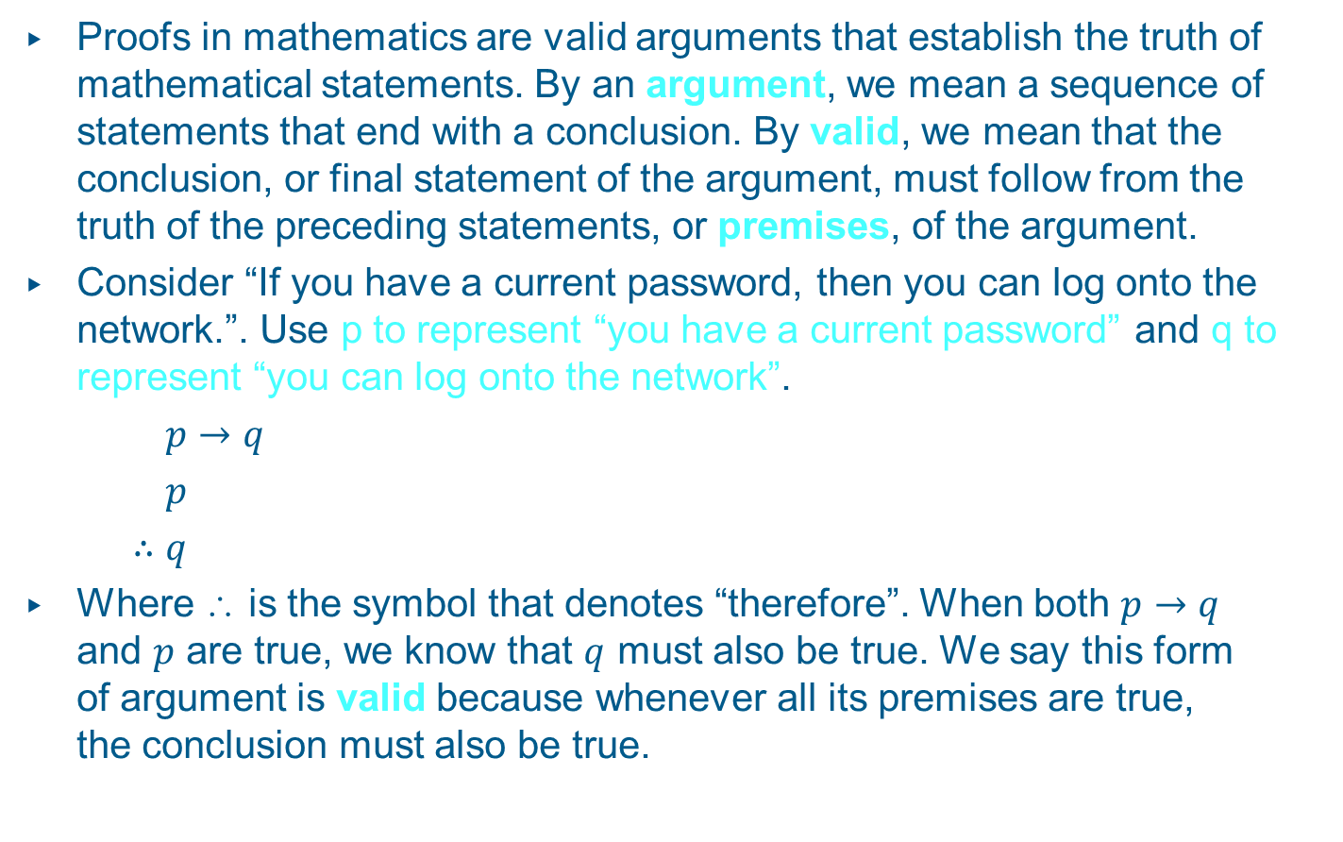
Rules of Inference
Proofs in mathematics are valid arguments that establish the truth of mathematical statements. By an argument, we mean a sequence of statements that end with a conclusion. By valid, we mean that the conclusion, or final statement of the argument, must follow from the truth of the preceding statements, or premises, of the argument.
Consider “If you have a current password, then you can log onto the network.”. Use p to represent “you have a current password” and q to represent “you can log onto the network”.
$p→q$
$p$
$∴q$
Where ∴ is the symbol that denotes “therefore”. When both $p→q$ and $p$ are true, we know that $q$ must also be true. We say this form of argument is valid because whenever all its premises are true, the conclusion must also be true.

Slide 4
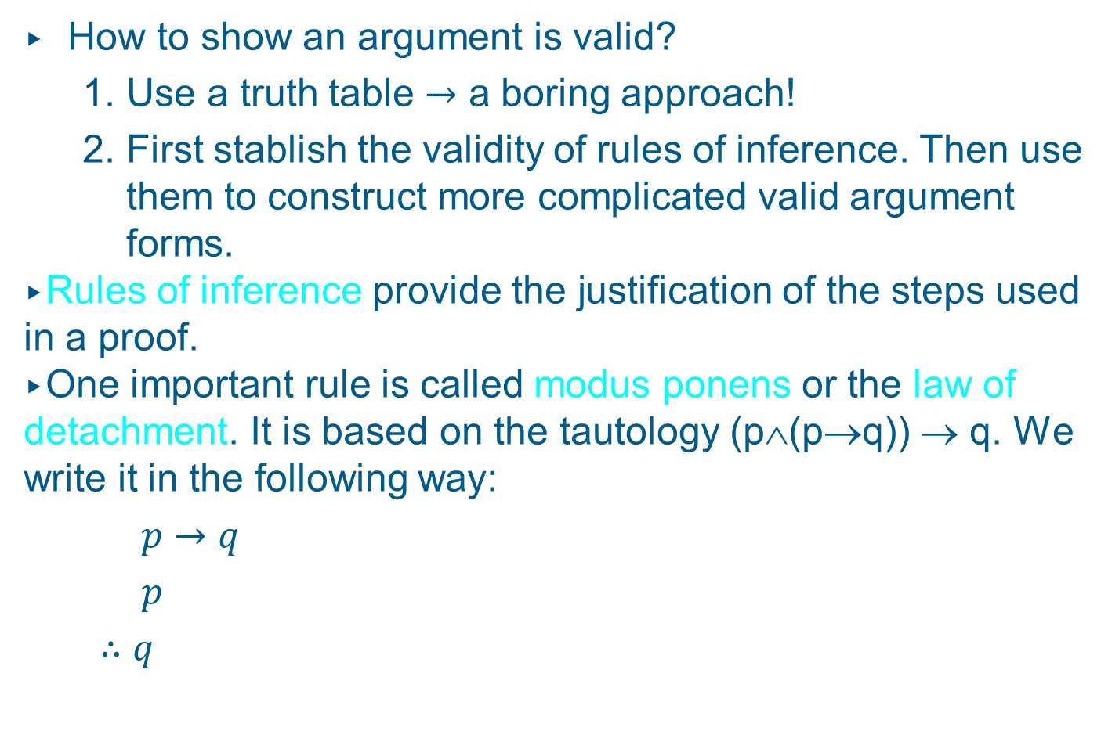
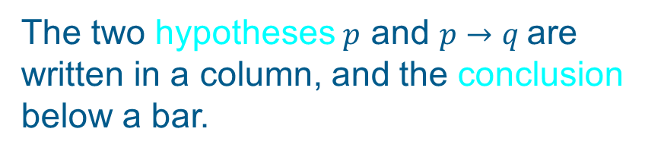
Rules of Inference
How to show an argument is valid?
  Use a truth table $→$ a boring approach!
  First stablish the validity of rules of inference. Then use them to construct more complicated valid argument forms.
Rules of inference provide the justification of the steps used in a proof.
One important rule is called modus ponens or the law of detachment. It is based on the tautology (p∧(p→q)) → q. We write it in the following way:
$p→q$
$p$
$∴q$
The two hypotheses $p$ and $p→q$are
written in a column, and the conclusion
below a bar.

Slide 5
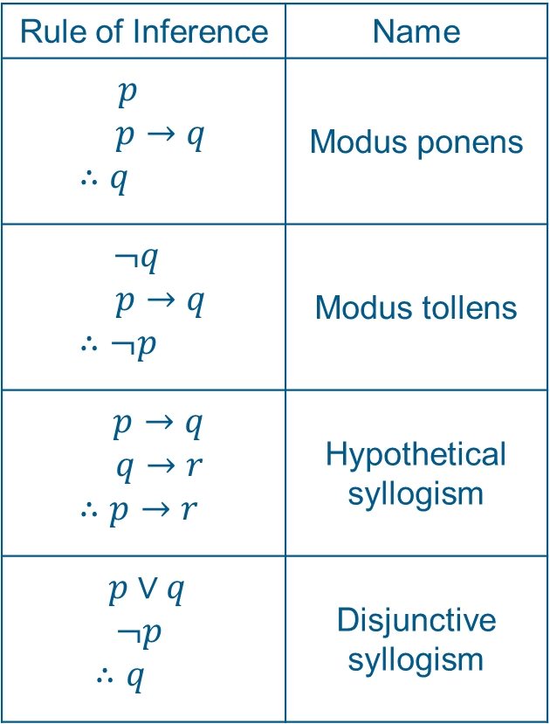
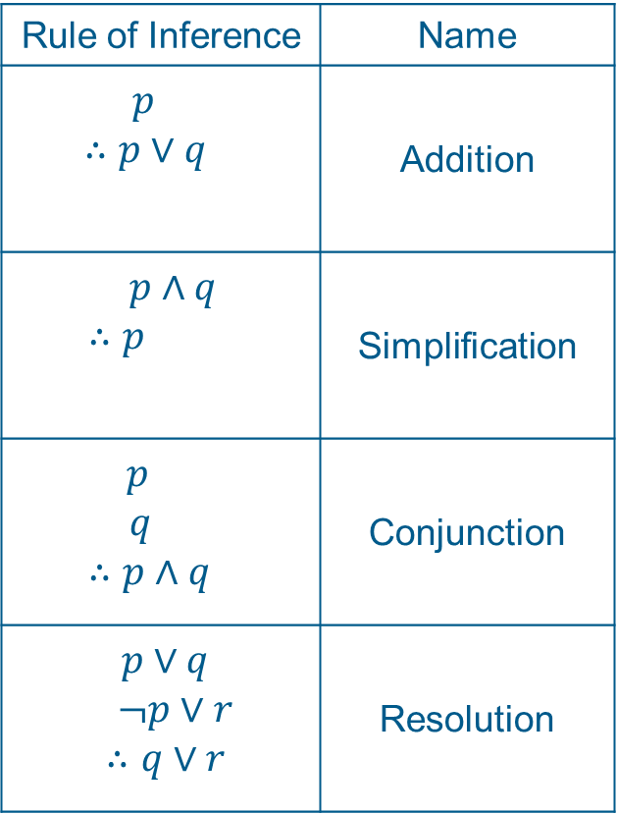
Rules of Inference
Rule of Inference | Name
$$p$$ $p→q$ $$∴q$$ | Modus ponens
$¬q$ $p→q$ $$∴¬p$$ | Modus tollens
$p→q$ $q→r$ $$∴p→r$$ | Hypothetical syllogism
$$p∨q$$ $¬p$ $$∴q$$ | Disjunctive syllogism
Rule of Inference | Name
$$p$$ $∴p∨q$ | Addition
$p∧q$ $$∴p$$ | Simplification
$p$ $q$ $$∴p∧q$$ | Conjunction
$$p∨q$$ $¬p∨r$ $$∴q∨r$$ | Resolution

Slide 6
Arguments
Example:
“If 101 is divisible by 3, then 101² is divisible by 9. 101 is divisible by 3. Consequently, 101² is divisible by 9.”
Although the argument is valid, its conclusion is incorrect, because one of the hypotheses is false (“101 is divisible by 3.”).
If in the above argument we replace 101 with 102, we could correctly conclude that 102² is divisible by 9.

Slide 7

Arguments
Which rule of inference was used in the last argument?
p: “101 is divisible by 3.”
q: “101² is divisible by 9.”
$$p$$
$$p→q$$
$$∴q$$
Modus ponens
Unfortunately, one of the hypotheses (p) is false. Therefore, the conclusion q is incorrect.

Slide 8
Arguments
Another example:
“If it rains today, then we will not have a barbeque today. If we do not have a barbeque today, then we will have a barbeque tomorrow.
Therefore, if it rains today, then we will have a barbeque tomorrow.”
This is a valid argument: If its hypotheses are true, then its conclusion is also true.

Slide 9
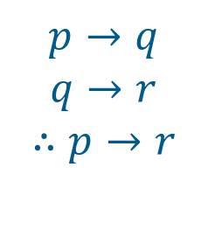
Arguments
Let us formalize the previous argument:
p: “It is raining today.”
q: “We will not have a barbecue today.”
r: “We will have a barbecue tomorrow.”
So the argument is of the following form:
$$p→q$$
$$q→r$$
$$∴p→r$$
Hypothetical syllogism

Slide 10
Arguments
Another example:
Gary is either intelligent or a good actor.
If Gary is intelligent, then he can count
from 1 to 10.
Gary can only count from 1 to 2.
Therefore, Gary is a good actor.
i: “Gary is intelligent.”
a: “Gary is a good actor.”
c: “Gary can count from 1 to 10.”

Slide 11
Arguments
i: “Gary is intelligent.”
a: “Gary is a good actor.”
c: “Gary can count from 1 to 10.”
Step 1: ¬c Hypothesis
Step 2: i → c Hypothesis
Step 3: ¬i Modus Tollens Steps 1 & 2
Step 4: a ∨ i Hypothesis
Step 5: a Disjunctive Syllogism
Steps 3 & 4
Conclusion: a (“Gary is a good actor.”)

Slide 12
Arguments
Yet another example:
If you listen to me, you will pass CS 220.
You passed CS 220.
Therefore, you have listened to me.
Is this argument valid?
No, it assumes ((p→q) ∧ q) → p.
This statement is not a tautology. It is false if p is false and q is true. This type of incorrect reasoning is called the fallacy of affirming the conclusion.

Slide 13
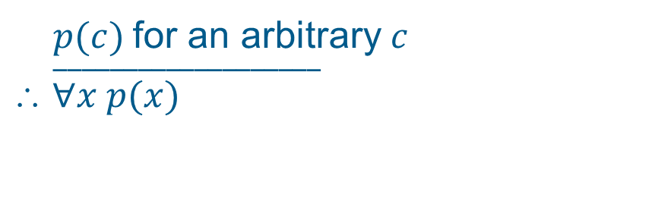
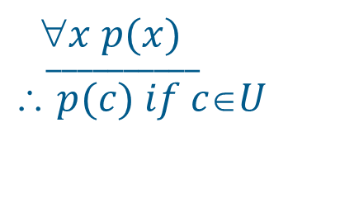
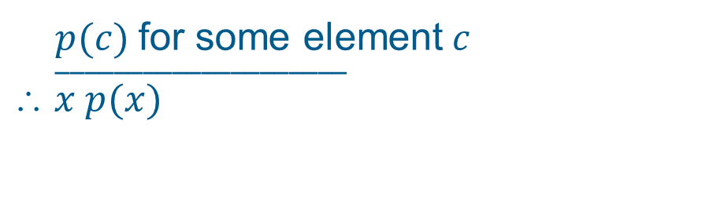
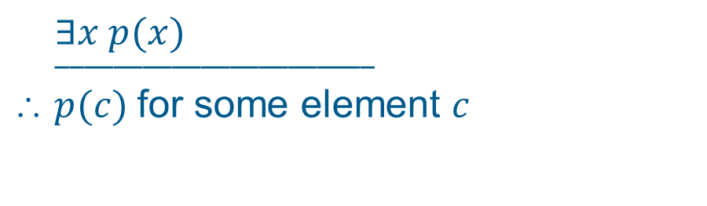
Rules of Inference for Quantified Statements
$$x p(x)$$
$__________$
$$ p(c) if cU$$
Universal instantiation
$p(c)$for an arbitrary$c$
$$___________________$$
$$ ∀x p(x)$$
Universal generalization
$$∃x p(x)$$
$$______________________$$
$ p(c)$for some element $c$
Existential instantiation
$p(c)$for some element$c$
$$____________________$$
$$ x p(x)$$
Existential generalization

Slide 14
Rules of Inference for Quantified Statements
Example:
Every UMB student is a genius.
George is a UMB student.
Therefore, George is a genius.
U(x): “x is a UMB student.”
G(x): “x is a genius.”

Slide 15
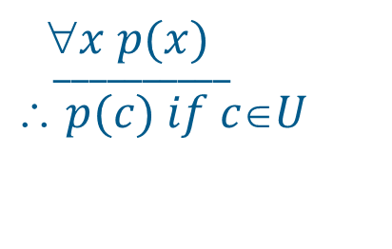
Rules of Inference for Quantified Statements
The following steps are used in the argument:
Step 1: ∀x (U(x) → G(x)) Hypothesis
Step 2: U(George) → G(George) Univ. instantiation using Step 1
Step 3: U(George) Hypothesis
Step 4: G(George) Modus ponens
using Steps 2 & 3
$$x p(x)$$
$__________$
$$ p(c) if cU$$
Universal instantiation

Slide 16
Mathematical Reasoning
We need mathematical reasoning to
determine whether a mathematical argument is
correct or incorrect and
construct mathematical arguments.
Mathematical reasoning is not only important for conducting proofs and program verification, but also for artificial intelligence systems (drawing inferences).

Slide 17
Terminology
An axiom is a basic assumption about mathematical structures that needs no proof.
We can use a proof to demonstrate that a particular statement is true. A proof consists of a sequence of statements that form an argument.
The steps that connect the statements in such a sequence are the rules of inference.
Cases of incorrect reasoning are called fallacies.
A theorem is a statement that can be shown to be true. Less important theorems sometimes are called propositions.

Slide 18
Terminology
A lemma is a simple theorem used as an intermediate result in the proof of another theorem.
A corollary is a proposition that follows directly from a theorem that has been proved.
A conjecture is a statement whose truth value is unknown. It is a statement that is being proposed to be a true statement, usually on the basis of some partial evidence. Once it is proven, it becomes a theorem.

Slide 19
Proving Theorems
Direct proof:
An implication p→q can be proved by showing that if p is true, then q is also true.
Example: Give a direct proof of the theorem
“If n is odd, then n² is odd.”
Idea: Assume that the hypothesis of this implication is true (n is odd). Then use rules of inference and known theorems to show that q must also be true (n² is odd).

Slide 20
Proving Theorems
n is odd.
Then n = 2k + 1, where k is an integer.
Consequently, n² = (2k + 1)².
= 4k² + 4k + 1
= 2(2k² + 2k) + 1
Since n² can be written in this form, it is odd.

Slide 21
Proving Theorems
Indirect proof (Contrapositive):
An implication p→q is equivalent to its contra-positive ¬q → ¬p. Therefore, we can prove p→q by showing that whenever q is false, then p is also false.
Example: Give an indirect proof of the theorem
“If 3n + 2 is odd, then n is odd.”
Idea: Assume that the conclusion of this implication is false (n is even). Then use rules of inference and known theorems to show that p must also be false (3n + 2 is even).

Slide 22
Proving Theorems
n is even.
Then n = 2k, where k is an integer.
It follows that 3n + 2 = 3(2k) + 2
= 6k + 2
= 2(3k + 1)
Therefore, 3n + 2 is even.
We have shown that the contrapositive of the implication is true, so the implication itself is also true (If 3n + 2 is odd, then n is odd).

Slide 23
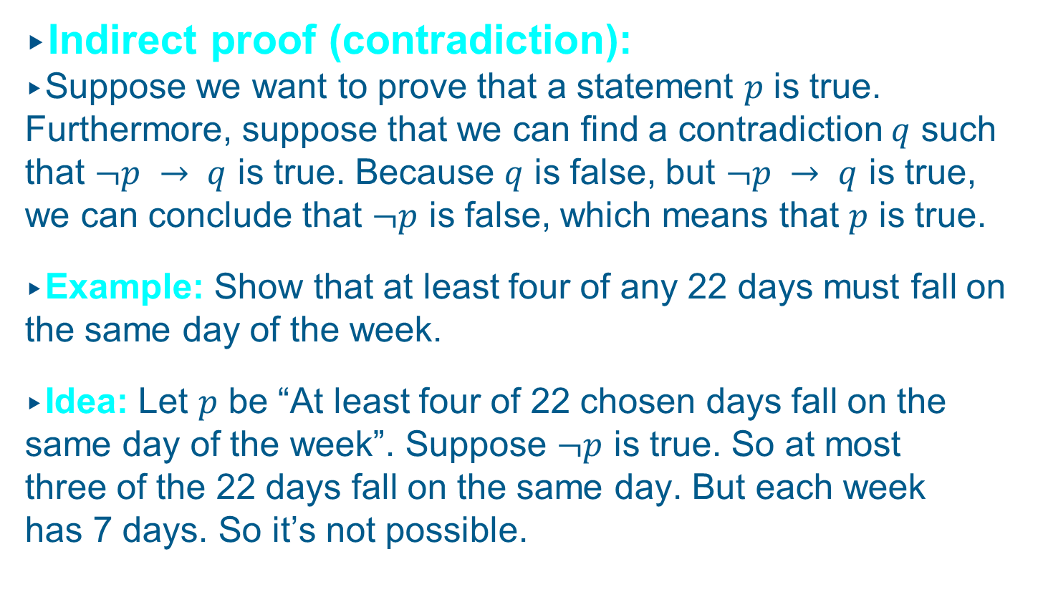
Proving Theorems
Indirect proof (contradiction):
Suppose we want to prove that a statement $p$ is true. Furthermore, suppose that we can find a contradiction $q$ such that $¬p → q$ is true. Because $q$ is false, but $¬p → q$ is true, we can conclude that $¬p$ is false, which means that $p$ is true.
Example: Show that at least four of any 22 days must fall on the same day of the week.
Idea: Let $p$ be “At least four of 22 chosen days fall on the same day of the week”. Suppose $¬p$ is true. So at most three of the 22 days fall on the same day. But each week has 7 days. So it’s not possible.

Slide 24
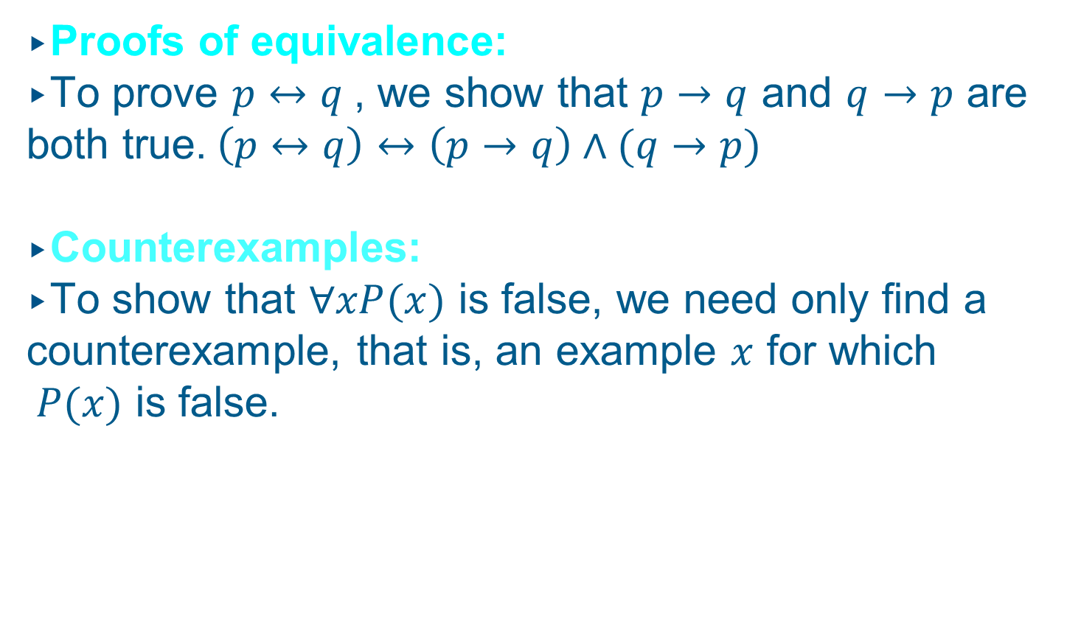
Proving Theorems
Proofs of equivalence:
To prove $p↔q$, we show that $p→q$ and $q→p$ are both true.$\left(p↔q\right)↔\left(p→q\right)∧(q→p)$
Counterexamples:
To show that $∀xP(x)$ is false, we need only find a counterexample, that is, an example $x$ for which $P(x)$ is false.

Slide 25
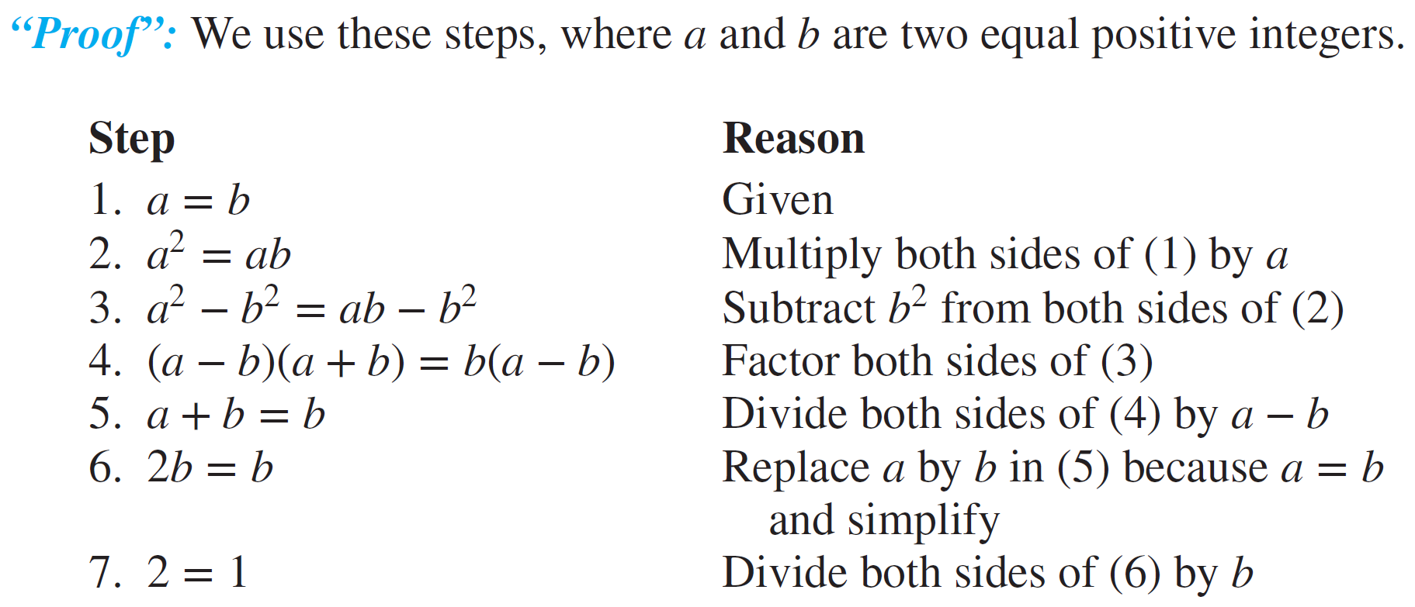
Mistakes in Proofs
1. Some mistakes result from the introduction of steps that do not logically follow from those that precede it.
Example: Proof of 1=2

Slide 26
Mistakes in Proofs
Solution:
Every step is valid except for step 5, where we divided both sides by a − b. The error is that a − b equals zero; division of both sides of an equation by the same quantity is valid as long as this quantity is not zero.

Slide 27
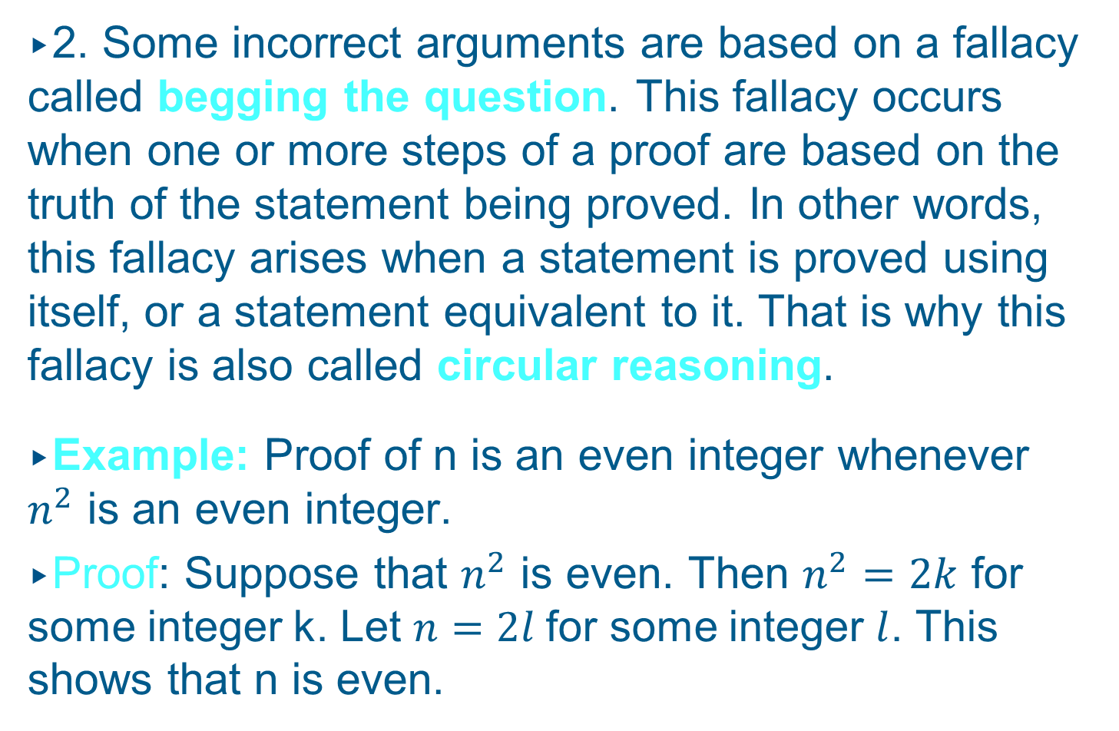
Mistakes in Proofs
2. Some incorrect arguments are based on a fallacy called begging the question. This fallacy occurs when one or more steps of a proof are based on the truth of the statement being proved. In other words, this fallacy arises when a statement is proved using itself, or a statement equivalent to it. That is why this fallacy is also called circular reasoning.
Example: Proof of n is an even integer whenever $n^{2}$ is an even integer.
Proof: Suppose that $n^{2}$ is even. Then $n^{2}=2k$ for some integer k. Let $n=2l$for some integer $l$. This shows that n is even.

Slide 28
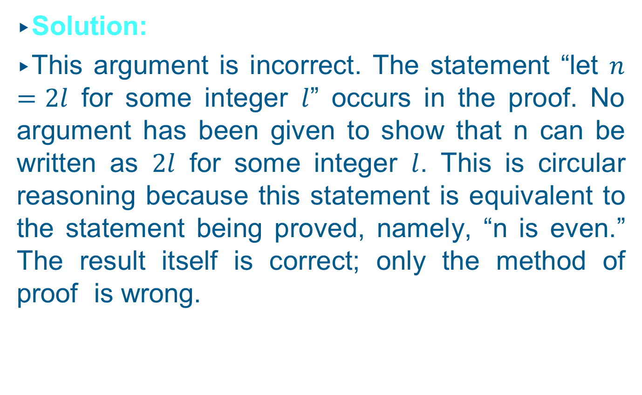
Mistakes in Proofs
Solution:
This argument is incorrect. The statement “let $n=2l$ for some integer $l$” occurs in the proof. No argument has been given to show that n can be written as $2l$ for some integer $l$. This is circular reasoning because this statement is equivalent to the statement being proved, namely, “n is even.” The result itself is correct; only the method of proof is wrong.

Slide 29
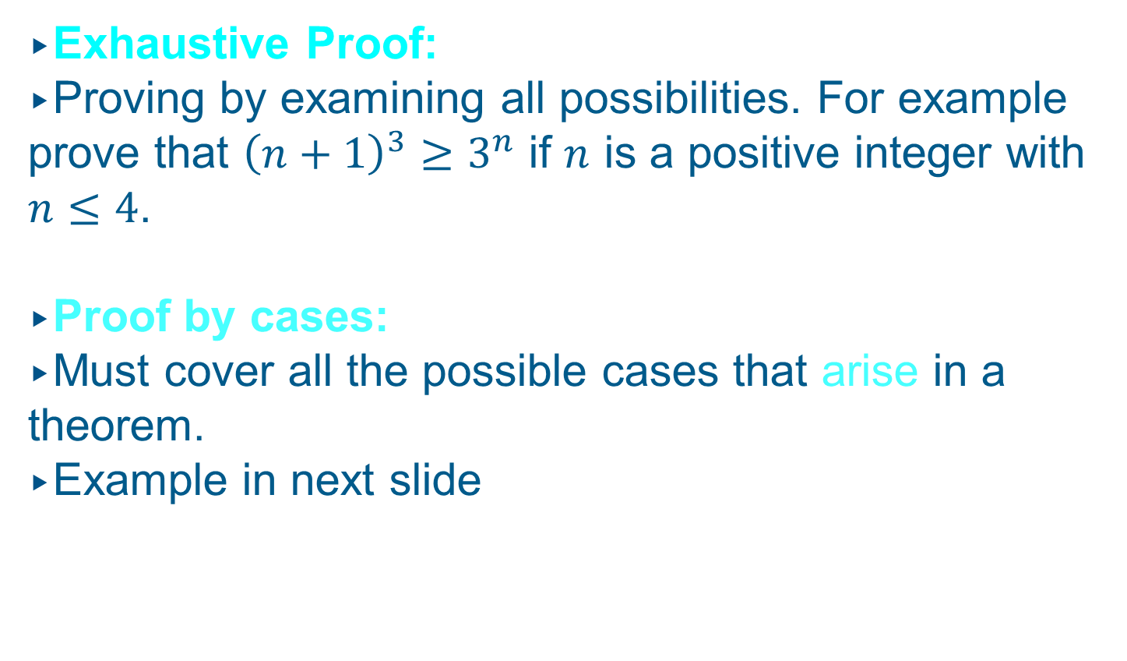
Exhaustive Proof and Proof by Cases
Exhaustive Proof:
Proving by examining all possibilities. For example prove that ${\left(n+1\right)}^{3}≥3^{n}$ if $n$ is a positive integer with $n≤4$.
Proof by cases:
Must cover all the possible cases that arise in a theorem.
Example in next slide

Slide 30
Proving by Cases
For every positive integer n, n(n + 1) is even.
Idea: Let us first show that the product of an even number m and an odd number n is always even:
m = 2k
n = 2p + 1
mn = 2k (2p + 1) = 4kp + 2k
mn = 2(2kp + k)
Since k and p are integers, (2kp + k) is an integer as well, and we have shown that mn is even.

Slide 31
Proving by Cases
The remainder of the proof becomes easy if we separately consider each of the two main situations that can occur:
Case I: n is even.
Then n(n + 1) means that we multiply an even number with an odd one. As shown above, the result must be even.
Case II: n is odd.
Then n(n + 1) means that we multiply an odd number with an even one. As shown above, the result must be even.
Since there are no other cases, we have proven that n(n + 1) s always even.

Slide 32
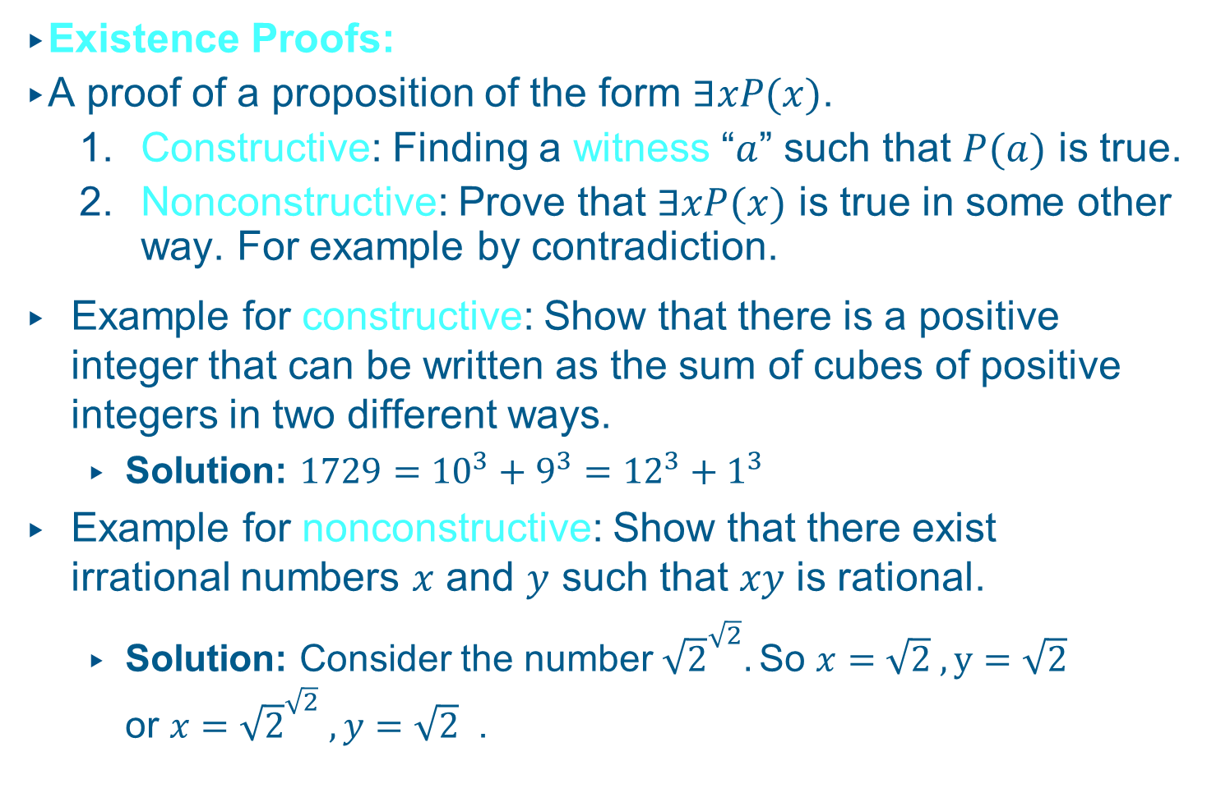
Existence and Uniqueness Proofs
Existence Proofs:
A proof of a proposition of the form $∃xP(x)$.
  Constructive: Finding a witness “$a$” such that $P(a)$ is true.
  Nonconstructive: Prove that $∃xP(x)$ is true in some other way. For example by contradiction.
Example for constructive: Show that there is a positive integer that can be written as the sum of cubes of positive integers in two different ways.
  Solution: $1729={10}^{3}+9^{3}={12}^{3}+1^{3}$
Example for nonconstructive: Show that there exist irrational numbers $x$ and $y$ such that $xy$ is rational.
  Solution: Consider the number ${\sqrt{2}}^{\sqrt{2}}.$So $x=\sqrt{2} , y=\sqrt{2}$ or $x={\sqrt{2}}^{\sqrt{2}} , y=\sqrt{2}$ .

Slide 33
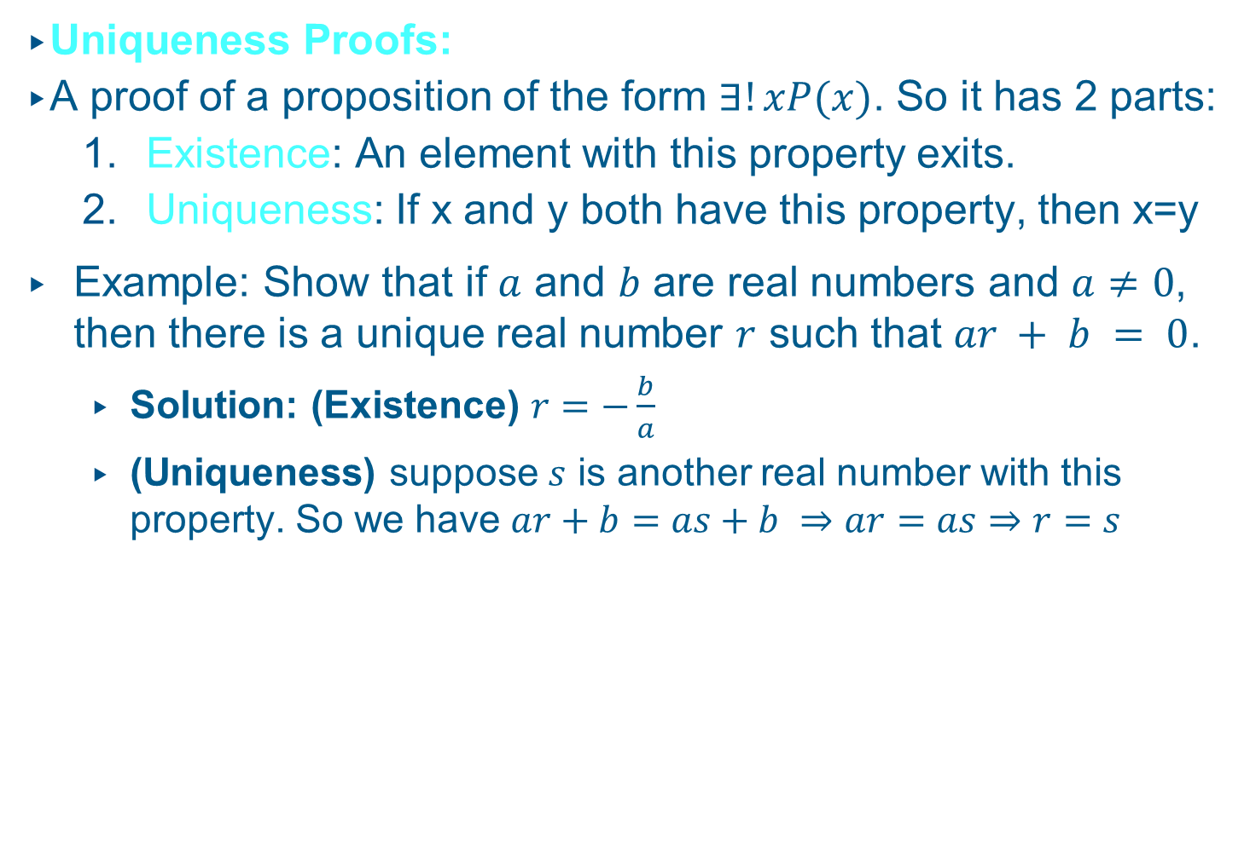
Existence and Uniqueness Proofs
Uniqueness Proofs:
A proof of a proposition of the form $∃!xP(x)$. So it has 2 parts:
  Existence: An element with this property exits.
  Uniqueness: If x and y both have this property, then x=y
Example: Show that if $a$ and $b$ are real numbers and $a≠0$, then there is a unique real number $r$ such that $ar + b = 0$.
  Solution: (Existence) $r=−\frac{b}{a}$
  (Uniqueness) suppose $s$ is another real number with this property. So we have $ar+b=as+b ⇒ar=as⇒r=s$

