Slide 1
We will cover these parts of the book (8th edition): 4.1, 4.2 4.3.1-4.3.3 4.3.6-4.3.8 5.1.1-5.1.7

Slide 2
Now let us study some…
Number Theory

Slide 3
Division
Let $a$ be an integer and $d$ a positive integer. Then there are unique integers $q$ and $r$, with $0 ≤ r < d$, such that $a = dq + r$.
$d$ is called divisor, $a$ is called the dividend, $q$ is called the quotient, and $r$ is called the remainder. This notation is used to express the quotient and remainder:
$q = a div d$, $r = a mod d$

Slide 4
The Division Algorithm
Example:
When we divide 17 by 5, we have
17 = 5⋅3 + 2.
17 is the dividend,
5 is the divisor,
3 is called the quotient, and
2 is called the remainder.

Slide 5
The Division Algorithm
Another example:
What happens when we divide -11 by 3 ?
Note that the remainder cannot be negative.
-11 = 3⋅(-4) + 1.
-11 is the dividend,
3 is the divisor,
-4 is called the quotient, and
1 is called the remainder.

Slide 6
Division
If a and b are integers with a ≠ 0, we say that a divides b if there is an integer c so that b = ac.
When a divides b we say that a is a factor of b and that b is a multiple of a.
The notation a | b means that a divides b.
We write a X b when a does not divide b.
(see book for correct symbol).

Slide 7
Divisibility Theorems
For integers a, b, and c it is true that
if a | b and a | c, then a | (b + c)
Example: 3 | 6 and 3 | 9, so 3 | 15.
if a | b, then a | bc for all integers c
Example: 5 | 10, so 5 | 20, 5 | 30, 5 | 40, …
if a | b and b | c, then a | c
Example: 4 | 8 and 8 | 24, so 4 | 24.
if a | b and a | c, then a | mb + nc
Example: 4 | 8 and 4 | 12, so 4 | 40.

Slide 8
Modular Arithmetic
Let a be an integer and m be a positive integer. We denote by a mod m the remainder when a is divided by m.
Examples:
9 mod 4 =
1
9 mod 3 =
0
9 mod 10 =
9
-13 mod 4 =
3

Slide 9
Congruences
Let a and b be integers and m be a positive integer. We say that a is congruent to b modulo m if m divides a – b.
We use the notation a ≡ b (mod m) to indicate that a is congruent to b modulo m.
In other words: a ≡ b (mod m) if and only if a mod m = b mod m.

Slide 10
Congruences
Examples:
Is it true that 46 ≡ 68 (mod 11) ?
Yes, because 11 | (46 – 68).
Is it true that 46 ≡ 68 (mod 22)?
Yes, because 22 | (46 – 68).
For which integers z is it true that z ≡ 12 (mod 10)?
It is true for any z∈{…,-28, -18, -8, 2, 12, 22, 32, …}
Theorem: Let m be a positive integer. The integers a and b are congruent modulo m if and only if there is an integer k such that a = b + km.

Slide 11
Congruences
Theorem: Let m be a positive integer. If a ≡ b (mod m) and c ≡ d (mod m), then a + c ≡ b + d (mod m) and ac ≡ bd (mod m).
Proof:
We know that a ≡ b (mod m) and c ≡ d (mod m) implies that there are integers s and t with b = a + sm and d = c + tm.
Therefore,
b + d = (a + sm) + (c + tm) = (a + c) + m(s + t) and
bd = (a + sm)(c + tm) = ac + m(at + cs + stm).
Hence, a + c ≡ b + d (mod m) and ac ≡ bd (mod m).

Slide 12
Congruences
Let $m$ be a positive integer and let $a$ and $b$ be integers. Then
$\left(a + b\right) mod m = \left(\left(a mod m\right)+ \left(b mod m\right)\right) mod m$
and
ab mod m = ((a mod m)(b mod m)) mod m.

Slide 13
Arithmetic Modulo $m$
We can define arithmetic operations on $Z_{m}$, the set of nonnegative integers less than $m$, that is, the set $\left\{0, 1,…, m−1\right\}:$
Addition: $a+_{m}b=\left(a+b\right) mod m$
Multiplication: $a⋅_{m}b=\left(a⋅b\right) mod m$
Example:
$7+_{11}9=\left(7+9\right) mod 11=16 mod 11=5$
$7⋅_{11}9=\left(7⋅9\right) mod 11=63 mod 11=8$

Slide 14
Arithmetic Modulo $m$
$+_{m}$ and $⋅_{m}$ satisfy these properties: (if a,b,c belong to $Z_{m}$)
Closure: $a+_{m}b$ and $a⋅_{m}b$ belong to $Z_{m}$
Associativity: $\left(a+_{m}b\right)+_{m}c=a+_{m}(b+_{m}c)$ and ${\left(a⋅_{m}b\right)⋅}_{m}c=a⋅_{m}(b⋅_{m}c)$
Commutativity: $a+_{m}b=b+_{m}a$ and $a⋅_{m}b=b⋅_{m}a$
Identity elements: The elements 0 and 1 are identity elements for addition and multiplication modulo $m$, respectively. $a+_{m}0=0+_{m}a=a$ and $a⋅_{m}1=1⋅_{m}a=a$
Additive inverses: If $a≠0$, then $m−a$ is an additive inverse of $a$ modulo $m$ and 0 is its own additive inverse. That is $a+_{m}(m − a) = 0$ and $0+_{m}0=0$
Distributivity: $a⋅_{m}\left(b+_{m}c\right)=(a⋅_{m}b)+_{m}(a⋅_{m}c)$

Slide 15
Representations of Integers
Let b be a positive integer greater than 1. Then if n is a positive integer, it can be expressed uniquely in the form:
n = a_{k}b^{k} + a_{k-1}b^{k-1} + … + a₁b + a₀,
where k is a nonnegative integer,
a₀, a₁, …, a_{k} are nonnegative integers less than b,
and a_{k} ≠ 0.
Example for b=10:
859 = 8⋅10² + 5⋅10¹ + 9⋅10⁰

Slide 16
Representations of Integers
Example for b=2 (binary expansion):
(10110)₂ = 1⋅2⁴ + 1⋅2² + 1⋅2¹ = (22)₁₀
Example for b=16 (hexadecimal expansion):
(we use letters A to F to indicate numbers 10 to 15)
(3A0F)₁₆ = 3⋅16³ + 10⋅16² + 15⋅16⁰ = (14863)₁₀
Example for b=8 (octal expansion)
(7016)₈= 7⋅8³ + 1⋅8¹ + 6⋅8⁰ = 3598

Slide 17
Representations of Integers
How can we construct the base b expansion of an integer n?
First, divide n by b to obtain a quotient q₀ and remainder a₀, that is,
n = bq₀ + a₀, where 0 ≤ a₀ < b.
The remainder a₀ is the rightmost digit in the base b expansion of n.
Next, divide q₀ by b to obtain:
q₀ = bq₁ + a₁, where 0 ≤ a₁ < b.
a₁ is the second digit from the right in the base b expansion of n. Continue this process until you obtain a quotient equal to zero.

Slide 18
Representations of Integers
Example: What is the base 8 expansion of (12345)₁₀ ?
First, divide 12345 by 8:
12345 = 8⋅1543 + 1
1543 = 8⋅192 + 7
192 = 8⋅24 + 0
24 = 8⋅3 + 0
3 = 8⋅0 + 3
The result is: (12345)₁₀ = (30071)₈.

Slide 19
Representations of Integers
procedure base_b_expansion(n, b: positive integers)
q := n
k := 0
while q ≠ 0
begin
a_{k} := q mod b
q := ⎣q/b⎦
k := k + 1
end
return (a_{k-1} … a₁a₀)
{the base b expansion of n is (a_{k-1} … a₁a₀)_{b} }

Slide 20
Conversion between Binary, Octal, and Hexadecimal expansion
Conversion between binary and octal and between binary and hexadecimal expansions is extremely easy because each octal digit corresponds to a block of three binary digits and each hexadecimal digit corresponds to a block of four binary digits, with these correspondences shown below with these correspondences shown:

Slide 21
Addition of Integers
How do we (humans) add two integers?
Example: 7583 + 4932
1
1
carry
1
1
2
5
1
5
1
1
carry
Binary expansions: (1011)₂ + (1010)₂
(
1
0
1
0
1
)₂

Slide 22
Addition of Integers
Let a = (a_{n-1}a_{n-2}…a₁a₀)₂, b = (b_{n-1}b_{n-2}…b₁b₀)_{2.}
How can we algorithmically add these two binary numbers?
First, add their rightmost bits:
a₀ + b₀ = c₀⋅2 + s₀,
where s₀ is the rightmost bit in the binary expansion of a + b, and c₀ is the carry.
Then, add the next pair of bits and the carry:
a₁ + b₁ + c₀ = c₁⋅2 + s₁,
where s₁ is the next bit in the binary expansion of a + b, and c₁ is the carry.

Slide 23
Addition of Integers
Continue this process until you obtain c_{n-1}.
The leading bit of the sum is s_{n} = c_{n-1}.
The result is:
a + b = (s_{n}s_{n-1}…s₁s₀)₂

Slide 24
Addition of Integers
Example:
Add a = (1110)₂ and b = (1011)₂.
a₀ + b₀ = 0 + 1 = 0⋅2 + 1, so that c₀ = 0 and s₀ = 1.
a₁ + b₁ + c₀ = 1 + 1 + 0 = 1⋅2 + 0, so c₁ = 1 and s₁ = 0.
a₂ + b₂ + c₁ = 1 + 0 + 1 = 1⋅2 + 0, so c₂ = 1 and s₂ = 0.
a₃ + b₃ + c₂ = 1 + 1 + 1 = 1⋅2 + 1, so c₃ = 1 and s₃ = 1.
s₄ = c₃ = 1.
Therefore, s = a + b = (11001)₂.

Slide 25
Addition of Integers
procedure add(a, b: positive integers)
c := 0
for j := 0 to n-1 {larger integer (a or b) has n digits}
begin
d := ⎣(a_{j} + b_{j} + c)/2⎦
s_{j} := a_{j} + b_{j} + c – 2d
c := d
end
s_{n} := c
return (s₀s₁…s_{n}) {the binary expansion of the sum is (s_{n}s_{n-1}…s₁s₀)₂}

Slide 26
Multiplication of Integers
How do we (humans) multiply two integers?
Example: 7583 x 32
15166
+ 22749
242656
Binary expansions:
110
x 101
110
000
+ 110
11110

Slide 27
Multiplication of Integers
Let a = (a_{n-1}a_{n-2}…a₁a₀)₂, b = (b_{n-1}b_{n-2}…b₁b₀)_{2.}
How can we algorithmically add these two binary numbers?
The conventional algorithm works as follows. Using the distributive law, we see that:
$ab=a\left(b_{0}2^{0}+b_{1}2^{1}+…+b_{n−1}2^{n−1}\right)= a\left(b_{0}2^{0}\right)+a\left(b_{1}2^{1}\right)+…+a\left(b_{n−1}2^{n−1}\right)$
We first note that $ab_{j}=a$ if $b_{j}=1$ and $ab_{j}=0$ if $b_{j}=0$. Each time we multiply a term by 2, we shift its binary expansion one place to the left and add a zero at the tail end of the expansion.

Slide 28
Multiplication of Integers
Consequently, we can obtain $\left(ab_{j}\right)2^{j}$ by shifting the binary expansion of $ab_{j}$ j places to the left, adding j zero bits at the tail end of this binary expansion. Finally, we obtain $ab$ by adding the $n$ integers $ab_{j}2^{j}$, $j=0, 1, 2,…, n−1$.

Slide 29
Multiplication of Integers
Example:
Product of a = (110)₂ and b = (101)₂.
$ab_{0}∙2^{0}={\left(110\right)}_{2}∙1∙2^{0}={\left(110\right)}_{2}$
$ab_{1}∙2^{1}={\left(110\right)}_{2}∙0∙2^{1}={\left(0000\right)}_{2}$
$ab_{2}∙2^{2}={\left(110\right)}_{2}∙1∙2^{2}={\left(11000\right)}_{2}$
Now add ${\left(110\right)}_{2}$, ${\left(0000\right)}_{2}$, and ${\left(11000\right)}_{2}$. Carrying out these additions shows that $ab={\left(11110\right)}_{2}$

Slide 30
Multiplication of Integers
procedure multiply(a, b: positive integers) {the binary expansions of a and b are (a_{n-1}a_{n-2}…a₁a₀)₂ and (b_{n-1}b_{n-2}…b₁b₀)₂ respectively}
for j := 0 to n-1
if $b_{j}=1$ then $c_{j}≔a$ shifted $j$ places
else $c_{j}≔0$ {c₀,c₁, …, c_{n-1} are the partial products}
p := 0
for j := 0 to n-1
p := add(p, $c_{j}$)
return p {p is the value of $ab$} {the binary expansion of the sum is (s_{n}s_{n-1}…s₁s₀)₂}

Slide 31
Fast modular exponentiation
Find $b^{n} mod m$.
First observe that we can avoid using large amount of memory if we compute $b^{n} mod m$ by successively computing $b^{k} mod m$ for $k=1, 2,…, n$ using the fact that $b^{k+1} mod m=b\left(b^{k} mod m\right) mod m$. However, this approach is impractical because it requires $n−1$ multiplications of integers and $n$ might be huge.
Faster way:
Suppose $n={\left(a_{k−1}…a_{1}a_{0}\right)}_{2}$. First note that $b^{n}=b^{(a_{k−1}∙2^{k−1}+…+a_{1}∙2+a_{0})}=b^{a_{k−1}∙2^{k−1}}∙…{∙b}^{a_{1}∙2}∙b^{a_{0}}$

Slide 32
Fast modular exponentiation
This shows that to compute $b^{n}$, we need only compute the values of $b, b^{2}, {{(b}^{2})}^{2}=b^{4},{{(b}^{4})}^{2}=b^{8}, …, {b^{2}}^{k}$. Once we have these values, we multiply the terms ${b^{2}}^{j}$ in this list, where $a_{j}=1$.
This gives us $b^{n}$. Then the algorithm finds $b mod m$, $b^{2} mod m$, $b^{4} mod m$, …, $b^{2^{k−1}} mod m$ and multiplies together those terms $b^{2^{j}} mod m$ where $a_{j}=1,$finding the remainder of the product when divided by $m$ after each multiplication.

Slide 33
Fast modular exponentiation
procedure modular_exponentiation(b: integer, $n={\left(a_{k−1}a_{k−2}…a_{1}a_{0}\right)}_{2}$, m: positive integer)
$x≔1$
$power≔b mod m$
for i := 0 to k-1
begin
if $a_{i}=1$ then $x≔\left(x∙power\right) mod m$
$power≔\left(power∙power\right) mod m$
end
return $x$ {$x$ equals $b^{n} mod m$}

Slide 34
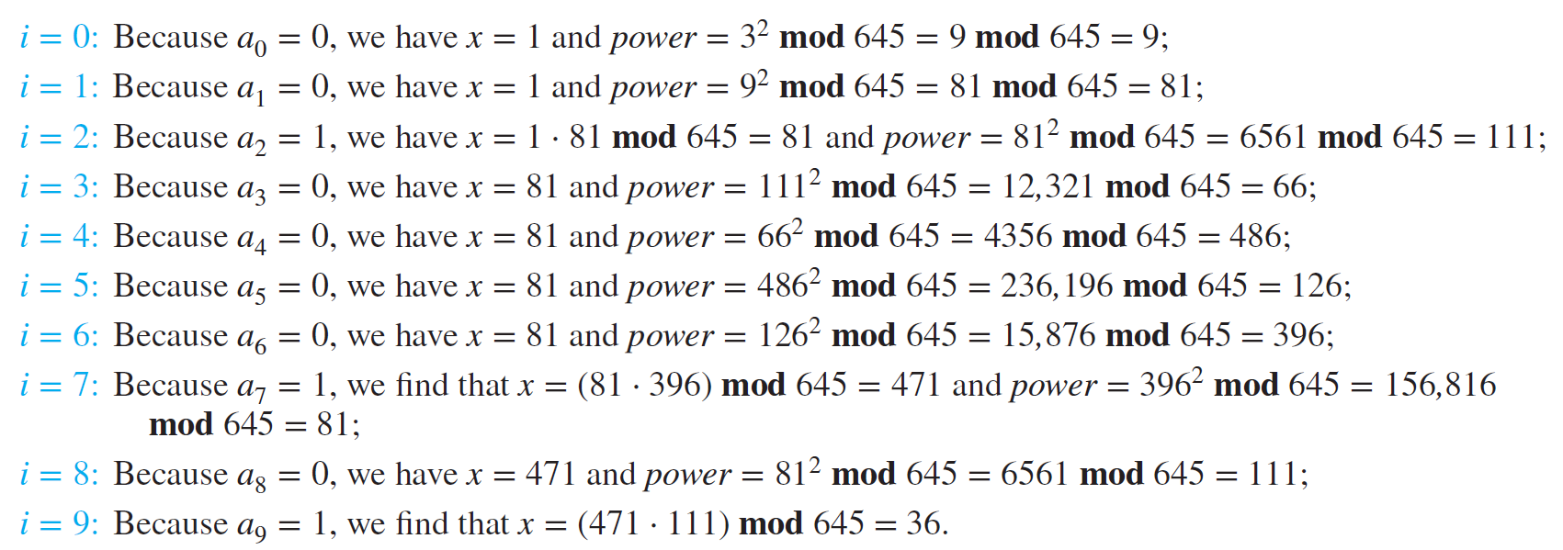
Fast modular exponentiation
Example: find $3^{644} mod 645.$
$644={(1010000100)}_{2}$

Slide 35
Primes
A positive integer p greater than 1 is called prime if the only positive factors of p are 1 and p.
A positive integer that is greater than 1 and is not prime is called composite.
The fundamental theorem of arithmetic:
Every positive integer can be written uniquely as the product of primes, where the prime factors are written in order of increasing size.

Slide 36
Primes
Examples:
15 =
3·5
48 =
2·2·2·2·3 = 2⁴·3
17 =
17
100 =
2·2·5·5 = 2²·5²
512 =
2·2·2·2·2·2·2·2·2 = 2⁹
515 =
5·103
28 =
2·2·7 = 2²·7

Slide 37
Primes
If n is a composite integer, then n has a prime divisor less than or equal .
This is easy to see: if n is a composite integer, it must have two divisors p₁ and p₂ such that p₁⋅p₂ = n and p₁ ≥ 2 and p₂ ≥ 2.
p₁ and p₂ cannot both be greater than $\sqrt{n},$ because then p₁⋅p₂ would be greater than n.
If the smaller number of p₁ and p₂ is not a prime itself, then it can be broken up into prime factors that are smaller than itself but ≥ 2.

Slide 38
Greatest Common Divisors
Let a and b be integers, not both zero.
The largest integer d such that d | a and d | b is called the greatest common divisor of a and b.
The greatest common divisor of a and b is denoted by gcd(a, b).
Example 1: What is gcd(48, 72) ?
The positive common divisors of 48 and 72 are 1, 2, 3, 4, 6, 8, 12, 16, and 24, so gcd(48, 72) = 24.
Example 2: What is gcd(19, 72) ?
The only positive common divisor of 19 and 72 is 1, so gcd(19, 72) = 1.

Slide 39
Greatest Common Divisors
Using prime factorizations:
a = p₁ª1 p₂ª2 … p_{n}ªn , b = p₁^{b}1 p₂^{b}2 … p_{n}^{b}n ,
where p₁ < p₂ < … < p_{n} and a_{i}, b_{i} ∈ N for 1 ≤ i ≤ n
gcd(a, b) = p₁^{min(a}1^{, b}1⁾ p₂^{min(a}2^{, b}2⁾ … p_{n}^{min(a}n^{, b}n⁾
Example:
a = 60 =
2² 3¹ 5¹
b = 54 =
2¹ 3³ 5⁰
gcd(a, b) =
2¹ 3¹ 5⁰ = 6

Slide 40
Relatively Prime Integers
Definition:
Two integers a and b are relatively prime if gcd(a, b) = 1.
Examples:
Are 15 and 28 relatively prime?
Yes, gcd(15, 28) = 1.
Are 55 and 28 relatively prime?
Yes, gcd(55, 28) = 1.
Are 35 and 28 relatively prime?
No, gcd(35, 28) = 7.

Slide 41
Relatively Prime Integers
Definition:
The integers a₁, a₂, …, a_{n} are pairwise relatively prime if gcd(a_{i}, a_{j}) = 1 whenever 1 ≤ i < j ≤ n.
Examples:
Are 15, 17, and 27 pairwise relatively prime?
No, because gcd(15, 27) = 3.
Are 15, 17, and 28 pairwise relatively prime?
Yes, because gcd(15, 17) = 1, gcd(15, 28) = 1 and gcd(17, 28) = 1.

Slide 42
Least Common Multiples
Definition:
The least common multiple of the positive integers a and b is the smallest positive integer that is divisible by both a and b.
We denote the least common multiple of a and b by lcm(a, b).
Examples:
lcm(3, 7) =
21
lcm(4, 6) =
12
lcm(5, 10) =
10

Slide 43
Least Common Multiples
Using prime factorizations:
a = p₁ª1 p₂ª2 … p_{n}ªn , b = p₁^{b}1 p₂^{b}2 … p_{n}^{b}n ,
where p₁ < p₂ < … < p_{n} and a_{i}, b_{i} ∈ N for 1 ≤ i ≤ n
lcm(a, b) = p₁^{max(a}1^{, b}1⁾ p₂^{max(a}2^{, b}2⁾ … p_{n}^{max(a}n^{, b}n⁾
Example:
a = 60 =
2² 3¹ 5¹
b = 54 =
2¹ 3³ 5⁰
lcm(a, b) =
2² 3³ 5¹ = 4275 = 540

Slide 44
GCD and LCM
a = 60 =
2² 3¹ 5¹
b = 54 =
2¹ 3³ 5⁰
gcd(a, b) =
2¹ 3¹ 5⁰ = 6
lcm(a, b) =
2² 3³ 5¹ = 540
Theorem: ab =
gcd(a,b)$∙$lcm(a,b)

Slide 45
The Euclidean Algorithm
The Euclidean Algorithm finds the greatest common divisor of two integers a and b.
For example, if we want to find gcd(287, 91), we divide 287 (the larger number) by 91 (the smaller one):
287 = 91⋅3 + 14
287 - 91⋅3 = 14
287 + 91⋅(-3) = 14
We know that for integers a, b and c, if a | b, then a | bc for all integers c.
Therefore, any divisor of 91 is also a divisor of 91⋅(-3).

Slide 46
The Euclidean Algorithm
287 + 91⋅(-3) = 14
We also know that for integers a, b and c,
if a | b and a | c, then a | (b + c).
Therefore, any divisor of 287 and 91 must also be a divisor of 287 + 91⋅(-3), which is 14.
Consequently, the greatest common divisor of 287 and 91 must be the same as the greatest common divisor of 14 and 91:
gcd(287, 91) = gcd(14, 91).

Slide 47
The Euclidean Algorithm
In the next step, we divide 91 by 14:
91 = 14⋅6 + 7
This means that gcd(14, 91) = gcd(14, 7).
So we divide 14 by 7:
14 = 7⋅2 + 0
We find that 7 | 14, and thus gcd(14, 7) = 7.
Therefore, gcd(287, 91) = 7
So we have this Lemma:
Let $a=bq+r$, where $a,b,q,$ and $r$ are integers. Then $\gcd\left(a,b\right)=gcd⁡(b,r)$

Slide 48
The Euclidean Algorithm
In pseudocode, the algorithm can be implemented as follows:
procedure gcd(a, b: positive integers)
x := a
y := b
while y ≠ 0
begin
r := x mod y
x := y
y := r
end
return x {x is gcd(a, b)}

Slide 49
GCDs as Linear Combinations
Bézout’s Theorem: If $a$ and $b$ are positive integers, then there exist integers $s$ and $t$ such that $\gcd\left(a,b\right)=sa+tb$.
$s$ and $t$are called Bézout’s coefficients and the above equation is called Bézout’s identity.
We will see two methods to find the Bézout’s identity of two integers.
Working backward through the divisions of the Euclidean algorithm.
Extended Euclidean algorithm

Slide 50
GCDs as Linear Combinations
To run this extended Euclidean algorithm, we set $s_{0}=1, s_{1}=0, t_{0}=0$, and $t_{1}=1$ and let
$s_{j}=s_{j−2}−q_{j−1}s_{j−1}$ and $t_{j}=t_{j−2}−q_{j−1}t_{j−1}$
for $j=2,3,…,n$, where the $q_{j}$ are the quotients in the divisions used when the Euclidean algorithm finds gcd(a, b).

Slide 51
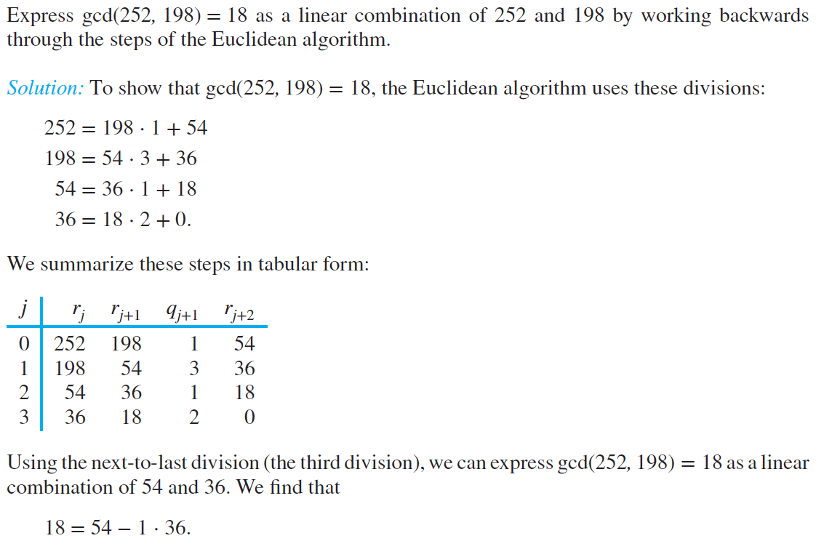
GCDs as Linear Combinations
Example for first method:

Slide 52
GCDs as Linear Combinations

Slide 53
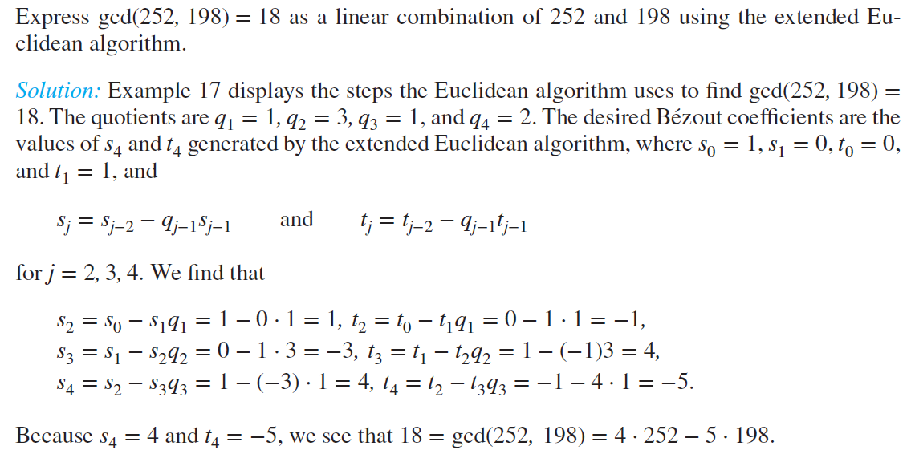
GCDs as Linear Combinations
Example for second method:

Slide 54
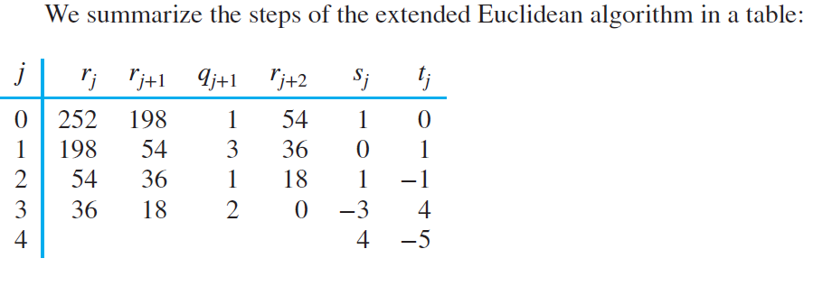
GCDs as Linear Combinations

Slide 55
GCDs as Linear Combinations
Lemma: If $a,b,$ and $c$ are positive integers such that $\gcd\left(a,b\right)=1$ and $a|bc$, then $a|c$.
Proof:
$$\gcd\left(a,b\right)=1⇒∃s,t\left(sa+tb=1\right)⇒sac+tbc=c$$
We have $a|bc⇒a|tbc$ and we know that $a|sac$.
So we have $a|sac+tbc⇒a|c$

Slide 56
GCDs as Linear Combinations
Lemma: If $p$ is a prime and $p|a_{1}a_{2}⋯a_{n}$, where each $a_{i}$ is an integer, then $p|a_{i}$ for some $i$.
Proof:
By induction. (will be covered in the next sessions)

Slide 57
GCDs as Linear Combinations
Lemma: Let $m$ be a positive integer and let $a, b$, and $c$ be integers. If $ac≡bc$(mod $m$) and $gcd⁡(c,m)=1$, then $a≡b$ (mod $m$).
Proof:
$ac≡bc \text{(}\text{mod} m\text{)}$ $⇒m|ac−bc=c(a−b)$
Because $\gcd\left(c,m\right)=1$, based on the previous lemma, we have $m|a−b⇒a≡b$ (mod $m$)

Slide 58
Now it’s Time for…
Induction and Recursion

Slide 59
Induction
The principle of mathematical induction is a useful tool for proving that a certain predicate is true for all natural numbers.
It cannot be used to discover theorems, but only to prove them.
To prove that propositional function $P(n)$ is true for all positive integers $n$, we complete two steps:
Basis step: Verify $P(1)$ (or $P(0)$) is true.
Inductive step: Show that the conditional statement $P(k)→P(k+1)$ is true for all positive integers $k$.

Slide 60
Induction
Example: Show that $n<2^{n}$for all positive integers $n$.
Let $P(n)$ be the proposition "$n<2^{n}$“.
Show that $P(1)$ is true.
P(1) is true, because $1<2^{1}$
Show that if $P(n)$ is true, then $P(n+1)$ is true
Assume that $n<2^{n}$ is true. We need to show that $P(n+1)$ is true, i.e. $n+1<2^{n+1}.$
We start from $P(n)$: $n<2^{n}⇒n+1<2^{n}+1≤2^{n}+2^{n}=2^{n+1}$
Therefor, if $n<2^{n}$, then $n+1<2^{n+1}$
So $n<2^{n}$ is true for any positive integer.

Slide 61
Induction
Example: $1+2+…+n=\sum_{i=1}^{n}{i=\frac{n\left(n+1\right)}{2}}$
Show that $P(1)$ is true.
P(1) is true, because $1=\frac{1∗2}{2}$
Show that if $P(n)$ is true, then $P(n+1)$ is true
$$1+2+…+n=\frac{n\left(n+1\right)}{2}⇒1+2+…+n+\left(n+1\right)=\frac{n\left(n+1\right)}{2}+\left(n+1\right)=\left(n+1\right)\left(\frac{n}{2}+1\right)=\frac{\left(n+1\right)\left(n+2\right)}{2}=\frac{(n+1)(\left(n+1\right)+1)}{2}$$
So $P(n)$ is true for any positive integer.

