Slide 1
We will cover these parts of the book (8th edition):
6.3-6.4
7.1
7.2.1-7.2.7
7.4.1-7.4.4
7.4.6

Slide 2
Permutations and Combinations
How many different sets of 3 people can we pick from a group of 6?
There are 6 choices for the first person, 5 for the second one, and 4 for the third one, so there are
6⋅5⋅4 = 120 ways to do this.
This is not the correct result!
For example, picking person C, then person A, and then person E leads to the same group as first picking E, then C, and then A.
However, these cases are counted separately in the above equation.

Slide 3
Permutations and Combinations
So how can we compute how many different subsets of people can be picked (that is, we want to disregard the order of picking) ?
To find out about this, we need to look at permutations.
A permutation of a set of distinct objects is an ordered arrangement of these objects.
An ordered arrangement of r elements of a set is called an r-permutation.

Slide 4
Permutations and Combinations
Example: Let S = {1, 2, 3}.
The arrangement 3, 1, 2 is a permutation of S.
The arrangement 3, 2 is a 2-permutation of S.
The number of r-permutations of a set with n distinct elements is denoted by P(n, r).
We can calculate P(n, r) with the product rule:
P(n, r) = n⋅(n – 1)⋅(n – 2) ⋅…⋅(n – r + 1).
(n choices for the first element, (n – 1) for the second one, (n – 2) for the third one…)

Slide 5
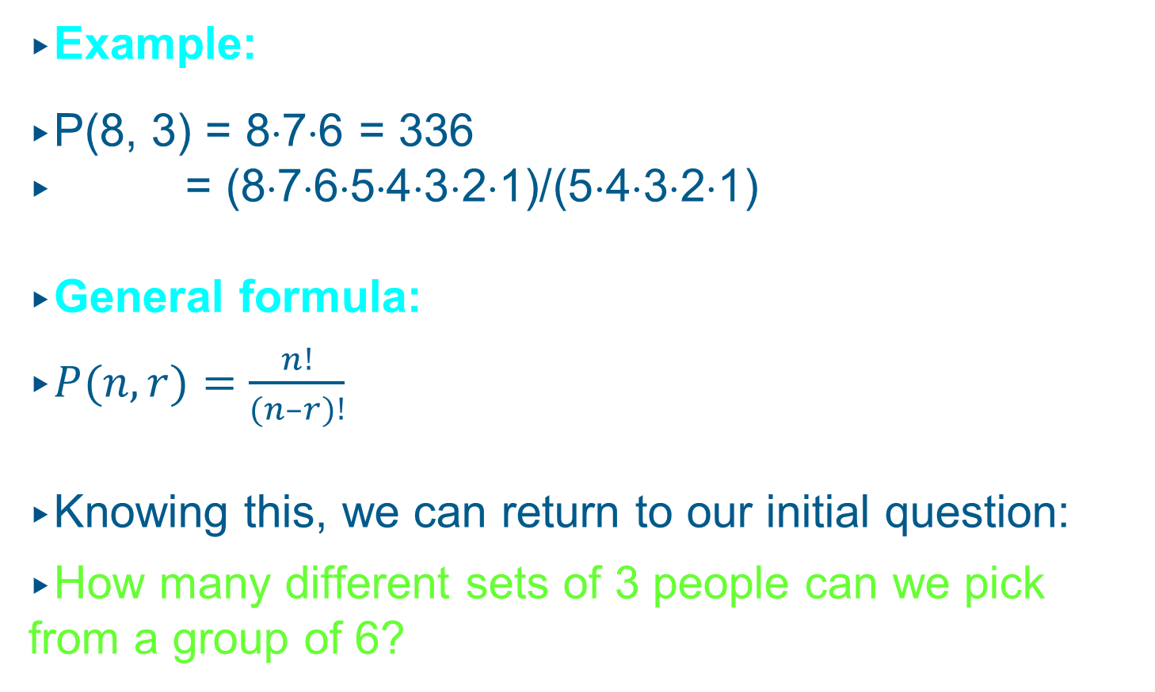
Permutations and Combinations
Example:
P(8, 3) = 8⋅7⋅6 = 336
= (8⋅7⋅6⋅5⋅4⋅3⋅2⋅1)/(5⋅4⋅3⋅2⋅1)
General formula:
$P(n, r)=\frac{n!}{(n–r)!}$
Knowing this, we can return to our initial question:
How many different sets of 3 people can we pick from a group of 6?

Slide 6
Permutations and Combinations
An r-combination of elements of a set is an unordered selection of r elements from the set.
Thus, an r-combination is simply a subset of the set with r elements.
Example: Let S = {1, 2, 3, 4}.
Then {1, 3, 4} is a 3-combination from S.
The number of r-combinations of a set with n distinct elements is denoted by C(n, r).
Example: C(4, 2) = 6, since, for example, the 2-combinations of a set {1, 2, 3, 4} are {1, 2}, {1, 3},
{1, 4}, {2, 3}, {2, 4}, {3, 4}.

Slide 7
Permutations and Combinations
How can we calculate C(n, r)?
Consider that we can obtain the r-permutations of a set in the following way:
First, we form all the r-combinations of the set
(there are C(n, r) such r-combinations).
Then, we generate all possible orderings within each of these r-combinations (there are P(r, r) such orderings in each case).
Therefore, we have:
P(n, r) = C(n, r)⋅P(r, r)

Slide 8
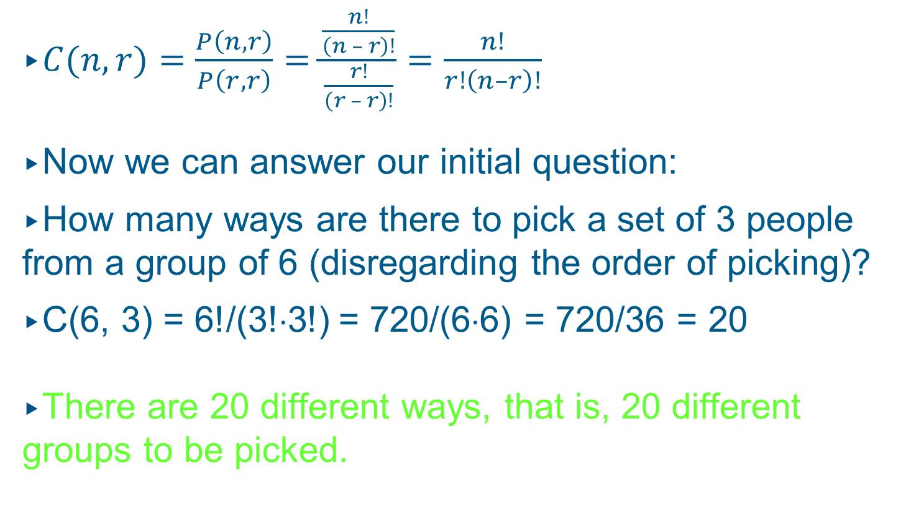
Permutations and Combinations
$C(n, r)=\frac{P\left(n, r\right)}{P\left(r, r\right)}=\frac{\frac{n!}{\left(n – r\right)!}}{\frac{r!}{\left(r – r\right)!}}=\frac{n!}{r!\left(n–r\right)!}$
Now we can answer our initial question:
How many ways are there to pick a set of 3 people from a group of 6 (disregarding the order of picking)?
C(6, 3) = 6!/(3!⋅3!) = 720/(6⋅6) = 720/36 = 20
There are 20 different ways, that is, 20 different groups to be picked.

Slide 9
Permutations and Combinations
Corollary:
Let n and r be nonnegative integers with r ≤ n.
Then C(n, r) = C(n, n – r).
Note that “picking a group of r people from a group of n people” is the same as “splitting a group of n people into a group of r people and another group of (n – r) people”.

Slide 10
Combinations
Proof:
This symmetry is intuitively plausible. For example, let us consider a set containing six elements (n = 6).
Picking two elements and leaving four is essentially the same as picking four elements and leaving two.
In either case, our number of choices is the number of possibilities to divide the set into one set containing two elements and another set containing four elements.

Slide 11
Permutations and Combinations
Example:
A soccer club has 8 female and 7 male members. For today’s match, the coach wants to have 6 female and 5 male players on the grass. How many possible configurations are there?
C(8, 6) ⋅ C(7, 5) = 8!/(6!⋅2!) ⋅ 7!/(5!⋅2!)
= 28⋅21
= 588

Slide 12
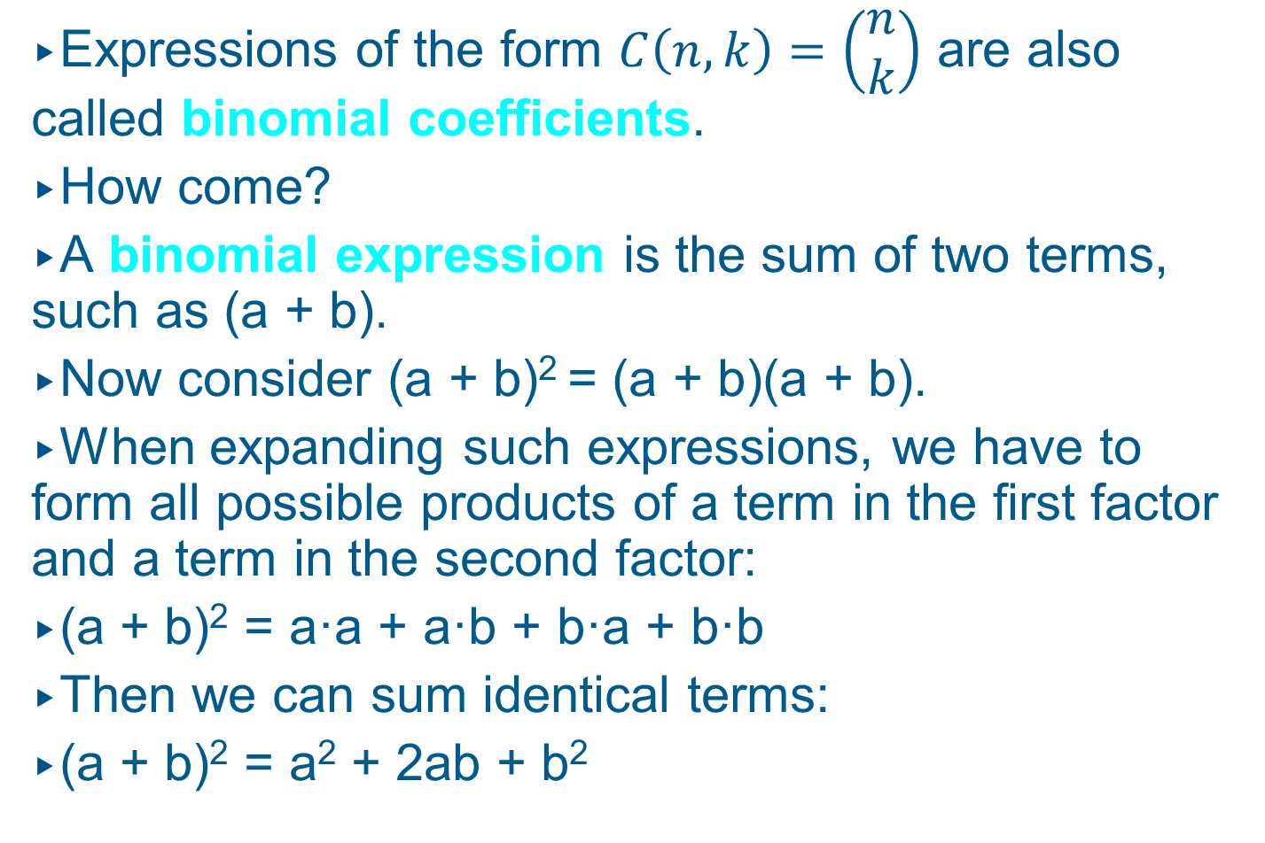
Binomial Coefficients
Expressions of the form $C\left(n, k\right)=\left(\begin{aligned}n \\ k\end{aligned}\right)$ are also called binomial coefficients.
How come?
A binomial expression is the sum of two terms, such as (a + b).
Now consider (a + b)² = (a + b)(a + b).
When expanding such expressions, we have to form all possible products of a term in the first factor and a term in the second factor:
(a + b)² = a·a + a·b + b·a + b·b
Then we can sum identical terms:
(a + b)² = a² + 2ab + b²

Slide 13
Binomial Coefficients
For (a + b)³ = (a + b)(a + b)(a + b) we have
(a + b)³ = aaa + aab + aba + abb + baa + bab + bba + bbb
(a + b)³ = a³ + 3a²b + 3ab² + b³
There is only one term a³, because there is only one possibility to form it: Choose a from all three factors: C(3, 3) = 1.
There is three times the term a²b, because there are three possibilities to choose a from a subset of two out of the three factors: C(3, 2) = 3.
Similarly, there is three times the term ab²
(C(3, 1) = 3) and once the term b³ (C(3, 0) = 1).

Slide 14
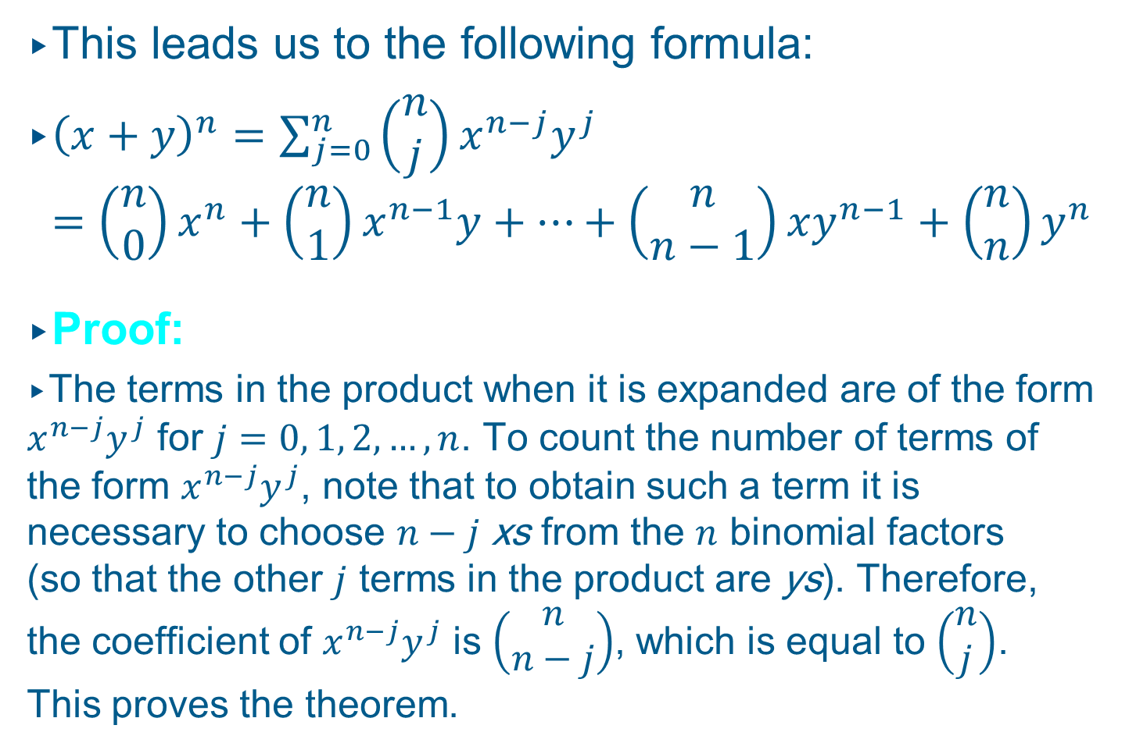
Binomial Coefficients
This leads us to the following formula:
${\left(x+y\right)}^{n}=\sum_{j=0}^{n}{\left(\begin{aligned}n \\ j\end{aligned}\right)x^{n−j}y^{j}}$
$$=\left(\begin{aligned}n \\ 0\end{aligned}\right)x^{n}+\left(\begin{aligned}n \\ 1\end{aligned}\right)x^{n−1}y+…+\left(\begin{aligned}n \\ n−1\end{aligned}\right)xy^{n−1}+\left(\begin{aligned}n \\ n\end{aligned}\right)y^{n}$$
Proof:
The terms in the product when it is expanded are of the form $x^{n−j}y^{j}$ for $j=0, 1, 2,…, n$. To count the number of terms of the form $x^{n−j}y^{j}$, note that to obtain such a term it is necessary to choose $n−j$ xs from the $n$ binomial factors (so that the other $j$ terms in the product are ys). Therefore, the coefficient of $x^{n−j}y^{j}$ is $\left(\begin{aligned}n \\ n−j\end{aligned}\right)$, which is equal to $\left(\begin{aligned}n \\ j\end{aligned}\right)$. This proves the theorem.
(Binomial Theorem)

Slide 15
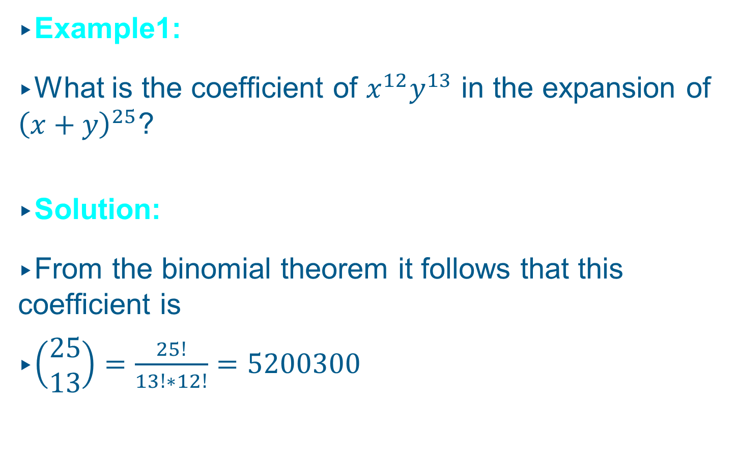
Binomial Coefficients
Example1:
What is the coefficient of $x^{12}y^{13}$ in the expansion of ${\left(x+y\right)}^{25}$?
Solution:
From the binomial theorem it follows that this coefficient is
$\left(\begin{aligned}25 \\ 13\end{aligned}\right)=\frac{25!}{13!∗12!}=5200300$

Slide 16
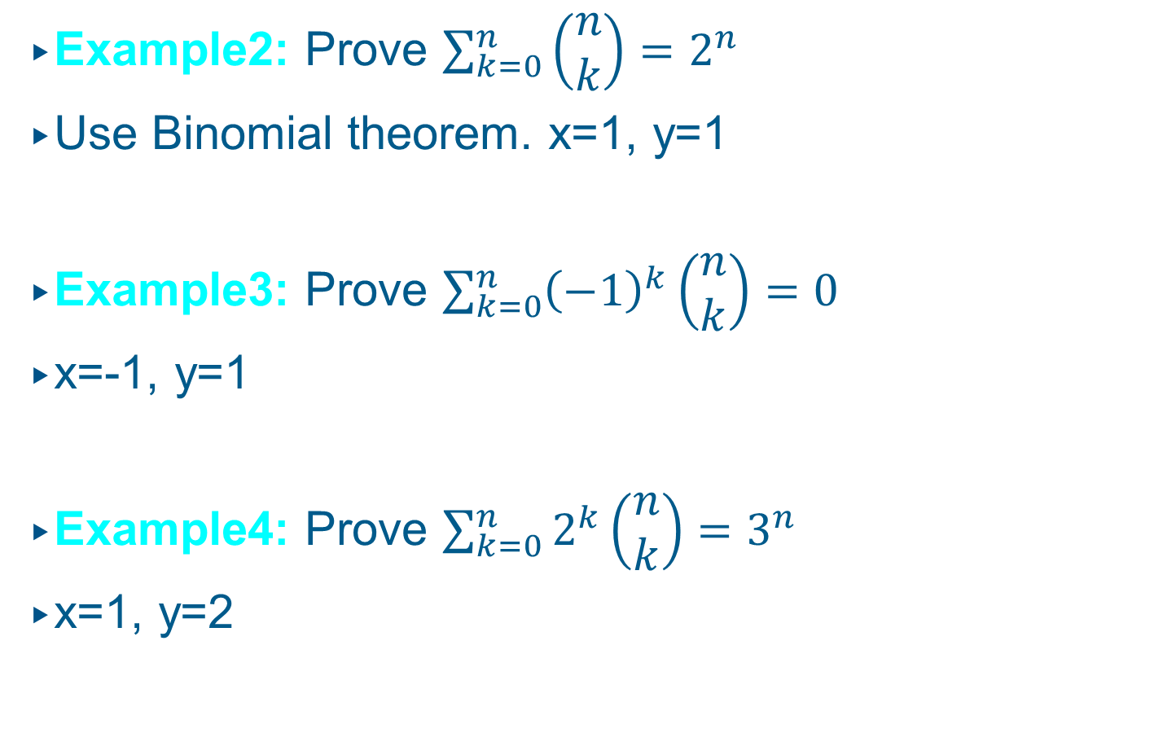
Binomial Coefficients
Example2: Prove $\sum_{k=0}^{n}{\left(\begin{aligned}n \\ k\end{aligned}\right)=2^{n}}$
Use Binomial theorem. x=1, y=1
Example3: Prove $\sum_{k=0}^{n}{{\left(−1\right)}^{k}\left(\begin{aligned}n \\ k\end{aligned}\right)=0}$
x=-1, y=1
Example4: Prove $\sum_{k=0}^{n}{2^{k}\left(\begin{aligned}n \\ k\end{aligned}\right)=3^{n}}$
x=1, y=2

Slide 17
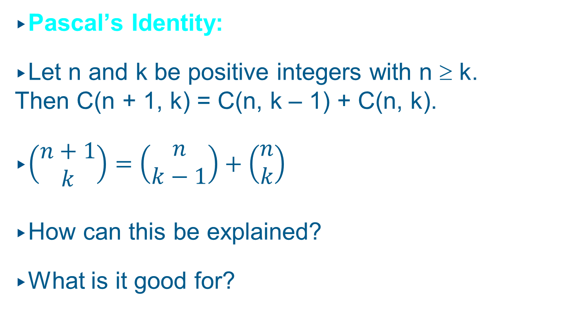
Combinations
Pascal’s Identity:
Let n and k be positive integers with n ≥ k.
Then C(n + 1, k) = C(n, k – 1) + C(n, k).
$\left(\begin{aligned}n+1 \\ k\end{aligned}\right)=\left(\begin{aligned}n \\ k−1\end{aligned}\right)+\left(\begin{aligned}n \\ k\end{aligned}\right)$
How can this be explained?
What is it good for?

Slide 18
Combinations
Imagine a set S containing n elements and a set T containing (n + 1) elements, namely all elements in S plus a new element a.
Calculating C(n + 1, k) is equivalent to answering the question: How many subsets of T containing k items are there?
Case I: The subset contains (k – 1) elements of S
plus the element a: C(n, k – 1) choices.
Case II: The subset contains k elements of S and
does not contain a: C(n, k) choices.
Sum Rule: C(n + 1, k) = C(n, k – 1) + C(n, k).

Slide 19
Pascal’s Triangle
In Pascal’s triangle, each number is the sum of the numbers to its upper left and upper right:
With the help of Pascal’s triangle, you can find powers of binomial expressions.
For example, the fifth row of Pascal’s triangle (1 – 4 – 6 – 4 – 1) helps us to compute (a + b)⁴:
(a + b)⁴ = a⁴ + 4a³b + 6a²b² + 4ab³ + b⁴
1
1
1
1
2
1
1
3
3
1
1
4
6
4
1
…
…
…
…
…
…

Slide 20
Pascal’s Triangle
Since we have C(n + 1, k) = C(n, k – 1) + C(n, k) and
C(0, 0) = 1, we can use Pascal’s triangle to simplify the computation of C(n, k):
k
C(0, 0) = 1
C(1, 0) = 1
C(1, 1) = 1
n
C(2, 0) = 1
C(2, 1) = 2
C(2, 2) = 1
C(3, 0) = 1
C(3, 1) = 3
C(3, 2) = 3
C(3, 3) = 1
C(4, 0) = 1
C(4, 1) = 4
C(4, 2) = 6
C(4, 3) = 4
C(4, 4) = 1

Slide 21

Some other identities
Vandermonde’s: $\left(\begin{aligned}m+n \\ r\end{aligned}\right)=\sum_{k=0}^{r}{\left(\begin{aligned}m \\ r−k\end{aligned}\right)\left(\begin{aligned}n \\ k\end{aligned}\right)}$
$\left(\begin{aligned}2n \\ n\end{aligned}\right)=\sum_{k=0}^{n}{{\left(\begin{aligned}n \\ k\end{aligned}\right)}^{2}}$
$\left(\begin{aligned}n+1 \\ r+1\end{aligned}\right)=\sum_{j=r}^{n}{\left(\begin{aligned}j \\ r\end{aligned}\right)}$

Slide 22
Now it’s time to look at…
Discrete Probability

Slide 23
Discrete Probability
Everything you have learned about counting constitutes the basis for computing the probability of events to happen.
In the following, we will use the notion experiment for a procedure that yields one of a given set of possible outcomes.
This set of possible outcomes is called the sample space of the experiment.
An event is a subset of the sample space.

Slide 24
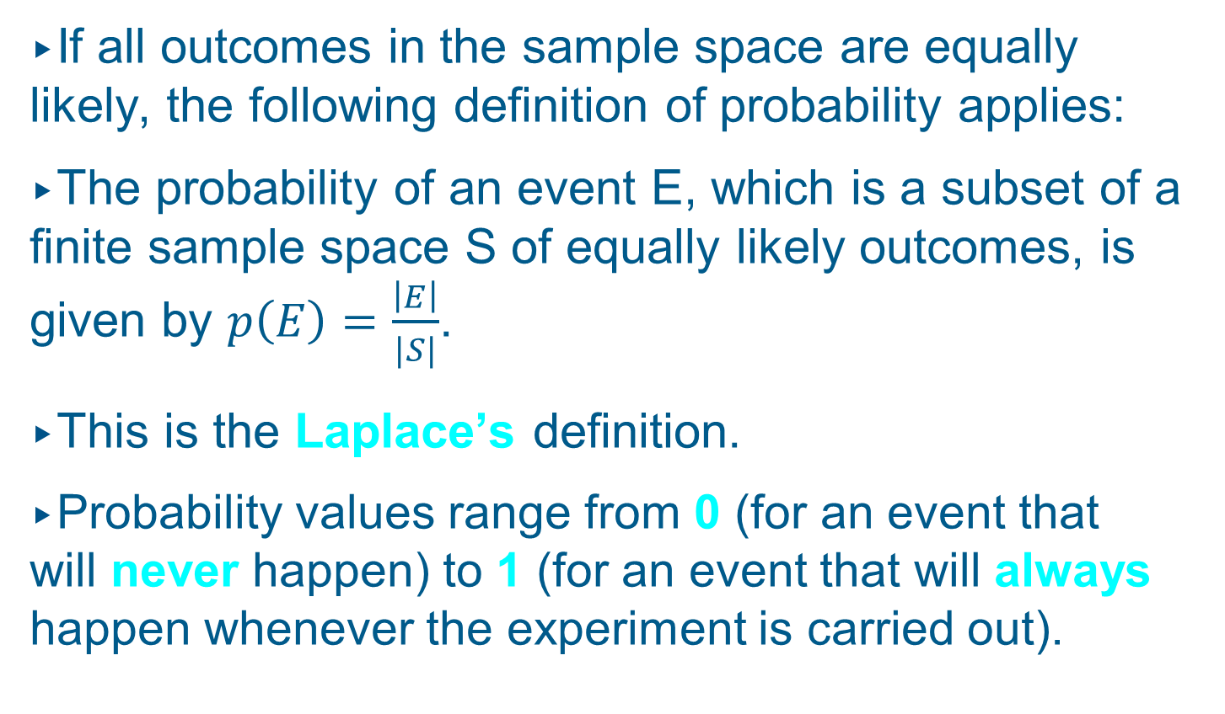
Discrete Probability
If all outcomes in the sample space are equally likely, the following definition of probability applies:
The probability of an event E, which is a subset of a finite sample space S of equally likely outcomes, is given by $p\left(E\right)=\frac{\left|E\right|}{|S|}$.
This is the Laplace’s definition.
Probability values range from 0 (for an event that will never happen) to 1 (for an event that will always happen whenever the experiment is carried out).

Slide 25
Discrete Probability
Example I:
An urn contains four blue balls and five red balls. What is the probability that a ball chosen from the urn is blue?
Solution:
There are nine possible outcomes, and the event “blue ball is chosen” comprises four of these outcomes. Therefore, the probability of this event is 4/9 or approximately 44.44%.

Slide 26
Discrete Probability
Example II:
What is the probability of winning the lottery 6/49, that is, picking the correct set of six numbers out of 49?
Solution:
There are C(49, 6) possible outcomes. Only one of these outcomes will actually make us win the lottery.
p(E) = 1/C(49, 6) = 1/13,983,816

Slide 27
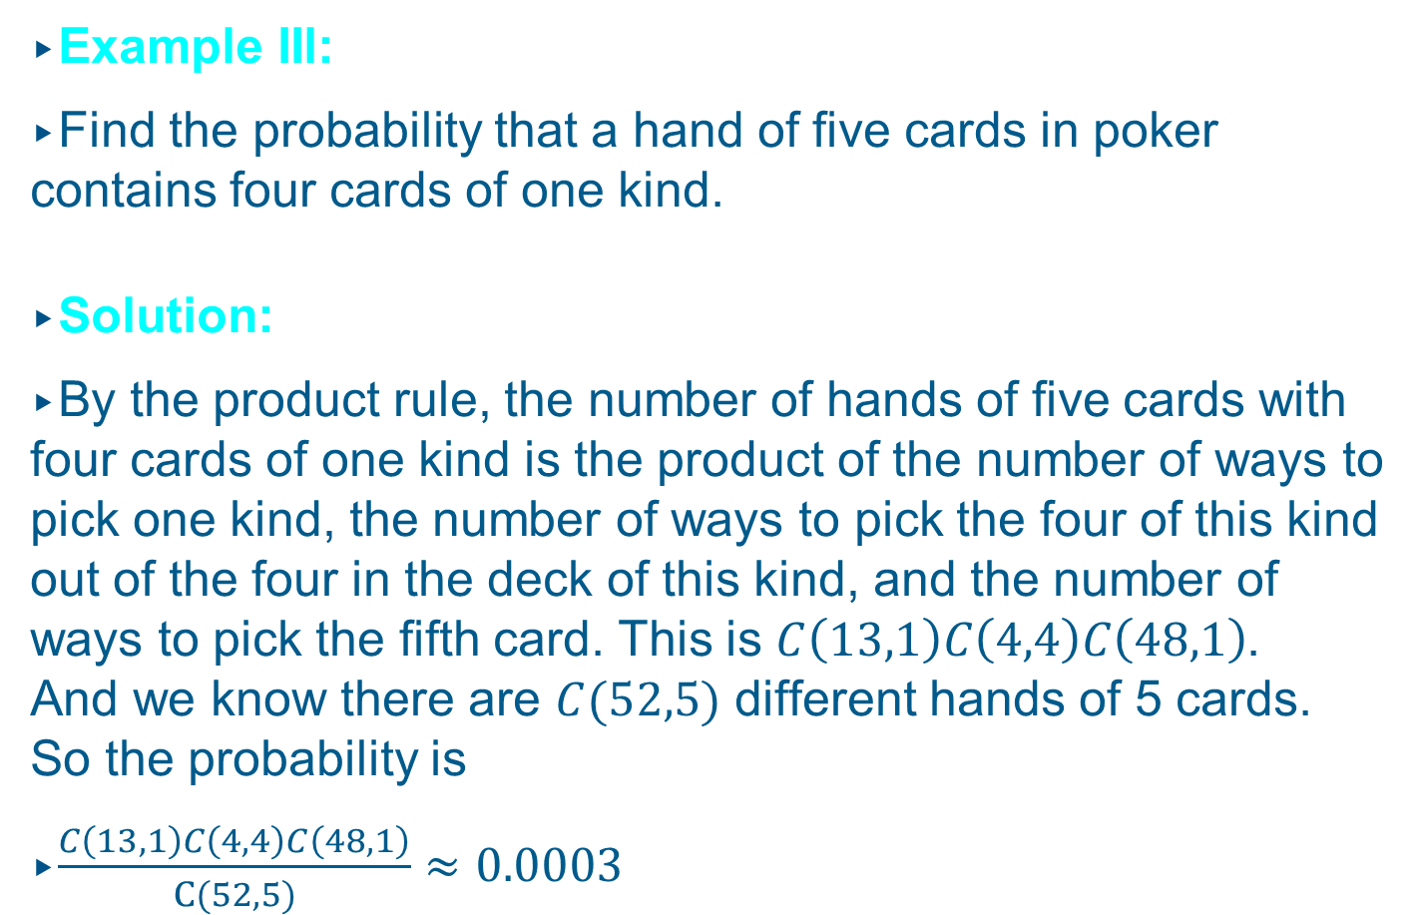
Discrete Probability
Example IIl:
Find the probability that a hand of five cards in poker contains four cards of one kind.
Solution:
By the product rule, the number of hands of five cards with four cards of one kind is the product of the number of ways to pick one kind, the number of ways to pick the four of this kind out of the four in the deck of this kind, and the number of ways to pick the fifth card. This is $C\left(13,1\right)C\left(4,4\right)C\left(48,1\right)$. And we know there are $C(52,5)$ different hands of 5 cards. So the probability is
$\frac{C\left(13,1\right)C\left(4,4\right)C\left(48,1\right)}{C(52,5)}≈0.0003$

Slide 28
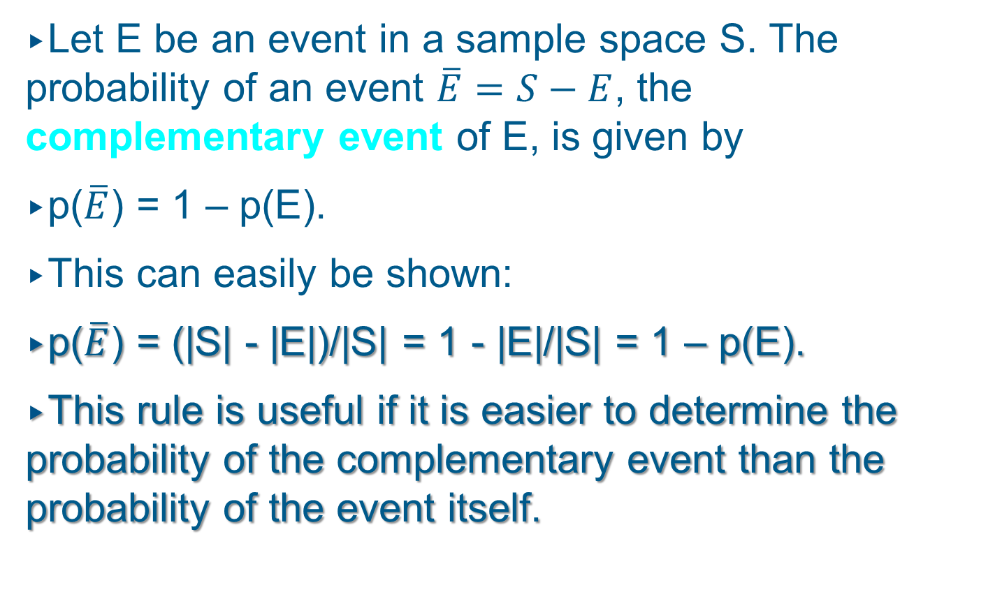
Complementary Events
Let E be an event in a sample space S. The probability of an event $\overline{E}=S−E$, the complementary event of E, is given by
p($\overline{E}$) = 1 – p(E).
This can easily be shown:
p($\overline{E}$) = (|S| - |E|)/|S| = 1 - |E|/|S| = 1 – p(E).
This rule is useful if it is easier to determine the probability of the complementary event than the probability of the event itself.

Slide 29
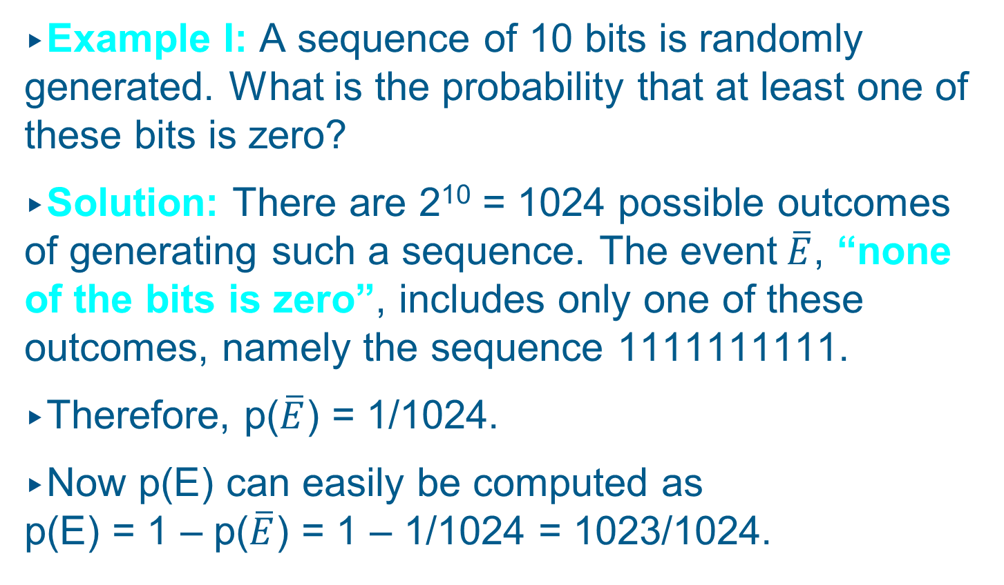
Complementary Events
Example I: A sequence of 10 bits is randomly generated. What is the probability that at least one of these bits is zero?
Solution: There are 2¹⁰ = 1024 possible outcomes of generating such a sequence. The event$\overline{E}$, “none of the bits is zero”, includes only one of these outcomes, namely the sequence 1111111111.
Therefore, p($\overline{E}$) = 1/1024.
Now p(E) can easily be computed as
p(E) = 1 – p($\overline{E}$) = 1 – 1/1024 = 1023/1024.

Slide 30
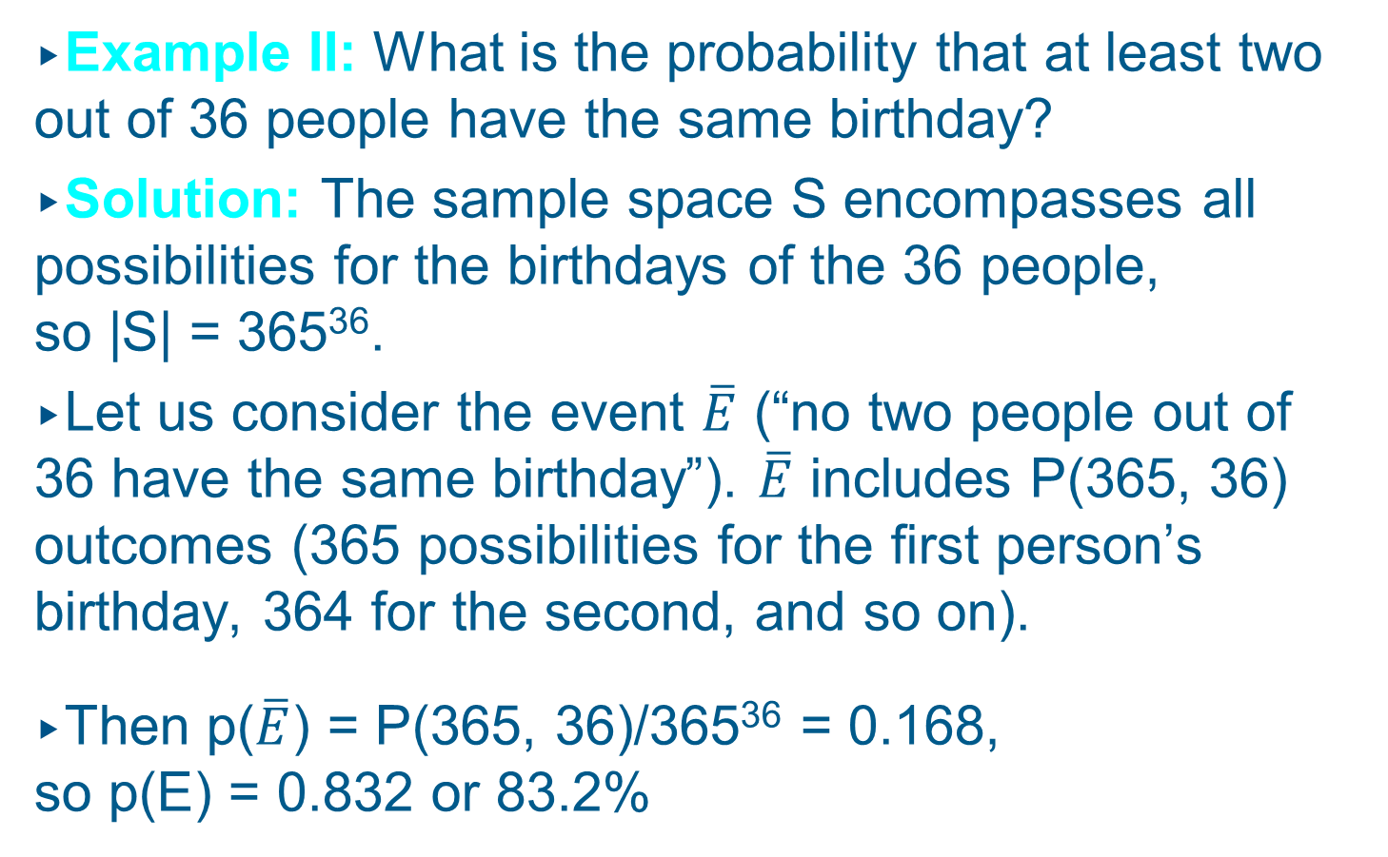
Complementary Events
Example II: What is the probability that at least two out of 36 people have the same birthday?
Solution: The sample space S encompasses all possibilities for the birthdays of the 36 people,
so |S| = 365³⁶.
Let us consider the event $\overline{E}$ (“no two people out of 36 have the same birthday”). $\overline{E}$ includes P(365, 36) outcomes (365 possibilities for the first person’s birthday, 364 for the second, and so on).
Then p($\overline{E}$) = P(365, 36)/365³⁶ = 0.168,
so p(E) = 0.832 or 83.2%

Slide 31
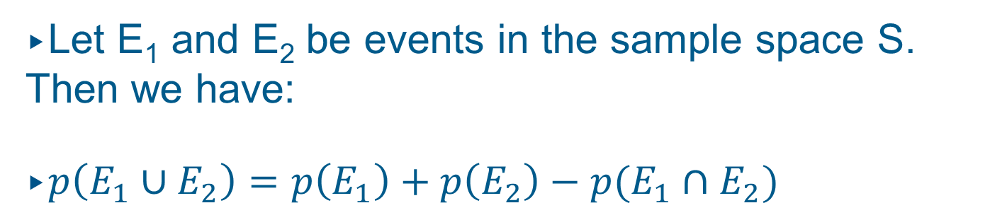
Discrete Probability
Let E₁ and E₂ be events in the sample space S.
Then we have:
$p\left(E_{1}∪E_{2}\right)=p\left(E_{1}\right)+p\left(E_{2}\right)−p(E_{1}∩E_{2})$
Does this remind you of something?
Of course, the principle of inclusion-exclusion.

Slide 32
Discrete Probability
Example: What is the probability of a positive integer selected at random from the set of positive integers not exceeding 100 to be divisible by 2 or 5?
Solution:
E₂: “integer is divisible by 2”
E₅: “integer is divisible by 5”
E₂ = {2, 4, 6, …, 100}
|E₂| = 50
p(E₂) = 0.5

Slide 33
Discrete Probability
E₅ = {5, 10, 15, …, 100}
|E₅| = 20
p(E₅) = 0.2
E₂ ∩ E₅ = {10, 20, 30, …, 100}
|E₂ ∩ E₅| = 10
p(E₂ ∩ E₅) = 0.1
p(E₂ ∪ E₅) = p(E₂) + p(E₅) – p(E₂ ∩ E₅ )
p(E₂ ∪ E₅) = 0.5 + 0.2 – 0.1 = 0.6

Slide 34
Discrete Probability
What happens if the outcomes of an experiment are not equally likely?
In that case, we assign a probability p(s) to each outcome s∈S, where S is the sample space.
Two conditions have to be met:
(1): 0 ≤ p(s) ≤ 1 for each s∈S, and
(2): ∑_{s∈S} p(s) = 1
This means, as we already know, that (1) each probability must be a value between 0 and 1, and (2) the probabilities must add up to 1, because one of the outcomes is guaranteed to occur.

Slide 35
Discrete Probability
The function p from the set of all outcomes of the sample space S is called a probability distribution.
How can we obtain these probabilities p(s) ?
The probability p(s) assigned to an outcome s equals the limit of the number of times s occurs divided by the number of times the experiment is performed.

Slide 36
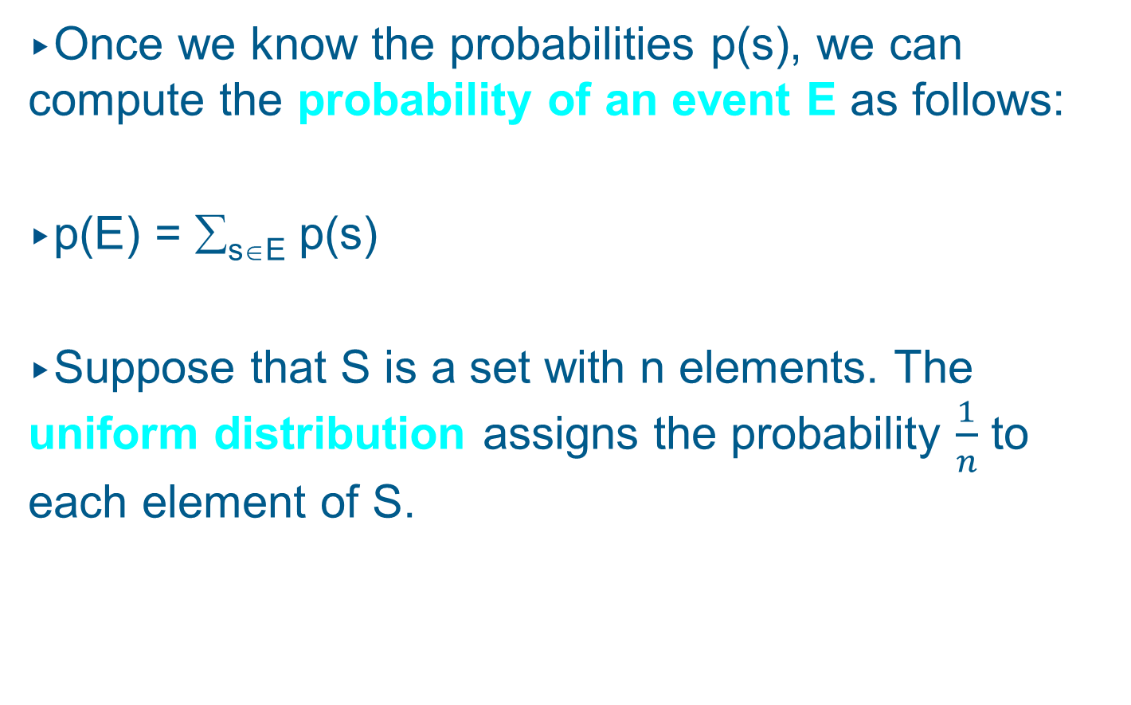
Discrete Probability
Once we know the probabilities p(s), we can compute the probability of an event E as follows:
p(E) = ∑_{s∈E} p(s)
Suppose that S is a set with n elements. The uniform distribution assigns the probability $\frac{1}{n}$ to each element of S.

Slide 37
Discrete Probability
Example I: A die is biased so that the number 3 appears twice as often as each other number.
What are the probabilities of all possible outcomes?
Solution: There are 6 possible outcomes s₁, …, s₆.
p(s₁) = p(s₂) = p(s₄) = p(s₅) = p(s₆)
p(s₃) = 2p(s₁)
Since the probabilities must add up to 1, we have:
5p(s₁) + 2p(s₁) = 1
7p(s₁) = 1
p(s₁) = p(s₂) = p(s₄) = p(s₅) = p(s₆) = 1/7,
p(s₃) = 2/7

Slide 38
Discrete Probability
Example II: For the biased die from Example I, what is the probability that an odd number appears when we roll the die?
Solution:
E_{odd} = {s₁, s₃, s₅}
Remember the formula p(E) = ∑_{s∈E} p(s).
p(E_{odd}) = ∑_{s∈Eodd} p(s) = p(s₁) + p(s₃) + p(s₅)
p(E_{odd}) = 1/7 + 2/7 + 1/7 = 4/7 = 57.14%

Slide 39
Conditional Probability
If we toss a coin three times, what is the probability that an odd number of tails appears (event E), if the first toss is a tail (event F) ?
If the first toss is a tail, the possible sequences are TTT, TTH, THT, and THH.
In two out of these four cases, there is an odd number of tails.
Therefore, the probability of E, under the condition that F occurs, is 0.5.
We call this conditional probability.

Slide 40
Conditional Probability
If we want to compute the conditional probability of E given F, we use F as the sample space.
For any outcome of E to occur under the condition that F also occurs, this outcome must also be in
E ∩ F.
Definition: Let E and F be events with p(F) > 0.
The conditional probability of E given F, denoted by p(E | F), is defined as
p(E | F) = p(E ∩ F)/p(F)

Slide 41
Conditional Probability
Example: What is the probability of a random bit string of length four to contain at least two consecutive 0s, given that its first bit is a 0 ?
Solution:
E: “bit string contains at least two consecutive 0s”
F: “first bit of the string is a 0”
We know the formula p(E | F) = p(E ∩ F)/p(F).
E ∩ F = {0000, 0001, 0010, 0011, 0100}
p(E ∩ F) = 5/16
p(F) = 8/16 = 1/2
p(E | F) = (5/16)/(1/2) = 10/16 = 5/8 = 0.625

Slide 42
Independence
Let us return to the example of tossing a coin three times.
Does the probability of event E (odd number of tails) depend on the occurrence of event F (first toss is a tail) ?
In other words, is it the case that
p(E | F) ≠ p(E) ?
We actually find that p(E | F) = 0.5 and p(E) = 0.5,
so we say that E and F are independent events.

Slide 43
Independence
Because we have p(E | F) = p(E ∩ F)/p(F),
p(E | F) = p(E) if and only if p(E ∩ F) = p(E)p(F).
Definition: The events E and F are said to be independent if and only if p(E ∩ F) = p(E)p(F).
Obviously, this definition is symmetrical for E and F. If we have p(E ∩ F) = p(E)p(F), then it is also true that p(F | E) = p(F).

Slide 44
Independence
Example: Suppose E is the event of rolling an even number with an unbiased die. F is the event that the resulting number is divisible by three. Are events E and F independent?
Solution:
p(E) = 1/2, p(F) = 1/3.
|E ∩ F|= 1 (only 6 is divisible by both 2 and 3)
p(E ∩ F) = 1/6
p(E ∩ F) = p(E)p(F)
Conclusion: E and F are independent.

Slide 45
Bernoulli Trials
Suppose an experiment with two possible outcomes, such as tossing a coin.
Each performance of such an experiment is called a Bernoulli trial.
We will call the two possible outcomes a success or a failure, respectively.
If p is the probability of a success and q is the probability of a failure, it is obvious that
p + q = 1.

Slide 46
Bernoulli Trials
Often we are interested in the probability of exactly k successes when an experiment consists of n independent Bernoulli trials.
Example:
A coin is biased so that the probability of head is 2/3. What is the probability of exactly four heads to come up when the coin is tossed seven times?

Slide 47
Bernoulli Trials
Solution:
There are 2⁷ = 128 possible outcomes.
The number of possibilities for four heads among the seven trials is C(7, 4).
The seven trials are independent, so the probability of each of these outcomes is
(2/3)⁴(1/3)³.
Consequently, the probability of exactly four heads to appear is
C(7, 4)(2/3)⁴(1/3)³ = 560/2187 = 25.61%

Slide 48
Bernoulli Trials
Illustration: Let us denote a success by ‘S’ and a failure by ‘F’. As before, we have a probability of success p and probability of failure q = 1 – p.
What is the probability of two successes in five independent Bernoulli trials?
Let us look at a possible sequence:
SSFFF
What is the probability that we will generate exactly this sequence?

Slide 49
Bernoulli Trials
Sequence:
Probability:
S
S
F
F
F
p
p
q
q
q
= p²q³
Another possible sequence:
Sequence:
Probability:
F
S
F
S
F
q
p
q
p
q
= p²q³
Each sequence with two successes in five trials occurs with probability p²q³.

Slide 50
Bernoulli Trials
And how many possible sequences are there?
In other words, how many ways are there to pick two items from a list of five?
We know that there are C(5, 2) = 10 ways to do this, so there are 10 possible sequences, each of which occurs with a probability of p²q³.
Therefore, the probability of any such sequence to occur when performing five Bernoulli trials is
C(5, 2) p²q³.
In general, for k successes in n Bernoulli trials we have a probability of C(n,k)p^{k}q^{n-k}.

Slide 51
Random Variables
In some experiments, we would like to assign a numerical value to each possible outcome in order to facilitate a mathematical analysis of the experiment.
For this purpose, we introduce random variables.
Definition: A random variable is a function from the sample space of an experiment to the set of real numbers. That is, a random variable assigns a real number to each possible outcome.
Note: Random variables are functions, not variables, and they are not random, but map random results from experiments onto real numbers in a well-defined manner.

Slide 52
Random Variables
Example:
Let X be the result of a rock-paper-scissors game.
If player A chooses symbol a and player B chooses symbol b, then
X(a, b) = 1, if player A wins,
= 0, if A and B choose the same symbol,
= -1, if player B wins.

Slide 53
Random Variables
X(rock, rock) =
0
X(rock, paper) =
-1
X(rock, scissors) =
1
X(paper, rock) =
1
X(paper, paper) =
0
X(paper, scissors) =
-1
X(scissors, rock) =
-1
X(scissors, paper) =
1
X(scissors, scissors) =
0

Slide 54
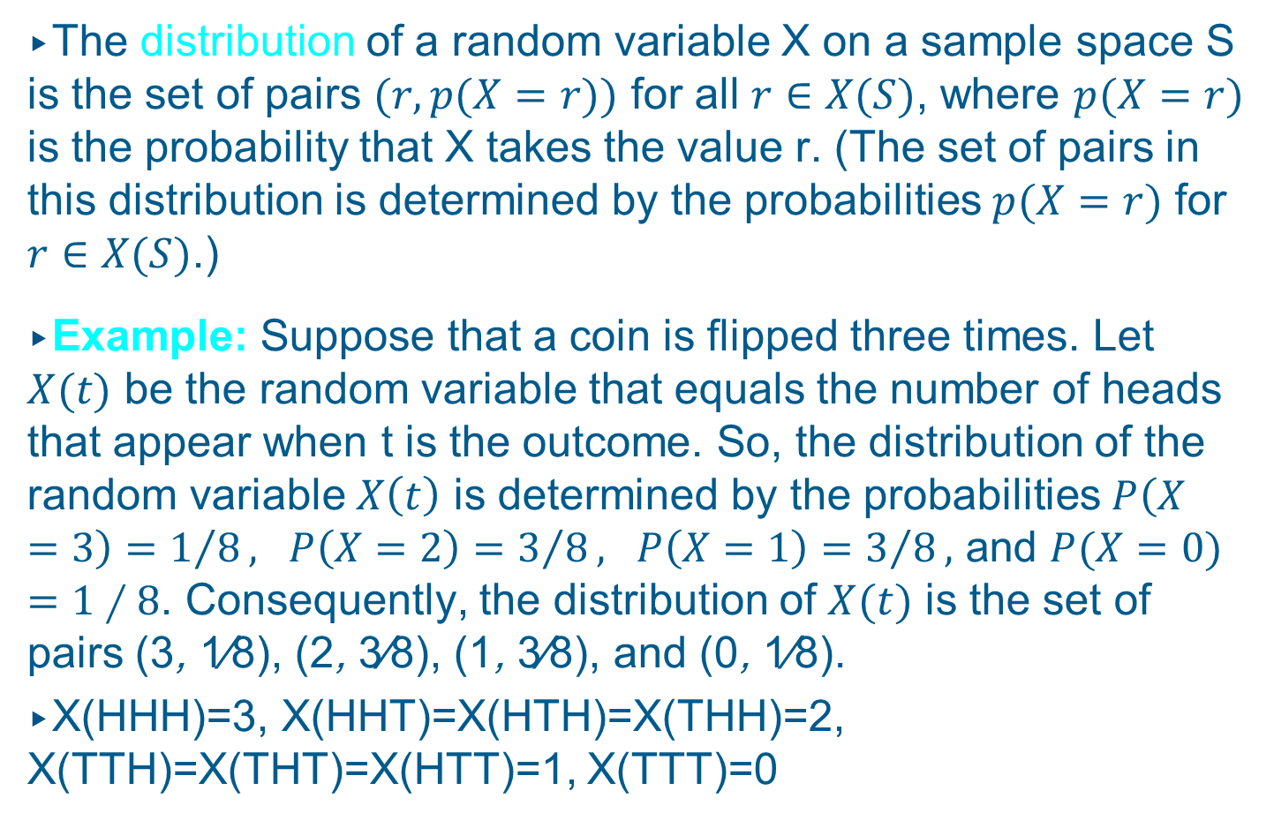
Random Variables
The distribution of a random variable X on a sample space S is the set of pairs $(r, p(X=r))$ for all $r∈X(S)$, where $p(X=r)$ is the probability that X takes the value r. (The set of pairs in this distribution is determined by the probabilities $p(X=r)$ for $r∈X(S)$.)
Example: Suppose that a coin is flipped three times. Let $X(t)$ be the random variable that equals the number of heads that appear when t is the outcome. So, the distribution of the random variable $X\left(t\right)$ is determined by the probabilities $P\left(X=3\right)=1/8, P\left(X=2\right)=3/8, P\left(X=1\right)=3/8,$ and $P(X=0)=1∕8$. Consequently, the distribution of $X(t)$ is the set of pairs (3, 1∕8), (2, 3∕8), (1, 3∕8), and (0, 1∕8).
X(HHH)=3, X(HHT)=X(HTH)=X(THH)=2, X(TTH)=X(THT)=X(HTT)=1, X(TTT)=0

Slide 55
Expected Values
Once we have defined a random variable for our experiment, we can statistically analyze the outcomes of the experiment.
For example, we can ask: What is the average value (called the expected value) of a random variable when the experiment is carried out a large number of times?
Can we just calculate the arithmetic mean across all possible values of the random variable?

Slide 56
Expected Values
No, we cannot, since it is possible that some outcomes are more likely than others.
For example, assume the possible outcomes of an experiment are 1 and 2 with probabilities of 0.1 and 0.9, respectively.
Is the average value 1.5?
No, since 2 is much more likely to occur than 1, the average must be larger than 1.5.

Slide 57
Expected Values
Instead, we have to calculate the weighted sum of all possible outcomes, that is, each value of the random variable has to be multiplied with its probability before being added to the sum.
In our example, the average value is given by
0.1⋅1 + 0.9⋅2 = 0.1 + 1.8 = 1.9.

Slide 58
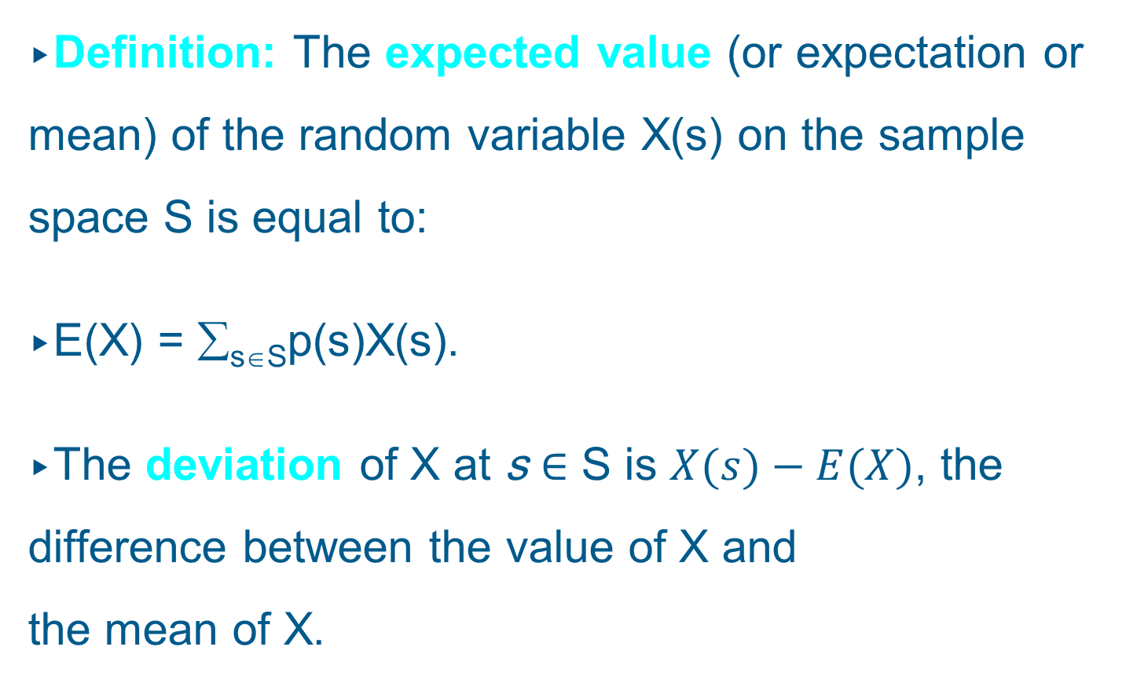
Expected Values
Definition: The expected value (or expectation or mean) of the random variable X(s) on the sample space S is equal to:
E(X) = ∑_{s∈S}p(s)X(s).
The deviation of X at s ∈ S is $X(s)−E(X)$, the difference between the value of X and the mean of X.

Slide 59
Expected Values
Example: Let X be the random variable equal to the sum of the numbers that appear when a pair of dice is rolled.
There are 36 outcomes (= pairs of numbers from 1 to 6).
The range of X is {2, 3, 4, 5, 6, 7, 8, 9, 10, 11, 12}.
Are the 36 outcomes equally likely?
Yes, if the dice are not biased.
Are the 11 values of X equally likely to occur?
No, the probabilities vary across values.

Slide 60
Expected Values
P(X = 2) =
1/36
P(X = 3) =
2/36 = 1/18
P(X = 4) =
3/36 = 1/12
P(X = 5) =
4/36 = 1/9
P(X = 6) =
5/36
P(X = 7) =
6/36 = 1/6
P(X = 8) =
5/36
P(X = 9) =
4/36 = 1/9
P(X = 10) =
3/36 = 1/12
P(X = 11) =
2/36 = 1/18
P(X = 12) =
1/36

Slide 61
Expected Values
E(X) = 2⋅(1/36) + 3⋅(1/18) + 4⋅(1/12) + 5⋅(1/9) +
6⋅(5/36) + 7⋅(1/6) + 8⋅(5/36) + 9⋅(1/9) +
10⋅(1/12) + 11⋅(1/18) + 12⋅(1/36)
E(X) = 7
This means that if we roll two dice many times, sum all the numbers that appear and divide the sum by the number of trials, we expect to find a value of 7.

Slide 62
Expected Values
Theorem:
If X and Y are random variables on a sample space S, then E(X + Y) = E(X) + E(Y).
Furthermore, if X_{i}, i = 1, 2, …, n with a positive integer n, are random variables on S, then
E(X₁ + X₂ + … + X_{n}) = E(X₁) + E(X₂) + … + E(X_{n}).
Moreover, if a and b are real numbers, then
E(aX + b) = aE(X) + b.

Slide 63
Expected Values
Knowing this theorem, we could now solve the previous example much more easily:
Let X₁ and X₂ be the numbers appearing on the first and the second die, respectively.
For each die, there is an equal probability for each of the six numbers to appear. Therefore, E(X₁) = E(X₂) = (1 + 2 + 3 + 4 + 5 + 6)/6 = 7/2.
We now know that
E(X₁ + X₂) = E(X₁) + E(X₂) = 7.

Slide 64
Expected Values
We can use our knowledge about expected values to compute the average-case complexity of an algorithm.
Let the sample space be the set of all possible inputs a₁, a₂, …, a_{n}, and the random variable X assign to each a_{j} the number of operations that the algorithm executes for that input.
For each input a_{j}, the probability that this input occurs is given by p(a_{j}).
The algorithm’s average-case complexity then is:
E(X) = ∑_{j=1,…,n}p(a_{j})X(a_{j})

Slide 65
Expected Values
However, in order to conduct such an average-case analysis, you would need to find out:
the number of steps that the algorithms takes
for any (!) possible input, and
the probability for each of these inputs to
occur.
For most algorithms, this would be a highly complex task, so we will stick with the worst-case analysis.

Slide 66
Independent Random Variables
Definition: The random variables X and Y on a sample space S are independent if
p(X = r₁ ∧ Y = r₂) = p(X = r₁) ⋅ p(Y = r₂).
In other words, X and Y are independent if the probability that X = r₁ ∧ Y = r₂ equals the product of the probability that X = r₁ and the probability that Y = r₂ for all real numbers r₁ and r₂.

Slide 67
Independent Random Variables
Example: Are the random variables X₁ and X₂ from the “pair of dice” example independent?
Solution:
p(X₁ = i) = 1/6
p(X₂ = j) = 1/6
p(X₁ = i ∧ X₂ = j) = 1/36
Since p(X₁ = i ∧ X₂ = j) = p(X₁ = i)⋅p(X₂ = j) ,
the random variables X₁ and X₂ are independent.

Slide 68
Independent Random Variables
Theorem: If X and Y are independent random variables on a sample space S, then
E(XY) = E(X)E(Y).
Note:
E(X + Y) = E(X) + E(Y) is true for any X and Y, but
E(XY) = E(X)E(Y) needs X and Y to be independent.
How come?

Slide 69
Independent Random Variables
Example: Let X and Y be random variables on some sample space, and each of them assumes the values 1 and 3 with equal probability.
Then E(X) = E(Y) = 2
If X and Y are independent, we have:
E(X + Y) = 1/4·(1 + 1) + 1/4·(1 + 3) +
1/4·(3 + 1) + 1/4·(3 + 3) = 4 = E(X) + E(Y)
E(XY) = 1/4·(1·1) + 1/4·(1·3) +
1/4·(3·1) + 1/4·(3·3) = 4 = E(X)·E(Y)

Slide 70
Independent Random Variables
Let us now assume that X and Y are correlated in such a way that Y = 1 whenever X = 1, and Y = 3 whenever X = 3.
E(X + Y) = 1/2·(1 + 1) + 1/2·(3 + 3)
= 4 = E(X) + E(Y)
E(XY) = 1/2·(1·1) + 1/2·(3·3)
= 5 ≠ E(X)·E(Y)

