Slide 1
We will cover these parts of the book (8th edition):
8.1.1, 8.1.2
8.2.1, 8.2.2(up to page 544)
8.3.1, 8.3.2
9.1
9.2.1-9.2.4
9.3

Slide 2
Now it’s Time for…
Advanced Counting

Slide 3
Recurrence Relations
A recurrence relation for the sequence {a_{n}} is an equation that expresses a_{n} is terms of one or more of the previous terms of the sequence, namely, a₀, a₁, …, a_{n-1}, for all integers n with
n ≥ n₀, where n₀ is a nonnegative integer.
A sequence is called a solution of a recurrence relation if its terms satisfy the recurrence relation.
In this section we will show that such relations can be used to study and to solve counting problems.

Slide 4
Recurrence Relations
In other words, a recurrence relation is like a recursively defined sequence, but without specifying any initial values (initial conditions).
Therefore, the same recurrence relation can have (and usually has) multiple solutions.
If both the initial conditions and the recurrence relation are specified, then the sequence is uniquely determined.

Slide 5
Recurrence Relations
Example:
Consider the recurrence relation
a_{n} = 2a_{n-1} – a_{n-2} for n = 2, 3, 4, …
Is the sequence {a_{n}} with a_{n}=3n a solution of this recurrence relation?
For n ≥ 2 we see that
2a_{n-1} – a_{n-2} = 2(3(n – 1)) – 3(n – 2) = 3n = a_{n}.
Therefore, {a_{n}} with a_{n}=3n is a solution of the recurrence relation.

Slide 6
Recurrence Relations
Is the sequence {a_{n}} with a_{n}=5 a solution of the same recurrence relation?
For n ≥ 2 we see that
2a_{n-1} – a_{n-2} = 2⋅5 - 5 = 5 = a_{n}.
Therefore, {a_{n}} with a_{n}=5 is also a solution of the recurrence relation.

Slide 7
Modeling with Recurrence Relations
Example:
Someone deposits $10,000 in a savings account at a bank yielding 5% per year with interest compounded annually. How much money will be in the account after 30 years?
Solution:
Let P_{n} denote the amount in the account after n years.
How can we determine P_{n} on the basis of P_{n-1}?

Slide 8
Modeling with Recurrence Relations
We can derive the following recurrence relation:
P_{n} = P_{n-1} + 0.05P_{n-1} = 1.05P_{n-1}.
The initial condition is P₀ = 10,000.
Then we have:
P₁ = 1.05P₀
P₂ = 1.05P₁ = (1.05)²P₀
P₃ = 1.05P₂ = (1.05)³P₀
…
P_{n} = 1.05P_{n-1} = (1.05)^{n}P₀
We now have a formula to calculate P_{n} for any natural number n and can avoid the iteration.

Slide 9
Modeling with Recurrence Relations
Let us use this formula to find P₃₀ under the
initial condition P₀ = 10,000:
P₃₀ = (1.05)³⁰⋅10,000 = 43,219.42
After 30 years, the account contains $43,219.42.

Slide 10
Modeling with Recurrence Relations
Another example:
Let a_{n} denote the number of bit strings of length n that do not have two consecutive 0s (“valid strings”). Find a recurrence relation and give initial conditions for the sequence {a_{n}}.
Solution:
Idea: The number of valid strings equals the number of valid strings ending with a 0 plus the number of valid strings ending with a 1.

Slide 11
Modeling with Recurrence Relations
Let us assume that n ≥ 3, so that the string contains at least 3 bits.
Let us further assume that we know the number a_{n-1} of valid strings of length (n – 1) and the number a_{n-2} of valid strings of length (n – 2).
Then how many valid strings of length n are there, if the string ends with a 1?
There are a_{n-1} such strings, namely the set of valid strings of length (n – 1) with a 1 appended to them.
Note: Whenever we append a 1 to a valid string, that string remains valid.

Slide 12
Modeling with Recurrence Relations
Now we need to know: How many valid strings of length n are there, if the string ends with a 0?
Valid strings of length n ending with a 0 must have a 1 as their (n – 1)st bit (otherwise they would end with 00 and would not be valid).
And what is the number of valid strings of length (n – 1) that end with a 1?
We already know that there are a_{n-1} strings of length n that end with a 1.
Therefore, there are a_{n-2} strings of length (n – 1) that end with a 1.

Slide 13
Modeling with Recurrence Relations
So there are a_{n-2} valid strings of length n that end with a 0 (all valid strings of length (n – 2) with 10 appended to them).
As we said before, the number of valid strings is the number of valid strings ending with a 0 plus the number of valid strings ending with a 1.
That gives us the following recurrence relation:
a_{n} = a_{n-1} + a_{n-2}

Slide 14
Modeling with Recurrence Relations
What are the initial conditions?
a₁ = 2 (0 and 1)
a₂ = 3 (01, 10, and 11)
a₃ = a₂ + a₁ = 3 + 2 = 5
a₄ = a₃ + a₂ = 5 + 3 = 8
a₅ = a₄ + a₃ = 8 + 5 = 13
…
This sequence satisfies the same recurrence relation as the Fibonacci sequence.
Since a₁ = f₃ and a₂ = f₄, we have a_{n} = f_{n+2}.

Slide 15
Solving Recurrence Relations
In general, we would prefer to have an explicit formula to compute the value of a_{n} rather than conducting n iterations.
For one class of recurrence relations, we can obtain such formulas in a systematic way.
Those are the recurrence relations that express the terms of a sequence as linear combinations of previous terms.

Slide 16
Solving Recurrence Relations
Definition: A linear homogeneous recurrence relation of degree k with constant coefficients is a recurrence relation of the form:
a_{n} = c₁a_{n-1} + c₂a_{n-2} + … + c_{k}a_{n-k},
Where c₁, c₂, …, c_{k} are real numbers, and c_{k} ≠ 0.
A sequence satisfying such a recurrence relation is uniquely determined by the recurrence relation and the k initial conditions
a₀ = C₀, a₁ = C₁, a₂ = C₂, …, a_{k-1} = C_{k-1}.

Slide 17
Solving Recurrence Relations
Examples:
The recurrence relation P_{n} = (1.05)P_{n-1}
is a linear homogeneous recurrence relation of degree one.
The recurrence relation f_{n} = f_{n-1} + f_{n-2}
is a linear homogeneous recurrence relation of degree two.
The recurrence relation a_{n} = a_{n-5}
is a linear homogeneous recurrence relation of degree five.

Slide 18
Solving Recurrence Relations
Basically, when solving such recurrence relations, we try to find solutions of the form a_{n} = r^{n}, where r is a constant.
a_{n} = r^{n} is a solution of the recurrence relation
a_{n} = c₁a_{n-1} + c₂a_{n-2} + … + c_{k}a_{n-k} if and only if
r^{n} = c₁r^{n-1} + c₂r^{n-2} + … + c_{k}r^{n-k}.
Divide this equation by r^{n-k} and subtract the right-hand side from the left:
r^{k} - c₁r^{k-1} - c₂r^{k-2} - … - c_{k-1}r - c_{k} = 0
This is called the characteristic equation of the recurrence relation.

Slide 19
Solving Recurrence Relations
The solutions of this equation are called the characteristic roots of the recurrence relation.
Let us consider linear homogeneous recurrence relations of degree two.
Theorem: Let c₁ and c₂ be real numbers. Suppose that r² – c₁r – c₂ = 0 has two distinct roots r₁ and r₂.
Then the sequence {a_{n}} is a solution of the recurrence relation a_{n} = c₁a_{n-1} + c₂a_{n-2} if and only if a_{n} = α₁r₁^{n} + α₂r₂^{n} for n = 0, 1, 2, …, where α₁ and α₂ are constants.
The proof is shown on page 542/543 (8th Edition), 515/516 (7th Edition)

Slide 20
Solving Recurrence Relations
Example: What is the solution of the recurrence relation a_{n} = a_{n-1} + 2a_{n-2} with a₀ = 2 and a₁ = 7 ?
Solution: The characteristic equation of the recurrence relation is r² – r – 2 = 0. (because C₁=1, C₂=2)
Its roots are r = 2 and r = -1.
Hence, the sequence {a_{n}} is a solution to the recurrence relation if and only if:
a_{n} = α₁2^{n} + α₂(-1)^{n} for some constants α₁ and α₂.

Slide 21
Solving Recurrence Relations
Given the equation a_{n} = α₁2^{n} + α₂(-1)^{n} and the initial conditions a₀ = 2 and a₁ = 7, it follows that
a₀ = 2 = α₁ + α₂
a₁ = 7 = α₁⋅2 + α₂ ⋅(-1)
Solving these two equations gives us
α₁ = 3 and α₂ = -1.
Therefore, the solution to the recurrence relation and initial conditions is the sequence {a_{n}} with
a_{n} = 3⋅2^{n} – (-1)^{n}.

Slide 22
Solving Recurrence Relations
Another Example: Give an explicit formula for the Fibonacci numbers.
Solution: The Fibonacci numbers satisfy the recurrence relation f_{n} = f_{n-1} + f_{n-2} with initial conditions f₀ = 0 and f₁ = 1.
The characteristic equation is r² – r – 1 = 0.
Its roots are

Slide 23
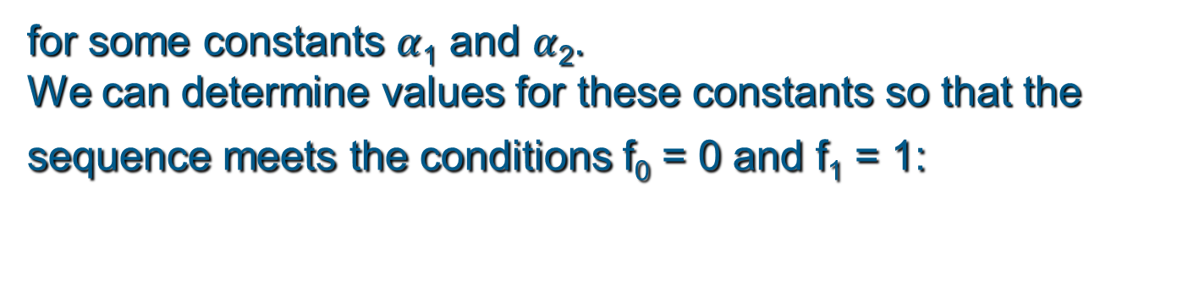
Solving Recurrence Relations
Therefore, the Fibonacci numbers are given by
for some constants $α$₁ and $α$₂.
We can determine values for these constants so that the sequence meets the conditions f₀ = 0 and f₁ = 1:

Slide 24
Solving Recurrence Relations
The unique solution to this system of two equations and two variables is
So finally we obtained an explicit formula for the Fibonacci numbers:

Slide 25
Solving Recurrence Relations
But what happens if the characteristic equation has only one root?
How can we then match our equation with the initial conditions a₀ and a₁ ?
Theorem: Let c₁ and c₂ be real numbers with c₂ ≠ 0. Suppose that r² – c₁r – c₂ = 0 has only one root r₀.
A sequence {a_{n}} is a solution of the recurrence relation a_{n} = c₁a_{n-1} + c₂a_{n-2} if and only if
a_{n} = α₁r₀^{n} + α₂nr₀^{n}, for n = 0, 1, 2, …, where α₁ and α₂ are constants.

Slide 26
Solving Recurrence Relations
Example: What is the solution of the recurrence relation a_{n} = 6a_{n-1} – 9a_{n-2} with a₀ = 1 and a₁ = 6?
Solution: The only root of r² – 6r + 9 = 0 is r₀ = 3.
Hence, the solution to the recurrence relation is
a_{n} = α₁3^{n} + α₂n3^{n} for some constants α₁ and α₂.
To match the initial condition, we need
a₀ = 1 = α₁
a₁ = 6 = α₁⋅3 + α₂⋅3
Solving these equations yields α₁ = 1 and α₂ = 1.
Consequently, the overall solution is given by
a_{n} = 3^{n} + n3^{n}.

Slide 27
Divide-and-Conquer Relations
Some algorithms take a problem and successively divide it into one or more smaller problems until there is a trivial solution to them.
For example, the binary search algorithm recursively divides the input into two halves and eliminates the irrelevant half until only one relevant element remained.
This technique is called “divide and conquer”.
We can use recurrence relations to analyze the complexity of such algorithms.

Slide 28
Divide-and-Conquer Relations
Suppose that an algorithm divides a problem (input) of size n into a subproblems, where each subproblem is of size n/b. Assume that g(n) operations are performed for such a division of a problem.
Then, if f(n) represents the number of operations required to solve the problem, it follows that f satisfies the recurrence relation
f(n) = af(n/b) + g(n).
This is called a divide-and-conquer recurrence relation.

Slide 29
Divide-and-Conquer Relations
Example: The binary search algorithm reduces the search for an element in a search sequence of size n to the binary search for this element in a search sequence of size n/2 (if n is even).
Two comparisons are needed to perform this reduction.
Hence, if f(n) is the number of comparisons required to search for an element in a search sequence of size n, then
f(n) = f(n/2) + 2 if n is even.

Slide 30
Divide-and-Conquer Relations
Usually, we do not try to solve such divide-and conquer relations, but we use them to derive a
big-O estimate for the complexity of an algorithm.
Master Theorem: Let f be an increasing function that satisfies the recurrence relation
f(n) = af(n/b) + cn^{d}
whenever n = b^{k}, where k is a positive integer, a, c, and d are real numbers with a ≥ 1, and b is an integer greater than 1. Then f(n) is
O(n^{d}), if a < b^{d},
O(n^{d} log n) if a = b^{d},
O(n^{logba}) if a > b^{d}

Slide 31
Divide-and-Conquer Relations
Example:
For binary search, we have
f(n) = f(n/2) + 2, so a = 1, b = 2, and d = 0
(d = 0 because here, g(n) does not depend on n).
Consequently, a = b^{d}, and therefore,
f(n) is O(n^{d} log n) = O(log n).
The binary search algorithm has logarithmic time complexity.

Slide 32
How About Some…
Relations

Slide 33
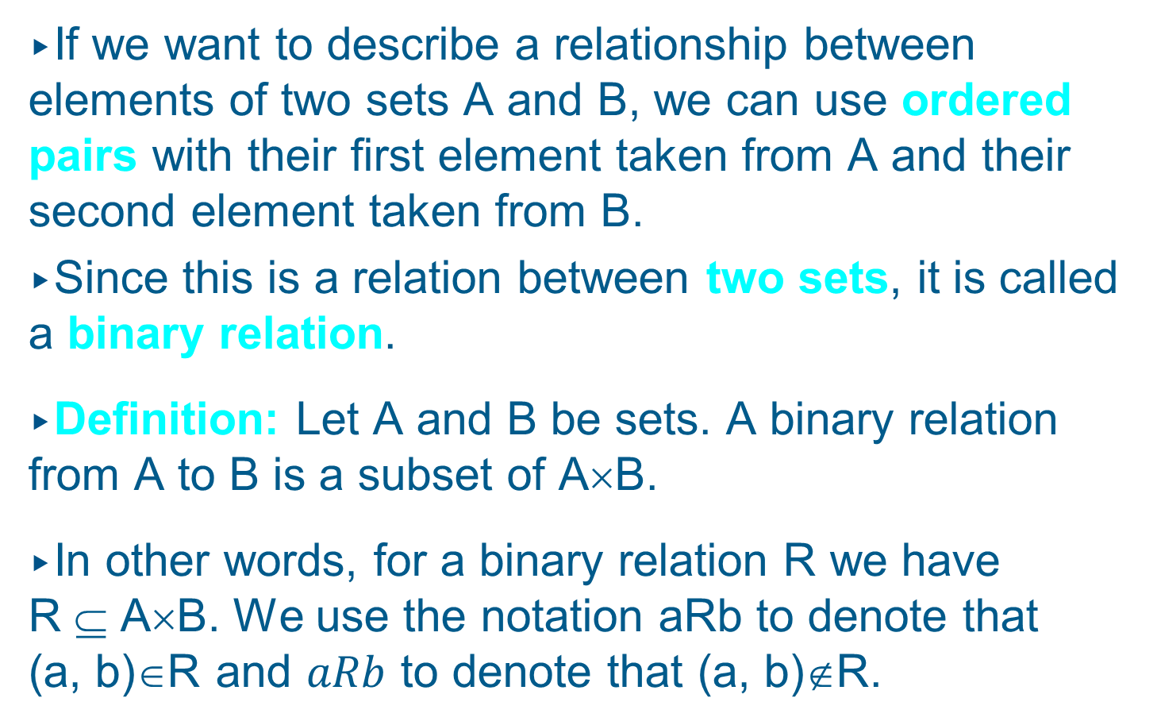
Relations
If we want to describe a relationship between elements of two sets A and B, we can use ordered pairs with their first element taken from A and their second element taken from B.
Since this is a relation between two sets, it is called a binary relation.
Definition: Let A and B be sets. A binary relation from A to B is a subset of A×B.
In other words, for a binary relation R we have
R ⊆ A×B. We use the notation aRb to denote that (a, b)∈R and $aRb$ to denote that (a, b)∉R.

Slide 34
Relations
When (a, b) belongs to R, a is said to be related to b by R.
Example: Let P be a set of people, C be a set of cars, and D be the relation describing which person drives which car(s).
P = {Carl, Suzanne, Peter, Carla},
C = {Mercedes, BMW, tricycle}
D = {(Carl, Mercedes), (Suzanne, Mercedes),
(Suzanne, BMW), (Peter, tricycle)}
This means that Carl drives a Mercedes, Suzanne drives a Mercedes and a BMW, Peter drives a tricycle, and Carla does not drive any of these vehicles.

Slide 35
Functions as Relations
You might remember that a function f from a set A to a set B assigns a unique element of B to each element of A.
The graph of f is the set of ordered pairs (a, b) such that b = f(a).
Since the graph of f is a subset of A×B, it is a relation from A to B.
Moreover, for each element a of A, there is exactly one ordered pair in the graph that has a as its first element and b as its second element.

Slide 36
Functions as Relations
Conversely, if R is a relation from A to B such that every element in A is the first element of exactly one ordered pair of R, then a function can be defined with R as its graph.
This is done by assigning to an element a∈A the unique element b∈B such that (a, b)∈R.

Slide 37
Relations on a Set
Definition: A relation on the set A is a relation from A to A.
In other words, a relation on the set A is a subset of A×A.
Example: Let A = {1, 2, 3, 4}. Which ordered pairs are in the relation R = {(a, b) | a < b} ?

Slide 38
Relations on a Set
Solution: R = {
(1, 2),
(1, 3),
(1, 4),
(2, 3),
(2, 4),
(3, 4)}
1
1
R | 1 | 2 | 3 | 4
1
2
3
4
X
X
X
2
2
X
X
3
3
X
4
4

Slide 39
Relations on a Set
How many different relations can we define on a set A with n elements?
A relation on a set A is a subset of A×A.
How many elements are in A×A ?
There are n² elements in A×A, so how many subsets (= relations on A) does A×A have?
The number of subsets that we can form out of a set with m elements is 2^{m}. Therefore, 2^{n2} subsets can be formed out of A×A.
Answer: We can define 2^{n2} different relations on A.

Slide 40
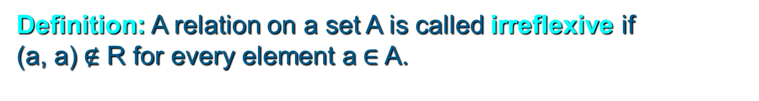
Properties of Relations
We will now look at some useful ways to classify relations.
Definition: A relation R on a set A is called reflexive if (a, a)∈R for every element a∈A.
Are the following relations on {1, 2, 3, 4} reflexive?
R = {(1, 1), (1, 2), (2, 3), (3, 3), (4, 4)}
No
R = {(1, 1), (2, 2), (2, 3), (3, 3), (4, 4)}
Yes
R = {(1, 1), (2, 2), (3, 3)}
No
Definition: A relation on a set A is called irreflexive if (a, a)$∉$ R for every element a$∈$A.

Slide 41
Properties of Relations
Definitions:
A relation R on a set A is called symmetric if (b, a)∈R whenever (a, b)∈R for all a, b∈A.
A relation R on a set A is called antisymmetric if
a = b whenever (a, b)∈R and (b, a)∈R.
A relation R on a set A is called asymmetric if
(a, b)∈R implies that (b, a)∉R for all a, b∈A.

Slide 42
Properties of Relations
Definition: A relation R on a set A is called transitive if whenever (a, b)∈R and (b, c)∈R, then (a, c)∈R for a, b, c∈A.
Are the following relations on {1, 2, 3, 4}
transitive?
R = {(1, 1), (1, 2), (2, 2), (2, 1), (3, 3)}
Yes.
R = {(1, 3), (3, 2), (2, 1)}
No.
R = {(2, 4), (4, 3), (2, 3), (4, 1)}
No.

Slide 43
Counting Relations
Example: How many different reflexive relations can be defined on a set A containing n elements?
Solution: Relations on R are subsets of A×A, which contains n² elements.
Therefore, different relations on A can be generated by choosing different subsets out of these n² elements, so there are 2^{n2} relations.
A reflexive relation, however, must contain the n elements (a, a) for every a∈A.
Consequently, we can only choose among n² – n = n(n – 1) elements to generate reflexive relations, so there are 2^{n(n – 1)} of them.

Slide 44
Combining Relations
Relations are sets, and therefore, we can apply the usual set operations to them.
If we have two relations R₁ and R₂, and both of them are from a set A to a set B, then we can combine them to R₁ ∪ R₂, R₁ ∩ R₂, or R₁ – R₂.
In each case, the result will be another relation from A to B.

Slide 45
Combining Relations
… and there is another important way to combine relations.
Definition: Let R be a relation from a set A to a set B and S a relation from B to a set C. The composite of R and S is the relation consisting of ordered pairs (a, c), where a∈A, c∈C, and for which there exists an element b∈B such that (a, b)∈R and
(b, c)∈S. We denote the composite of R and S by
S°R.
In other words, if relation R contains a pair (a, b) and relation S contains a pair (b, c), then S°R contains a pair (a, c).

Slide 46
Combining Relations
Example: Let D and S be relations on A = {1, 2, 3, 4}.
D = {(a, b) | b = 5 - a} “b equals (5 – a)”
S = {(a, b) | a < b} “a is smaller than b”
D = {(1, 4), (2, 3), (3, 2), (4, 1)}
S = {(1, 2), (1, 3), (1, 4), (2, 3), (2, 4), (3, 4)}
S°D = {
(2, 4),
(3, 3),
(3, 4),
(4, 2),
(4, 3),
(4, 4)}
D maps an element a to the element (5 – a), and afterwards S maps (5 – a) to all elements larger than (5 – a), resulting in S ° D = {(a,b) | b > 5 – a} or S ° D = {(a,b) | a + b > 5}.

Slide 47
Combining Relations
We already know that functions are just special cases of relations (namely those that map each element in the domain onto exactly one element in the codomain).
If we formally convert two functions into relations, that is, write them down as sets of ordered pairs, the composite of these relations will be exactly the same as the composite of the functions (as defined earlier).

Slide 48
Combining Relations
Definition: Let R be a relation on the set A. The powers R^{n}, n = 1, 2, 3, …, are defined inductively by
R¹ = R
R^{n+1} = R^{n}°R
In other words:
R^{n} = R°R° … °R (n times the letter R)

Slide 49
Combining Relations
Theorem: The relation R on a set A is transitive if and only if R^{n} ⊆ R for all positive integers n.
Remember the definition of transitivity:
Definition: A relation R on a set A is called transitive if whenever (a, b)∈R and (b, c)∈R, then (a, c)∈R for a, b, c∈A.
The composite of R with itself contains exactly these pairs (a, c).
Therefore, for a transitive relation R, R°R does not contain any pairs that are not in R, so R°R ⊆ R.
Since R°R does not introduce any pairs that are not already in R, it must also be true that (R°R)°R ⊆ R, and so on, so that R^{n} ⊆ R.

Slide 50
n-ary Relations
In order to study an interesting application of relations, namely databases, we first need to generalize the concept of binary relations to n-ary relations.
Definition: Let A₁, A₂, …, A_{n} be sets. An n-ary relation on these sets is a subset of A₁×A₂×…×A_{n}.
The sets A₁, A₂, …, A_{n} are called the domains of the relation, and n is called its degree.

Slide 51
n-ary Relations
Example:
Let R = {(a, b, c) | a = 2b ∧ b = 2c with a, b, c∈Z}
What is the degree of R?
The degree of R is 3, so its elements are triples.
What are its domains?
Its domains are all equal to the set of integers.
Is (2, 4, 8) in R?
No.
Is (4, 2, 1) in R?
Yes.

Slide 52
Databases and Relations
Let us take a look at a type of database representation that is based on relations, namely the relational data model.
A database consists of n-tuples called records, which are made up of fields.
These fields are the entries of the n-tuples.
The relational data model represents a database as an n-ary relation, that is, a set of records.

Slide 53
Databases and Relations
Example: Consider a database of students, whose records are represented as 4-tuples with the fields Student Name, ID Number, Major, and GPA:
R = {(Ackermann, 00231455, CS, 3.88),
(Adams, 00888323, Physics, 3.45),
(Chou, 00102147, CS, 3.79),
(Goodfriend, 00453876, Math, 3.45),
(Rao, 00678543, Math, 3.90),
(Stevens, 00786576, Psych, 2.99)}
Relations that represent databases are also called tables, since they are often displayed as tables.

Slide 54
Databases and Relations
A domain of an n-ary relation is called a primary key if the n-tuples are uniquely determined by their values from this domain.
This means that no two records have the same value from the same primary key.
In our example, which of the fields Student Name, ID Number, Major, and GPA are primary keys?
Student Name and ID Number are primary keys, because no two students have identical values in these fields.
In a real student database, only ID Number would be a primary key.

Slide 55
Databases and Relations
In a database, a primary key should remain a primary key even if new records are added.
Therefore, we should use a primary key of the intension of the database, containing all the n-tuples that can ever be included in our database.
Combinations of domains can also uniquely identify n-tuples in an n-ary relation.
When the values of a set of domains determine an n-tuple in a relation, the Cartesian product of these domains is called a composite key.

Slide 56
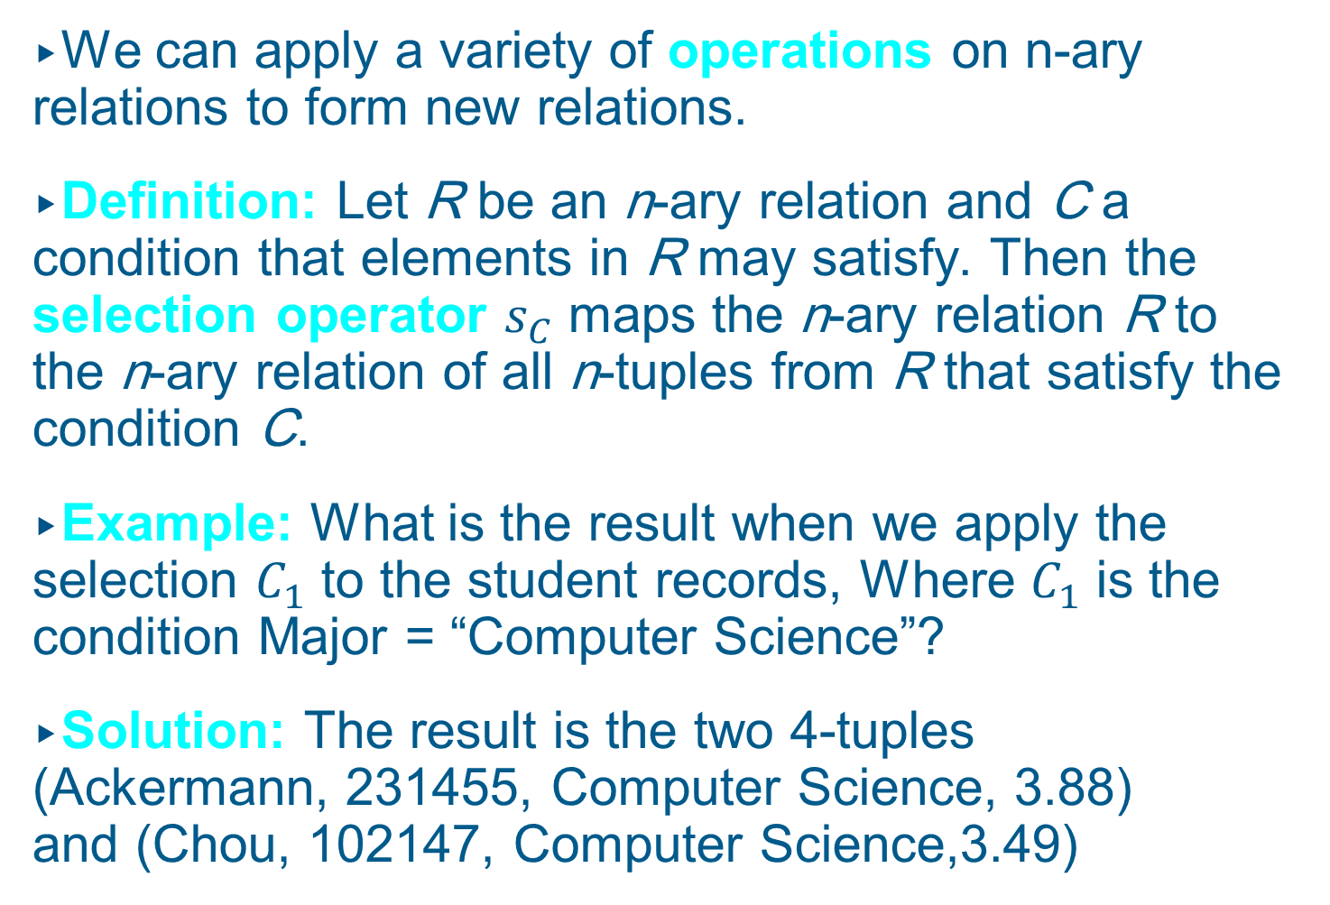
Databases and Relations
We can apply a variety of operations on n-ary relations to form new relations.
Definition: Let R be an n-ary relation and C a condition that elements in R may satisfy. Then the selection operator $s_{C}$ maps the n-ary relation R to the n-ary relation of all n-tuples from R that satisfy the condition C.
Example: What is the result when we apply the selection $C_{1}$ to the student records, Where $C_{1}$ is the condition Major = “Computer Science”?
Solution: The result is the two 4-tuples (Ackermann, 231455, Computer Science, 3.88) and (Chou, 102147, Computer Science,3.49)

Slide 57
Databases and Relations
Definition: The projection P_{i1, i2, …, im} maps the n-tuple (a₁, a₂, …, a_{n}) to the m-tuple (a_{i1}, a_{i2}, …, a_{im}), where m ≤ n.
In other words, a projection P_{i1, i2, …, im} keeps the m components a_{i1}, a_{i2}, …, a_{im} of an n-tuple and deletes its (n – m) other components.
Example: What is the result when we apply the projection P_{2,4} to the student record (Stevens, 00786576, Psych, 2.99) ?
Solution: It is the pair (00786576, 2.99).

Slide 58
Databases and Relations
In some cases, applying a projection to an entire table may not only result in fewer columns, but also in fewer rows.
Why is that?
Some records may only have differed in those fields that were deleted, so they become identical, and there is no need to list identical records more than once.

Slide 59
Databases and Relations
We can use the join operation to combine two tables into one if they share some identical fields.
Definition: Let R be a relation of degree m and S a relation of degree n. The join J_{p}(R, S), where p ≤ m and p ≤ n, is a relation of degree m + n – p that consists of all (m + n – p)-tuples
(a₁, a₂, …, a_{m-p}, c₁, c₂, …, c_{p}, b₁, b₂, …, b_{n-p}),
where the m-tuple (a₁, a₂, …, a_{m-p}, c₁, c₂, …, c_{p}) belongs to R and the n-tuple (c₁, c₂, …, c_{p}, b₁, b₂, …, b_{n-p}) belongs to S.

Slide 60
Databases and Relations
In other words, to generate J_{p}(R, S), we have to find all the elements in R whose p last components match the p first components of an element in S.
The new relation contains exactly these matches, which are combined to tuples that contain each matching field only once.

Slide 61
Databases and Relations
Example: What is J₁(Y, R), where Y contains the fields Student Name and Year of Birth,
Y = {(1978, Ackermann),
(1972, Adams),
(1917, Chou),
(1984, Goodfriend),
(1982, Rao),
(1970, Stevens)},
and R contains the student records as defined before?

Slide 62
Databases and Relations
Solution: The resulting relation is:
{(1978, Ackermann, 00231455, CS, 3.88),
(1972, Adams, 00888323, Physics, 3.45),
(1917, Chou, 00102147, CS, 3.79),
(1984, Goodfriend, 00453876, Math, 3.45),
(1982, Rao, 00678543, Math, 3.90),
(1970, Stevens, 00786576, Psych, 2.99)}
Since Y has two fields and R has four, the relation J₁(Y, R) has 2 + 4 – 1 = 5 fields.

Slide 63
Representing Relations
We already know different ways of representing relations. We will now take a closer look at two ways of representation: Zero-one matrices and directed graphs.
If R is a relation from A = {a₁, a₂, …, a_{m}} to B =
{b₁, b₂, …, b_{n}}, then R can be represented by the zero-one matrix M_{R} = [m_{ij}] with
m_{ij} = 1, if (a_{i}, b_{j})∈R, and
m_{ij} = 0, if (a_{i}, b_{j})∉R.
Note that for creating this matrix we first need to list the elements in A and B in a particular, but arbitrary order.

Slide 64
Representing Relations
Example: How can we represent the relation R from the set A = {1, 2, 3} to the set B = {1, 2} with R =
{(2, 1), (3, 1), (3, 2)} as a zero-one matrix?
Solution: The matrix M_{R} is given by

Slide 65
Representing Relations
What do we know about the matrices representing a relation on a set (a relation from A to A) ?
They are square matrices.
What do we know about matrices representing reflexive relations?
All the elements on the diagonal of such matrices M_{ref} must be 1s.

Slide 66
Representing Relations
What do we know about the matrices representing symmetric relations?
These matrices are symmetric, that is, M_{R} = (M_{R})^{t}.
symmetric matrix,
symmetric relation.
non-symmetric matrix,
non-symmetric relation.

Slide 67
Representing Relations
The Boolean operations join and meet (you remember?) can be used to determine the matrices representing the union and the intersection of two relations, respectively.
To obtain the join of two zero-one matrices, we apply the Boolean “or” function to all corresponding elements in the matrices.
To obtain the meet of two zero-one matrices, we apply the Boolean “and” function to all corresponding elements in the matrices.

Slide 68

Representing Relations
Example: Let the relations R and S be represented by the matrices
What are the matrices representing R$∪$S and R$∩$S?
Solution: These matrices are given by

Slide 69
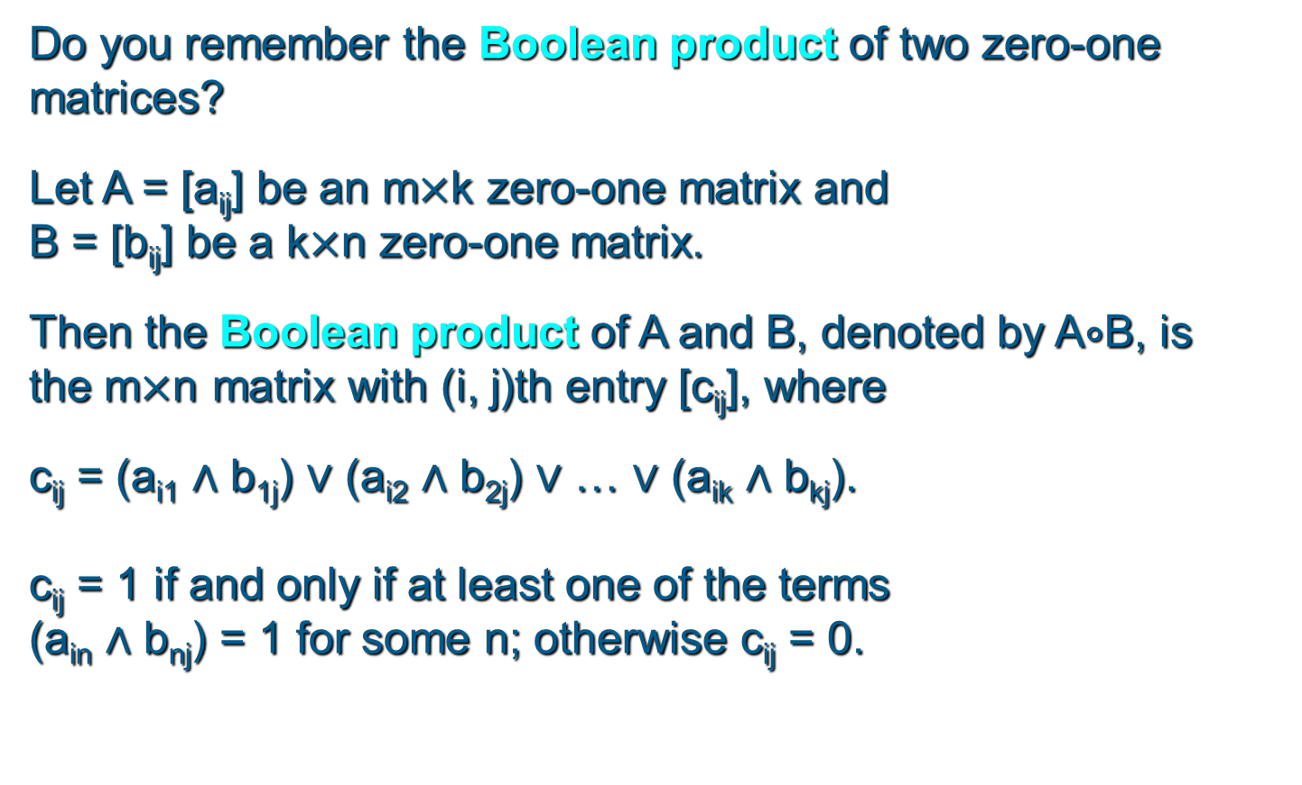
Representing Relations Using Matrices
Do you remember the Boolean product of two zero-one matrices?
Let A = [a_{ij}] be an m$×$k zero-one matrix and
B = [b_{ij}] be a k$×$n zero-one matrix.
Then the Boolean product of A and B, denoted by A$∘$B, is the m$×$n matrix with (i, j)th entry [c_{ij}], where
c_{ij} = (a_{i1} $∧$ b_{1j}) $∨$ (a_{i2} $∧$ b_{2j}) $∨$ … $∨$ (a_{ik} $∧$ b_{kj}).
c_{ij} = 1 if and only if at least one of the terms
(a_{in} $∧$ b_{nj}) = 1 for some n; otherwise c_{ij} = 0.

Slide 70
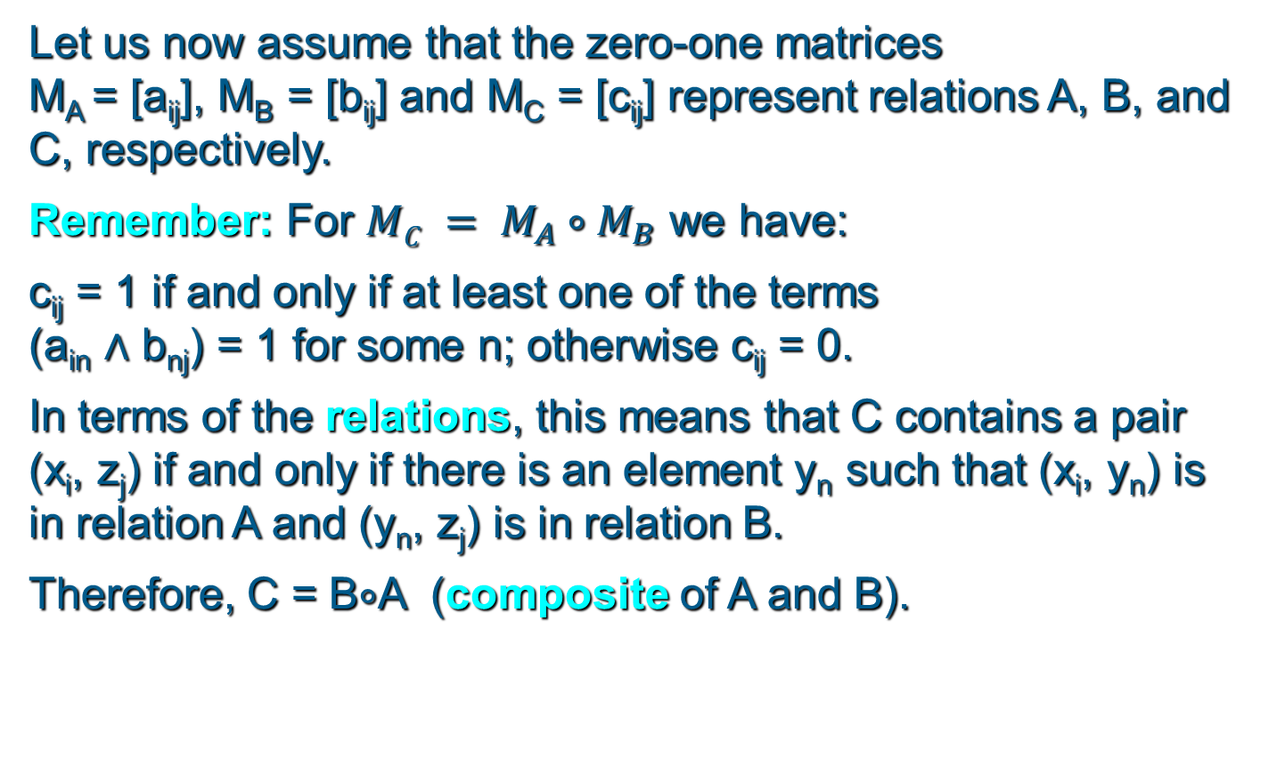
Representing Relations Using Matrices
Let us now assume that the zero-one matrices
M_{A} = [a_{ij}], M_{B} = [b_{ij}] and M_{C} = [c_{ij}] represent relations A, B, and C, respectively.
Remember: For $MC = M_{A}∘M_{B}$ we have:
c_{ij} = 1 if and only if at least one of the terms
(a_{in} $∧$ b_{nj}) = 1 for some n; otherwise c_{ij} = 0.
In terms of the relations, this means that C contains a pair (x_{i}, z_{j}) if and only if there is an element y_{n} such that (x_{i}, y_{n}) is in relation A and (y_{n}, z_{j}) is in relation B.
Therefore, C = B$∘$A (composite of A and B).

Slide 71
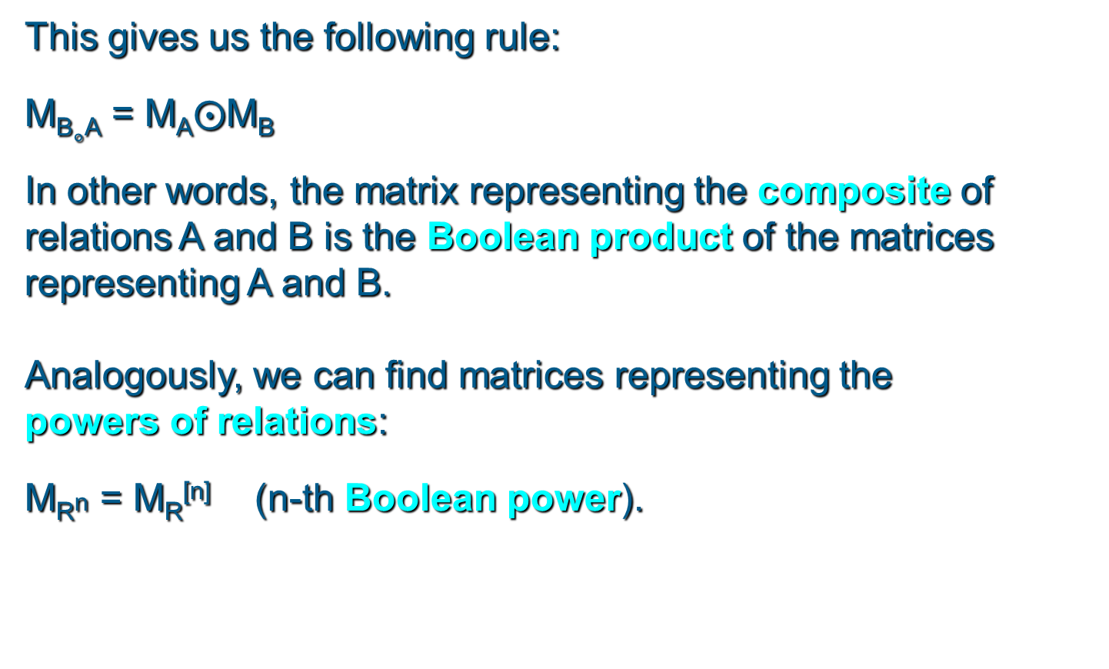
Representing Relations Using Matrices
This gives us the following rule:
M_{B}$∘$_{A} = M_{A}$⨀$M_{B}
In other words, the matrix representing the composite of relations A and B is the Boolean product of the matrices representing A and B.
Analogously, we can find matrices representing the powers of relations:
M_{R}n = M_{R}^{[n]} (n-th Boolean power).

Slide 72
Representing Relations Using Matrices
Example: Find the matrix representing R², where the matrix representing R is given by
Solution: The matrix for R² is given by

Slide 73
Representing Relations Using Digraphs
Definition: A directed graph, or digraph, consists of a set V of vertices (or nodes) together with a set E of ordered pairs of elements of V called edges (or arcs).
The vertex a is called the initial vertex of the edge (a, b), and the vertex b is called the terminal vertex of this edge.
We can use arrows to display graphs.

Slide 74
Representing Relations Using Digraphs
Example: Display the digraph with V = {a, b, c, d},
E = {(a, b), (a, d), (b, b), (b, d), (c, a), (c, b), (d, b)}.
a
b
d
c
An edge of the form (b, b) is called a loop.

Slide 75
Representing Relations Using Digraphs
Obviously, we can represent any relation R on a set A by the digraph with A as its vertices and all pairs (a, b)∈R as its edges.
Vice versa, any digraph with vertices V and edges E can be represented by a relation on V containing all the pairs in E.
This one-to-one correspondence between relations and digraphs means that any statement about relations also applies to digraphs, and vice versa.

