Slide 1
We will cover these parts of the book (8th edition):
9.4.1-9.4.4
9.5
9.6.1
10.1
10.2.1-10.2.4
10.2.7

Slide 2
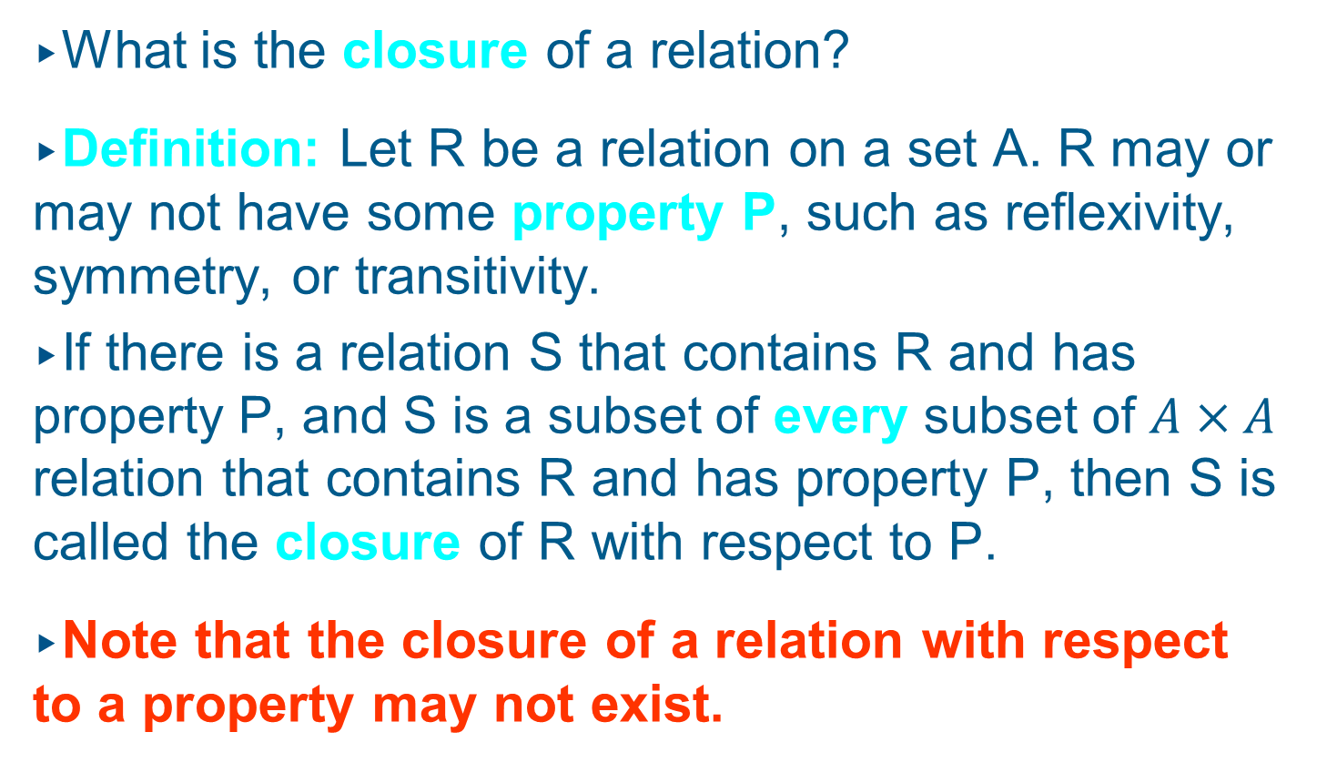
Closures of Relations
What is the closure of a relation?
Definition: Let R be a relation on a set A. R may or may not have some property P, such as reflexivity, symmetry, or transitivity.
If there is a relation S that contains R and has property P, and S is a subset of every subset of $A×A$ relation that contains R and has property P, then S is called the closure of R with respect to P.
Note that the closure of a relation with respect to a property may not exist.

Slide 3
Closures of Relations
Example I: Find the reflexive closure of relation R = {(1, 1), (1, 2), (2, 1), (3, 2)} on the set A = {1, 2, 3}.
Solution: We know that any reflexive relation on A must contain the elements (1, 1), (2, 2), and (3, 3).
By adding (2, 2) and (3, 3) to R, we obtain the reflexive relation S, which is given by
S = {(1, 1), (1, 2), (2, 1), (2, 2), (3, 2), (3, 3)}.
S is reflexive, contains R, and is contained within every reflexive relation that contains R.
Therefore, S is the reflexive closure of R.

Slide 4
Closures of Relations
Example II: Find the symmetric closure of the relation R = {(a, b) | a > b} on the set of positive integers.
Solution: The symmetric closure of R is given by
R∪R⁻¹ = {(a, b) | a > b} ∪ {(b, a) | a > b}
= {(a, b) | a ≠ b}

Slide 5
Closures of Relations
Example III: Find the transitive closure of the relation R = {(1, 3), (1, 4), (2, 1), (3, 2)} on the set
A = {1, 2, 3, 4}.
Solution: R would be transitive, if for all pairs
(a, b) and (b, c) in R there were also a pair (a, c) in R.
If we add the missing pairs (1, 2), (2, 3), (2, 4), and (3, 1), will R be transitive?
No, because the extended relation R contains (3, 1) and (1, 4), but does not contain (3, 4), (1, 1), (2, 2), (3, 3).
By adding new elements to R, we also add new requirements for its transitivity. We need to look
at paths in digraphs to solve this problem.

Slide 6
Closures of Relations
Imagine that we have a relation R that represents all train connections in the US.
For example, if (Boston, Philadelphia) is in R, then there is a direct train connection from Boston to Philadelphia.
If R contains (Boston, Philadelphia) and (Philadelphia, Washington), there is an indirect connection from Boston to Washington.
Because there are indirect connections, it is not possible by just looking at R to determine which cities are connected by trains.
The transitive closure of R contains exactly those pairs of cities that are connected, either directly or indirectly.

Slide 7
Closures of Relations
Definition: A path from a to b in the directed graph G is a sequence of one or more edges (x₀, x₁), (x₁, x₂), (x₂, x₃), …, (x_{n-1}, x_{n}) in G, where x₀ = a and x_{n} = b.
In other words, a path is a sequence of edges where the terminal vertex of an edge is the same as the initial vertex of the next edge in the path.
This path is denoted by x₀, x₁, x₂, …, x_{n} and has length n.
A path that begins and ends at the same vertex is called a circuit or cycle.

Slide 8
Closures of Relations
Example: Let us take a look at the following graph:
a
b
d
c
Is c,a,b,d,b a path in this graph?
Yes
Is d,b,b,b,d,b,d a circuit in this graph?
Yes
Is there any circuit including c in this graph?
No

Slide 9
Closures of Relations
Due to the one-to-one correspondence between graphs and relations, we can transfer the definition of path from graphs to relations:
Definition: There is a path from a to b in a relation R, if there is a sequence of elements a, x₁, x₂, …,
x_{n-1}, b with (a, x₁)∈R, (x₁, x₂)∈R, …, and (x_{n-1}, b)∈R.
Theorem: Let R be a relation on a set A. There is a path from a to b if and only if (a, b)∈R^{n} for some positive integer n.

Slide 10
Closures of Relations
According to the train example, the transitive closure of a relation consists of the pairs of vertices in the associated directed graph that are connected by a path.
Definition: Let R be a relation on a set A. The connectivity relation R* consists of the pairs (a, b) such that there is a path between a and b in R.
We know that R^{n} consists of the pairs (a, b) such that a and b are connected by a path of length n.
Therefore, R* is the union of R^{n} across all positive integers n:

Slide 11
Closures of Relations
Theorem: The transitive closure of a relation R equals the connectivity relation R*.
But how can we compute R* ?
Lemma: Let A be a set with n elements, and let R be a relation on A. If there is a path in R from a to b, then there is such a path with length not exceeding n.
Moreover, if a ≠ b and there is a path in R from a to b, then there is such a path with length not exceeding (n – 1).

Slide 12
Closures of Relations
This lemma is based on the observation that if a path from a to b visits any vertex more than once, it must include at least one circuit.
These circuits can be eliminated from the path, and the reduced path will still connect a and b.
Theorem: For a relation R on a set A with n elements, the transitive closure R* is given by:
R* = R∪R²∪R³∪…∪R^{n}
For matrices representing relations we have:
M_{R*} = M_{R}∨M_{R}^{[2]}∨M_{R}^{[3]}∨…∨M_{R}^{[n]}

Slide 13
Closures of Relations
Let us finally solve Example III by finding the transitive closure of the relation R = {(1, 3), (1, 4), (2, 1), (3, 2)} on the set A = {1, 2, 3, 4}.
R can be represented by the following matrix M_{R}:

Slide 14
Closures of Relations

Slide 15
Closures of Relations
Solution: The transitive closure of the relation R = {(1, 3), (1, 4), (2, 1), (3, 2)} on the set A = {1, 2, 3, 4} is given by the relation
{(1, 1), (1, 2), (1, 3), (1, 4), (2, 1), (2, 2), (2, 3), (2, 4),
(3, 1), (3, 2), (3, 3), (3, 4)}

Slide 16
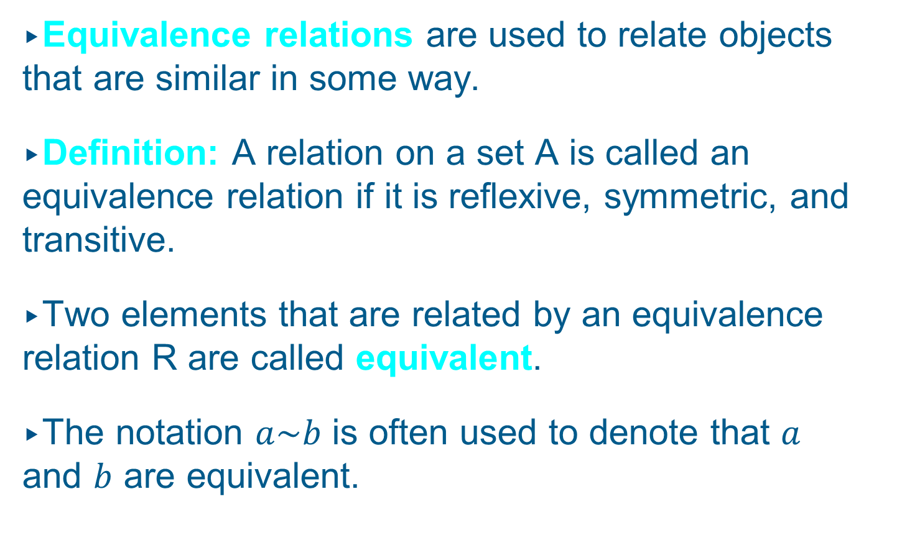
Equivalence Relations
Equivalence relations are used to relate objects that are similar in some way.
Definition: A relation on a set A is called an equivalence relation if it is reflexive, symmetric, and transitive.
Two elements that are related by an equivalence relation R are called equivalent.
The notation $a\sim b$ is often used to denote that $a$ and $b$ are equivalent.

Slide 17
Equivalence Relations
Since R is symmetric, a is equivalent to b whenever b is equivalent to a.
Since R is reflexive, every element is equivalent to itself.
Since R is transitive, if a and b are equivalent and b and c are equivalent, then a and c are equivalent.
Obviously, these three properties are necessary for a reasonable definition of equivalence.

Slide 18
Equivalence Relations
Example: Suppose that R is the relation on the set of strings that consist of English letters such that aRb if and only if l(a) = l(b), where l(x) is the length of the string x. Is R an equivalence relation?
Solution:
R is reflexive, because l(a) = l(a) and therefore
aRa for any string a.
R is symmetric, because if l(a) = l(b) then l(b) =
l(a), so if aRb then bRa.
R is transitive, because if l(a) = l(b) and l(b) = l(c),
then l(a) = l(c), so aRb and bRc implies aRc.
R is an equivalence relation.

Slide 19
Equivalence Classes
Definition: Let R be an equivalence relation on a set A. The set of all elements that are related to an element a of A is called the equivalence class of a.
The equivalence class of a with respect to R is denoted by [a]_{R}.
When only one relation is under consideration, we will delete the subscript R and write [a] for this equivalence class.
If b∈[a]_{R}, b is called a representative of this equivalence class.

Slide 20
Equivalence Classes
Example: In the previous example (strings of identical length), what is the equivalence class of the word mouse, denoted by [mouse] ?
Solution: [mouse] is the set of all English words containing five letters.
For example, ‘horse’ would be a representative of this equivalence class.

Slide 21
Equivalence Classes
Theorem: Let R be an equivalence relation on a set A. The following statements are equivalent:
aRb
[a] = [b]
[a] ∩ [b] ≠ ∅
Reminder: A partition of a set S is a collection of disjoint nonempty subsets of S that have S as their union. In other words, the collection of subsets A_{i},
i∈I, forms a partition of S if and only if
(i) A_{i} ≠ ∅ for i∈I
A_{i} ∩ A_{j} = ∅, if i ≠ j
∪_{i∈I} A_{i} = S

Slide 22
Equivalence Classes
Theorem: Let R be an equivalence relation on a
set S. Then the equivalence classes of R form a partition of S. Conversely, given a partition
{A_{i} | i∈I} of the set S, there is an equivalence relation R that has the sets A_{i}, i∈I, as its equivalence classes.

Slide 23
Equivalence Classes
Example: Let us assume that Frank, Suzanne and George live in Boston, Stephanie and Max live in Lübeck, and Jennifer lives in Sydney.
Let R be the equivalence relation {(a, b) | a and b live in the same city} on the set P = {Frank, Suzanne, George, Stephanie, Max, Jennifer}.
Then R = {(Frank, Frank), (Frank, Suzanne),
(Frank, George), (Suzanne, Frank), (Suzanne, Suzanne), (Suzanne, George), (George, Frank),
(George, Suzanne), (George, George), (Stephanie,
Stephanie), (Stephanie, Max), (Max, Stephanie),
(Max, Max), (Jennifer, Jennifer)}.

Slide 24
Equivalence Classes
Then the equivalence classes of R are:
{{Frank, Suzanne, George}, {Stephanie, Max}, {Jennifer}}.
This is a partition of P.
The equivalence classes of any equivalence relation R defined on a set S constitute a partition of S, because every element in S is assigned to exactly one of the equivalence classes.

Slide 25
Equivalence Classes
Another example: Let R be the relation
{(a, b) | a ≡ b (mod 3)} on the set of integers.
Is R an equivalence relation?
Yes, R is reflexive, symmetric, and transitive.
What are the equivalence classes of R ?
{{…, -6, -3, 0, 3, 6, …},
{…, -5, -2, 1, 4, 7, …},
{…, -4, -1, 2, 5, 8, …}}
Again, these three classes form a partition of the set of integers.

Slide 26
Partial Orderings
Sometimes, relations define an order on the elements in a set.
Definition: A relation R on a set S is called a partial ordering or partial order if it is reflexive, antisymmetric, and transitive.
A set S together with a partial ordering R is called a partially ordered set, or poset, and is denoted by (S, R). Members of S are called elements of the poset.

Slide 27
Partial Orderings
Example: Consider the “greater than or equal” relation ≥ (defined by {(a, b) | a ≥ b}).
Is ≥ a partial ordering on the set of integers?
≥ is reflexive, because a ≥ a for every integer a.
≥ is antisymmetric, because if a ≠ b, then
a ≥ b ∧ b ≥ a is false.
≥ is transitive, because if a ≥ b and b ≥ c, then
a ≥ c.
Consequently, (Z, ≥) is a partially ordered set.

Slide 28
Partial Orderings
Another example: Is the “inclusion relation” ⊆
a partial ordering on the power set of a set S?
⊆ is reflexive, because A ⊆ A for every set A.
⊆ is antisymmetric, because if A ≠ B, then
A ⊆ B ∧ B ⊆ A is false.
⊆ is transitive, because if A ⊆ B and B ⊆ C, then
A ⊆ C.
Consequently, (P(S), ⊆) is a partially ordered set.

Slide 29
Partial Orderings
In a poset the notation a ≤ b denotes that (a, b)∈R.
Note that the symbol ≤ is used to denote the relation in any poset, not just the “less than or equal” relation.
The notation a < b denotes that a ≤ b, but a ≠ b.
If a < b we say “a is less than b” or “b is greater than a”.

Slide 30
Partial Orderings
For two elements a and b of a poset (S, ≤) it is possible that neither a ≤ b nor b ≤ a.
Example: In (P(Z), ⊆), {1, 2} is not related to {1, 3}, and vice versa, since neither is contained within
the other.
Definition: The elements a and b of a poset (S, ≤) are called comparable if either a ≤ b or b ≤ a.
When a and b are elements of S such that neither a ≤ b nor b ≤ a, then a and b are called incomparable.

Slide 31
Partial Orderings
For some applications, we require all elements of a set to be comparable.
For example, if we want to write a dictionary, we need to define an order on all English words (alphabetic order).
Definition: If (S, ≤) is a poset and every two elements of S are comparable, S is called a totally ordered or linearly ordered set, and ≤ is called a total order or linear order. A totally ordered set is also called a chain.

Slide 32
Partial Orderings
Example I: Is (Z, ≤) a totally ordered set?
Yes, because a ≤ b or b ≤ a for all integers a and b.
Example II: Is (Z⁺, |) a totally ordered set?
No, because it contains incomparable elements such as 5 and 7.

Slide 33
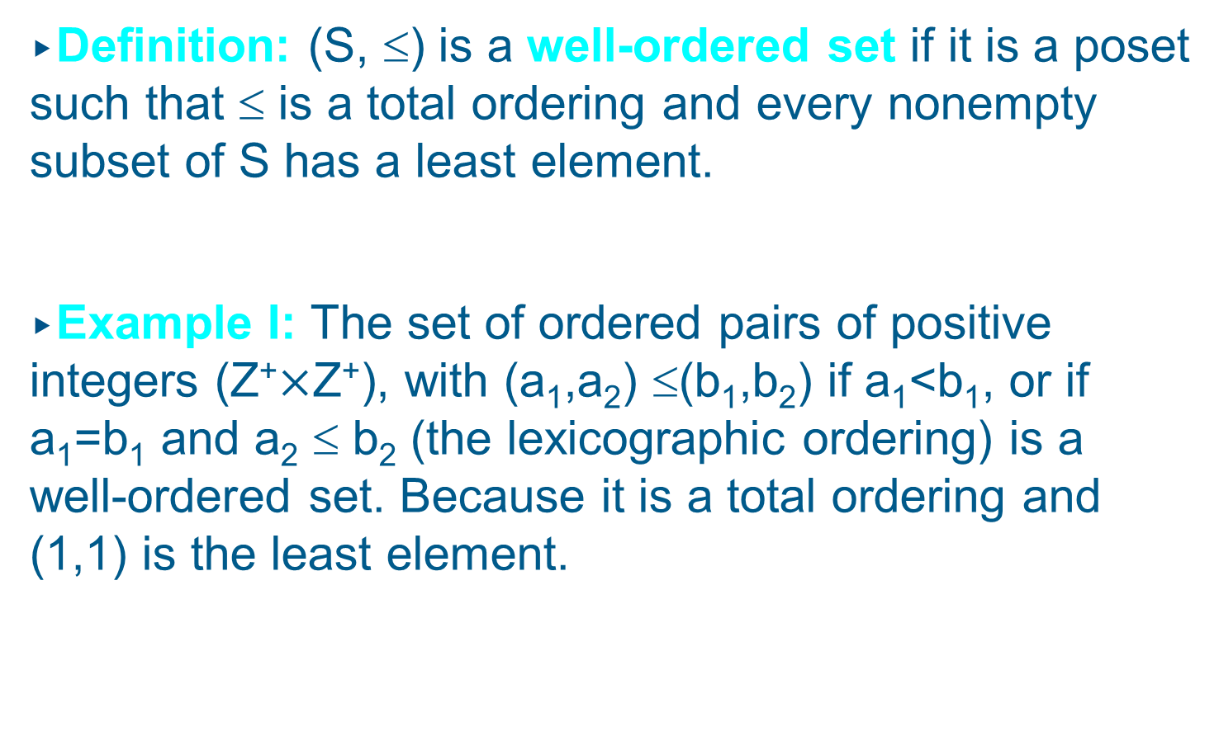
Partial Orderings
Definition: (S, ≤) is a well-ordered set if it is a poset such that ≤ is a total ordering and every nonempty subset of S has a least element.
Example I: The set of ordered pairs of positive integers (Z⁺$×$Z⁺), with (a₁,a₂) ≤(b₁,b₂) if a₁<b₁, or if a₁=b₁ and a₂ ≤ b₂ (the lexicographic ordering) is a well-ordered set. Because it is a total ordering and (1,1) is the least element.

Slide 34
Partial Orderings
The Principle of Well-ordered Induction:
Suppose that S is a well-ordered set. Then P(x) is true for all x ∈ S, if
  Inductive step: For every y ∈ S, if P(x) is true for all x ∈ S with x < y, then P(y) is true.
Proof: Suppose it is not the case that P(x) is true for all x ∈ S. Then there is an element y ∈ S such that P(y) is false. Consequently, the set A = {x ∈ S ∣ P(x) is false} is nonempty.

Slide 35
Partial Orderings
Because S is well-ordered, A has a least element a. By the choice of a as a least element of A, we know that P(x) is true for all x ∈ S with x < a. This implies by the inductive step P(a) is true. This contradiction shows that P(x) must be true for all x ∈ S.

Slide 36
Let us switch to a new topic:
Graphs

Slide 37
Introduction to Graphs
Definition: A simple graph G = (V, E) consists of V, a nonempty set of vertices (or nodes), and E, a set of unordered pairs of distinct elements of V called edges. Each edge has either one or two vertices associated with it, called its endpoints. An edge is said to connect its endpoints.
A simple graph is just like a directed graph, but with no specified direction of its edges.
Sometimes we want to model multiple connections between vertices, which is impossible using simple graphs.
In these cases, we have to use multigraphs.

Slide 38
Introduction to Graphs
Definition: A multigraph G = (V, E) consists of a set V of vertices, a set E of edges, and a function
f from E to {{u, v} | u, v ∈ V, u ≠ v}.
The edges e₁ and e₂ are called multiple or parallel edges if f(e₁) = f(e₂).
Note:
Edges in multigraphs are not necessarily defined
as pairs, but can be of any type.
No loops are allowed in multigraphs (u ≠ v).

Slide 39
Introduction to Graphs
Example: A multigraph G with vertices V =
{a, b, c, d}, edges {1, 2, 3, 4, 5} and function f with
f(1) = {a, b}, f(2) = {a, b}, f(3) = {b, c}, f(4) = {c, d} and f(5) = {c, d}:
1
4
a
b
3
c
d
2
5

Slide 40
Introduction to Graphs
If we want to define loops, we need the following
type of graph:
Definition: A pseudograph G = (V, E) consists of a set V of vertices, a set E of edges, and a function
f from E to {{u, v} | u, v ∈ V}.
An edge e is a loop if f(e) = {u, u} for some u∈V.

Slide 41
Introduction to Graphs
Here is a type of graph that we already know:
Definition: A directed graph G = (V, E) consists of a set V of vertices and a set E of edges that are ordered pairs of elements in V.
… leading to a new type of graph:
Definition: A directed multigraph G = (V, E) consists of a set V of vertices, a set E of edges, and a function f from E to {(u, v) | u, v ∈ V}.
The edges e₁ and e₂ are called multiple edges if f(e₁) = f(e₂).

Slide 42
Introduction to Graphs
Example: A directed multigraph G with vertices V = {a, b, c, d}, edges {1, 2, 3, 4, 5} and function f with f(1) = (a, b), f(2) = (b, a), f(3) = (c, b),
f(4) = (c, d) and f(5) = (c, d):
1
4
a
b
3
c
d
2
5

Slide 43
Introduction to Graphs
Types of Graphs and Their Properties
Type
Edges
Multiple Edges?
Loops?
simple graph
undirected
no
no
multigraph
undirected
yes
no
pseudograph
undirected
yes
yes
simple dir. graph
directed
no
no
dir. multigraph
directed
yes
yes
mixed graph
dir and undir
yes
yes

Slide 44
Graph Models
Example I: How can we represent a network of (bi-directional) railways connecting a set of cities?
We should use a simple graph with an edge {a, b} indicating a direct train connection between cities a and b.
Toronto
Boston
Lübeck
New York
Hamburg
Washington

Slide 45
Graph Models
Example II: In a round-robin tournament, each team plays against each other team exactly once. How can we represent the results of the tournament (which team beats which other team)?
We should use a directed graph with an edge (a, b) indicating that team a beats team b.
Maple Leafs
Bruins
Penguins
Lübeck Giants

Slide 46
Graph Terminology
Definition: Two vertices u and v in an undirected graph G are called adjacent (or neighbors) in G if {u, v} is an edge in G.
If e = {u, v}, the edge e is called incident with the vertices u and v. The edge e is also said to connect u and v.
The vertices u and v are called endpoints of the edge {u, v}.

Slide 47
Graph Terminology
Definition: The set of all neighbors of a vertex v of G = (V, E), denoted by N(v), is called the neighborhood of v.
If A is a subset of V, we denote by N(A) the set of all vertices in G that are adjacent to at least one vertex in A. So, N(A) = ⋃v∈A N(v).

Slide 48
Graph Terminology
Definition: The degree of a vertex in an undirected graph is the number of edges incident with it, except that a loop at a vertex contributes twice to the degree of that vertex.
In other words, you can determine the degree of a vertex in a displayed graph by counting the lines that touch it.
The degree of the vertex v is denoted by deg(v).

Slide 49
Graph Terminology
A vertex of degree 0 is called isolated, since it is not adjacent to any vertex.
Note: A vertex with a loop at it has at least degree 2 and, by definition, is not isolated, even if it is not adjacent to any other vertex.
A vertex of degree 1 is called pendant. It is adjacent to exactly one other vertex.

Slide 50
Graph Terminology
Example: Which vertices in the following graph are isolated, which are pendant, and what is the maximum degree? What type of graph is it?
i
h
d
a
e
g
b
c
f
j
Solution: Vertex f is isolated, and vertices a, d and j are pendant. The maximum degree is deg(g) = 5.
This graph is a pseudograph (undirected, loops).

Slide 51
Graph Terminology
Let us look at the same graph again and determine the number of its edges and the sum of the degrees of all its vertices:
i
h
d
a
e
g
b
c
f
j
Result: There are 9 edges, and the sum of all degrees is 18. This is easy to explain: Each new edge increases the sum of degrees by exactly two.

Slide 52
Graph Terminology
The Handshaking Theorem: Let G = (V, E) be an undirected graph with e edges. Then
2e = ∑_{v∈V} deg(v)
Note: This theorem holds even if multiple edges and/or loops are present.
Example: How many edges are there in a graph with 10 vertices, each of degree 6?
Solution: The sum of the degrees of the vertices is 6⋅10 = 60. According to the Handshaking Theorem, it follows that 2e = 60, so there are 30 edges.

Slide 53
Graph Theorems
Theorem: An undirected graph has an even number of vertices of odd degree.
Idea: There are three possibilities for adding an edge to connect two vertices in the graph:
Before: After:
Both vertices have
even degree
Both vertices have
odd degree
Both vertices have
odd degree
Both vertices have
even degree
One vertex has odd degree, the other even
One vertex has even degree, the other odd

Slide 54
Graph Theorems
There are two possibilities for adding a loop to a vertex in the graph:
Before: After:
The vertex has
even degree
The vertex has
even degree
The vertex has
odd degree
The vertex has
odd degree

Slide 55
Graph Terminology
So if there is an even number of vertices of odd degree in the graph, it will still be even after adding an edge.
Therefore, since an undirected graph with no edges has an even number of vertices with odd degree (zero), the same must be true for any undirected graph.

Slide 56
Graph Terminology
Definition: When (u, v) is an edge of the graph G with directed edges, u is said to be adjacent to v, and v is said to be adjacent from u.
The vertex u is called the initial vertex of (u, v), and v is called the terminal vertex of (u, v).
The initial vertex and terminal vertex of a loop are the same.

Slide 57
Graph Terminology
Definition: In a graph with directed edges, the in-degree of a vertex v, denoted by deg⁻(v), is the number of edges with v as their terminal vertex.
The out-degree of v, denoted by deg⁺(v), is the number of edges with v as their initial vertex.
Question: How does adding a loop to a vertex change the in-degree and out-degree of that vertex?
Answer: It increases both the in-degree and the out-degree by one.

Slide 58
Graph Terminology
Example: What are the in-degrees and out-degrees of the vertices a, b, c, d in this graph:
deg⁻(a) = 1
deg⁺(a) = 2
deg⁻(b) = 4
deg⁺(b) = 2
a
b
deg⁻(d) = 2
deg⁺(d) = 1
deg⁻(c) = 0
deg⁺(c) = 2
d
c

Slide 59
Graph Terminology
Theorem: Let G = (V, E) be a graph with directed edges. Then:
∑_{v∈V} deg⁻(v) = ∑_{v∈V} deg⁺(v) = |E|
This is easy to see, because every new edge increases both the sum of in-degrees and the sum of out-degrees by one.

Slide 60
Special Graphs
Definition: The complete graph on n vertices, denoted by K_{n}, is the simple graph that contains exactly one edge between each pair of distinct vertices.
K₁
K₂
K₃
K₄
K₅

Slide 61
Special Graphs
Definition: The cycle C_{n}, n ≥ 3, consists of n vertices v₁, v₂, …, v_{n} and edges {v₁, v₂}, {v₂, v₃}, …, {v_{n-1}, v_{n}}, {v_{n}, v₁}.
C₃
C₄
C₅
C₆

Slide 62
Special Graphs
Definition: We obtain the wheel W_{n} when we add an additional vertex to the cycle C_{n}, for n ≥ 3, and connect this new vertex to each of the n vertices in C_{n} by adding new edges.
W₃
W₄
W₅
W₆

Slide 63
Special Graphs
Definition: The n-cube, denoted by Q_{n}, is the graph that has vertices representing the 2^{n} bit strings of length n. Two vertices are adjacent if and only if the bit strings that they represent differ in exactly one bit position.
011
111
01
11
010
110
001
101
0
1
00
10
000
100
Q₁
Q₂
Q₃

Slide 64
Special Graphs
Definition: A simple graph is called bipartite if its vertex set V can be partitioned into two disjoint nonempty sets V₁ and V₂ such that every edge in the graph connects a vertex in V₁ with a vertex in V₂ (so that no edge in G connects either two vertices in V₁ or two vertices in V₂).
When this condition holds, we call the pair (V1, V2) a bipartition of the vertex set V of G.

Slide 65
Special Graphs
For example, consider a graph that represents each person in a mixed-doubles tennis tournament (i.e., teams consist of one female and one male player).
Players of the same team are connected by edges.
This graph is bipartite, because each edge connects a vertex in the subset of males with a vertex in the subset of females.

Slide 66
Special Graphs
Example I: Is C₃ bipartite?
v₁
No, because there is no way to partition the vertices into two sets so that there are no edges with both endpoints in the same set.
v₂
v₃
Example II: Is C₆ bipartite?
v₁
v₁
v₆
v₆
Yes, because we can display C₆ like this:
v₂
v₅
v₂
v₅
v₃
v₄
v₃
v₄

Slide 67
Special Graphs
Definition: The complete bipartite graph K_{m,n} is the graph that has its vertex set partitioned into two subsets of m and n vertices, respectively. Two vertices are connected if and only if they are in different subsets.
K_{3,2}
K_{3,4}

Slide 68
Operations on Graphs
Definition: A subgraph of a graph G = (V, E) is a graph H = (W, F) where W⊆V and F⊆E.
A subgraph H of G is a proper subgraph of G if H≠G.
Note: Of course, H is a valid graph, so we cannot remove any endpoints of remaining edges when creating H.
Example:
K₅
subgraph of K₅

Slide 69
Operations on Graphs
Definition: The subgraph induced by a subset W of the vertex set V is the graph (W,F), where the edge set F contains an edge in E if and only if both endpoints of this edge are in W.
Example:
a
a
e
b
e
b
c
d
c
Subgraph induced by W={a,b,c,e} of K₅
K₅

Slide 70

Operations on Graphs
Definition: The union of two simple graphs G₁ =
(V₁, E₁) and G₂ = (V₂, E₂) is the simple graph with vertex set V₁ ∪ V₂ and edge set E₁ ∪ E₂.
The union of G₁ and G₂ is denoted by G₁ ∪ G₂.
G₁
G₂
G₁ $∪$ G₂ = K₅

