Slide 1
Midterm review

Slide 2
Lec1-3 Application
Search Engine
1. Create index; 2. Query index; 3. Ranking
Multimedia
1. Understand the multimedia; 2. Multimedia annotation/retrieval
Social Network
1. Directed/undirected graph; 2. in/out degree

Slide 3
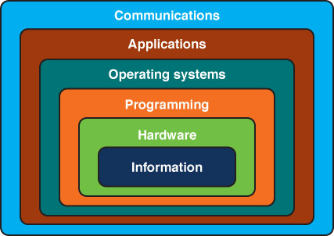
Lec4 Information layer I
Review of Computing System Layers
Numbers
Positional Notation
Conversion among different bases
Binary and Computers

Slide 4
Lec5 Information layer II
Analog vs. Digital
Data Compression
Text
Audio
Image and Graphic

Slide 5
Lec6 Hardware I
Gates
Types
Construction
Circuits
Adder
Multiplexer
Memory
IC

Slide 6
Lec7 Hardware II
Moore's Law
Von Neumann Computer
Input devices
Output devices
RAM, ROM, Hard rive, Processor, Cache

Slide 7
Lec8 Operating System
Operating Systems
Timelines
Statistics
Roles
Resource Management
CPU Scheduling
File System

