Slide 1
CS105 Introduction to Computer Concepts HTML
Instructor: Yang Mu

Slide 2
A browser retrieving a Web page

Slide 3
Static vs. Dynamic web page
A static web page is a web page that is delivered to the user exactly as stored.
Dynamic web pages are generated by a web application.

Slide 4
HTML
Provides a simple notation for describing nearly all of the features we would want to incorporate into design of our page.
Hyper-Text Markup Language
- Hyper : Links
- Text
- Markup : Tags to describe the page we are
designing.
- Language : It is a computer language with its
syntax and semantics.

Slide 5
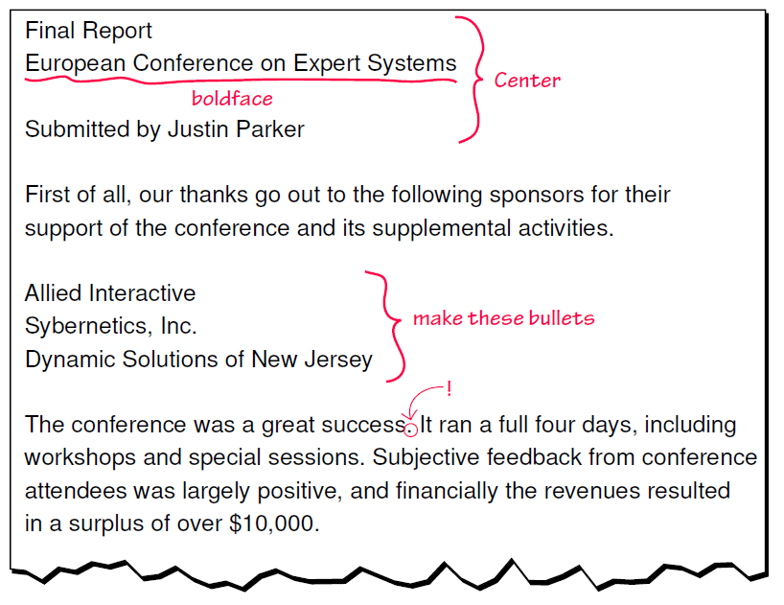
A marked-up document

Slide 6
What is an HTML file
An HTML file is a text file containing small markup tags.
The markup tags tell the web browser how to display the page.
These tags are called Elements.
An HTML file must have an htm or html file extension.
An HTML file can be created using a simple text editor

Slide 7
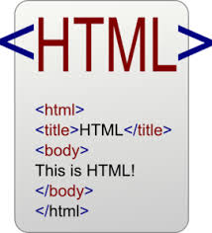
HTML Elements
HTML Tags
Tags are used to mark-up HTML elements.
Tags are surrounded by “<“ and “>” (angle brackets).
Tags normally come in pairs like <html> and </html>
Start and end tags mark off regions of the text file to indicate some processing that is to be applied to that section of text. This region is called the content of the element.
There are elements like <BR>, which do not mark blocks of text and thus do not require and end tag.
Tags are not case sensitive, <b> is the same as <B>

Slide 8
HTML Elements
Tag Attributes
Tags can have attributes to provide additional information about the HTML elements on your page.
<BODY BGCOLOR=“Red”> … </BODY> will show a red background.
Attributes are always added to the start tag of an HTML element.

Slide 9
HTML Elements
Headings
Headings are defined with the <H1> to <H6> tags. <H1> defines the largest heading. <H6> defines the smallest heading.
Paragraphs
Paragraphs are defined with the <P> tag.
Line Breaks
<BR> tag is used when you want to end a line, but you don’t want to start a new paragraph.
Horizontal Rule: <HR>
Comments in HTML
<!-- This is a comment --> is a comment and it will be ignored by the browser (Notes for programmers).

Slide 10
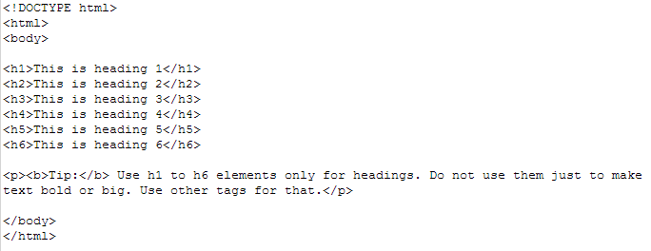
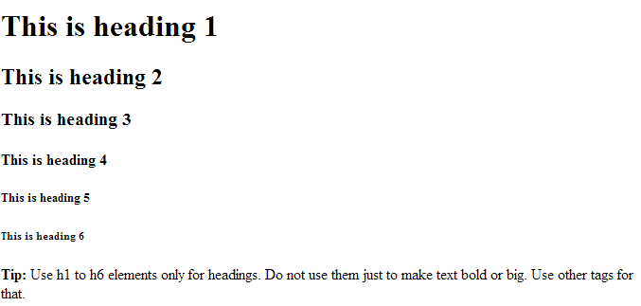
Example

Slide 11
Page Structure
HTML elements control the details of how a page gets displayed.
Every HTML document has the following basic structure:
<HTML>
<HEAD>
…
</HEAD>
<BODY>
…
</BODY>
</HTML>

Slide 12
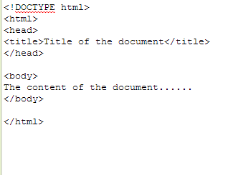
Page Structure
The HTML element surrounds the entire page description and identifies it to the browser as an HTML document.
The HEAD element contains relatively few elements that provide the browser information about the document.
The BODY element contains all of the text to be displayed and elements that control its display on the page.

Slide 13
Try HTML
Open Notepad++/Notepad or Wordpad.
Type:
Save the
<html>
<head>
<title>Title of Page</title>
</head>
<body>
This is my first homepage. <b>This text is bold</b>
</body>
</html>
file as “mypage.html”
Close the Notepad and find the file from local drive, you can see this file has the webpage icon, double click the file and see it through Internet Explorer.

Slide 14
HTML Links
HTML uses a hyperlink to link to another document on the web.
HTML uses the <a>(anchor) tag to create a link to another document
An anchor can point to any resource on the Web: an HTML page, an image, a sound file, a movie, etc.
The href attribute is used to address the document to link to
Ex: <a href=“www.cs.umb.edu”> CS Dept.</a>

Slide 15
HTML Links
The name attribute is used to create a named anchor. When using named anchors we can create links that can jump directly into a specific section on a page, instead of letting the user scroll around to find that section.
Ex. <a name=“Tips”> Tips to display</a>
And we can have a link to jump to Tips section:
<a href=“#Tips”>Go to Tips </a>.

Slide 16
HTML Images
An image element doesn’t contain anything and has no close tag.
<IMG
SRC = “ Some URL” (Required) Where the image is.
ALIGN = LEFT, RIGHT,
or CENTER How to align it on the page.
WIDTH = n Scale the image to n pixels wide.
HEIGHT = n Scale the image to n pixels high.
HSPACE = n Total space around the image horizontally.
VSPACE = n Total space around the image vertically.
ALT = “some text”> What shows up if the image doesn’t appear.

Slide 17
HTML Images
The IMG element is an element that uses its attributes to identify an image to be inserted into the page and to describe how the image is to be presented.
Images are identified using the required SRC attribute, the value of which is a URL.
Images don’t really live in the pages they appear in, but they are treated as implicit hyperlinks to the specified file.
The image may be aligned relative to the text it appears next to using the ALIGN attribute.
The size of the image can be controlled using the WIDTH and HEIGHT attributes.
The HSPACE and VSPACE attributes indicate the total number of pixels of space that will surround the image.
The ALT attribute should be used to provide a text substitute for non-graphical browsers and also for use while the image is loading.

Slide 18
HTML Tables
In HTML, tables are defined with the <TABLE> tag.
A table is divided into rows (with the <TR> tag, and each row is divided into data cells (with the <TD> tag). The letters TD stands for “table data” which is the content of a data cell.
A data cell can contain text, images, lists, paragraphs, forms, horizontal rules, tables, etc.

Slide 19
Tables and Border
If you do not specify a border attribute, the table will be displayed without any borders
To display the table with borders, you will have to use the border attribute
Ex. <table border=“1”>

Slide 20
Table and Heading
Headings in a table is defined with <th> tag.
Ex. <th>Column 1</th>

Slide 21
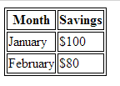
Example

Slide 22
HTML Tables
<TABLE
BORDER = n Width of the table border.
CELLSPACING = n Space between cells.
CELLPADDING = n Blank space within cells.
WIDTH = n or n% Width of the table in pixels
or as a portion of the page.
A table can only contain TR elements.
</TABLE>

Slide 23
HTML Tables
<TR
ALIGN = “LEFT”, “RIGHT”,
or “CENTER” Alignment of contents of data in cells.
VALIGN = “TOP”, “BOTTOM”,
or “MIDDLE”> Vertical alignment in cells.
A table row can only contain TD or TH elements.
</TR>

Slide 24
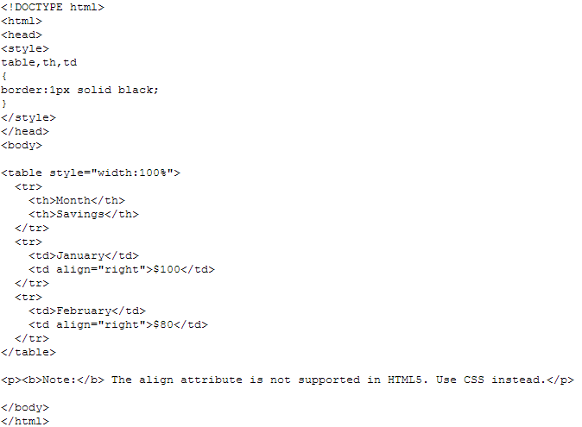
Example

Slide 25
HTML Tables
<TH
ALIGN = “LEFT”, “RIGHT”
or “CENTER” Alignment of contents in this cell.
VALIGN = “TOP”, “BOTTOM”
or “MIDDLE” Vertical alignment in this cell.
COLSPAN = n Width, in columns of this cell.
ROWSPAN = n> Height, in rows, of this cell.
A table header can contain text, images, links, lists, and tables.
</TH>

Slide 26
HTML Tables
<TD
ALIGN = “LEFT”, “RIGHT”
or “CENTER” Alignment of contents in this cell.
VALIGN = “TOP”, “BOTTOM”
or “MIDDLE” Vertical alignment in this cell.
COLSPAN = n Width, in columns, of this cell.
ROWSPAN = n> Height, in rows, of this cell.
A table data cell can contain text, images, links lists and tables.
</TD>

Slide 27
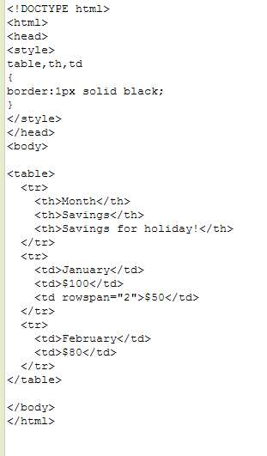
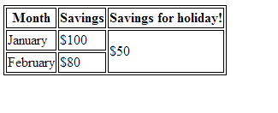
Example

Slide 28
HTML Lists
Unordered lists: a list of items marked with bullets
<ul>
<li> Dogs </li>
<li> Cats </li>
</ul>
Ordered lists: a list of items marked with numbers
<ol>
<li> Fish </li>
<li> Duck </li>
<ol>

Slide 29
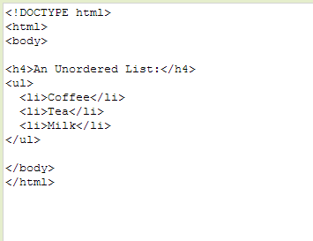
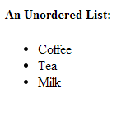
Example

Slide 30
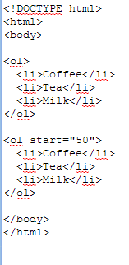
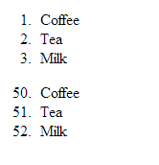

Slide 31
HTML Lists
A definition list is a list of terms and explanation of the terms.
<DL>
<DT>Coffee </DT>
<DD>Black hot drink </DD>
<DT> Milk </DT>
<DD> White cold drink </DD>
</DL>

Slide 32
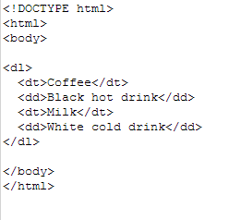
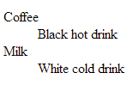
Example

Slide 33
HTML Lists
<OL
TYPE = “A”, “a”, “I”,
“i”, or “1” Type of label for items
START = n> Starting value for labels
<LI> …
<LI> …
</OL>
An ordered list can only contain LI elements.

Slide 34
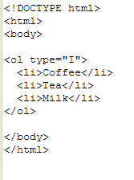
Example

Slide 35
HTML Lists
<UL
TYPE = “DISC”, “CIRCLE”
or “SQUARE”> Type of label for items.
<LI> …
<LI> …
</UL>
An unordered list can only contain LI elements.

Slide 36
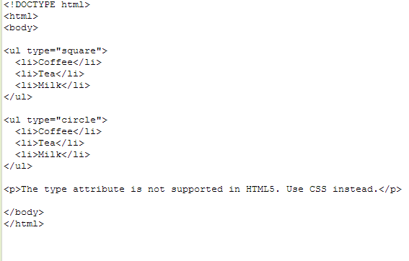
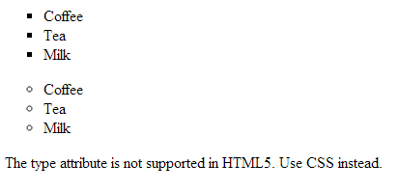
Example

Slide 37
HTML Lists
<LI
TYPE = “DISC”, “CIRCLE”,
or “SQUARE”
(In UL) Type of label for this and later items.
TYPE = “A”, “a”, “I”, “i”, or “1”
(In OL) Type of label for this and later items.
VALUE = n> (In OL) Label value.
A list item can contain text, lists, images, tables and links.
A list item doesn’t require a close tag, though it’s not a bad idea to put one in anyway.

Slide 38
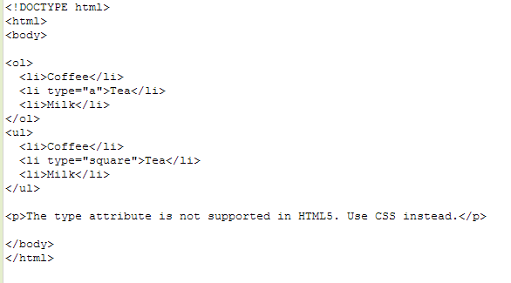
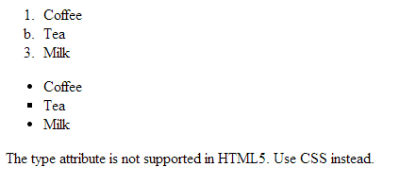
Example

Slide 39
HTML Frames
With frames, you can display more than one HTML document in the same browser window. Each HTML document is called a frame, and each frame is independent of the others
The Frameset tag
<frameset cols=“25%, 75%”>
<frame src=“frame_a.html”>
<frame src=“frame_b.html”>
</frameset>
The example shows a frameset with two columns. The first column is set to 25% of the width of the browser window, and the second is set to 75% width of the browser window.

Slide 40
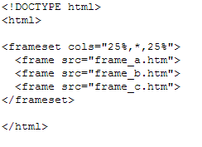
Example

Slide 41
HTML Frames
<FRAMESET
ROWS = n, n, … or n%, n%,… Height of the frames in
pixels or as a portion of the page.
COLS = n, n, … or n%, n%, … Width of the frames in
pixels or as a portion of the page.
BORDER = n Space, in pixels, between frames
BORDERCOLOR = “color”
Color of the border between frames.
FRAMEBORDER = “yes” or “no” >
</FRAMESET>

Slide 42
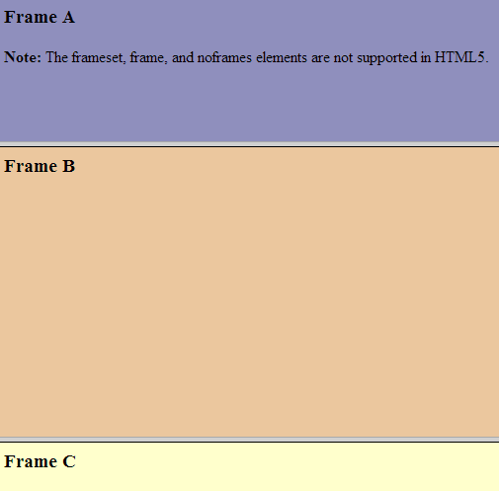
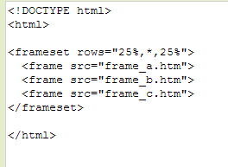
Example

Slide 43
HTML Frames
<FRAME
SRC = “some url” (Required) URL of the HTML
document that will appear in this frame.
MARGINWIDTH = n Blank pixels to be used to left
and right of this frame’s contents.
MARGINHEIGHT = n Blank pixels to be used to top
and bottom of this frame’s contents.
SCROLLING = “yes”, “no” or “auto”
NORESIZE
BORDERCOLOR = “color”
FRAMEBORDER = “yes” or “no”
</FRAME>

Slide 44
HTML Background
The <Body> tag has two attributes where you can specify backgrounds. The background can be a color or an image.
The BGCOLOR attribute sets the background to a color. The value of this attribute can be a hexadecimal number, an RGB value, or one of the 16 predefined color names.
<body bgcolor=“#000000”>
<body bgcolor=“rgb(0, 0, 0)”
<body bgcolor=“black”>
#00 00 00 three two digits hexadecimal numbers (base 16) ranging from 0 to 255 (00 to FF).
The first number specifies the intensity of red, second green and third blue.
Example: #000000 #FFFFFF #800080 (violet)

Slide 45
HTML Background
The background attribute sets the background to an image.
<body background=“yourimage.gif”>
<body background=“http://website.com/image.gif”>

Slide 46
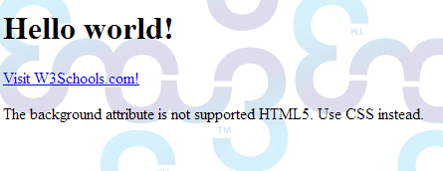
Example

Slide 47
Reference
http://www.w3schools.com/html/

