Slide 1
Project
Team: at most 3 members
Presentation: 10-20 minutes/team
REQUIREMENTS: All class members MUST attend the presentations, otherwise (-5%) of total grade!

Slide 2
Presentation slides
Design a website and use a presentation slides to show:
  1. what is the function of this website?
  2. why you want to design this website?
  3. what are the targeting users?
  4. what are the specialties of your website?
  5. etc.

Slide 3
Presentation slides
Implement sample webpages:
  At least one static webpage of your choice (use HTML+ CSS)
  At least one dynamic webpage of your choice (use JavaScript)

Slide 4
Evaluation
The evaluation will be based on the following criteria
Slides Design
Presentation Skills
Webpage Design
Send me email about your team members information no later than April 28.

Slide 5
Grading
Class attendance (10%)
Homework (20%)
Exam (50%)
Project and Presentation (20%)

Slide 6
CS105 Introduction to
Computer Concepts
Cascading Style Sheets (CSS)
Instructor: Yang Mu

Slide 7
Outline
What is CSS?
Why we need CSS?
How to use CSS?

Slide 8
Definition
Cascading Style Sheets (CSS) form the presentation layer of the user interface.
  Structure (XHTML)
  Behavior (Client-Side Scripting)
  Presentation (CSS)
Tells the browser agent how the element is to be presented to the user.

Slide 9
Why CSS?
CSS removes the presentation attributes from the structure allowing reusability, ease of maintainability, and an interchangeable presentation layer.
HTML was never meant to be a presentation language. Proprietary vendors have created tags to add presentation to structure.
  <font>
  <b>
  <i>
CSS allows us to make global and instantaneous changes easily.

Slide 10
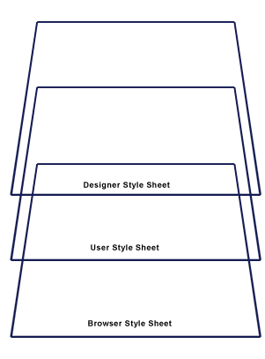
The Cascade
The power of CSS is found in the “cascade” which is the combination of the browser’s default styles, external style sheets, embedded, inline, and even user-defined styles.
The cascade sets priorities on the individual styles which effects inheritance.

Slide 11
CSS Inheritance
Allows elements to “inherit” styles from parent elements.
Helpful in reducing the amount of CSS to set styles for child elements.
Unless a more specific style is set on a child element, the element looks to the parent element for its styles.
Each style has a numeric specificity value that is given based on its selector.

Slide 12
Using Style Sheets
Inline Styles
  <p style=“font-size: 12px”>Inline Style Example</p>
Embedded Styles
  <style type=“text/css”>
  body {background-color:yellow;}
  p {color:blue;}
  </style>
External Style Sheet
  <link href=“stylesheet” type=“text/css” href=“location.css” />
  Preferred method.

Slide 13
CSS Syntax
selector/element {
property: value;
}
The selector can either be a grouping of elements, an indentifier, class, or single XHTML element (body, div, etc)

Slide 14
Type (Element) Selector
Specify the style(s) for a single XHTML element.
  body {
  margin: 0;
  padding: 0;
  border-top: 1px solid #ff0;
  }

Slide 15
Grouping Elements
Allows you to specify a single style for multiple elements at one time.
  h1, h2, h3, h4, h5, h6 {
  font-family: “Trebuchet MS”, sans-serif;
  }

Slide 16
The Class Selector
  <p class=“intro”>This is my introduction text</p>
  .intro {
  font: 12px verdana, sans-serif;
  margin: 10px;
  }

Slide 17
The Identifier Selector
  <p id=“intro”> This is my introduction text</p>
  #intro {
  border-bottom: 2px dashed #fff;
  }

Slide 18
CSS Selectors
Identifier or class? What’s the difference?
  An identifier is specified only once on a page and has a higher inheritance specificity than a class.
  A class is reusable as many times as needed in a page.
  Use identifiers for main sections and sub-sections of your document.

Slide 19
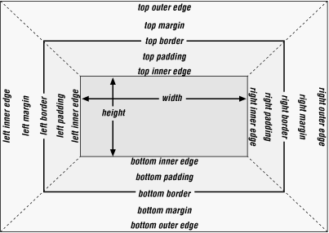
The Box Model
Every element in the DOM (Document Object Model) has a conceptual “box” for presentation.
The box consists of margin, padding, border, content (width, height), and offset (top, left)

Slide 20
CSS and Semantic Web
CSS aids in increasing the semantic value of the web content.
Increasing the semantic value of content aids in accessibility, and it is integral in the move away from (X)HTML to XML driven applications.
An example would be using an unordered list for navigation instead of a table.
  Navigation is truly a “list” of information and not tabular data.

Slide 21
CSS Browser Acceptance
The advent of modern browsers (IE 5.5+, Firefox 1.5+, Safari 2+, Opera) has eliminated the fear of effectively utilizing CSS.
There remain certain selectors and attributes that vary in browser acceptance, but IE7, FF 2, Safari 3 all accept the CSS 2.1 specification.
There no longer remains any excuse not to utilize CSS in your application.

Slide 22
CSS Fonts
Font-family
Font-weight
Font-style
Font-size

Slide 23
CSS Units & Colors
Units
  %
  in
  cm
  mm
  em
  px
  pt
Colors
  color name (red, etc)
  rgb(x,x,x)
  #rrggbb (HEX)

Slide 24
CSS Layout
Margin
Padding
Border
Z-index
Positioning
Width
Height
Float
Text-align
Vertical-align

Slide 25
CSS vs Table Layouts
Tables are designed only for tabular data and not for layout.
  Reduces semantic value of markup
  Makes updating difficult and impractical
CSS allows positioning that reduces overall markup size, form, and allows layout to be changed by only editing a stylesheet.
CSS layouts also improve accessibility, because screen readers turn off style sheets allowing only the content to remain.

Slide 26
CSS Text
Text-indent
Text-align
Text-decoration
Letter-spacing
Text-transform
Word-spacing
White-space

Slide 27
CSS Background
Background-color
Background-image
Background-position
Background-repeat

Slide 28
CSS Lists
List-style
List-style-image
List-style-position
List-style-type

Slide 29
CSS Shorthand
Consolidates many styles into a single declaration.
  font-family: verdana, sans-serif;
  font-weight: bold;
  font-size: 12px;
  → font: bold 12px verdana, sans-serif;
  padding-top: 5px;
  padding-right: 8px;
  padding-bottom: 5px;
  padding-left: 10px;
  → padding: 5px 8px 5px 10px;

Slide 30
CSS and Accessibility
Section 508 Standards
  “Web pages shall be designed so that all information conveyed with color is also available without color, for example from context or markup.” (1194.22C)
  “A text-only page, with equivalent information or functionality, shall be provided to make a web site comply with the provisions of this part, when compliance cannot be accomplished in any other way. The content of the text-only page shall be updated whenever the primary page changes.” (1194.22K)
By moving all presentation into style sheets and removing tables from layout the content is presented in an optimal manner to screen readers and other accessibility tools.
CSS 2.1 has “aural” properties that can be applied to content.

Slide 31
Recommendations
Remove antiquated browser checks and deliver different sheets.
Consolidate all our main styles into site.css in the App_Themes folder.
All CSS files should be in the App_Themes folder and have a .css extension (not .txt).
Make a decision on what standard colors, fonts, alignment, etc should go into the app.
Remove spacer.gifs, table layouts, and other browser hacks in lieu of proper CSS.
Make a decision on how individual modules should implement their styles.
Make a decision on how the CSS file is to be structured.
Move inline presentation formatting to CSS external sheets.

Slide 32
Resources
http://www.csszengarden.com
  This is CSS at its finest
http://www.w3.org/Style/CSS/
  The Official CSS Site
http://css.maxdesign.com.au/
  Australian firm, very professional
http://webmonkey.wired.com/webmonkey/reference/stylesheet_guide
  Where you can CSS and Web Design

