Slide 1
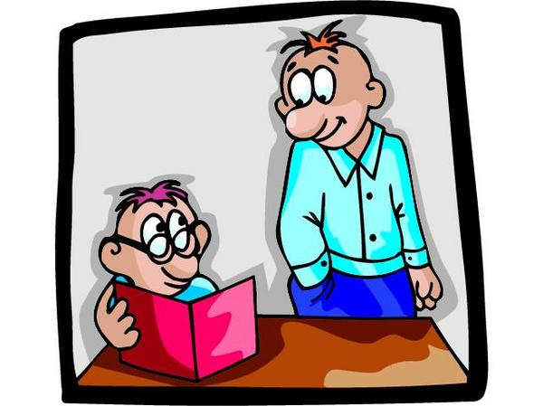
Cs105 Multimedia Information Systems
Instructor: Yang Mu
UMass Boston
Slides are from Dr. Dacheng Tao

Slide 2
Introduction to Multimedia Information Systems
Outline
Example multimedia systems
Central problems
Concepts
Important techniques
Media file types
color tutorial

Slide 3





Example multimedia systems

Slide 4

Central problems

Slide 5
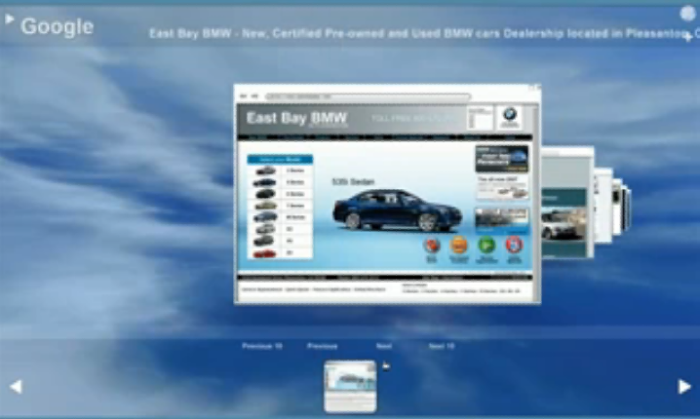
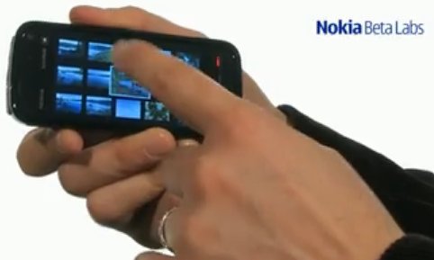
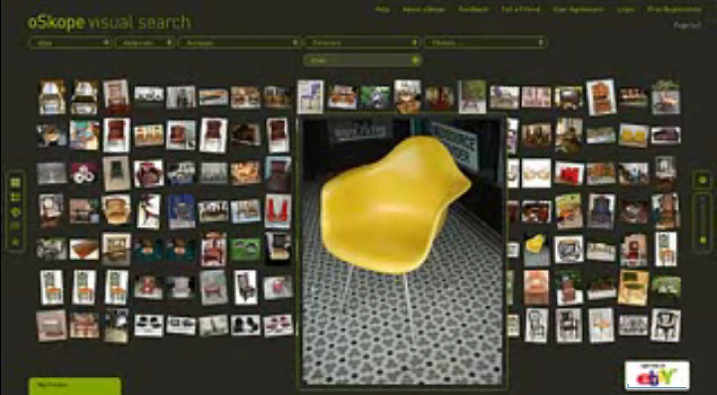
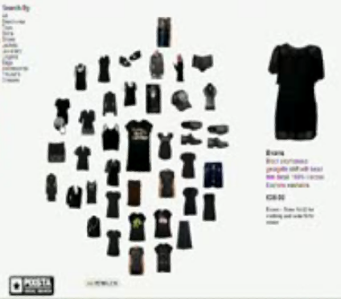
Central problems 1
Organize a large number of media files, e.g., image, music, video, and document.
Browse a collection of files.

Slide 6
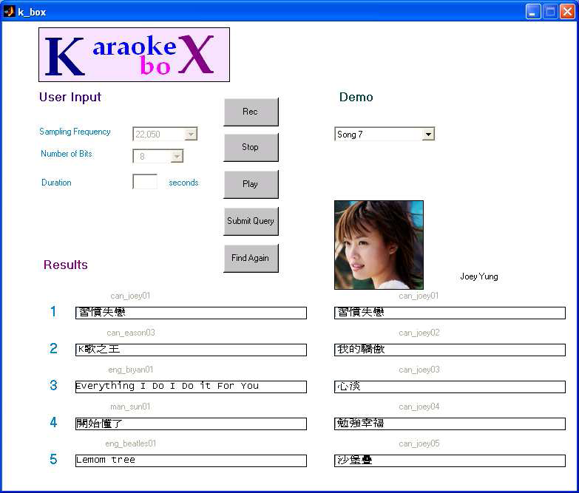
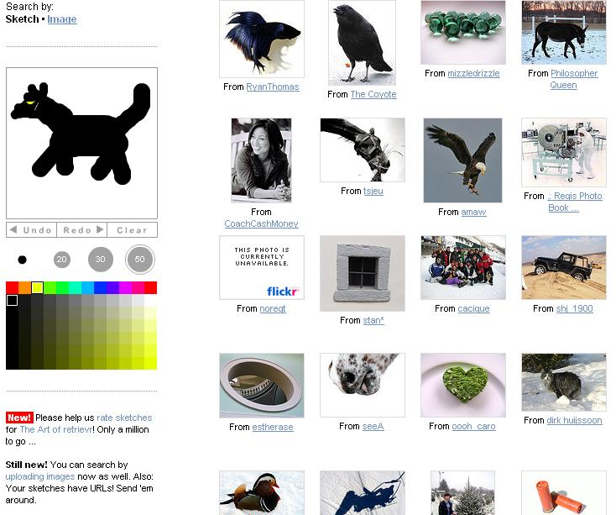

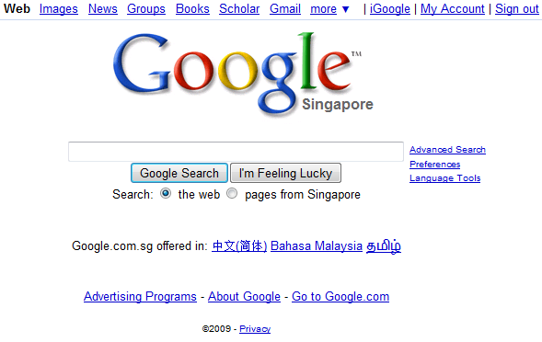

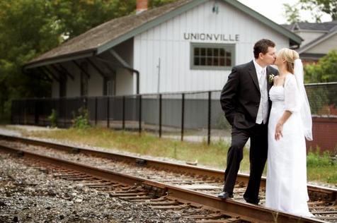
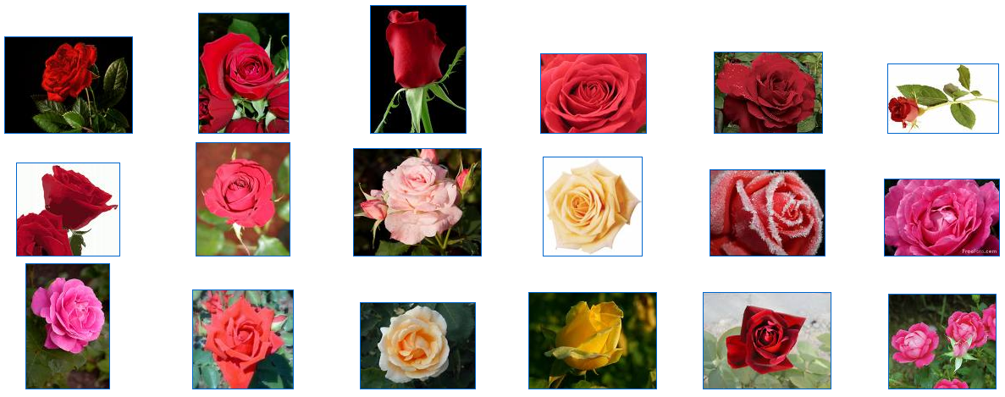

Central problems 2
Retrieve specific media files
  Text descriptions
  Example image/s
  Sketch
  Singing/humming
Notes:
Query by text, query by example, etc.

Slide 7
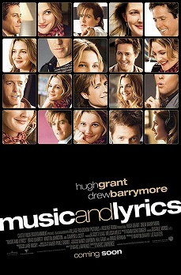
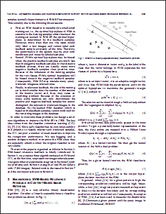
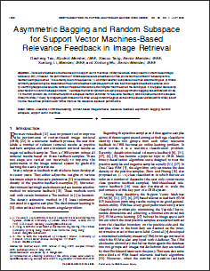
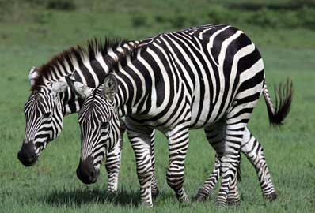
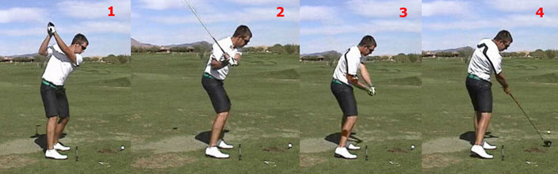
Central problems 3
Abstract: Relevance feedback schemes based on support vector machines (SVM) have been widely used in content-based image retrieval (CBIR). However, the performance of SVM-based relevance feedback is often poor when the number of labeled positive feedback samples is small. This is mainly due to three reasons: 1) an SVM classifier is unstable on a small-sized training set, 2) SVM’s optimal hyperplane may be biased when the positive feedback samples are much less than the negative feedback samples, and 3) overfitting happens because the number of feature dimensions is much higher than the size of the training set.
Media annotation
  Document abstraction
  Image annotation
  Video annotation
  Music annotation
Google: Relevance feedback schemes based on support vector machines (SVM) have been widely used in content-based image retrieval (CBIR). However, the performance of ...

Slide 8
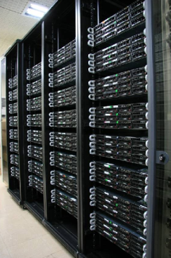
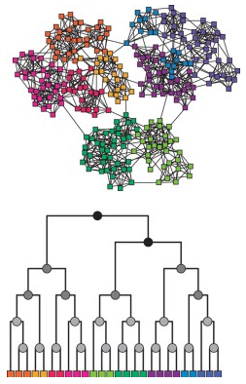
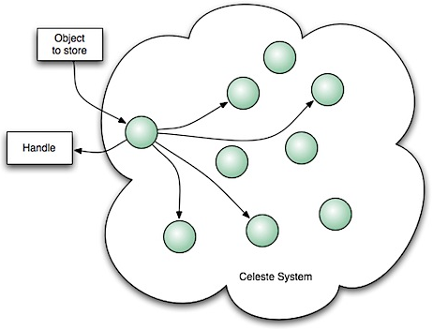
Central problems 4
Storage and indexing

Slide 9
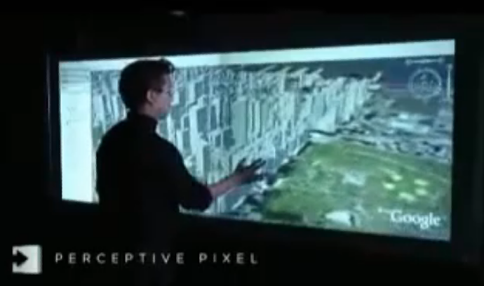
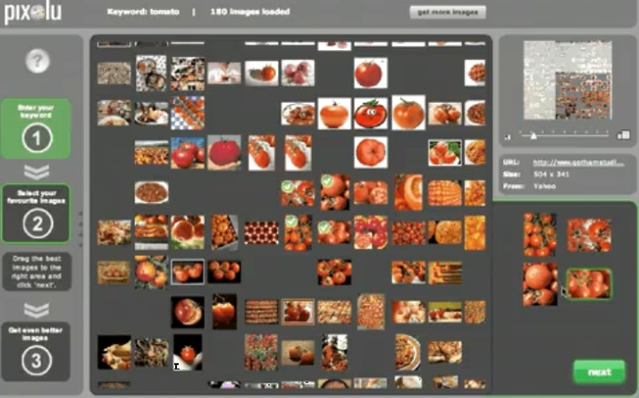
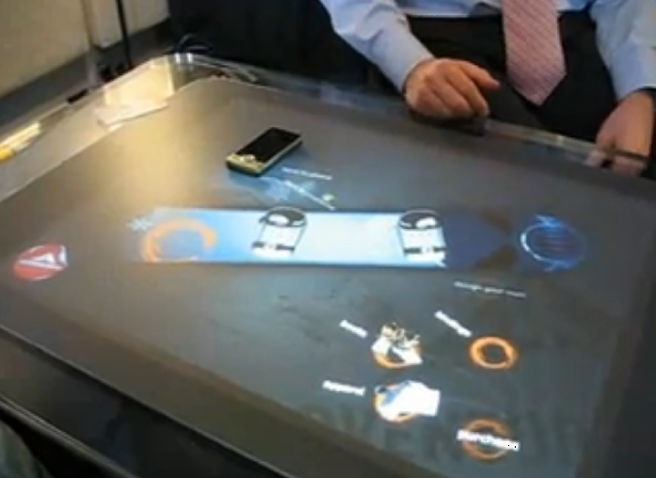
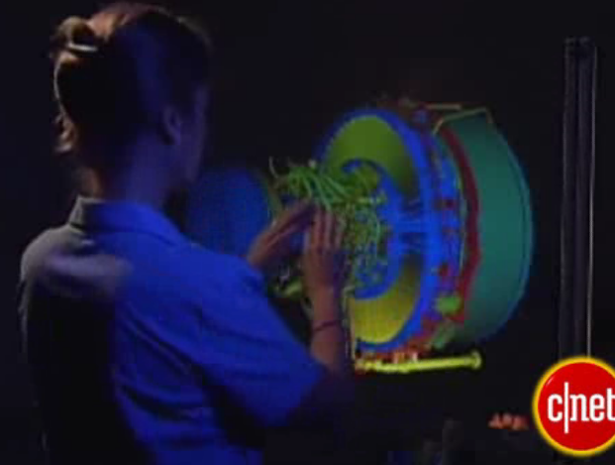
Central problems 5
Human computer interactions

Slide 10
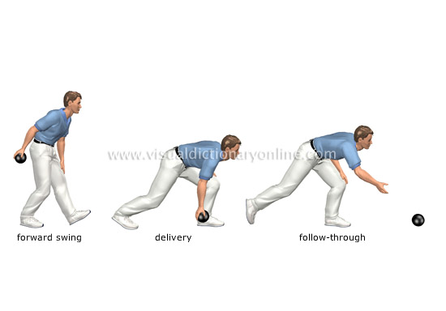
Important techniques

Slide 11
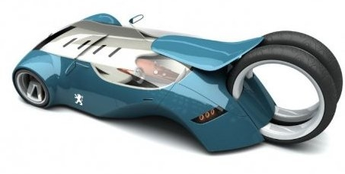
Concepts
Sample, example
Feature, trait, variable, character
Data set, database
Population
Training set, test set, validation set
Class, group, label
Model, model parameters

Slide 12
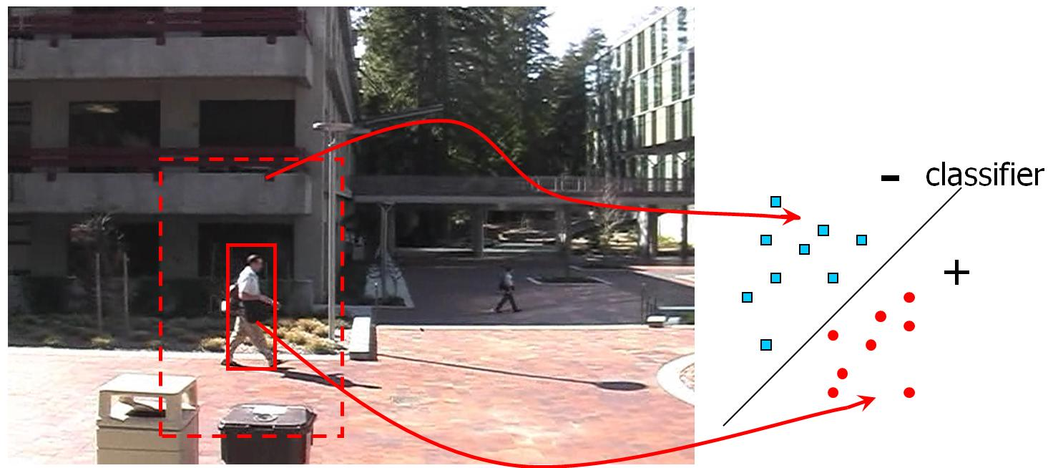
Important techniques 1
Classification (supervised learning)
Notes:
Statistical classification is a procedure in which individual items are placed into groups based on quantitative information on one or more characteristics inherent in the items (referred to as traits, variables, characters, etc) and based on a training set of previously labeled items.

Slide 13
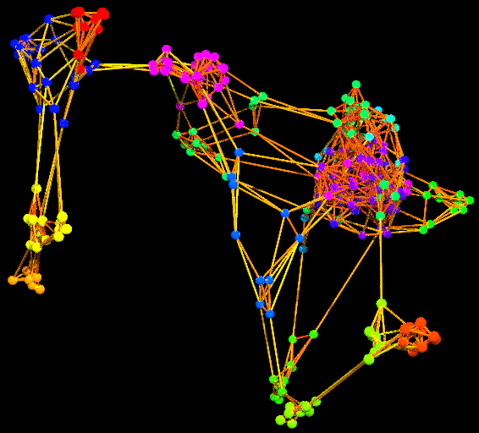
Important techniques 2
Clustering (unsupervised learning)
Notes:
Data clustering is a common technique for statistical data analysis, which is used in many fields, including machine learning, data mining, pattern recognition, image analysis and bioinformatics. Clustering is the classification of similar objects into different groups, or more precisely, the partitioning of a data set into subsets (clusters), so that the data in each subset (ideally) share some common trait - often proximity according to some defined distance measure.
Machine learning typically regards data clustering as a form of unsupervised learning.
Besides the term data clustering (or just clustering), there are a number of terms with similar meanings, including cluster analysis, automatic classification, numerical taxonomy, botryology and typological analysis.

Slide 14
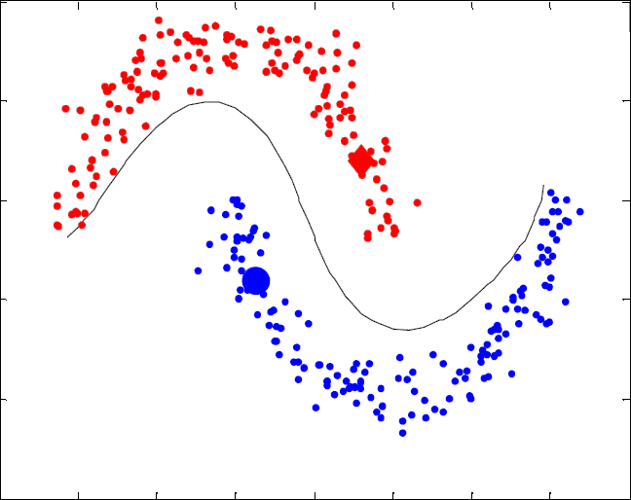
Important techniques 3
Semi-supervised learning
Notes:
In computer science, semi-supervised learning is a class of machine learning techniques that make use of both labeled and unlabeled data for training - typically a small amount of labeled data with a large amount of unlabeled data. Semi-supervised learning falls between unsupervised learning (without any labeled training data) and supervised learning (with completely labeled training data). Many machine-learning researchers have found that unlabeled data, when used in conjunction with a small amount of labeled data, can produce considerable improvement in learning accuracy. The acquisition of labeled data for a learning problem often requires a skilled human agent to manually classify training examples. The cost associated with the labeling process thus may render a fully labeled training set infeasible, whereas acquisition of unlabeled data is relatively inexpensive. In such situations, semi-supervised learning can be of great practical value.
One example of a semi-supervised learning technique is co-training, in which two or possibly more learners are each trained on a set of examples, but with each learner using a different, and ideally independent, set of features for each example.
An alternative approach is to model the joint probability distribution of the features and the labels. For the unlabelled data the labels can then be treated as 'missing data'. It is common to use the EM algorithm to maximize the likelihood of the model.

Slide 15
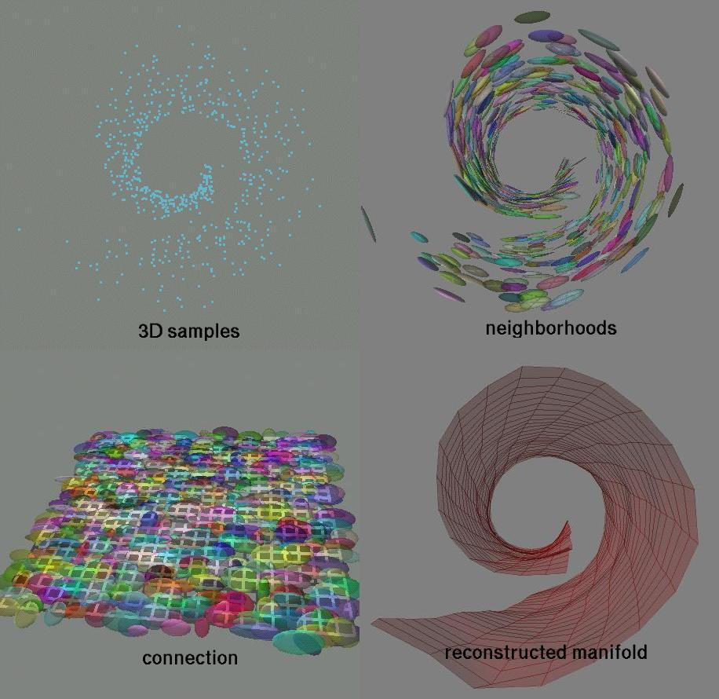
Important techniques 4
Dimension reduction (subspace learning)
Notes:
In statistics, dimension reduction is the process of reducing the number of random variables under consideration, and can be divided into feature selection and feature extraction. In physics, dimension reduction is a widely discussed phenomenon, whereby a physical system exists in three dimensions, but its properties behave like those of a lower-dimensional system.

Slide 16
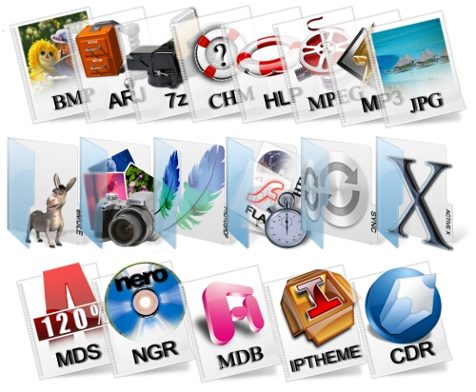
Media file types

Slide 17
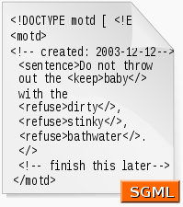
Document/text
Plain Text
  American Standard Code for Information Exchange (ASCII).
  Each ASCII code uses 8 bits to store each character.
Structured Text
  SGML, XML, HTML.
  Latex.
  Office Document Architecture (ODA).
Notes:
SGML: Standard Generalized Markup Language
XML is a subset of SGML. XML is used for general-purpose applications, such as the Semantic Web, XHTML, SVG, RSS, Atom, XML-RPC and SOAP.

Slide 18
Image
Images, often called pictures, are represented by bitmaps. A bitmap is a spatial two-dimensional matrix made up of individual picture elements (i.e., pixels).
Each pixel has a numerical value called amplitude. The number of bits available to code a pixel is called amplitude depth or pixel depth.
A pixel depth may represent:
  a black or white dot in bi-tonal images (1bit/pixel)
  a level of gray in continuous-tone, monochromatic images, (usually 8bits/pixel)
  the color attributes of the picture element in colored pictures. (usually 24bits/pixel)

Slide 19
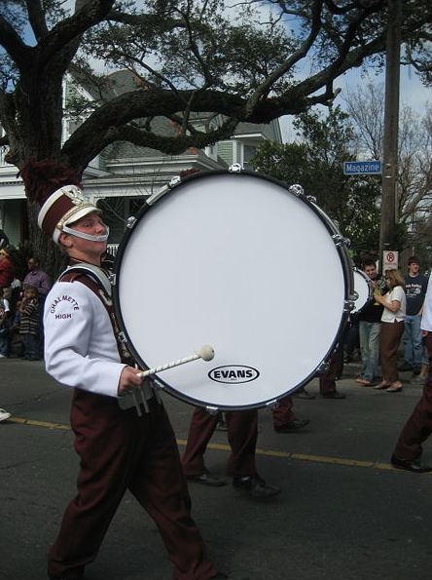
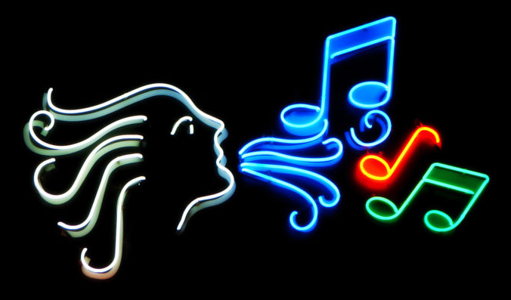
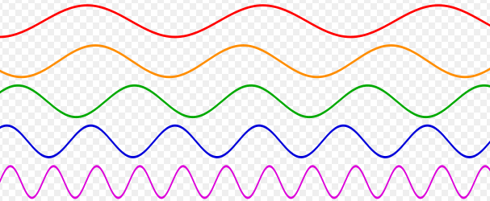
Audio + music
Audio is a travelling wave.
20 Hz and 20,000 Hz (20 kHz)
Music is an art form whose medium is sound.
Frequency (period) and amplitude
Notes:
Audio is a travelling wave which is an oscillation of pressure transmitted through a solid, liquid, or gas, composed of frequencies within the range of hearing and of a level sufficiently strong to be heard, or the sensation stimulated in organs of hearing by such vibrations.
For humans, hearing is normally limited to frequencies between about 12 Hz and 20,000 Hz (20 kHz), although these limits are not definite. The upper limit generally decreases with age.
Music is an art form whose medium is sound. Common elements of music are pitch (which governs melody and harmony), rhythm (and its associated concepts tempo, meter, and articulation), dynamics, and the sonic qualities of timbre and texture.
Frequence, period, amplitude

Slide 20

Video footage
In video, footage is the raw, unedited material as it had been originally filmed by Movie camera or recorded by a Video camera which usually must be edited to create a motion picture, video clip, television show or similar completed work.
Notes:
In film and video, footage is the raw, unedited material as it had been originally filmed by Movie camera or recorded by a Video camera which usually must be edited to create a motion picture, video clip, television show or similar completed work. More loosely, footage can also refer to all sequences used in film and video editing, such as special effects and archive material. Since the term originates in film, footage is only used for recorded images, such as film stock, videotapes or digitized clips – on live television, the signals from the cameras are called sources instead.

Slide 21
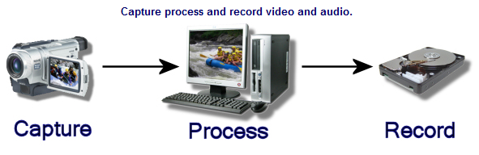
Video footage

Slide 22
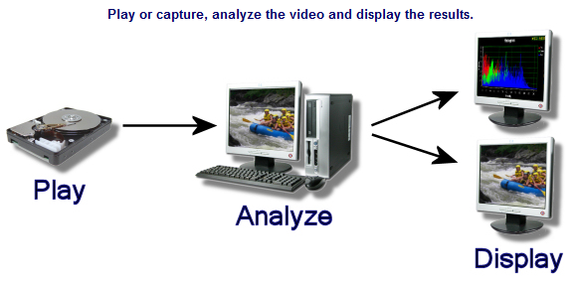
Video footage

Slide 23
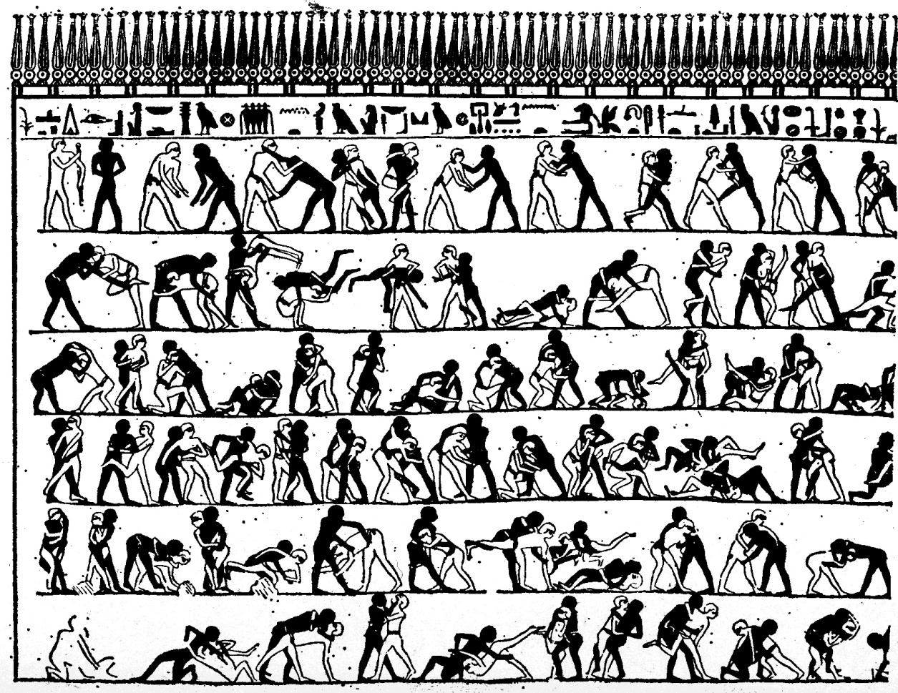
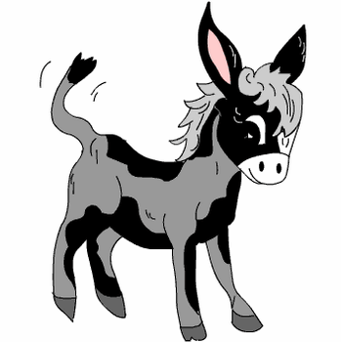
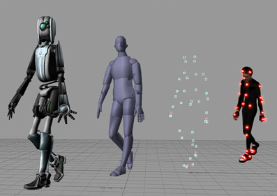
Animation
Notes:
An Egyptian burial chamber mural, approximately 4000 years old, shows wrestlers in action.
Animation is the rapid display of a sequence of images of 2-D or 3-D artwork or model positions in order to create an illusion of movement. It is an optical illusion of motion due to the phenomenon of persistence of vision, and can be created and demonstrated in a number of ways. The most common method of presenting animation is as a motion picture or video program, although several other forms of presenting animation also exist.
Computer animation (or CGI animation) is the art of creating moving images with the use of computers. It is a subfield of computer graphics and animation. Increasingly it is created by means of 3D computer graphics, though 2D computer graphics are still widely used for stylistic, low bandwidth, and faster real-time rendering needs. Sometimes the target of the animation is the computer itself, but sometimes the target is another medium, such as film. It is also referred to as CGI (computer-generated imagery or computer-generated imaging), especially when used in films.
To create the illusion of movement, an image is displayed on the computer screen and repeatedly replaced by a new image that is similar to the previous image, but advanced slightly in the time domain (usually at a rate of 24 or 30 frames/second). This technique is identical to how the illusion of movement is achieved with television and motion pictures.
Computer animation is essentially a digital successor to the art of stop motion animation of 3D models and frame-by-frame animation of 2D illustrations. For 3D animations, objects (models) are built on the computer monitor (modeled) and 3D figures are rigged with a virtual skeleton. For 2D figure animations, separate objects (illustrations) and separate transparent layers are used, with or without a virtual skeleton. Then the limbs, eyes, mouth, clothes, etc. of the figure are moved by the animator on key frames. The differences in appearance between key frames are automatically calculated by the computer in a process known as tweening or morphing. Finally, the animation is rendered.
For 3D animations, all frames must be rendered after modeling is complete. For 2D vector animations, the rendering process is the key frame illustration process, while tweened frames are rendered as needed. For pre-recorded presentations, the rendered frames are transferred to a different format or medium such as film or digital video. The frames may also be rendered in real time as they are presented to the end-user audience. Low bandwidth animations transmitted via the internet (e.g. 2D Flash, X3D) often use software on the end-users computer to render in real time as an alternative to streaming or pre-loaded high bandwidth animations.

Slide 24
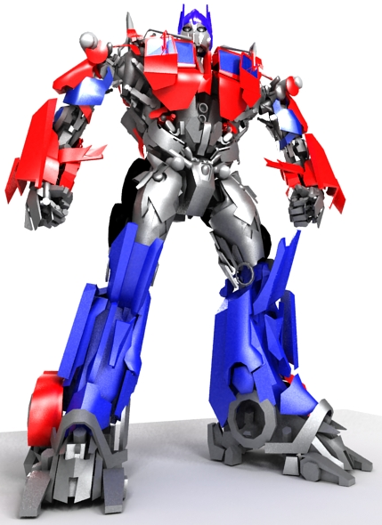
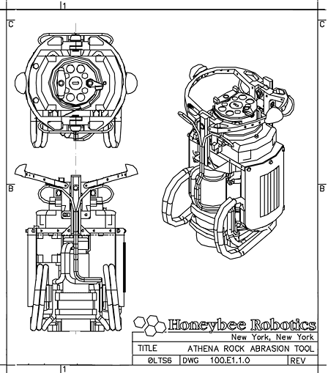
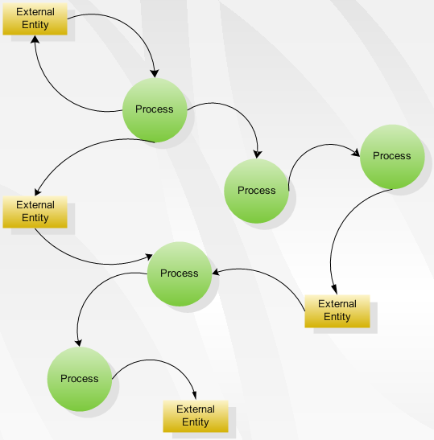
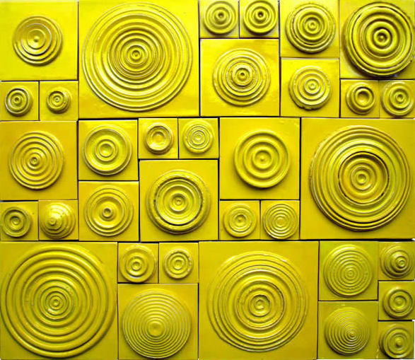
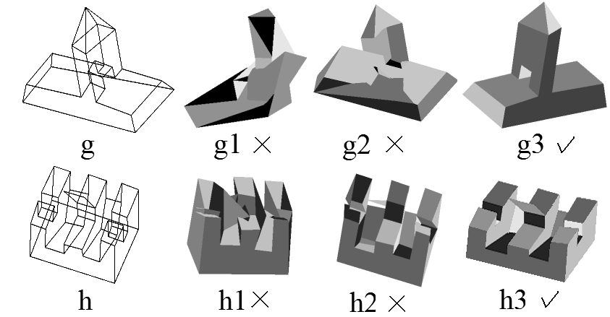
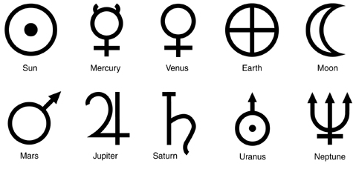
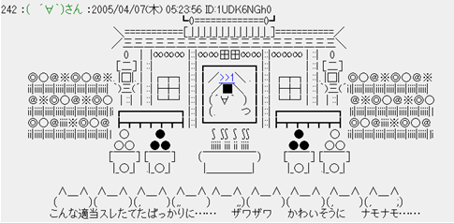
Graphics
Line drawings
Diagrams
Symbols
Geometric design
Maps
Photography
Engineering drawings
Computer graphics
Web graphics
Notes:
Graphics are visual presentations on some surface, such as a wall, canvas, computer screen, paper, or stone to brand, inform, illustrate, or entertain. Examples are photographs, drawings, Line Art, graphs, diagrams, typography, numbers, symbols, geometric designs, maps, engineering drawings, or other images. Graphics often combine text, illustration, and color. Graphic design may consist of the deliberate selection, creation, or arrangement of typography alone, as in a brochure, flier, poster, web site, or book without any other element. Clarity or effective communication may be the objective, association with other cultural elements may be sought, or merely, the creation of a distinctive style.
Graphics can be functional or artistic. The latter can be a recorded version, such as a photograph, or an interpretation by a scientist to highlight essential features, or an artist, in which case the distinction with imaginary graphics may become blurred.
==================
In the 1990s, Internet speeds increased, and Internet browsers capable of viewing images were released, the first being Mosaic. Websites began to use the GIF format to display small graphics, such as banners, advertisements and navigation buttons, on web pages. Modern web browsers can now display JPEG, PNG and increasingly, SVG images in addition to GIFs on web pages. SVG, and to some extent VML, support in some modern web browsers have made it possible to display vector graphics that are clear at any size. Plugins expand the web browser functions to display animated, interactive and 3-D graphics contained within file formats such as SWF and X3D.
Modern web graphics can be made with software such as Adobe Photoshop, the GIMP, or Corel Paint Shop Pro. Users of Microsoft Windows have MS Paint, which many find to be lacking in features. This is because MS Paint is a drawing package and not a graphics package.
Numerous platforms and websites have been created to cater to web graphics artists and to host their communities. A growing number of people use create internet forum signatures—generally appearing after a user's post—and other digital artwork, such as photo manipulations and large graphics.

Slide 25
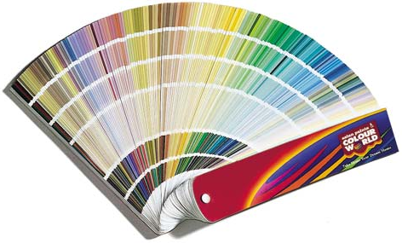
color tUtorial

Slide 26
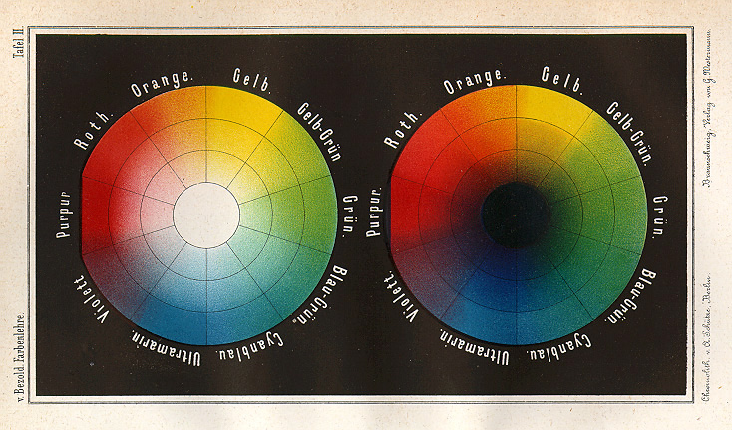
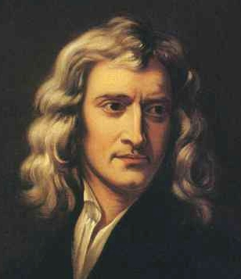
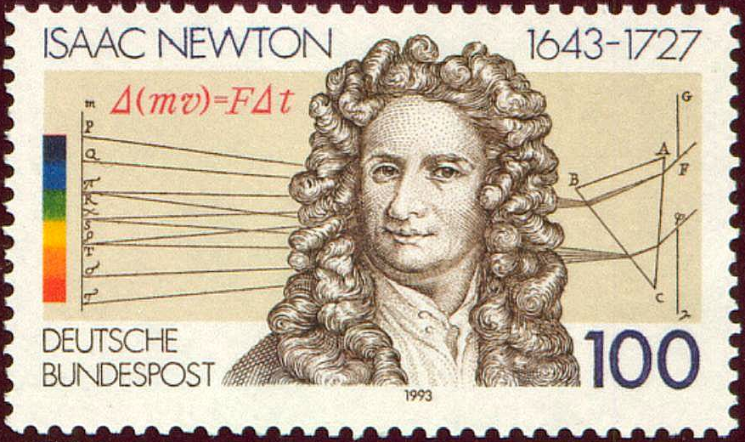
Newton and color wheel
White light is composed of all the colors of the spectrum.
The visible spectrum displayed as a wheel.
Notes:
In 1670, Sir Isaac Newton demonstrated that white light is composed of all the colors of the spectrum by refracting sunlight through a prism.
The visible spectrum displayed as a wheel.

Slide 27
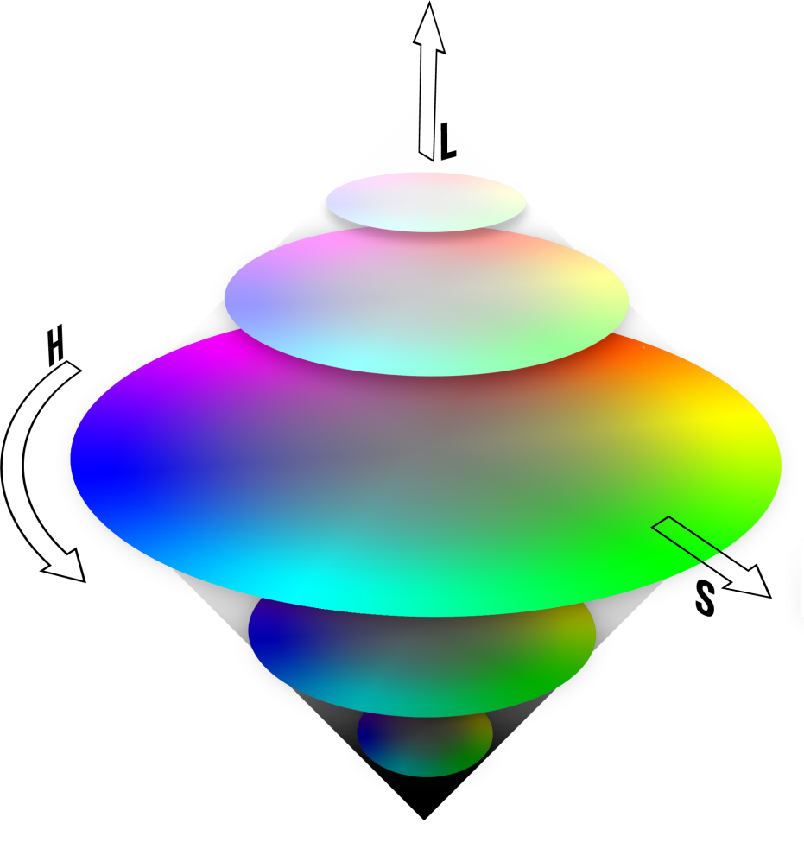
Lightness
Hue
Saturation
Notes:
The "primary" colors are made from equal amounts of the adjacent colors, and colors on opposite sides of the wheel are exact chromatic opposites. Mixing any two opposites anywhere on the wheel gives you grey.
For example, primary red is made of equal amounts of yellow and magenta, and is the chromatic opposite of cyan. Red plus cyan equals grey.
The hue is an attribute which describes the extent to which a color is pure (red, green, or blue). The saturation is a measure of the degree to which a pure color is diluted by white light.

Slide 28

Additive colors
The primary colors can be added to produce the secondary colors of light, e.g., magenta (red + blue), cyan (green + blue), and yellow (red + green).
Mixing the three primaries, or a secondary with its opposite primary color, in the right intensities produces white light.
This figure shows the three primary colors and their combinations to produce the secondary colors.
Notes:
Colored light can be created in two ways. Starting with no light, and gradually adding red, green and blue until you get the color you want, or starting with white light and subtracting what you don't want with cyan, magenta and yellow.
Pigment-based color systems are subtractive (YCM), while light-based color systems are additive (RGB). Film is pigment-based. Your monitor (surprise) is light-based.

Slide 29

Subtractive colors
In subtractive model, a primary color is defined as one that subtracts or absorbs a primary color of light and reflects or transmits the other two.
The primary colors of pigments are magenta, cyan, and yellow, and the secondary colors are red, green, and blue.
A proper combination of the three pigment primaries, or a secondary with its opposite primary, produces black.

Slide 30

Two points for you
White is the presence of all colors.
Black is the absence of all colors.

Slide 31


Bit depth
Our eyes are capable of detecting about 450 luminance values.
Unfortunately, conventional monitors are limited in dynamic range, and display only 256 values. This is why computer image files are in 8 bit color space. [Physically]
8 bit [0-255] ? vs. 16 bit [0-65535]
The disadvantage is in areas of subtle gradation, where 8 bit hasn't enough values to show all the transitions, resulting in banding.

Slide 32

color spaces
RGB
HSV and HSI
YCbCr
LAB and LUV
CMYK
etc
http://people.sc.fsu.edu/~burkardt/f_src/colors/colors.html
http://www.poynton.com/notes/color_and_gamma/ColorFAQ.html

Slide 33

color space FAQ
What is color?
What is intensity?
What is luminance?
What is lightness?
What is hue?
What is saturation?
http://www.faqs.org/faqs/graphics/colorspace-faq/

Slide 34
Essential points
color space FAQ
Additive and subtractive colors
Bit depth
What are supervised (unsupervised, semi-supervised) learning, manifold learning, dimension reduction, clustering?
What is query-by-example?

