Slide 1
CS105 Introduction to
Social Network
Lecture: Yang Mu
UMass Boston

Slide 2
10 Most Popular Websites
Site | Domain | Alexa traffic rank (May 2013) | Linking root domains (May 2013) | Google Display Network Ad Planner (July 2011) | Type
Facebook | facebook.com | 1 | 8,190,877 | 1 | Social Networking
Google | google.com | 2 | 4,533,883 | ^{NA} | Search
YouTube | youtube.com | 3 | 3,637,788 | 2 | Video-Sharing
Yahoo! | yahoo.com | 4 | 1,888,093 | 3 | Search
Baidu | baidu.com | 5 | 325,710 | 8 | Search
Wikipedia | wikipedia.org | 6 | 2,154,423 | 6 | Reference
Windows Live | live.com | 7 | 149,315 | 4 | Portal
Amazon.com | amazon.com | 8 | 1,177,136 | 24 | Commerce
Tencent QQ | qq.com | 9 | 472,087 | 10 | Instant Messaging
Twitter | twitter.com | 10 | 6,183,107 | 15 | Microblogging / Instant Messaging / Social Media
Ranking measures
Alexa traffic rank
Alexa Internet ranks websites based on a combined measure of page views and unique site users.
Alexa creates a list of "top websites" based on this data time-averaged over three month periods.
Linking root domains
The number of linking root domains is a measure of how many external sites link to the website.
Google Display Network Ad Planner
The Google Display Network Ad Planner measures the number of unique visitors, for use by Google's advertisers.

Slide 3
SOCIAL NETWORK
= SOCIA MEDIA + NETWORKING

Slide 4
SOCIA MEDIA IS AN UMBRELLA TERM
THAT DEFINES THE VARIOUS ACTIVITIES
THAT INTEGRATE TECHNOLOGY, SOCIAL
INTERACTION, AND THE
CONSTRUCTION OF WORDS, PICTURES,
VIDEOS AND AUDIO.
http://www.wikipedia.org

Slide 5
More simply put:
“Social media
is people having conversation online.”

Slide 6


The conversations are powered by …
Blogs
Micro Blogs
Online Chat
RSS
Video Sharing Sites
Photo Sharing Sites
…

Slide 7
“WHY SHOULD
I CARE?”

Slide 8
Reason #1
SOCIAL-NETWORKING SITES
ARE THE MOST
POPULAR SITES.

Slide 9

BECAUSE 3 OUT OF 4 AMERICANS USE SOCIAL TECHNOLOGY
Forrester, The Growth of Social Technology Adoption, 2008

Slide 10
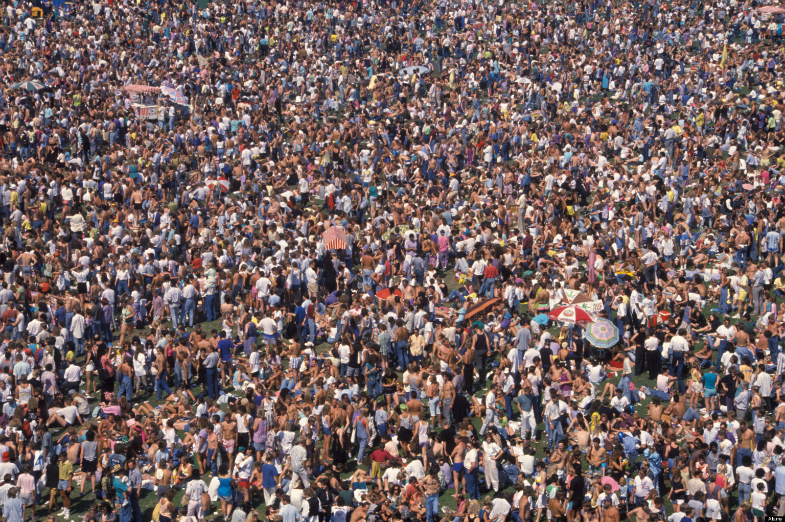
BECAUSE 2/3 of THE GLOBAL INTERNET POPULATION VISIT SOCIAL NETWORKS
Nielsen, Global Faces & Networked Places, 2009

Slide 11
Reason #2
78%
OF PEOPLE TRUST THE RECOMMENDATIONS OF OTHER CONSUMERS.
NIELSEN “TRUST IN ADVERTISING” REPORT, OCTOBER 2007

Slide 12
Reason #3
BECAUSE TIME SPENT ON SOCIAL NETWORKS IS GROWING AT 3X THE OVERALL INTERNET RATE, ACCOUNTING FOR ~10% OF ALL INTERNET TIME.
Nielsen, Global & Networked Places, 2009

Slide 13
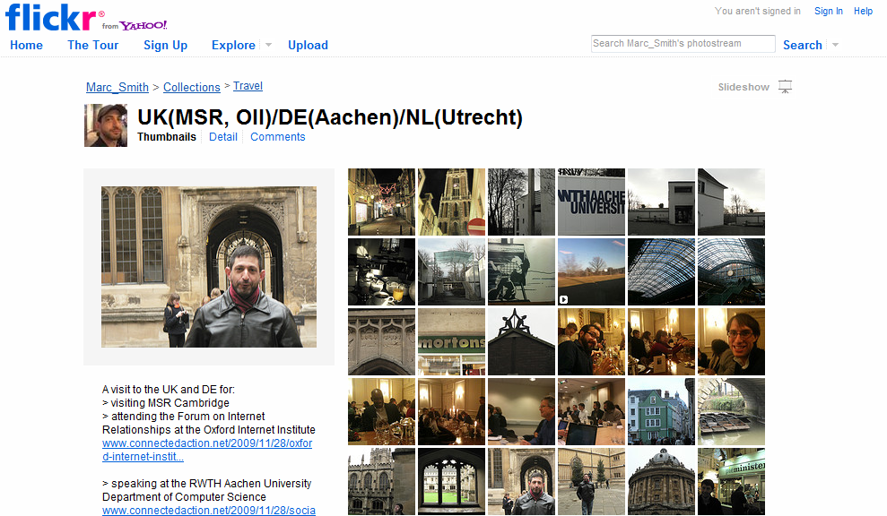
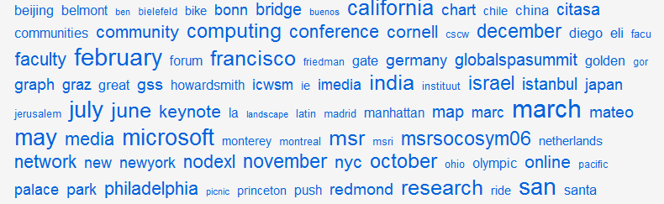

Slide 14
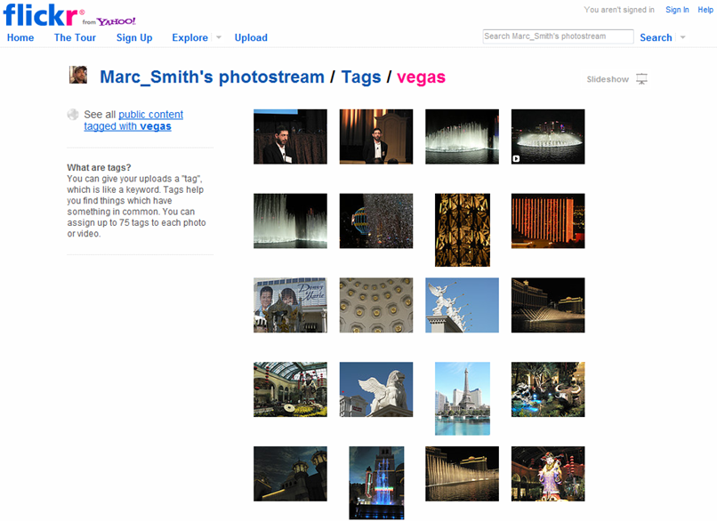

Slide 15
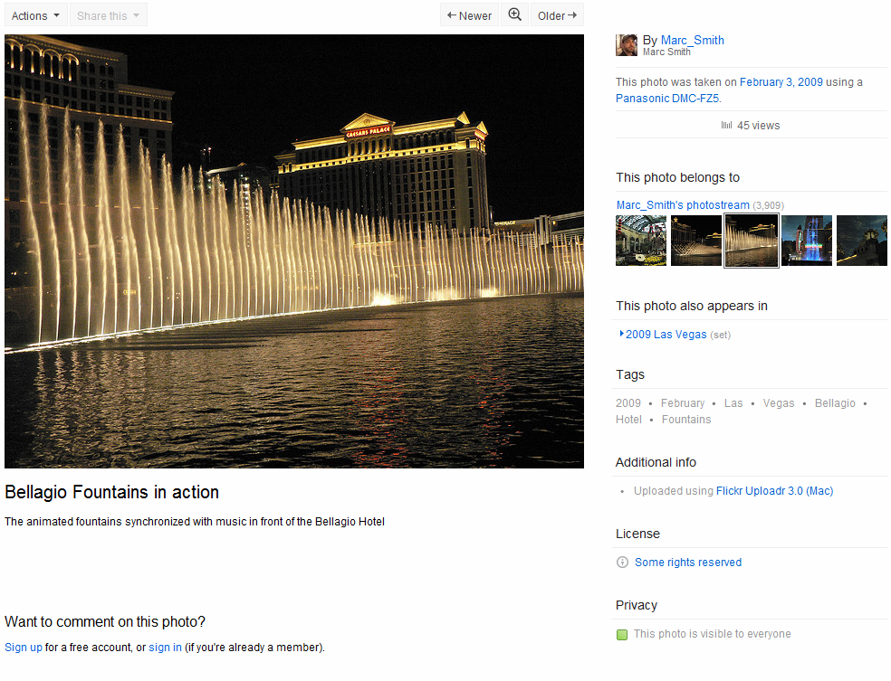


Slide 16
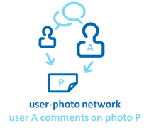
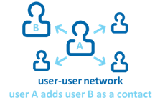

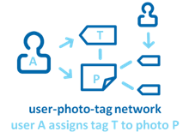
Flickr – Social Engagements

Slide 17
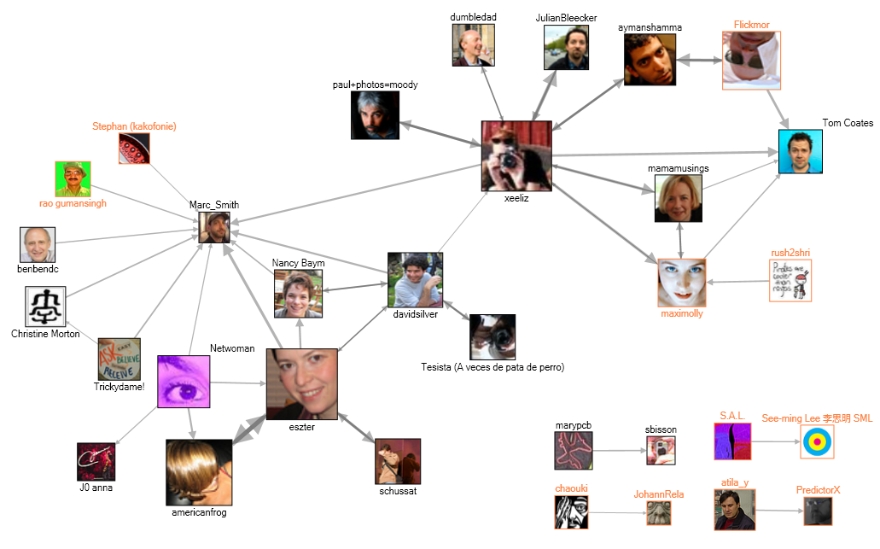
Flickr users who commented on Marc_Smith’s photos (more than 4 times)

Slide 18
Human Super-Connectors
Flickr users who commented on Marc_Smith’s photos (more than 4 times)

Slide 19
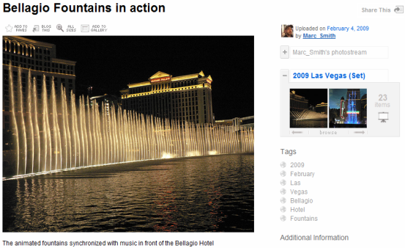
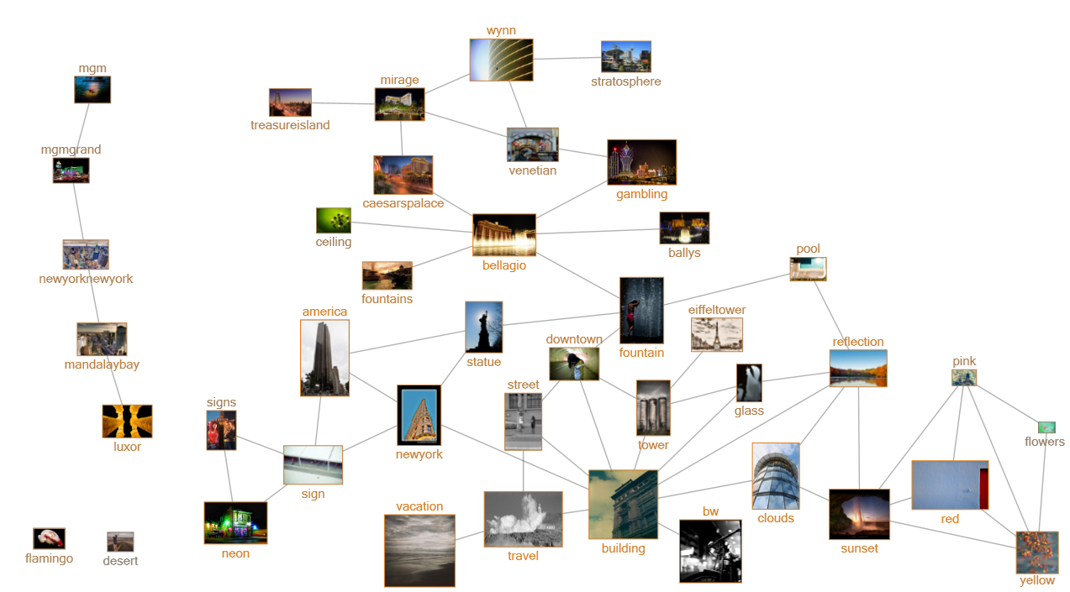
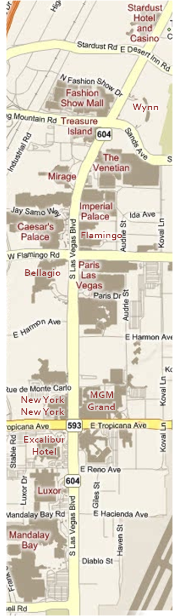
Flickr – Network Analysis

Slide 20
Flickr – Network Analysis

Slide 21
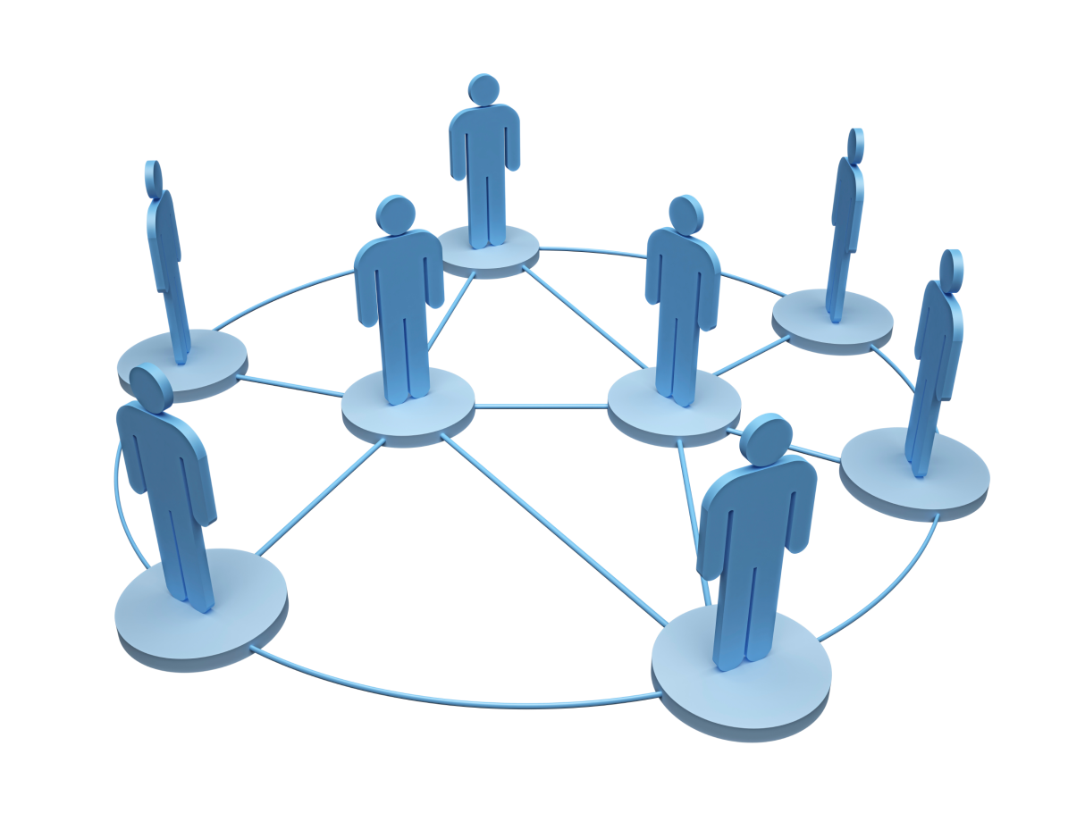
What is a Social Network ?
Network
– a set of nodes, points or locations connected

Slide 22


What is a Social Network ?
Social Network
- a social structure made up of individuals (or organizations) called "nodes", which are tied (connected) by one or more specific types of interdependency, such as friendship, common interest

Slide 23
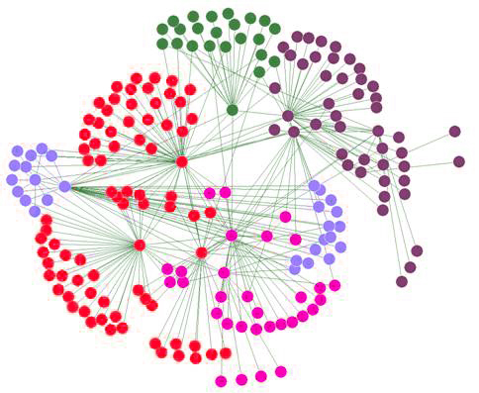
What is a Social Network ?
Social Network Analysis (SNA)
- views social relationships in terms of network theory consisting of nodes and ties (also called edges, links or connections).

Slide 24
Some concepts
A node or vertex is an individual unit in the graph or system.
A graph or system or network is a set of units that may be (but are not necessarily) connected to each other.

Slide 25
Some concepts
An “edge” is a connection or tie between two nodes.
A neighborhood N for a vertex or node is the set of its immediately connected nodes.
Degree: The degree k_{i} of a vertex or node is the number of other nodes in its neighborhood.

Slide 26
Some concepts
In an undirected graph or network, the edges are reciprocal—so if A is connected to B, B is by definition connected to A.
In a directed graph or network, the edges are not necessarily reciprocal—A may be connected to B, but B may not be connected to A (think of a graph with arrows indicating direction of the edges.)

Slide 27
A simple network analysis
1a
1b
Z
C
B
R
Y
A
D
E
S
T

Slide 28
CS105 Introduction to
Graph
Lecture: Yang Mu
UMass Boston

Slide 29
What is a Network?
1
3
1
2
3
2
4
5
6
4
5
6
Network = graph
Informally a graph is a set of nodes joined by a set of lines or arrows.

Slide 30
Graph-based representations
Representing a problem as a graph can provide a different point of view
Representing a problem as a graph can make a problem much simpler
  More accurately, it can provide the appropriate tools for solving the problem

Slide 31
What is network theory?
Network theory provides a set of techniques for analysing graphs
Complex systems network theory provides techniques for analysing structure in a system of interacting agents, represented as a network
Applying network theory to a system means using a graph-theoretic representation

Slide 32
What makes a problem graph-like?
There are two components to a graph
  Nodes and edges
In graph-like problems, these components have natural correspondences to problem elements
  Entities are nodes and interactions between entities are edges
Most complex systems are graph-like

Slide 33
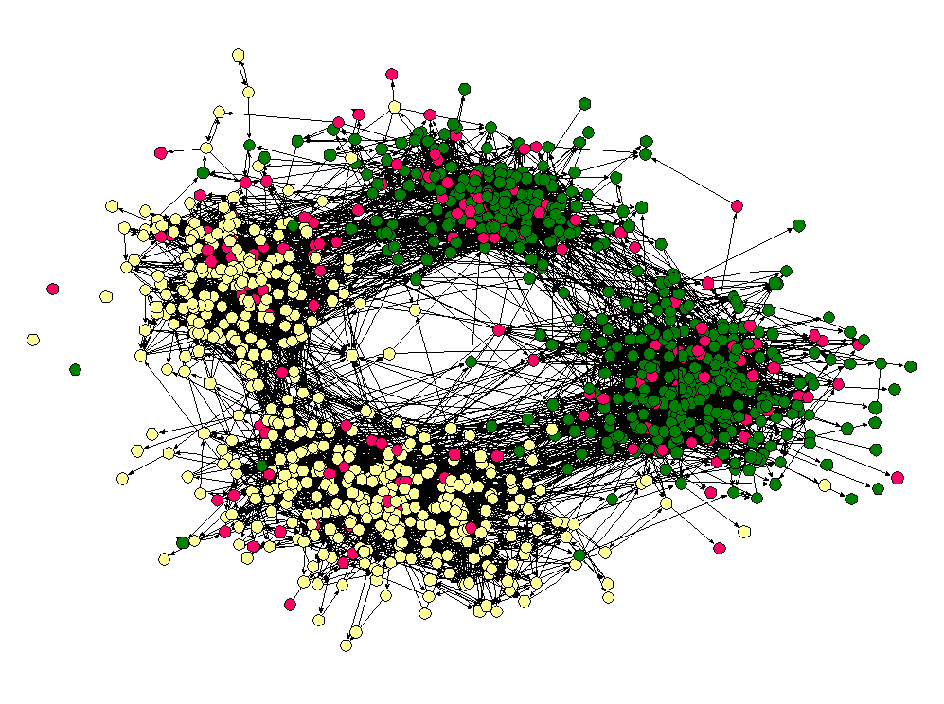
Friendship Network

Slide 34
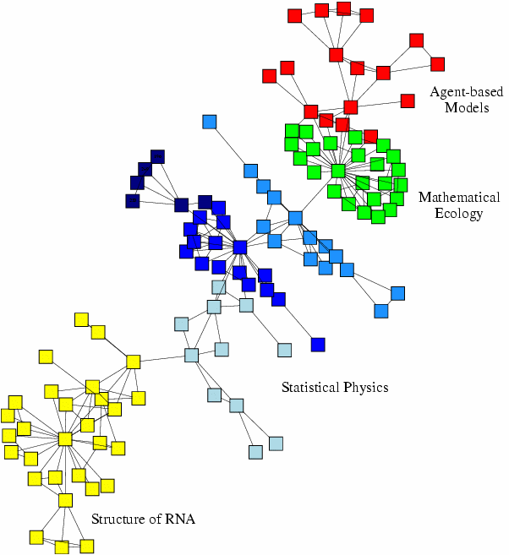
Scientific collaboration network

Slide 35
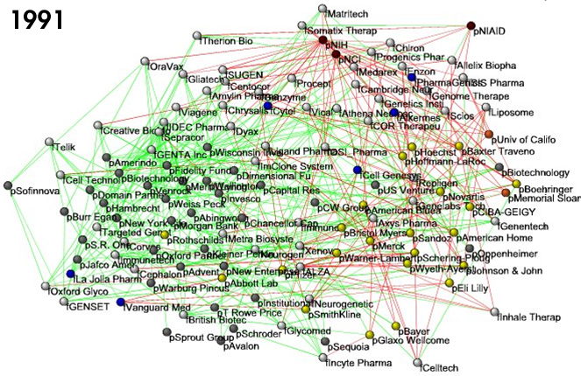
Business ties in US
biotech-industry

Slide 36
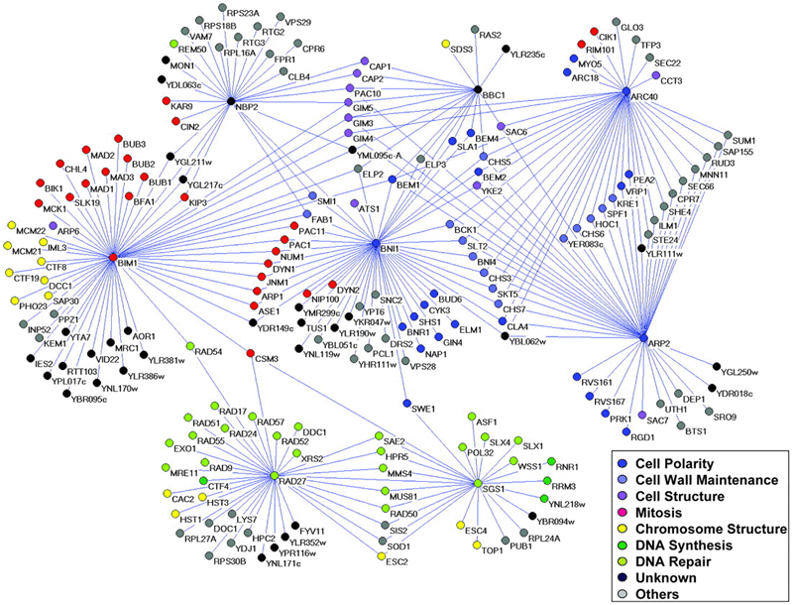
Genetic interaction network

Slide 37
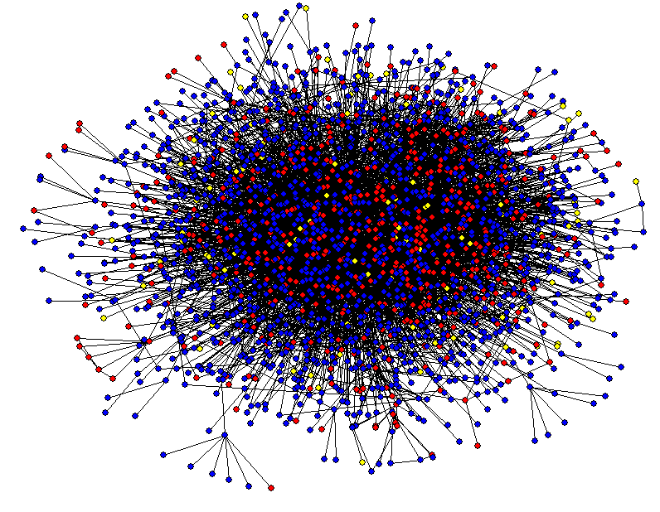
Protein-Protein Interaction Networks

Slide 38
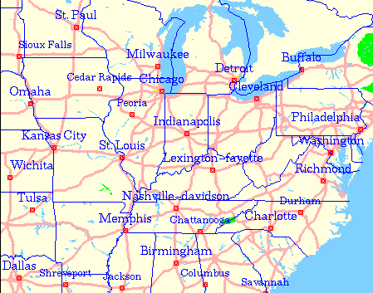
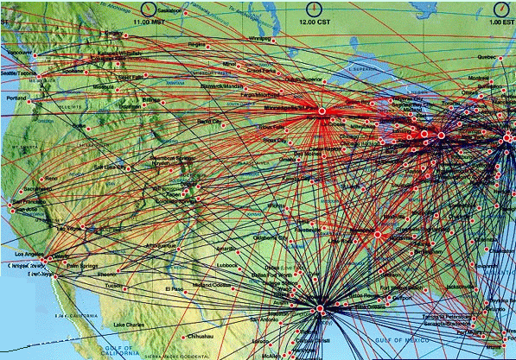
Transportation Networks

Slide 39
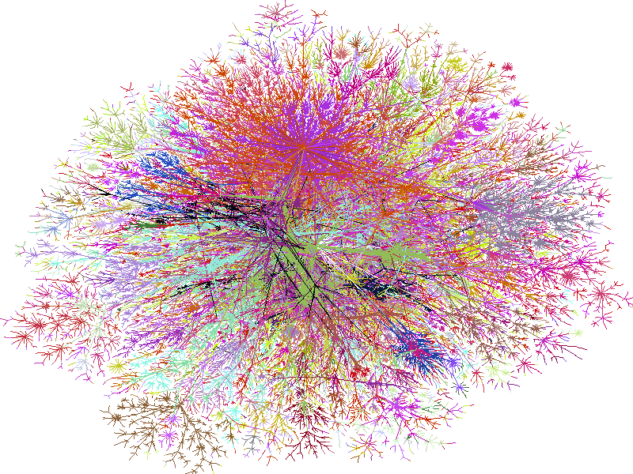
Internet

Slide 40
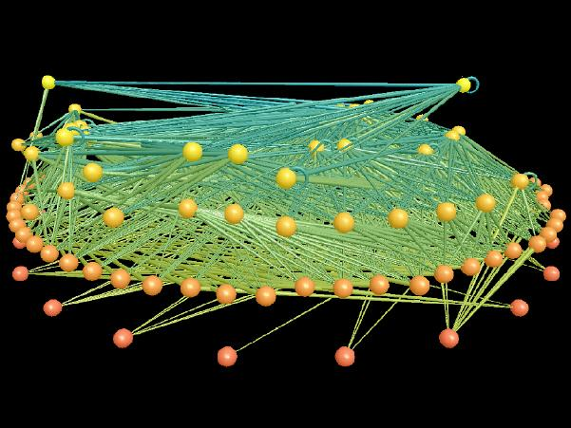
Ecological Networks

Slide 41
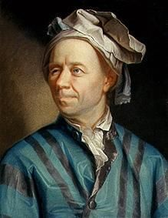
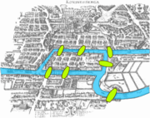
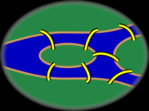
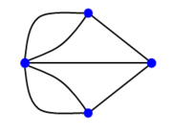
Graph Theory - History
Leonhard Euler's paper on “Seven Bridges of Königsberg” ,
published in 1736.
Notes:
The problem was to find a walk through the city that would cross each bridge once and only once.

Slide 42
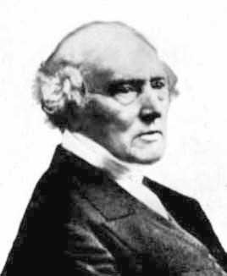
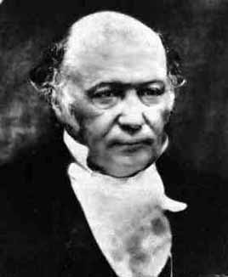
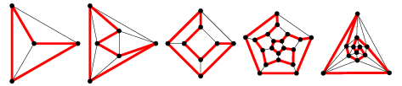
Graph Theory - History
Cycles in Polyhedra
Thomas P. Kirkman William R. Hamilton
Hamiltonian cycles in Platonic graphs
Notes:
Find a path that visits each vertex exactly once.

Slide 43
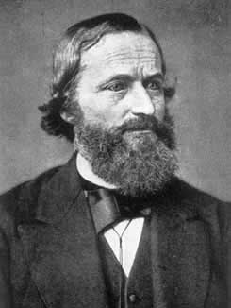
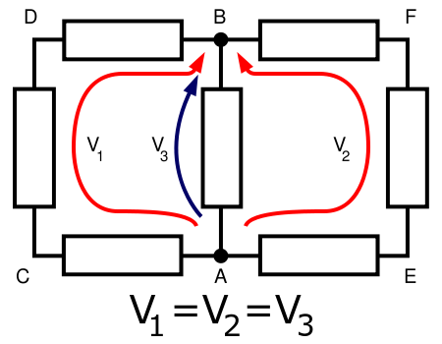
Graph Theory - History
Trees in Electric Circuits
Gustav Kirchhoff

Slide 44
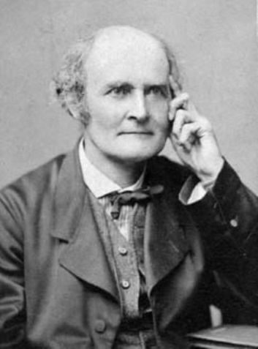
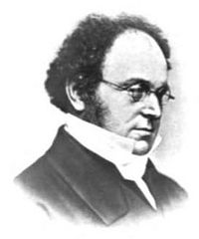
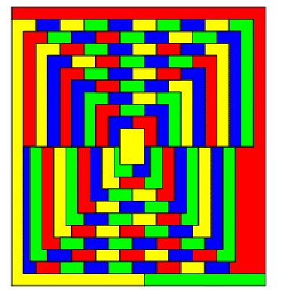
Graph Theory - History
Four Colors of Maps
Arthur Cayley Auguste DeMorgan

Slide 45
Definition: Graph
G is an ordered triple G:=(V, E, f)
  V is a set of nodes, points, or vertices.
  E is a set, whose elements are known as edges or lines.
  f is a function
    maps each element of E
    to an unordered pair of vertices in V.

Slide 46
Definitions
Vertex
  Basic Element
  Drawn as a node or a dot.
  Vertex set of G is usually denoted by V(G), or V
Edge
  A set of two elements
  Drawn as a line connecting two vertices, called end vertices, or endpoints.
  The edge set of G is usually denoted by E(G), or E.

Slide 47
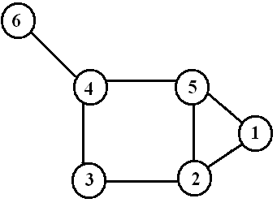
Example
V:={1,2,3,4,5,6}
E:={{1,2},{1,5},{2,3},{2,5},{3,4},{4,5},{4,6}}

Slide 48
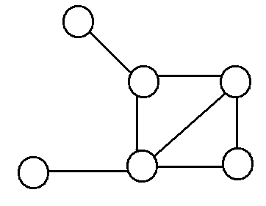
Simple Graphs
Simple graphs are graphs without multiple edges or self-loops.

Slide 49
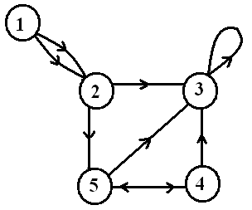
Directed Graph (digraph)
Edges have directions
  An edge is an ordered pair of nodes
loop
multiple arc
arc
node

Slide 50
Weighted graphs
1.2
2
1
2
3
1
2
3
.2
.5
1.5
5
3
.3
1
4
5
6
4
5
6
.5
is a graph for which each edge has an associated weight, usually given by a weight function w: E → R.

Slide 51
Structures and structural metrics
Graph structures are used to isolate interesting or important sections of a graph
Structural metrics provide a measurement of a structural property of a graph
  Global metrics refer to a whole graph
  Local metrics refer to a single node in a graph

Slide 52
Graph structures
Identify interesting sections of a graph
  Interesting because they form a significant domain-specific structure, or because they significantly contribute to graph properties
A subset of the nodes and edges in a graph that possess certain characteristics, or relate to each other in particular ways

Slide 53
Connectivity
a graph is connected if
  you can get from any node to any other by following a sequence of edges OR
  any two nodes are connected by a path.
A directed graph is strongly connected if there is a directed path from any node to any other node.

Slide 54
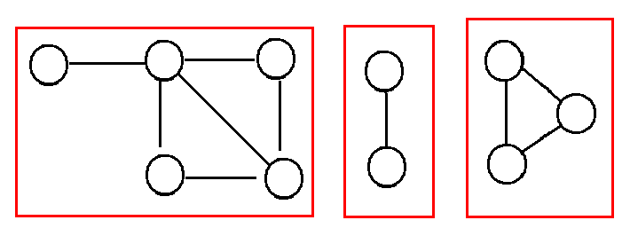
Component
Every disconnected graph can be split up into a number of connected components.

