Slide 1
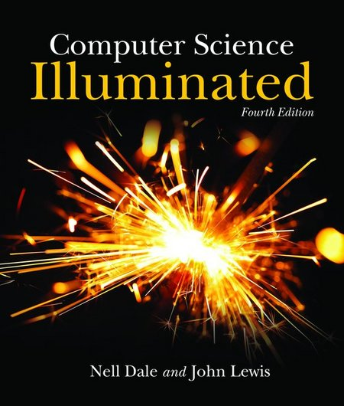
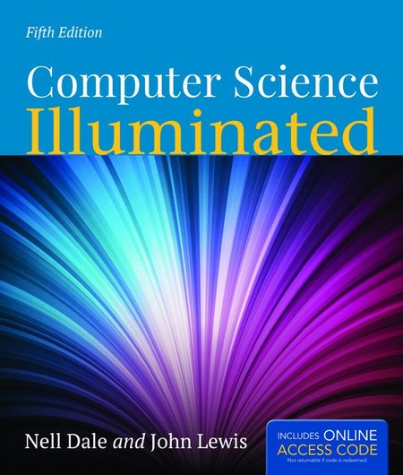
Textbook
Computer Science Illuminated 4th Edition By Nell Dale, John Lewis - Jones and Bartlett Publishers

Slide 2
Summarization
Search Engine
1. Create index; 2. Query index; 3. Ranking
Multimedia
1. Understand the multimedia; 2. Multimedia annotation/retrieval
Social Network
1. Directed/undirected graph; 2. in/out degree

Slide 3
CS105 Introduction to Computer Concepts Binary Values & Number systems
Instructor: Yang Mu

Slide 4
Outline
Review of Computing System Layers
Numbers
Positional Notation
Conversion among different bases
Binary and Computers

Slide 5
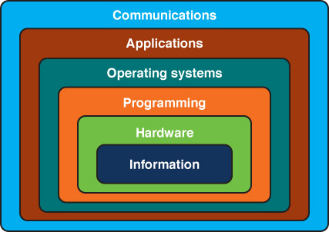
Layers of a Computer Systems

Slide 6
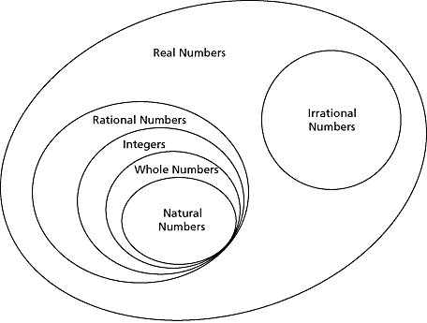
Number Categories
Natural numbers: zero and any number obtained by repeatedly adding one to it. E.g., 0, 1, 2, …
Negative numbers: a value less than 0, with a “–” sign. E.g., -10, -199, -2,…
Integers: natural number, negative number
Rational numbers: an integer or the quotient of two integers. E.g., -1,1/3, -3/2,…

Slide 7
Base of Number Systems
The base of a number system specifies the number of digits used in the system
E.g.,
Base 10 (decimal): 0, 1, …,9
Base 2 (binary): 0, 1
Base 8 (octal): 0, 1, …,7
The base also determines what the positions of digits mean

Slide 8
Positional Notation
Numbers are written using positional notation
E.g., 2012 in base 10
2012 = 2 x 10³ + 0 x 10² + 1 x 10¹ + 2 x 10⁰
Formula: V is value in base 10
R is the base
of the number
V = d_{n} * R^{n-1} + d_{n-1} * R^{n-2} + ... + d₂ * R + d₁
d is the digit in the
i^{th} position
in the number
n is the number of
digits in the number

Slide 9
Practice
642 in base 10
Could 642 be a base 2 number?
Suppose that 642 in base 13, what is the value in base 10?

Slide 10
Answer
642 in base 10 positional notation is:
6 x 10² = 6 x 100 = 600
+ 4 x 10¹ = 4 x 10 = 40
+ 2 x 10º = 2 x 1 = 2 = 642 in base 10
642 in base 13 positional notation is
642 in base 13 is equivalent to 1068 in base 10
+ 6 x 13² = 6 x 169 = 1014
+ 4 x 13¹ = 4 x 13 = 52
+ 2 x 13º = 2 x 1 = 2
= 1068 in base 10

Slide 11
Binary
Decimal is base 10 and has 10 digits: 0,1,2,3,4,5,6,7,8,9
Binary is base 2 and has 2 digits:
0,1
For a number to exist in a given base, it can only contain the digits in that base, which range from 0 up to (but not including) the base.
What bases can these numbers be in? 122, 198, 178, G1A4
9

Slide 12
Bases Higher than 10
How are digits in bases higher than 10 represented?
With distinct symbols for 10 and above.
Base 16 has 16 digits:
0,1,2,3,4,5,6,7,8,9,A,B,C,D,E, and F
10

Slide 13
Converting Octal to Decimal
What is the decimal equivalent of the octal number 642?
6 x 8² = 6 x 64 = 384
+ 4 x 8¹ = 4 x 8 = 32
+ 2 x 8º = 2 x 1 = 2
= 418 in base 10
11

Slide 14
Converting Hexadecimal to Decimal
What is the decimal equivalent of the hexadecimal number DEF?
D x 16² = 13 x 256 = 3328
+ E x 16¹ = 14 x 16 = 224
+ F x 16º = 15 x 1 = 15
= 3567 in base 10
Remember, the digits in base 16 are 0,1,2,3,4,5,6,7,8,9,A,B,C,D,E,F

Slide 15
Converting Binary to Decimal
What is the decimal equivalent of the binary number 1101110?
1 x 2⁶ = 1 x 64 = 64
+ 1 x 2⁵ = 1 x 32 = 32
+ 0 x 2⁴ = 0 x 16 = 0
+ 1 x 2³ = 1 x 8 = 8
+ 1 x 2² = 1 x 4 = 4
+ 1 x 2¹ = 1 x 2 = 2
+ 0 x 2º = 0 x 1 = 0
= 110 in base 10
13

Slide 16
Arithmetic in Binary
Remember that there are only 2 digits in binary, 0 and 1
1 + 1 is 0 with a carry
Carry Values
1 1 1 1 1 1
1 0 1 0 1 1 1
+1 0 0 1 0 1 1
1 0 1 0 0 0 1 0
14

Slide 17
Subtracting Binary Numbers
Remember borrowing? Apply that concept here:
1 2
2 0 2
1 0 1 0 1 1 1
- 1 1 1 0 1 1
0 0 1 1 1 0 0
15

Slide 18
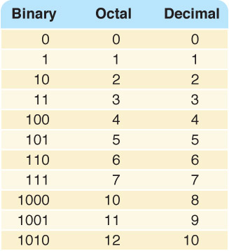
Counting in Binary/Octal/Decimal

Slide 19
Converting Binary to Octal
Mark groups of three (from right)
Convert each group
10101011 10 101 011
2 5 3
10101011 is 253 in base 8
17

Slide 20
Converting Binary to Hexadecimal
Mark groups of four (from right)
Convert each group
10101011 1010 1011
A B
10101011 is AB in base 16
18

Slide 21
Converting Decimal to Other Bases
Algorithm* for converting number in base 10 to other bases
While (the quotient is not zero)
1) Divide the decimal number by the new base
2) Make the remainder the next digit to the left in the answer
3) Replace the original decimal number with the quotient
Algorithm* i/ˈælɡərɪðəm/ (from Algoritmi, the Latin form of Al-Khwārizmī) is an effective method expressed as a finite list of well-defined instructions for calculating a function
19

Slide 22
Converting Decimal to Octal
What is 1988 (base 10) in base 8?
Try it!

Slide 23
Converting Decimal to Octal
248 31 _3 0
8 1988 8 248 8 31 8 3
16 24 24 0
38 08 7 3
32 8
68 0
64
4
Answer is : 3 7 0 4

Slide 24
Converting Decimal to Hexadecimal
What is 3567 (base 10) in base 16?
Try it!
20

Slide 25
Converting Decimal to Hexadecimal
222 13 0
16 3567 16 222 16 13
32 16 0
36 62 13
32 48
47 14
32
15
D E F
21

