Slide 1
CS105 Introduction to Computer Concepts Data Representation
Instructor: Yang Mu

Slide 2
Outline
Analog vs. Digital
Data Compression
Text
Image and Graphic
Video

Slide 3
Data and Computers
Computers are multimedia devices, dealing with a vast array of information categories
Computers store, present, and help us modify
Numbers
Text
Audio
Images and graphics
Video

Slide 4
Data and Computers
Data compression: Reduction in the amount of space needed to store a piece of data
Compression ratio: The size of the compressed data divided by the size of the original data
A data compression techniques can be
lossless, which means the data can be retrieved without any loss of the original information
lossy, which means some information may be lost in the process of compaction

Slide 5
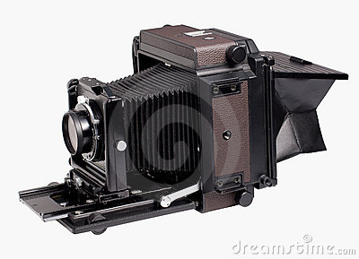
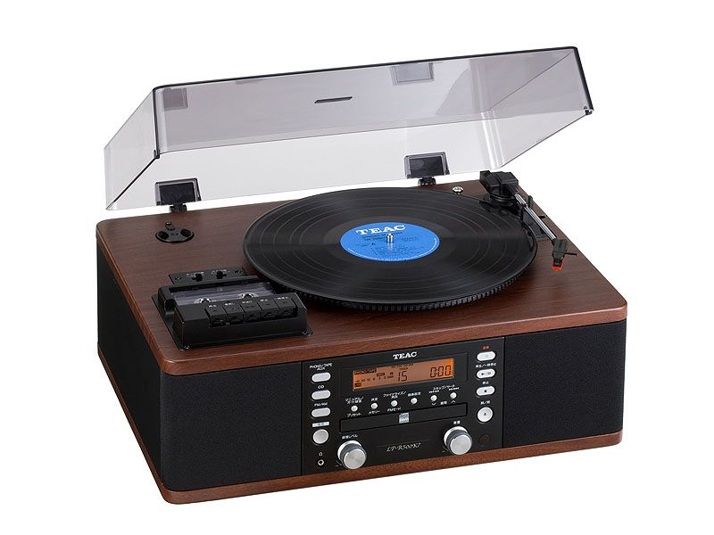
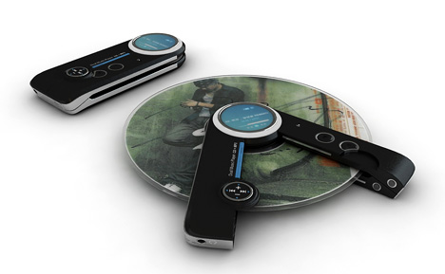
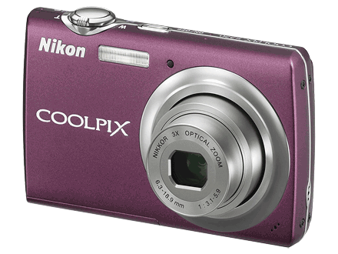
Analog vs. Digital
Wave form
Number form
Information can be represented in one of two ways: analog or digital
Analog data: A continuous representation, analogous to the actual information it represents
Digital data: A discrete representation, breaking the information up into separate elements
Analog Camera
CD player
Digital Camera
Analog Vinyl LP

Slide 6
Analog and Digital Information
Computers cannot work well with analog data, so we digitize the data
Digitize: Breaking data into pieces and representing those pieces separately
Why do we use binary to represent digitized data?
Notes:
Why do we use binary to represent digitized data?
-Less expensive, more reliable
-electronic signals are easier to maintain
The Quality Debate: While the digital format may appear to be blatantly superior to analog, many purists continue to disagree. With regards to movies, many directors find digital video to be flat and dull compared to the richness of analog film. Audiophiles have insisted that vinyl LPs provide sound with more depth, while CDs are tinny and inaccurate. Modern digital enthusiasts counter with the argument that analog devices are cumbersome. In the end, the actual merit of the relative sides' arguments may rely on personal taste.

Slide 7
Binary Representations
Facts:
One bit can be either 0 or 1
One bit can represent two things (Why?)
Two bits can represent four things (Why?)
Questions:
How many things can three bits represent?
How many things can n bits represent?
What happens every time you increase the number of bits by one?

Slide 8
Representing Text
What must be provided to represent text? There are finite number of characters to represent, so list them all and assign each a binary string
Character set: A list of characters and the codes used to represent each one
ASCII stands for American Standard Code for Information Interchange
ASCII originally used 7 bits to represent each character, allowing for 128 unique characters (Why?)
Later extended ASCII evolved so that all 8 bits were used
Question: How many characters could be represented? Is extended ASCII good enough?

Slide 9
ASCII Character Set Mapping
Notes:
The first 32 characters in the ASCII character chart do not have a simple character representation to print to the screen
Question: What do you think they are used for?

Slide 10
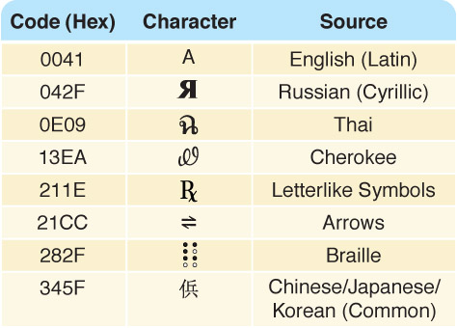
Unicode
Unicode uses 16 bits per character
Unicode is a superset of ASCII
The first 256 characters correspond exactly to the extended ASCII character set

Slide 11
Text Compression
Problem: Assigning 16 bits to each character in a document uses too much file space
→We need ways to store and transmit text efficiently
Text compression techniques
Keyword encoding
Run-length encoding
Huffman encoding

Slide 12
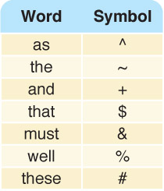
Keyword Encoding
Replace frequently used words with a single character

Slide 13
Keyword Encoding
Given the following paragraph,
We hold these truths to be self-evident, that all men are created equal, that they are endowed by their Creator with certain unalienable Rights, that among these are Life, Liberty and the pursuit of Happiness. ﾑ That to secure these rights, Governments are instituted among Men, deriving their just powers from the consent of the governed, ﾑ That whenever any Form of Government becomes destructive of these ends, it is the Right of the People to alter or to abolish it, and to institute new Government, laying its foundation on such principles and organizing its powers in such form, as to them shall seem most likely to effect their Safety and Happiness.

Slide 14
Keyword Encoding
The encoded paragraph is
We hold # truths to be self-evident, $ all men are created equal, $ ~y are endowed by ~ir Creator with certain unalienable Rights, $ among # are Life, Liberty + ~ pursuit of Happiness. — $ to secure # rights, Governments are instituted among Men, deriving ~ir just powers from ~ consent of ~ governed, — $ whenever any Form of Government becomes destructive of # ends, it is ~ Right of ~ People to alter or to abolish it, + to institute new Government, laying its foundation on such principles + organizing its powers in such form, ^ to ~m shall seem most likely to effect ~ir Safety + Happiness.

Slide 15
Keyword Encoding
What did we save?
Original paragraph
656 characters
Encoded paragraph
596 characters
Characters saved
60 characters
Compression ratio
596/656 = 0.9085
Could we use this substitution chart for all text?

Slide 16
Run-Length Encoding
A single character may be repeated over and over again in a long sequence
Replace a repeated sequence with
a flag character
repeated character
number of repetitions
*n8
* is the flag character
n is the repeated character
8 is the number of times n is repeated

Slide 17
Run-Length Encoding
Original text
bbbbbbbbjjjkllqqqqqq+++++
Encoded text
*b8jjjkll*q6*+5 (Why isn't l encoded? J?)
The compression ratio is 15/25 or .6
Encoded text
*x4*p4l*k7
Original text
xxxxpppplkkkkkkk
This type of repetition doesn’t occur in English text; can you think of a situation where it might occur?

Slide 18
Huffman Encoding
Problem: Why should the character “X" and "z" take up the same number of bits as "e" or " "?
Huffman codes use variable-length bit strings to represent each character. More frequently used letters have shorter strings to represent them

Slide 19
Huffman Encoding
ballboard would be
1010001001001010110001111011
compression ratio
28/72
Encode roadbed

Slide 20
Huffman Encoding
In Huffman encoding no character's bit string is the prefix of any other character's bit string
Algorithm: To decode
look for match left to right, bit by bit
record letter when a match is found
begin where you left off, going left to right

Slide 21
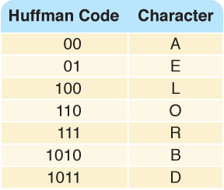
Huffman Encoding
Try it!
Decode
1011111001010

Slide 22
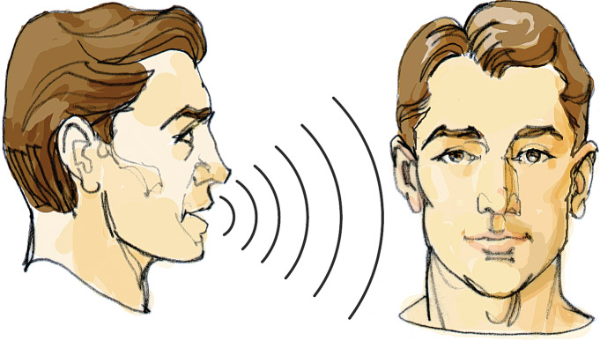
Representing Audio Information
We perceive sound when a series of air compressions vibrate a
membrane in our ear, which sends signals to our brain

Slide 23
Representing Audio Information
Digitize the signal by sampling
periodically measure the voltage
record the numeric value
Question: How often should we sample?
A sampling rate of about 40,000 times per second is enough to create a reasonable sound reproduction

Slide 24
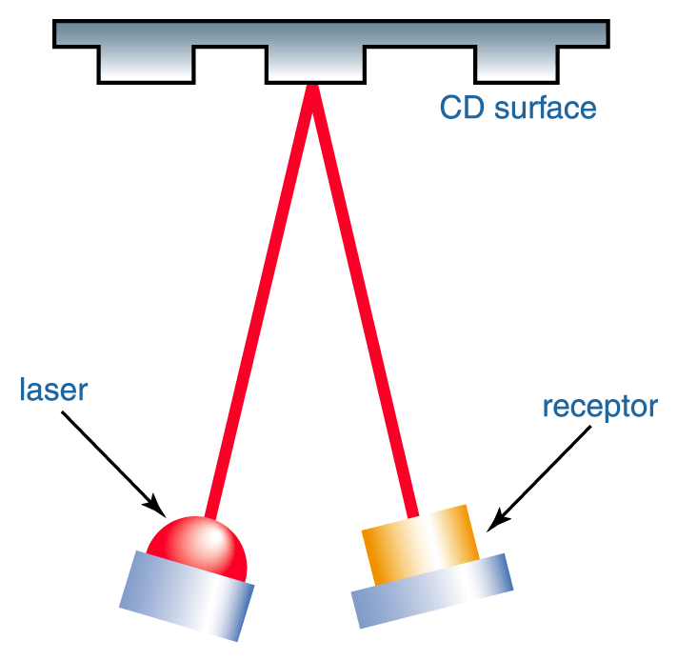
Representing Audio Information
Figure 3.9 A CD player reading binary information

Slide 25
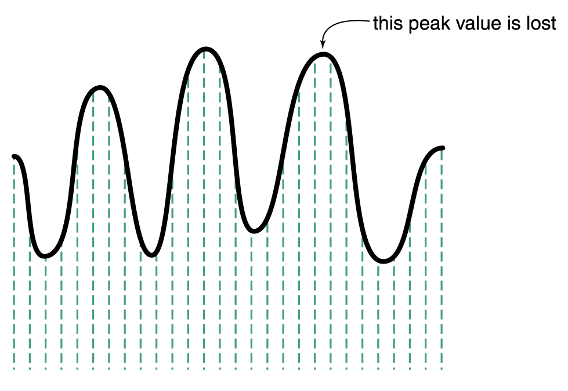
Representing Audio Information
Some data
is lost, but a
reasonable
sound is
reproduced
Figure 3.8 Sampling an audio signal

Slide 26
Representing Audio Information
CDs store audio information digitally
On the surface of the CD are microscopic pits that represent binary digits
A low intensity laser is pointed as the disc The laser light reflects strongly if the surface is smooth and poorly if the surface is pitted

Slide 27
Audio Formats
Audio Formats
WAV, AU, AIFF, VQF, and MP3
MP3 (MPEG-2, audio layer 3 file) is dominant
analyzes the frequency spread and discards information that can’t be heard by humans
bit stream is compressed using a form of Huffman encoding to achieve additional compression
Is this a lossy or lossless compression (or both)?

Slide 28
Representing Images and Graphics
Color Perception of the frequencies of light that reach the retinas of our eyes
Retinas have three types of color photo receptor cone cells that correspond to the colors of RED, GREEN, and BLUE

Slide 29
Representing Images and Graphics
Color is expressed as an RGB (red-green-blue) value--three numbers that indicate the relative contribution of each of these three primary colors
An RGB value of (255, 255, 0) maximizes the contribution of red and green, and minimizes the contribution of blue, which results in a bright yellow

Slide 30
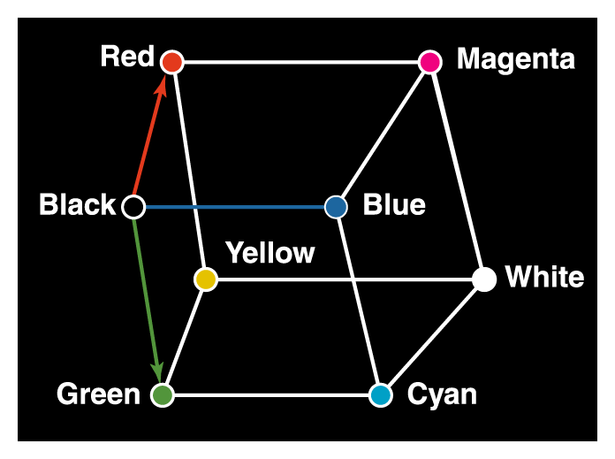
Representing Images and Graphics
Figure 3.10 Three-dimensional color space

Slide 31
Representing Images and Graphics
Color depth: The amount of data that is used to represent a color
HiColor: A 16-bit color depth: five bits used for each number in an RGB value with the extra bit sometimes used to represent transparency
TrueColor: A 24-bit color depth: eight bits used for each number in an RGB value

Slide 32
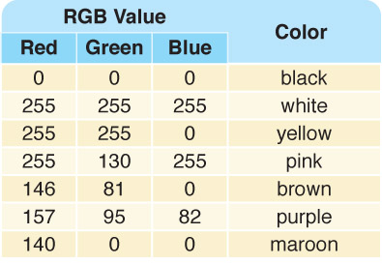
Representing Images and Graphics
A few TrueColor
RGB values and
the colors they
represent

Slide 33
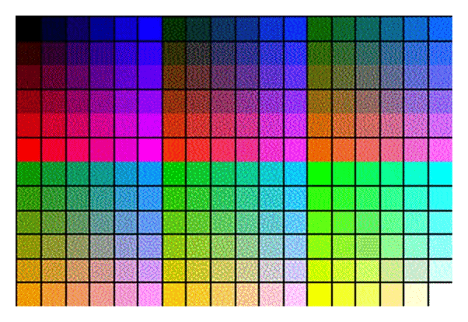
Indexed Color
A browser may support only a certain number of specific colors, creating a palette from which to choose
Figure 3.11 The Netscape color palette

Slide 34
Digitized Images and Graphics
Digitizing a picture Representing it as a collection of individual dots called pixels
Resolution The number of pixels used to represent a picture
Raster Graphics
Storage of data on a pixel-by-pixel basis
Bitmap (BMP), GIF, JPEG, and PNG are raster-grahics formats

Slide 35
Digitized Images and Graphics
Bitmap format: Contains the pixel color values of the image from left to right and from top to bottom
GIF format (indexed color): Each image is made up of only 256 colors
JPEG format: Averages color hues over short distances
PNG format: Like GIF but achieves greater compression with wider range of color depths
Which is better for line drawings? Pictures?

Slide 36
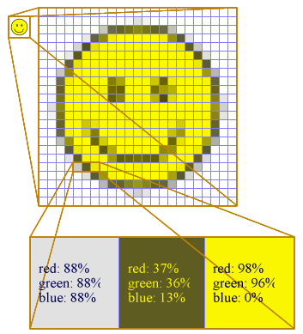
Digitized Images and Graphics

Slide 37
Vector Graphics
Vector graphics
A format that describes an image in terms of lines and geometric shapes
A vector graphic is a series of commands that describe a line’s direction, thickness, and color
The file sizes tend to be smaller because not every pixel is described

Slide 38
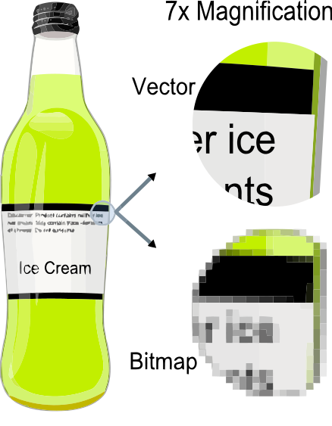
Vector Graphics
Pros: Vector graphics can be resized mathematically and changes can be calculated dynamically as needed
Cons: Vector graphics are not good for representing real-world images

Slide 39
Representing Video
Video codec COmpressor/DECompressor Methods used to shrink the size of a movie to allow it to be played on a computer or over a network
Almost all video codecs use lossy compressions to minimize the huge amounts of data associated with video

Slide 40
Representing Video
Temporal compression
A technique based on differences between consecutive frames: If most of an image in two frames hasn’t changed, why should we waste space to duplicate all of the similar information?
Spatial compression
A technique based on removing redundant information within a frame: This problem is essentially the same as that faced when compressing still images

Slide 41
In class exercise
1. What does it mean to digitize something?
2. How many things can be represented with five bits?
3. What is resolution?
4. Design a number system based on base 11
(a) calculate 5, 12, 21 in base 11.
(b) calculate 15+97 in base 11
(c) calculate 21-17 in base 11

