Slide 1
CS105 Introduction to Computer Concepts GATES and CIRCUITS
Instructor: Yang Mu

Slide 2
How computers use electric signals to represent and manipulate binary values?
Notes:
Any given electronic signal has a level of voltage. As we mentioned in the
last chapter, we distinguish between the two values of interest (binary 0
and 1) by the voltage level of a signal. In general, a voltage level in the
range of 0 to 2 volts is considered “low” and is interpreted as a binary 0.
A signal in the 2- to 5-volt range is considered “high” and is interpreted as
a binary 1. Signals in a computer are constrained to be within one range or
the other.

Slide 3
Outline
Gates
Types
Construction
Circuits
Adder
Multiplexer
Memory
IC

Slide 4
Computers and Electricity
Definitions:
Gate: A device that performs a basic operation on electrical signals
Circuits: Gates combined to perform more complicated tasks
How do we describe the behavior of gates and circuits?
Boolean expressions: Uses Boolean algebra, a mathematical notation for expressing two-valued logic
Logic diagrams: A graphical representation of a circuit; each gate has its own symbol
Truth tables: A table showing all possible input value and the associated output values

Slide 5
Gate Types
Six types of gates
NOT
AND
OR
XOR
NAND
NOR

Slide 6
NOT Gate
A NOT gate accepts one input signal (0 or 1) and returns the opposite signal as output
Figure 4.1 Various representations of a NOT gate

Slide 7
AND Gate
An AND gate accepts two input signals
If both are 1, the output is 1; otherwise, the output is 0
Figure 4.2 Various representations of an AND gate

Slide 8
OR Gate
An OR gate accepts two input signals
If both are 0, the output is 0; otherwise, the output is 1
Figure 4.3 Various representations of a OR gate

Slide 9
XOR Gate (exclusive OR)
An XOR gate accepts two input signals
If both are the same, the output is 0; otherwise,
the output is 1
Figure 4.4 Various representations of an XOR gate

Slide 10
NAND Gate
The NAND gate accepts two input signals
If both are 1, the output is 0; otherwise, the output is 1
Figure 4.5 Various representations of a NAND gate

Slide 11
NOR Gate
The NOR gate accepts two input signals
If both are 0, the output is 1; otherwise,
the output is 0
Figure 4.6 Various representations of a NOR gate

Slide 12
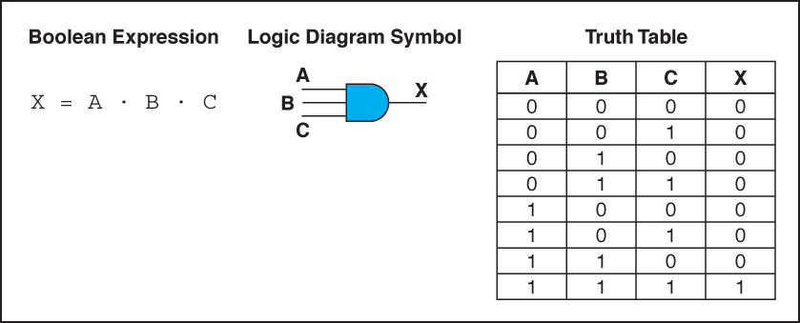
Gates with More Inputs
Gates can be designed to accept three or more input values
A three-input AND gate, for example, produces an output of 1 only if all input values are 1
Figure 4.7 Various representations of a three-input AND gate

Slide 13
Constructing Gates
Transistor
A device that acts either as a wire that conducts electricity or as a resistor that blocks the flow of electricity, depending on the voltage level of an input signal
A transistor has no moving parts, yet acts like a switch
It is made of a semiconductor material, which is neither a particularly good conductor of electricity nor a particularly good insulator

Slide 14
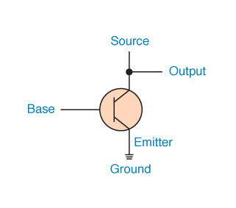
Constructing Gates
A transistor has three terminals
A source
A base
An emitter, typically connected to a ground wire
If the electrical signal is grounded, it is allowed to flow through an alternative route to the ground (literally) where it can do no harm
Figure 4.8 The connections of a transistor

Slide 15
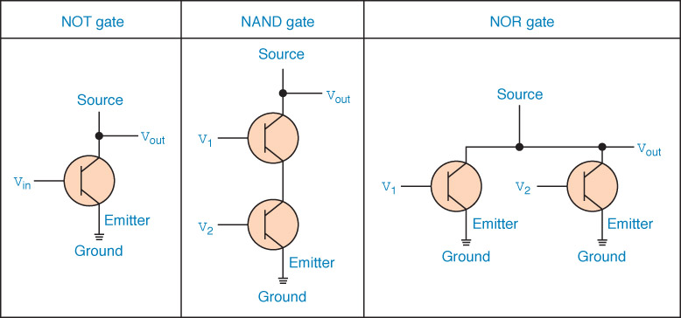
Constructing Gates
The easiest gates to create are the NOT, NAND, and NOR gates
Figure 4.9 Constructing gates using transistors

Slide 16
Circuits
Combinational circuit: The input values explicitly determine the output
Sequential circuit: The output is a function of the input values and the existing state of the circuit

Slide 17
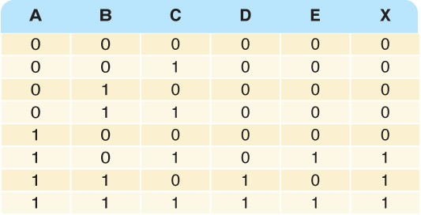
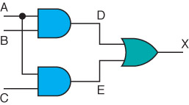
Combinational Circuits
Gates are combined into circuits by using the output of one gate as the input for another

Slide 18
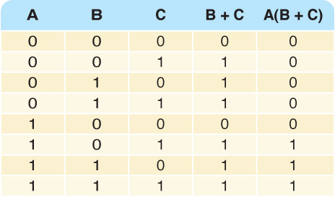
Combinational Circuits
Consider the following Boolean expression A(B + C)
Does this truth table look familiar?
Compare it with previous table

Slide 19
Combinational Circuits
Circuit equivalence
Two circuits that produce the same output for identical input
Boolean algebra allows us to apply provable mathematical principles to help design circuits
E.g., A(B + C) = AB + BC (distributive law) so circuits must be equivalent

Slide 20
Adders
At the digital logic level, addition is performed in binary
Addition operations are carried out by special circuits called, appropriately, adders

Slide 21
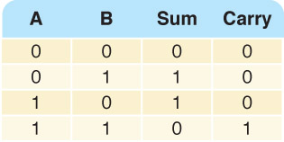
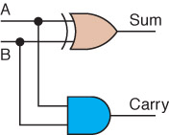
Adders
The result of adding two binary digits could produce a carry value
Recall that 1 + 1 = 10 in base two
Half adder
A circuit that computes the sum of two bits and produces the correct carry bit
Truth table

Slide 22
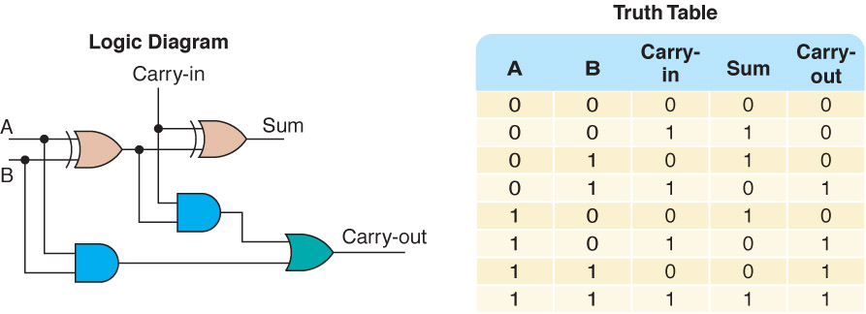
Adders
Full adder
A circuit that takes the carry-in value into account
Figure 4.10 A full adder

Slide 23
Multiplexers
Multiplexer
A circuit that uses a few input control signals to determine which of several output data lines is routed to its output

Slide 24
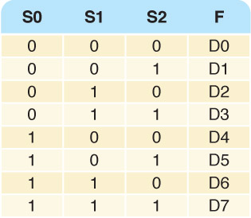
Multiplexers
The control lines S0, S1, and S2 determine which of eight other input lines
(D0 … D7) are routed to the output (F)
Figure 4.11 A block diagram of a multiplexer with three select control lines

Slide 25
Circuits as Memory
Digital circuits can be used to store information
These circuits form a sequential circuit, because the output of the circuit is also used as input to the circuit

Slide 26
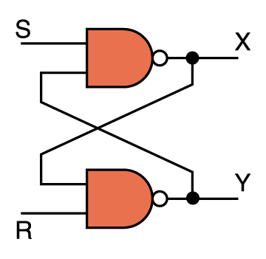
Circuits as Memory
An S-R latch stores a single binary digit (1 or 0)
There are several ways an S-R latch circuit can be designed using various kinds of gates
Figure 4.12 An S-R latch

Slide 27
Circuits as Memory
The design of this circuit guarantees that the two outputs X and Y are always complements of each other
The value of X at any point in time is considered to be the current state of the circuit
Therefore, if X is 1, the circuit is storing a 1; if X is 0, the circuit is storing a 0
Figure 4.12 An S-R latch

Slide 28
Integrated Circuits
Integrated circuit (also called a chip)
A piece of silicon on which multiple gates have been embedded
Silicon pieces are mounted on a plastic or ceramic package with pins along the edges that can be soldered onto circuit boards or inserted into appropriate sockets

Slide 29
Integrated Circuits
Integrated circuits (IC) are classified by the number of gates contained in them

Slide 30
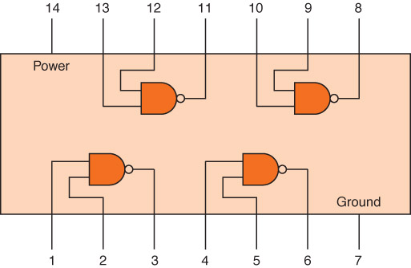
Integrated Circuits
Figure 4.13 An SSI chip contains independent NAND gates

Slide 31
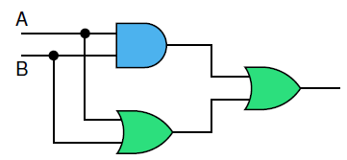
In class exercise
Write down the truth table for XOR
Of what is a transistor usually made?
Show the behavior of the following
circuit with a truth table:

