Slide 1
Introduction to Computer Hardware
CS105, UMass Boston
Lecture: Yang Mu

Slide 2
Computer History

Slide 3
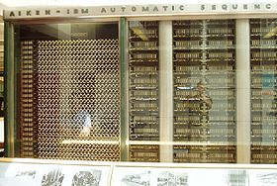
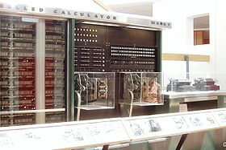
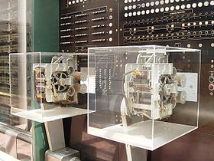
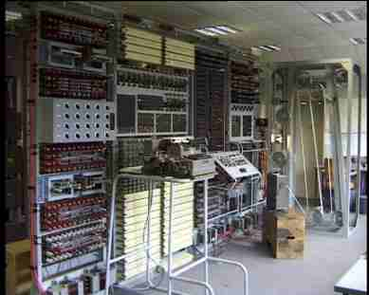
'Harvard Mk I' and Colossus -1943
Portion of the Harvard-IBM Mark 1, left side
Right side
Input/Output and control
Colossus
Notes:
Modern computing can probably be traced back to the 'Harvard Mk I' and Colossus (both of 1943). Colossus was an electronic computer built in Britain at the end 1943 and designed to crack the German coding system - Lorenz cipher. The 'Harvard Mk I' was a more general purpose electro-mechanical programmable computer built at Harvard University with backing from IBM. These computers were among the first of the 'first generation' computers.

Slide 4
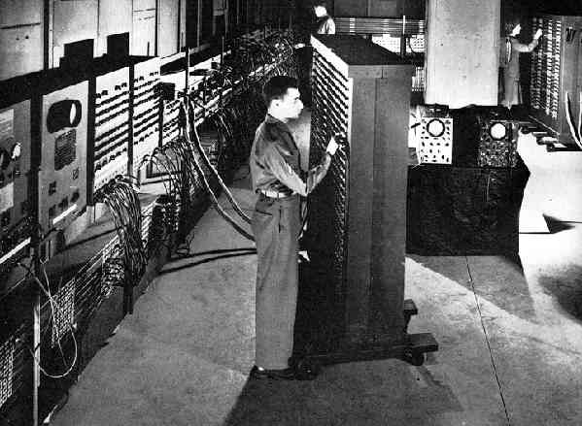
First Generation:
'ENIAC' (Electronic Numerical Integrator and Computer) - 1946
Notes:
First generation computers were normally based around wired circuits containing vacuum valves and used punched cards as the main (non-volatile) storage medium. Another general purpose computer of this era was 'ENIAC' (Electronic Numerical Integrator and Computer) which was completed in 1946. It was typical of first generation computers, it weighed 30 tonnes contained 18,000 electronic valves and consumed around 25KW of electrical power. It was, however, capable of an amazing 100,000 calculations a second.

Slide 5
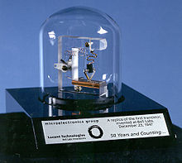
Second Generation:
The invention of the transistor in 1947
A transistor is a semiconductor device used to amplify and switch electronic signals and power. It is composed of a semiconductor material with at least three terminals for connection to an external circuit.
Notes:
The next major step in the history of computing was the invention of the transistor in 1947. This replaced the inefficient valves with a much smaller and more reliable component. Transistorised computers are normally referred to as 'Second Generation' and dominated the late 1950s and early 1960s. Despite using transistors and printed circuits these computers were still bulky and strictly the domain of Universities and governments.

Slide 6
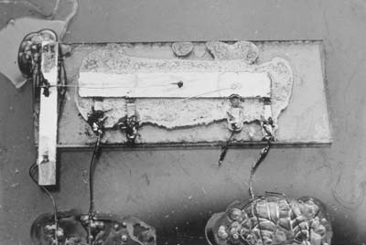
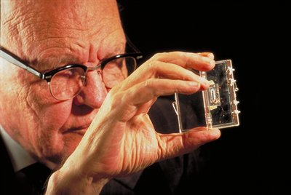
Third Generation:
The integrated circuit or microchip - 1958
Jack Kilby holding first integrated circuit
Notes:
The explosion in the use of computers began with 'Third Generation' computers. These relied Jack St. Claire Kilby's invention - the integrated circuit or microchip; the first integrated circuit was produced in September 1958 but computers using them didn't begin to appear until 1963. While large 'mainframes' such as the I.B.M. 360 increased storage and processing capabilities further, the integrated circuit allowed the development of Minicomputers that began to bring computing into many smaller businesses. Large scale integration of circuits led to the development of very small processing units, an early example of this is the processor used for analyising flight data in the US Navy's F14A `TomCat' fighter jet. This processor was developed by Steve Geller, Ray Holt and a team from AiResearch and American Microsystems.

Slide 7
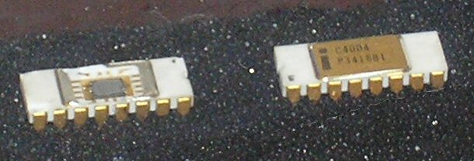
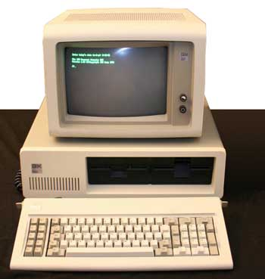
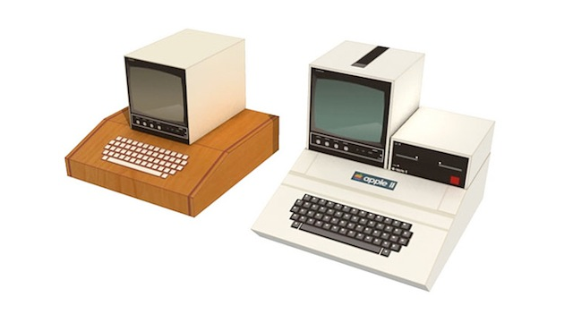
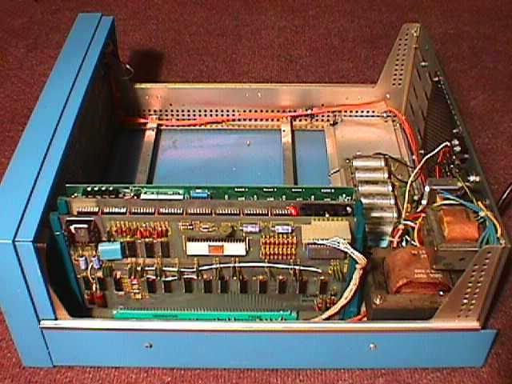
Fourth Generation: Intel chip -1971
The 4004 microprocessor
MITS Altair 8800
Notes:
On November 15th, 1971, Intel released the world's first commercial microprocessor, the 4004. Fourth generation computers were developed, using a microprocessor to locate much of the computer's processing abilities on a single (small) chip. Coupled with one of Intel's inventions - the RAM chip (Kilobits of memory on a single chip) - the microprocessor allowed fourth generation computers to be even smaller and faster than ever before. The 4004 was only capable of 60,000 instructions per second, but later processors (such as the 8086 that all of Intel's processors for the IBM PC and compatibles is based) brought ever increasing speed and power to the computers. Supercomputers of the era were immensely powerful, like the Cray-1 which could calculate 150 million floating point operations per second. The microprocessor allowed the development of microcomputers, personal computers that were small and cheap enough to be available to ordinary people. The first such personal computer was the MITS Altair 8800, released at the end of 1974, but it was followed by computers such as the Apple I & II, Commodore PET and eventually the original IBM PC in 1981.

Slide 8
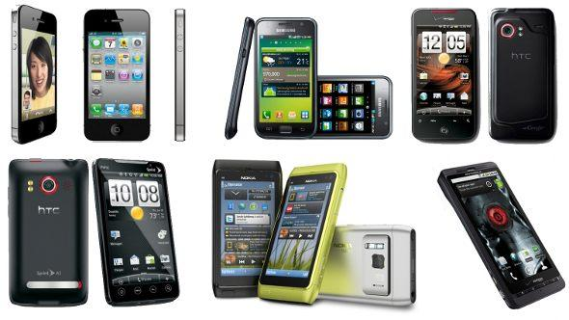
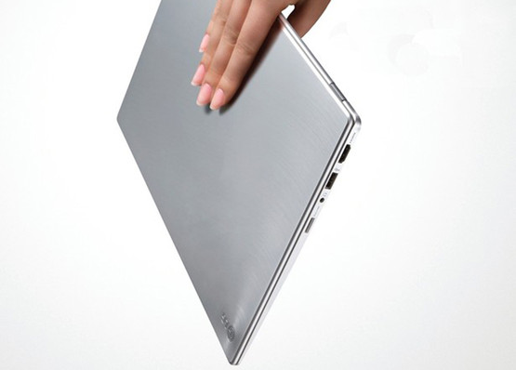
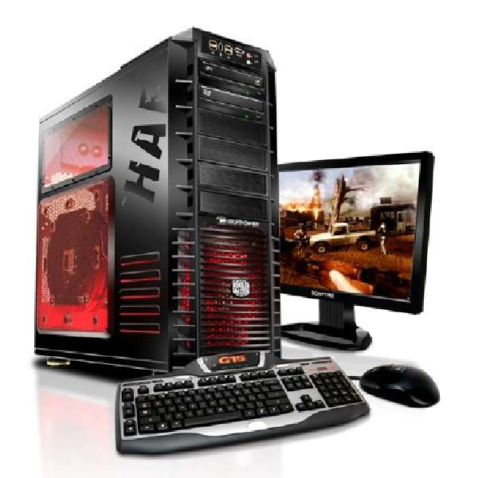
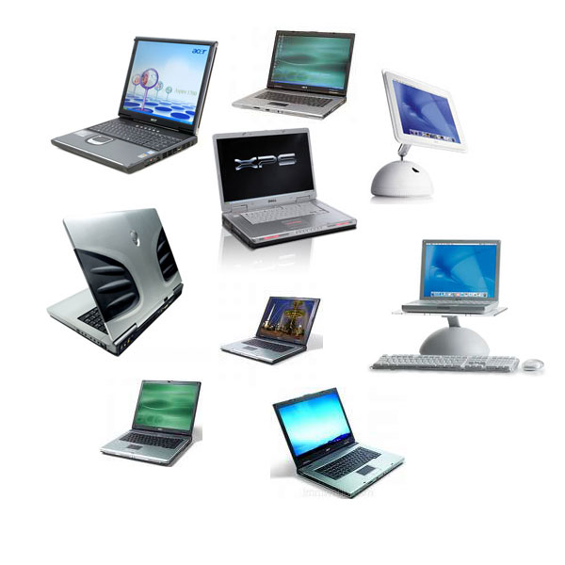
Today’s Computer
Notes:
Although processing power and storage capacities have increased beyond all recognition since the 1970s the underlying technology of LSI (large scale integration) or VLSI (very large scale integration) microchips has remained basically the same, so it is widely regarded that most of today's computers still belong to the fourth generation.

Slide 9
Computer Hardware
In this chapter:
  How did the computer become known as the stored-program computer?
    Do they all have the same characteristics?
  Memory on chips and memory on magnetic media, how do they differ?
  What do you look for when comparing memory devices?
  How is information moved around within the computer?
  How can you help your computer run better?

Slide 10
What is a Computer?
Computer
  Device capable of performing computations and making logical decisions
  Computers process data under the control of sets of instructions called computer programs
  Personal computers: economical enough for individual
  Distributed computing: computing distributed over networks
  Client/server computing: sharing of information across computer networks between file servers and clients (personal computers)

Slide 11
What is a Computer? (cont.)
Computer Hardware
  Various devices comprising a computer:
  Keyboard, screen, mouse, disks, memory, CD-ROM, and processing units
  Hardware Trends: every year or two the following approximately double (Moore’s Law):
    Amount of memory in which to execute programs
    Amount of secondary storage (such as disk storage)
      Used to hold programs and data over the longer term
    Processor speeds
      The speeds at which computers execute their programs

Slide 12
Moore's Law
Defined by Dr. Gordon Moore during the sixties.
Predicts an exponential increase in component density over time, with a doubling time of 18 months.
Applicable to microprocessors, DRAMs , DSPs and other microelectronics.
Monotonic increase in density observed since the 1960s.

Slide 13
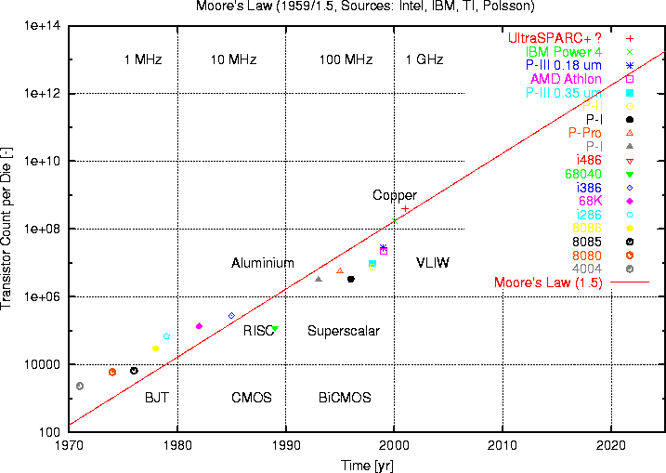
Moore’s Law - Density

Slide 14
Moore's Law and Performance
The performance of computers is determined by architecture and clock speed.
Clock speed doubles over a 3 year period due to the scaling laws on chip.
Processors using identical or similar architectures gain performance directly as a function of Moore's Law.
Improvements in internal architecture can yield better gains than predicted by Moore's Law.

Slide 15
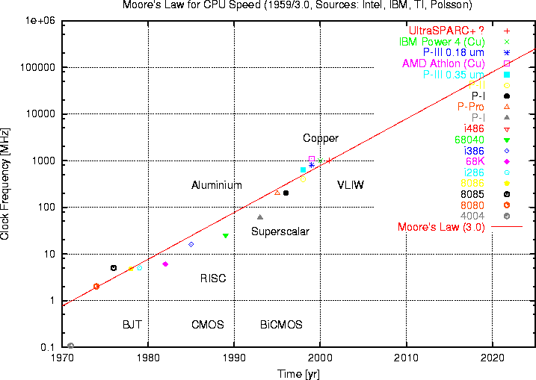
Moore’s Law - Clock Speed

Slide 16
Basic Concepts of Computer Hardware
Primary Memory
Input
Units
CPU
(Central Processing Unit)
Output
Units
This model of the typical digital computer is often called the von Neumann computer.
  Programs and data are stored in the same memory: primary memory.
  The computer can only perform one instruction at a time.

Slide 17
Basic Concepts of Computer Hardware
Input/Output (I/O): Refers to the process of getting information into and out of the computer.
  Input: Those parts of the computer receiving information to programs.
  Output: Those parts of the computer that provide results of computation to the person using the computer.

Slide 18
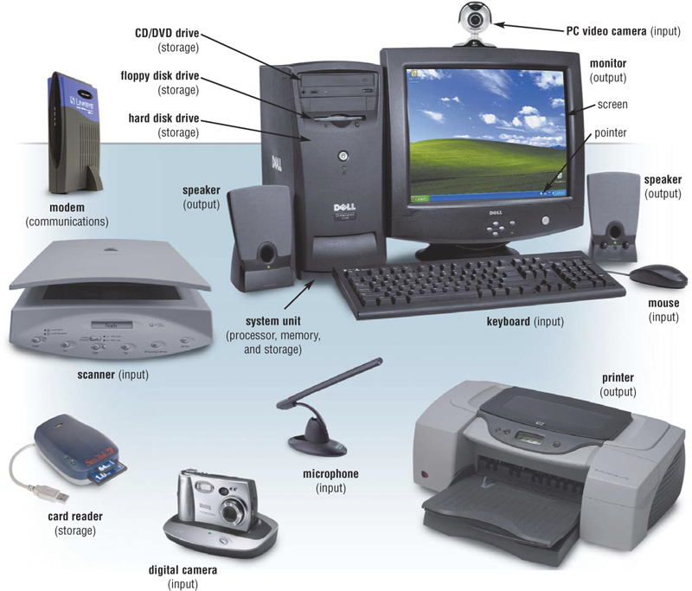
The Components of a Computer
What is an input device?
Hardware used
  to enter data
  and instructions

Slide 19
The Components of a Computer
What is an output device?
Hardware that
  conveys information
  to a user

Slide 20
Sources of Data for the Computer
Two types of data stored within a computer:
  Original data or information: Data being introduced to a computing system for the first time.
    Computers can deal directly with printed text, pictures, sound, and other common types of information.
  Previously stored data or information: Data that has already been processed by a computer and is being stored for later use.
    These are forms of binary data useful only to the computer.
    Examples: Floppy disks, DVD disks, and music CDs.

Slide 21
Input Devices
Two categories of input hardware:
  Those that deal with original data.
  Those that handle previously stored data.

Slide 22
Input Devices
Input hardware: Those that deal with original data.
  Keyboard
  Mouse
  Voice recognition hardware
  Scanner
  Digital camera
Digitizing: The process of taking a visual image, or audio recording and converting it to a binary form for the computer.
  Used as data for programs to display, play or manipulate the digitized data.

Slide 23
Input Devices
Connecting Hardware to the computer:
  Hardware needs access through some general input/output connection.
    Port: The pathway for data to go into and out of the computer from external devices such as keyboards.
      There are many standard ports as well as custom electronic ports designed for special purposes.
      Ports follow standards that define their use.
        e.g., USB
    Peripheral device: A piece of hardware like a printer or disk drive, that is outside the main computer.

Slide 24
Input Devices
Connecting Hardware to the computer: (continued)
  Hardware needs software on the computer that can service the device.
    Device driver: Software addition to the operating system that will allow the computer to communicate with a particular device.

Slide 25
Input Devices
Common Basic Technologies for Storing Binary Information:
  Electronic
  Magnetic
  Optical

Slide 26
Input Devices
Electronic Circuits
  Most expensive of the three forms for storing binary information.
  A flip-flop circuit has either one electronic status or the other. It is said to flip-flop from one to the other.
  Electronic circuits come in two forms:
    Permanent
    Non-permanent

Slide 27
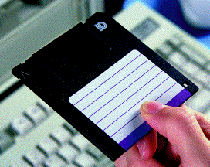
Input Devices
Magnetic Technology
  Two parts to most of the magnetic forms of information storage:
    The medium that stores the magnetic information.
      Example: Floppy disk. Tiny spots on the disk are magnetized to represent 0s and 1s.
    The device that can “read” that information from the medium.
      The drive spins the disk.
      It has a magnetic sensing arm that moves over the disk.
      Performs nondestructive reading.

Slide 28
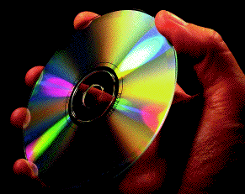
Input Devices
Optical
  Uses lasers to “read” the binary information from the medium, usually a disc.
    Millions of tiny holes are “burned” into the surface of the disc.
    The holes are interpreted as 1s. The absence of holes are interpreted as 0s.

Slide 29
Input Devices
Secondary Memory Input Devices
  These input devices are used by a computer to store information and then to retrieve that information as needed.
    External to the computer.
    Commonly consists of floppy disks, hard disk drives, or CD-ROMs.
  Secondary memory uses binary.
    The usual measurement is the byte.
      A byte consists of 8 binary digits (bits). The byte is a standard unit.

Slide 30
Input Devices
The four most important characteristics of storage devices:
  Speed and access time
  Cost / Removable versus non-removable
  Capacity
  Type of access

Slide 31
Output Devices
Output units store and display information (calculated results and other messages) for us to see and use.
  Floppy disk drives and Hard disk drives.
  Display monitors: Hi-resolution monitors come in two types:
    Cathode ray tube (CRT) - Streams of electrons make phosphors glow on a large vacuum tube.
    Liquid crystal display (LCD) - A flat panel display that uses crystals to let varying amounts of different colored light to pass through it.
      Developed primarily for portable computers.

Slide 32
Output Devices
Audio Output Devices
  Windows machines need special audio card for audio output.
  Macintosh has audio playback built in.
  Audio output is useful for:
    Music
      CD player is a computer.
      Most personal computers have CD players that can access both music CDs and CD-ROMs.
    Voice synthesis (becoming more human sounding.)
    Multimedia
    Specialized tasks (i.e.: elevator’s floor announcements)

Slide 33
Output Devices
Optical Disks: CD-ROM and DVD
  CD-ROM (Compact Disk - Read Only Memory)
    By its definition, CD-ROM is Read Only.
    Special CD drives “burn” information into blank CDs.
      Burn: A laser is used to “burn” craters into the surface to represent a binary 1.
      Two main types of CDs:
        CD-R (Compact Disk - Recordable)
        CD-WR (Compact Disk - ReWritable)
    It takes longer to write to a CD-R than a hard drive.
    Special software is needed to record.

Slide 34
What to Consider before Buying a New Computer?
Why do you want to buy a computer?
Who is going to use the computer?
How long are you going to keep this new computer?
Do you or will you have a wireless network in your house?
Do you want the new computer to be portable?
How much do you want to spend when you buy a computer?
Etc.
Know your NEEDS
Know your computer SKILLS
Know your financial LIMITS
Notes:
http://www.sensible-computer-help.com/buy-a-computer.html

Slide 35
Computer Components
Input/Output (Mouse, Keyboard, Display)
Processor and Memory
Storage
Multimedia( Audio, Graphics and Video Support)
Connection and Expansion
Battery and Power
Communication

Slide 36
Input
Keyboard
  E.g., Full-size backlit keyboard with 78 (U.S.) or 79 (ISO) keys, including 12 function keys and 4 arrow keys
Mouse/Track-pad
  E.g., Multi-Touch trackpad for precise cursor control; supports inertial scrolling, pinch, rotate, swipe, three-finger swipe…

Slide 37
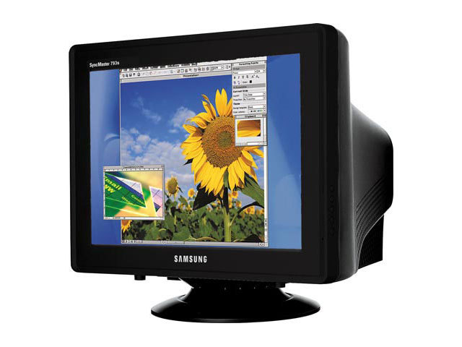
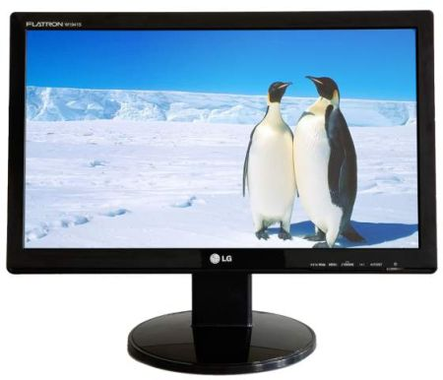
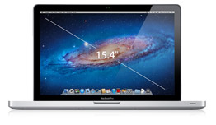
Display
15.4-inch (diagonal) LED-backlit glossy or optional antiglare widescreen display with support for millions of colors
Supported resolutions: 1440 by 900 (native), 1280 by 800, 1152 by 720, 1024 by 640, and 800 by 500 pixels at 16:10 aspect ratio

Slide 38
Sizes in Perspective
What is a hertz?

Slide 39

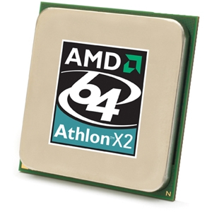
Processor
What is a CPU and what does it do? The Central Processing Unit (CPU) is the ‘brain’ of the computer, it lets the other components of the computer know what they have to do
Why do I need one? Having a better CPU (measured in GigaHertz) greatly improves the overall speed of your computer. The faster the Processors speed, the more calculations your computer can do in a short space of time.
What is available and what are the benefits of each?
  Single Core Processors: Have one “core” allowing them to process sets of instructions as they are transmitted to the CPU.
  Dual Core processors: Have 2 “Cores” that allow processing of multiple instructions at the same time.
  Quad Core Processors ?
E.g., 2.4GHz quad-core Intel Core i7 processor with 6MB shared L3 cache
Notes:
http://www.techradar.com/news/computing-components/intel-vs-amd-which-processor-is-best--936589

Slide 40
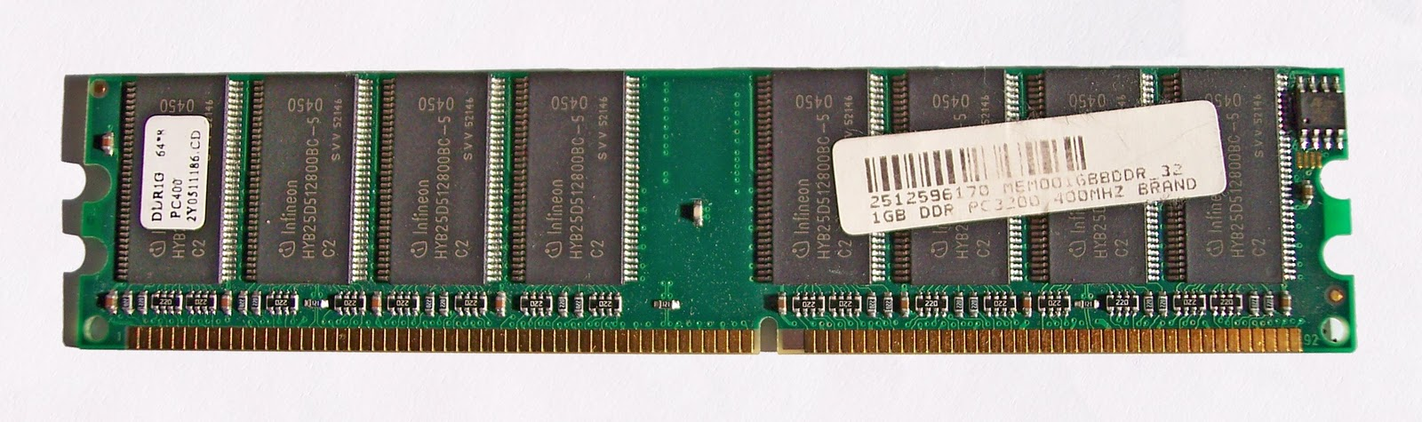
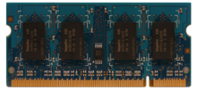
Memory - RAM
RAM stands for Random Access Memory and is typically measured in megabytes. It is responsible for the speed at which the computer processes data and actions.
Why do I need one? The more RAM your computer has, the quicker it can access your programs and files.
Types:
  SDRAM: Synchronous dynamic random access memory
  DDR: Double Data Rate RAM. It is used in most computers and is faster than older SDRAM types.
  DDR2, DDR3: Newer styles of DDR RAM which boasts extra performance due to the increased speed at which it runs.
E.g., 4GB (two 2GB SO-DIMMs) of 1333MHz DDR3 memory; two SO-DIMM slots support up to 8GB
Notes:
- http://en.wikipedia.org/wiki/Synchronous_dynamic_random-access_memory
A SO-DIMM, or small outline dual in-line memory module, is a type of computer memory built using integrated circuits.
SO-DIMMs (also written SODIMMs) are a smaller alternative to a DIMM, being roughly half the size of regular DIMMs. SO-DIMMs are often used in systems which have space restrictions such as notebooks, small footprint PCs (such as those with a Mini-ITX motherboard), high-end upgradable office printers, and networking hardware like routers.

Slide 41
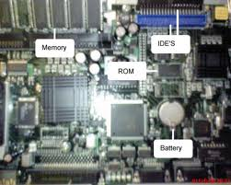
Rom
Read-only memory
a type of storage media that is used in computers and other electronic devices.
ROM image
  a computer file which contains a copy of the data from a read-only memory chip

Slide 42
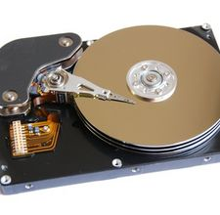
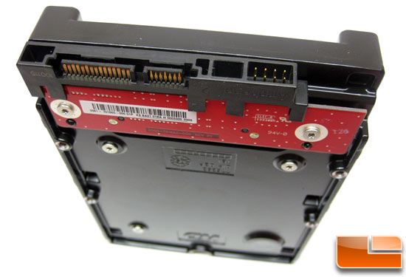
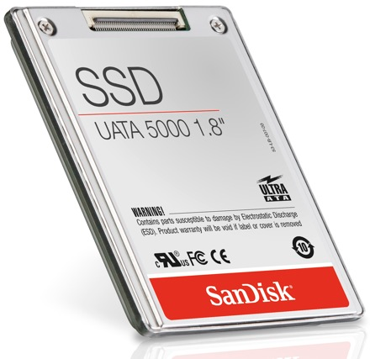
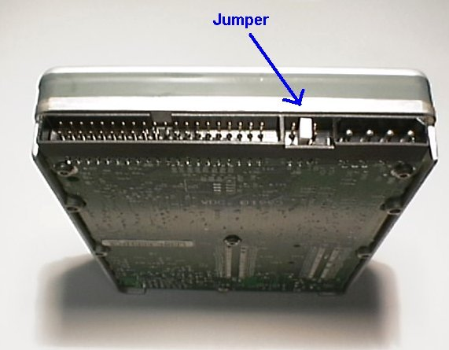
Internal Storage
Hard drive is where all your data are stored. It is the computers long term memory. The size of a hard drive is measured in gigabytes (Gb)
Types: PATA, SATA, SSD
E.g., 750GB 5400-rpm Serial ATA hard drive

Slide 43
External Storage
DVD-RW, DVD+RW; 24x CD-R; 10x CD-RW
Blu-ray
Flash Drive
External Hard Drive

Slide 44
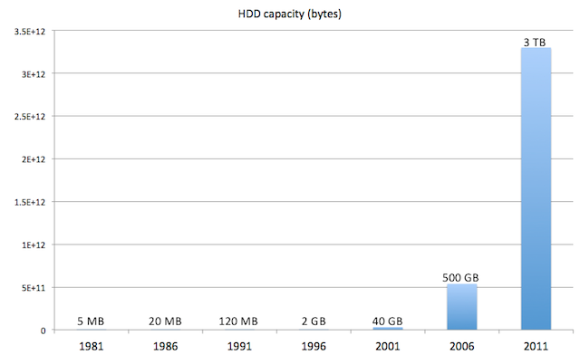
Statistics
Source: Information explosion: how rapidly expanding storage spurs innovation

Slide 45
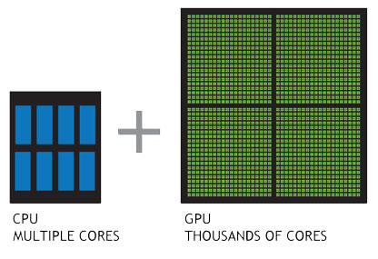
Multimedia
Stereo speakers with subwoofers; Omnidirectional microphone (located under left speaker grille); Audio line in minijack (digital/analog); Audio line out/headphone minijack (digital/analog)
AMD Radeon HD 6750M graphics processor with 512MB of GDDR5 memory on 2.2GHz configuration

Slide 46

Connection and Expansion
MagSafe power port
Gigabit Ethernet port
FireWire 800 port (up to 800 Mbps)
Two USB 2.0 ports (up to 480 Mbps)
Thunderbolt port (up to 10 Gbps)
Audio line in; Audio line out
SDXC card slot
Kensington lock slot

Slide 47
Battery and Power
Built-in 77.5-watt-hour lithium-polymer battery

Slide 48
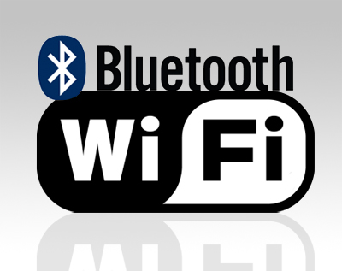
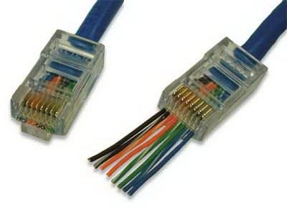
Communication
Wi-Fi wireless networking (based on IEEE 802.11n specification); IEEE 802.11a/b/g compatible
Bluetooth 2.1 + EDR (Enhanced Data Rate)
Wireless technology10/100/1000BASE-T Gigabit Ethernet (RJ-45 connector)

Slide 49
Software
Microsoft® Windows 7® Professional
Microsoft® Office Home and Student 2007
36-Month subscription to McAfee Security Center Anti-virus

Slide 50
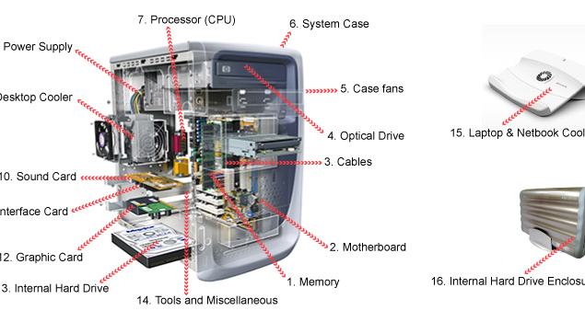
All together

Slide 51
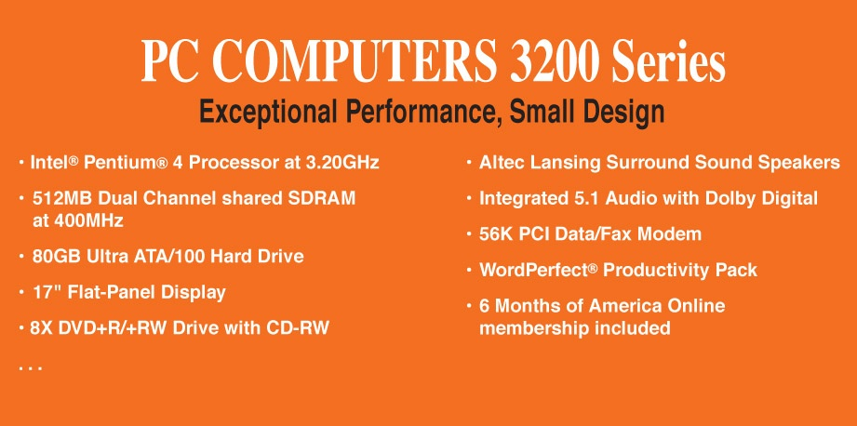
Computer Ads
Consider the following ad:
Insatavialion 640 Laptop
Exceptional Performance and Portability
• 85 WHr Lithium Ion Battery
• (2) USB 2.0, HDMI, 15-pin VGA, Ethernet
10/100/1000, IEEE 1394 Firewire, Express
Card, Audio line-in, line-out, mic-in
• 14.8W X 1.2H X 10.1D, 5.6 lbs
• Microsoft0® Windows 7® Professional
• Microsoft® Office Home and Student
2007
• 36-Month subscription to McAfee
Security Center Anti-virus
• Intel® Core™ 2 Duo (2.66GHz/1066Mhz
FSB/6MB cache)
• 15.6” High Definition (1080p) LED
Backlit LCD Display (1366 x 768)
• 512MB ATI Mobility Radeon Graphics
• Built-in 2.0MP Web Camera
• 4GB Shared Dual Channel DDR2 at
800MHz
• 500GB SATA Hard Drive at 5400RPM
• 8X Slot Load DL DVD+/- RW Drive
• 802.11 a/g/n and Bluetooth 3.0

Slide 52
Sizes in Perspective
Intel Processor
speed 2.66 GHz
SDRAM
size 4GB
speed 800 MHz
500GB SATA at 5400 RPM
Transfer rate 300MB per second
To which do these apply?
Bigger is better
Faster is better
Smaller is better

Slide 53
Post-PC computing

Slide 54
Outline
What is Post-PC Computing?
History
Drivers of the Post-PC Era
Hardware/Software

Slide 55
What is Post-PC Computing?
The term was invented by Apple CEO Steve Jobs
Definition: a new era of computing that takes the PC off its pedestal and makes it just another computing device, putting it on equal footing with smartphones, tablets, eBook readers, gaming consoles, and interactive TVs.
Notes:
Apple CEO Steve Jobs coined the term “Post PC” in reference to a new era of
computing that takes the PC off its pedestal and makes it just another computing device, putting
it on equal footing with smartphones, tablets, eBook readers, gaming consoles, and interactive TVs.
Smartphones and tablets in particular are spearheading this wave of change as they shift consumer
expectations about computing, data access, and media consumption. Over the next year marketers
looking to get ahead of the curve will need to explore new ways to integrate unique smartphone
and tablet executions into their campaigns.
WHAT IS POST-PC COMPUTING?
Not only have smartphones and tablets brought mobile marketing to the forefront of strategists’ minds,
but we are also seeing them applied to enhance traditional media such as TV and print to make them
more interactive and engaging to audiences. By linking post-PC devices to TVs and print through
technologies like audiotagging and visual search, participants have more options for how they choose
to interact with video and text content, leading to true three-screen experiences that make a piece
of content interactive across phone, TV, and computer.
But moving into a post-PC era presents unique challenges to marketers and brands. Analytics, targeting,
and customization best practices need to be applied to to traditional media to create enhanced
versions of TV shows or customized digital magazines and newspapers. In other cases, marketers will
need to learn when to walk away from some digital traditions in favor of creating
post-PC experiences from the ground up.

Slide 56
Drivers of the Post-PC Era
Technology Drivers
Cultural Drivers
Declining PC Shipments, while Smartphones and Tablets Rise
Continued Improvement in Mobile Computing Power
Mobile Media Production
Computers Are Everywhere
Real-time Lifestyles
Time-shifted Content Consumption
Recommendation Addiction
Gone Gaming
Notes:
Declining PC Shipments, while Smartphones and Tablets Rise
By Q1 2011, 4.8% of U.S. consumers owned a tablet, according to Nielsen, after really only being on the
market for a year and eBook reader adoption is 9%, though some expect tablets to quickly overtake
that market segment. By comparison, it took two and a half years for Apple to sell 50,000 Apple IIs in
the late 70s.
By the end of the first quarter of 2011, global smartphone and tablet shipments had already overtaken
PC and laptop shipments. For the first quarter of 2011 research firm IDC has indicated that PC shipment
growth is declining, and though not all of this decline can be attributed to smartphone and tablet
growth, shifting consumer expectations for computing devices are strong drivers of this trend.
Continued Improvement in
Mobile Computing Power
Other improvements in post-PC performance are
found in the improved quality of the wireless networks
upon which so many of these devices depend. In the
case of mobile networks, 3G speeds have become
accessible to consumers in major markets across the
US, giving most people access to the data speeds
needed to use mobile media experiences ranging
from apps to mobile music and video.
With the roll out of 4G networks from global wireless companies, mobile data
performance should only increase, rivaling the speed of the wired Internet connections that
most people currently rely on. Improvements in wired Internet also serve to bolster post-PC device
performance. For example, tablets are often used in the home since most entry-level tablets
are WiFi-only.
Mobile Media Production
Another technological trend fueling this era
is related to development of mobile media
in general. Tools like Sencha and others are
creating environments that make HTML5/CSS3
implementation as relatively simple as designing
in Flash. With the new standards for mobile
advertising units and best practices for
touch-based experiences surfacing, mobile
ad companies have also moved toward a
trend of turnkey creative development.
Computers Are Everywhere
Technologists are quick to remind people that
the computers they carry in their pockets are
more powerful than the computers used to send
man to the moon. While true, it’s also important
to keep in mind that these computers are moving
beyond smartphones and tablets and into
televisions, cars, and even kitchen appliances.
Real-time Lifestyles
Consumers are inundated with real-time information. Status updates, photos, check-ins, email, text
messaging, and chat are communication tools that increasingly demand quick response times and
condition everyday people to essentially be “on call” to the demands of their new digital lifestyles.
Proximity-based social networks are another interesting trend within the post-PC space. With untethered
devices, it’s often more important to be connected to people nearby. This trend emerged early on with
the WiFi connectivity of the Nintendo DS, which connected nearby gamers for local multiplayer competitions.
New proximity-based social networks can be seen in a service like Color, a small photo-sharing
service that groups photos and videos together based on how close people are to each other, making
it possible to create large media galleries from live events by aggregating nearby people’s content.
Time-shifted Content Consumption
People are enabled to consume content whenever
they want to, on any device. Regardless of whether
or not DVRs significantly impact TV advertising, the
technology has created a consumer expectation of
on-demand content that fits into individual schedules.
Consumers overcame the restrictions of TV schedules
with the DVR, and they have moved that expectation
into post-PC media consumption as well.
One aspect of this trend is manifested in continuity
across devices. Consumers are now coming to expect
that if they begin to watch a program on Netflix
on one device such as their Xbox, they should be
able to continue to watch it on the go on their tablet
after leaving the living room.
Recommendation Addiction
People have come to expect instant access to high quality information. For this reason, people are
increasingly turning to trusted data sources before making decisions, which is having an impact on
everything from shopping to health related topics.
Whether it’s looking for recommendations on what products to buy or where to go eat, consumers
are relying more on the advice of friends and trusted Internet sources to help make these decisions.
Real-time feedback from sites like Twitter and Facebook make it easy for people to gauge their
networks’ opinions on what to do and where to go.
Other sites are focusing on becoming trusted sources for curating and personalizing recommendations.
Instead of relying on a video store clerk to recommend a movie to watch, Netflix and other sites are
using more sophisticated recommendation algorithms to simplify decision-making and increase the
quality of the media experience through personalized suggestions tailored to the individual.
Gone Gaming
Video games have broken free of being media created primarily for teenage boys and young adult
men to an easily accessible form of entertainment that now caters to all audiences. Casual games
have become more popular, especially in the form of social games played on Facebook, and their
popularity has successfully altered the entire gaming industry into one that develops
fun gaming experiences for all audiences.
The growth of gaming has also led to new revenue sources for everyone involved in the industry.
Advertising revenue within gaming is looking to grow, as more brands are taking in-game advertising
seriously when it comes to working with social and mobile games. Whether it’s a promotion of branded
virtual goods in a game or giving real world rewards such as coupons for beating the boss on level 3,
brands are finding new ways to reach gaming audiences, with surprising results.
Source: Moxie Q3-2011 Trends Report

Slide 57
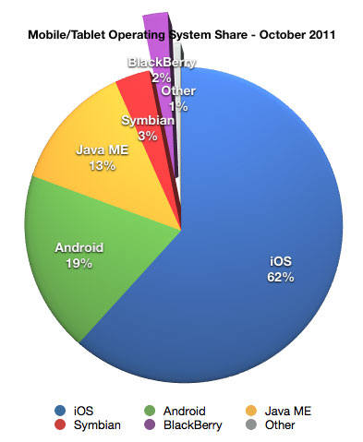
Notes:
Source: http://www.macobserver.com/tmo/article/ios_web_traffic_share_now_over_60/

Slide 58
Why Post-PC?
The declining importance of PCs and laptops as consumers adopt wireless devices like smartphones and tablets to handle their computing needs.
Facts:
  Tablets Aren’t Mobile
  Leapfrogging to Post-PC Lifestyles
  People like to read on Tablets
  Ad-supported hardware is appealing
Notes:
1. Tablets Aren’t Mobile
Tablet owners are primarily using these devices at home, not on the go. Therefore, tablets shouldn’t be part of “mobile” strategy.
2. Leapfrogging to Post-PC Lifestyles
It is more comfortable using their smartphones and tablets than using PCs and laptops. Other studies have shown that a growing portion of the United States are relying only on their smartphones for Internet access, so this behavior is likely to increase as more people purchase these powerful wireless devices.
3. They’d Rather Read on Tablets
There seems to be a common sentiment among observers of the eReader and tablet markets that people will always prefer reading
on books and magazines. Within a year of the first iPad’s launch, 85% of the respondents indicated that they prefer reading on tablets/
smartphones to newspapers/magazines.
4. Ad-Supported Hardware Is Appealing
The ad-supported Amazon Kindle is already the highest selling product in Amazon’s eReader line. How receptive consumers are to ad-supported hardware if it results in a cheaper price? 73% indicated they would be willing to pay for ad-supported devices.

Slide 59
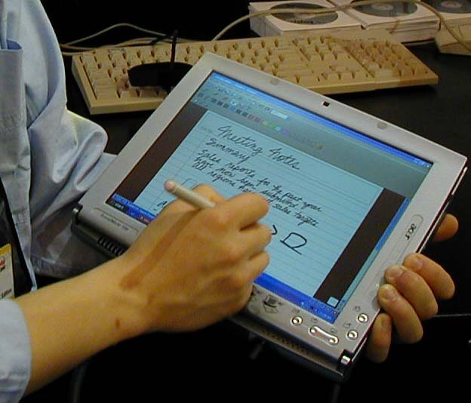
What is “Tablet”?
A plate on which we can write.

Slide 60
The History of Tablet PCs
Concepts of writing on computer is not new –
1. Pen Windows OS from Microsoft (In the time of Windows 3.1)
2. Windows 95 Pen Edition
3. Newton Pen input device (from Apple Computer)
But all failed…

Slide 61
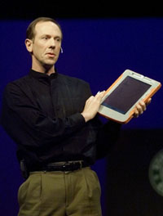
The History of Tablet PCs
Bert Keely – the dreamer of Tablet PCs.
First drawing the future of Tablet in the SGI lab.
In order to fulfill his dream, he met the CEOs of Apple and Dell, but all of them refused Keely.
Finally, Bill Gates accepted his suggestion, and soon decided to develop an OS for his dream.
Microsoft software architect Bert Keely shows a prototype of the Tablet PC during Bill Gates' keynote at COMDEX/Fall 2000.

Slide 62
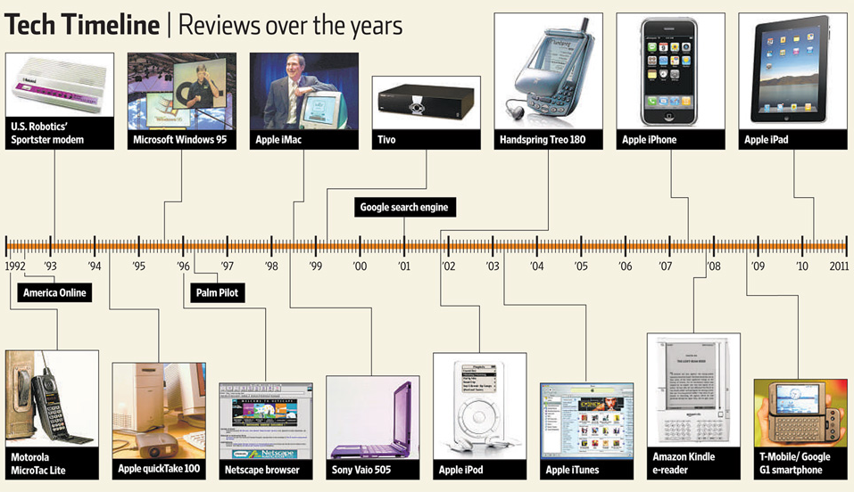
Notes:
Source: http://allthingsd.com/20111102/dialing-up-20-years-of-gadget-reviews/#slideshow-1-1

Slide 63
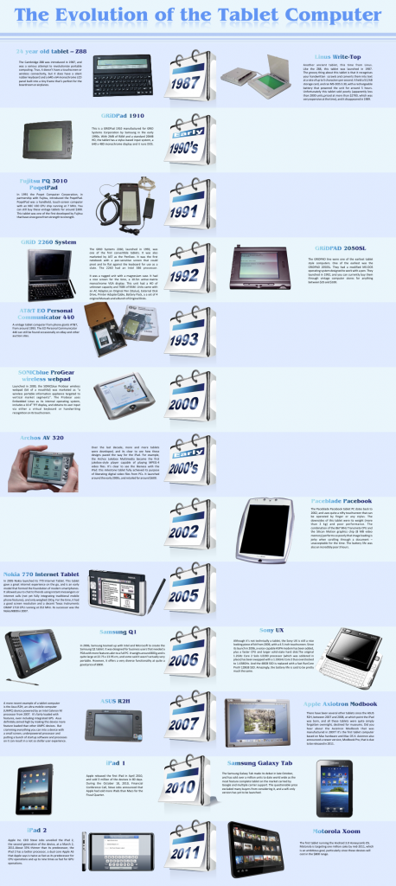
Notes:
Source:
http://www.huffingtonpost.com/2010/04/15/history-tablet-pc-photos_n_538806.html#s80379&title=Google_Android_Tablet
http://bestandroidtabletreviews.net/2011/08/the-timeline-of-the-tablet-pc-as-we-know-it/

