Slide 1
Introduction to Operation System
CS105
Instructor: Yang Mu

Slide 2
Outline
Operating Systems
Timelines
Statistics
Roles
Resource Management
CPU Scheduling
File System

Slide 3
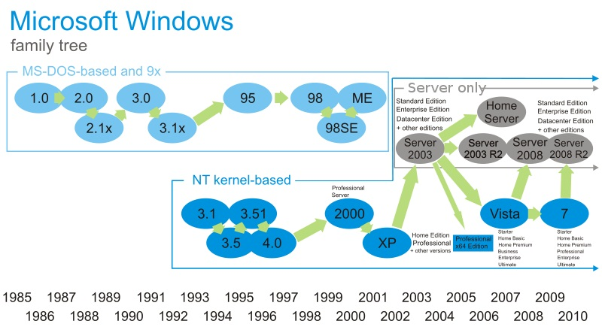
Notes:
- Windows 8 Review: http://channel9.msdn.com/Blogs/Windows-Blog/Windows-8-Consumer-Preview-Demo
- Windows NT (New Technology) is a family of operating systems produced by Microsoft, the first version of which was released in July 1993. It was a powerful high-level-language-based, processor-independent, multiprocessing, multiuser operating system with features comparable to Unix.

Slide 4
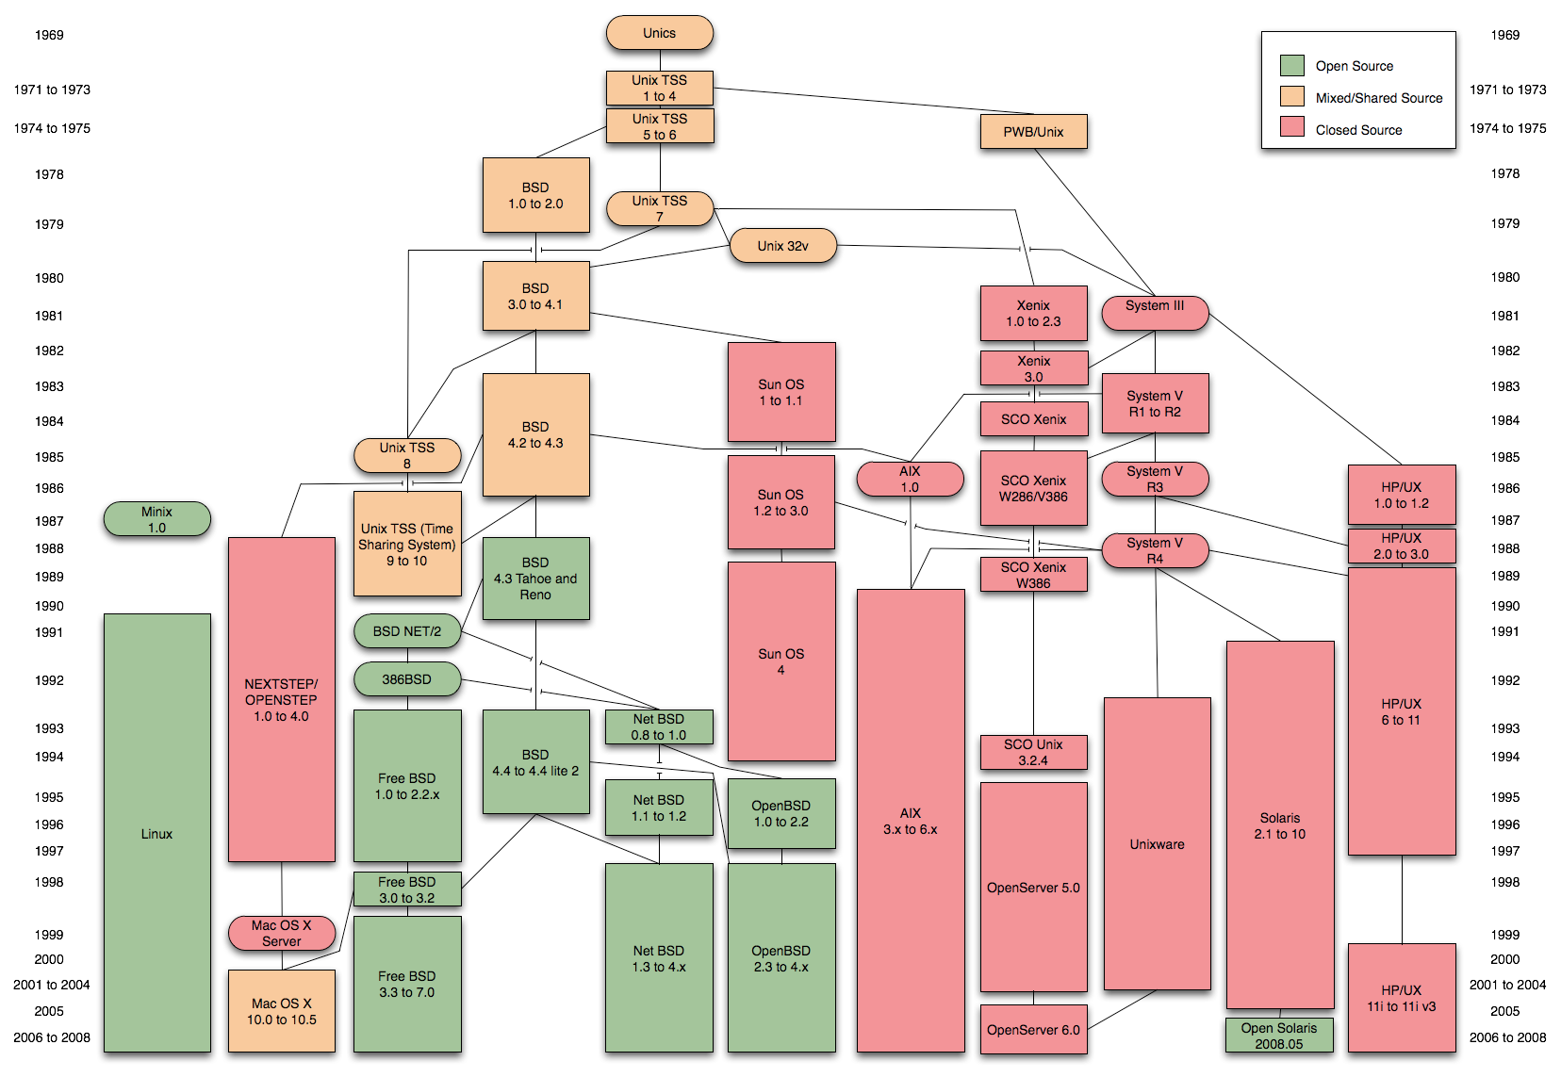
Notes:
OpenBSD is a Unix-like computer operating system descended from Berkeley Software Distribution (BSD), a Unix derivative developed at the University of California, Berkeley.
MINIX is an inexpensive minimal Unix-like operating system, designed for education in computer science, written by Andrew S. Tanenbaum. Starting with version 3, MINIX was free and redesigned for “serious” use.In 1991 while attending the University of Helsinki, Torvalds became curious about the operating systems [27] and frustrated by the licensing of MINIX, which limited it to educational use only. He began to work on his own operating system which eventually became the Linux kernel.

Slide 5
Mac OS

Slide 6
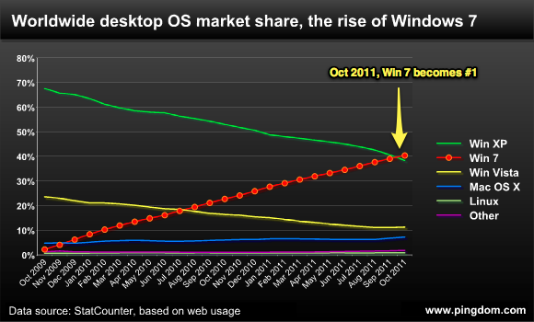
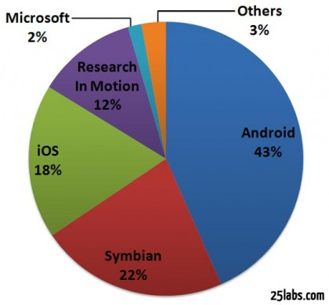
OS Market Share
Notes:
Smartphone operating system market share – Q2 2011

Slide 7
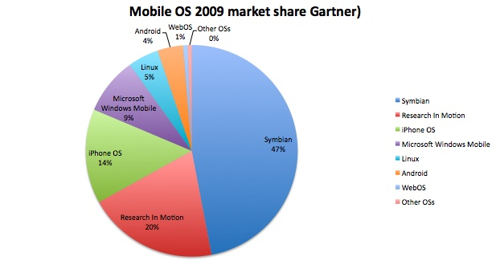
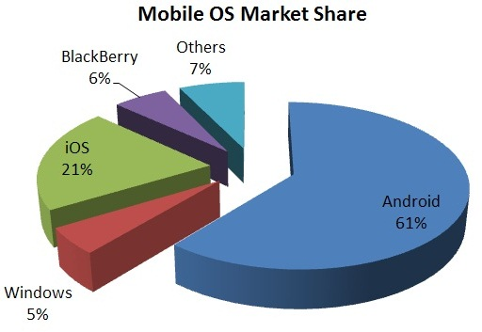
OS Market Share
2012

Slide 8
What is an OS?
Human Users
Application software: Software written to address specific needs- to solve problems in the real world
System software: Software that manages a computer system and interact with hardware
OS: System software that manages computer resources and provides an interface for system interaction
Hardware
Application Software
Operating System
Other system software

Slide 9
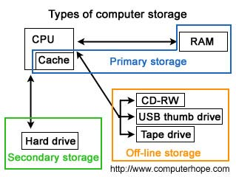
Software type
Human Users
Application Software
Microsoft office
Windows 7
Driver
Compiler
Operating System
Other system software
Hardware
Can we have more than one OS?
Where does the computer store the boot information?
Can Windows version Microsoft office be used in Linux?

Slide 10
Resource Management
Recall: Executing program resides in main memory
Processed in the CPU by fetch- execute cycle
In the real world, we have multiple programs running
Multiprogramming: technique for keeping multiple programs in main memory competing for CPU
Memory management: Keeping track of programs in memory and their addresses (location in memory)
Each active program (in execution) in memory is called a process
Keeping careful track of processes and their different states is known as process management
Keeping track of processes getting CPU time is CPU scheduling
OS itself is a software that gets CPU time as well

Slide 11
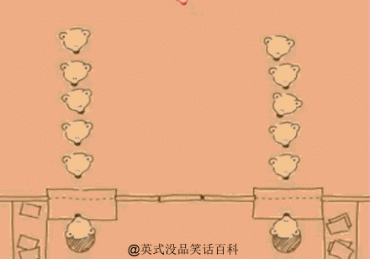
CPU Scheduling
How do processes get CPU time? How does the OS make sure that the CPU is ‘shared nicely’ by the processes?
CPU scheduling is the act of determining which process in the ready state should be moved to the running state
Non preemptive scheduling: Decisions made by the CPU when the current process in the running state gives up the CPU voluntarily
Preemptive scheduling: Decisions made when the OS favors another process and switches the current process for another one
Turnaround time: CPU scheduling metric that measures the elapsed time between a process’s arrival and its completion
Expect average time to be small!

Slide 12
First come first served (FCFS)
Processes are moved to the CPU in the order they arrive
Gantt chart: a bar chart used to display a schedule
Process | Time/ms
P₁ | 24
P₂ | 3
P₃ | 3
P₁ | P₂ | P₃
0
24
27
30
Average turnaround time = (24+27+30)/3 = 27 ms

Slide 13
Shortest job first (SJF)
Processes with the shortest service time are processed first
Process | Time/ms
P₁ | 24
P₂ | 3
P₃ | 3
P₂ | P₃ | P₁
0
3
6
30
Average turnaround time = (3+6+30)/3 = 13 ms

Slide 14
Round Robin (RR)
Processing time is distributed equitably among all ready processes.
Time slice: The amount of time given to each process. The CPU will give up the process for another one once the time is up.
Process | Time/ms
P₁ | 24
P₂ | 3
P₃ | 3
Time slice is 4 ms
P₁ | P₂ | P₃ | P₁ | P₁ | P₁ | P₁ | P₁
0
4
7
10
14
18
22
26
30
Average turnaround time = (30+7+10)/3 = 15.67 ms

Slide 15
Performance characteristics
Which scheduling algorithm is better?
Hard to determine based on this example!
Each algorithm is optimal for specific set of processes
Round Robin
Good average turnaround time
Interactive or timesharing systems
Most widely used and fair
Shortest job first
Best average turnaround time
Comes with overhead since CPU service time needs to be determined and processes sorted accordingly
Algorithm | Average Turnaround time/ms
FCFS | 27
SJF | 13
RR | 15.67

Slide 16
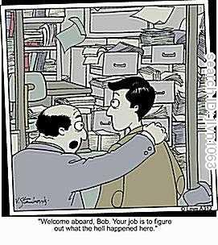
File Systems
A method of storing and organizing computer files and their data
Usually reside on secondary storage devices
Hard disks
File: A named collection of related information stored in a secondary storage device
File System: is the logical view that an OS provides so that users can manage data as a collection of files
Files can be grouped into directories

Slide 17
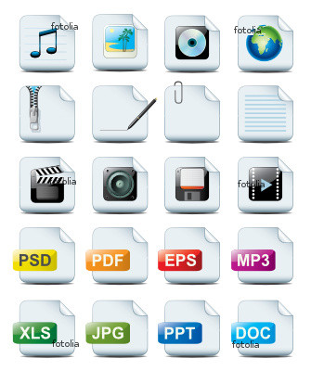
File Attributes
Name: The symbolic file name is the only information kept in human-readable form
Type: This is needed for the OS in order to decode/process data in the file
Different systems support different types such as .txt, .doc, .jpg, .bmp
Each file has its own unique structure
Location: Address of the device and the location on that device
Size: Number of bytes, words
Protection: Access-control information on who can read, write or execute
Time, date, user-identification
Creation, last modification, last use
Useful for protection, security and usage monitoring

Slide 18
File Operations
Operating system must do some basic file operations:
Create a file : Allocate space, record name and location
Writing a file: Data entry
Reading a file
Deleting a file: Release file space
Truncate a file: Erase user content data in a file
Other operations include:
Appending new information to a file
Renaming an existing file
Copying an existing file
Opening/Closing an existing file

Slide 19
File Access
File pointer: Location in a file where the next read/write operation takes place
Can be use controlled
Sequential file access
Direct file access
Beginning
End
Beginning
Current file
pointer
End
Current file
pointer
0 1 2 3 4 5 6 7 8 9 10 11 12 13 14 15 16 17. .
Rewind
Read or write
Jump to any logical record
File
File
Notes:
Sequential file access: technique in which data in a file is accessed in a linear fashion
Direct file access: file is accessed directly by specifying logical record numbers in no particular order
Logical record numbers: numbered lines/logical records

Slide 20
File Protection
Information in a computer system
Reliability or guarding against physical damage, hardware problems
Protection
Ensure reliability by backing up data
Depends on the user, once a day
Protection
Single user system – storage and locking in dvds
Multiple use system – things become tricky!
Each user can have various levels of access to their own files and other user’s files
Controlled access
 | Read | Write/Delete | Execute
Owner | Yes | Yes | No
Group | Yes | No | No
World | No | No | No
Notes:
Sequential file access: technique in which data in a file is accessed in a linear fashion
Direct file access: file is accessed directly by specifying logical record numbers
Logical record numbers: numbered lines/logical records

Slide 21
Directories
Directory: Named collection of files
Why do we need directories:
Organizational purposes for the user
Directory tree: A structure showing the nested directory organization of the file system
Root directory: The directory at the topmost level in which all others are contained
Working directory: The currently active subdirectory
Cannot have two files with the same name under one subdirectory/folder

Slide 22
Directory Trees
C:\
Root
WINDOWS
My Documents
Programs
Sub Directory
Calc.exe
directions.txt
landscape.jpg
MS Office
Drivers
Powerpoint.exe
Downloads
E55IC.ICM
WinWord.exe
landscape.jpg
ATNS2XX.DL
Terminator2.mov
System
Letters
3dMaze.scr
cancelMag.doc
adobep4.hlp
WinZip
QTImage.qtx
Applications
WinZip32.exe
calState.doc
umass.doc
whatsnew.txt
CS105
homework.doc
Notes.doc

Slide 23
Path names
To use a particular file, you have to indicate their path:
Mouse clicks – graphical interface of the OS
Text designation of the location of the file on disk which called a path
Absolute path: A path that begins at the root and lists all successive directories
Example: C:\My Documents\Downloads\Terminator2.mov
Relative path: A path that begins in the current working directory
Example: Current working directory: C:\My Documents\Letters
Access umass.doc: Applications\umass.doc
Working our way back up: (..) Parent directory (.) current directory
Example: ..\landscape.jpg
..\..\Programs\WinZip\whatsnew.txt

