Slide 1
Introduction to: Programming
CS105
Lecture: Yang Mu

Slide 2
Data types
Three categories of primitive data types:
numerical, string, and boolean.
A numerical variable represents a number.
A string variable represents text, for example "2" and "asdf".
A boolean represents either true or false.

Slide 3
Expressions and Statements
Expression: evaluates a value
Statement: does not return a value

Slide 4
Expression
Three general kinds of expressions are
numerical expressions, boolean expressions, and string expressions.
Expression contains: terms and operators.
Function calls are always expressions.

Slide 5
Statement
A statement does NOT return a value, but does something.
Every statement is one or more lines of code.
Every expression is always inside a statement.

Slide 6
Assignment statements
Assignment statements look like variable_name = some_expression. some_expression is ALWAYS some kind of expression.
After this statement is run, variable_name now stores the value of some_expression.
For example, a_variable=4+6 assigns the value 10 to a_variable.
a_variable + 5 now yields 15, and print(a_variable) will print out ?.
A common type of assignment statement looks like var = var + 1.
This takes the current value of var, adds one to it, then assigns that value back to the variable var.
For example, if var was 5 before this line of code runs, then var will be ?

Slide 7
Flow control statements
if statements, while loops, and for loops,
because they make the program skip or repeat some lines of code.

Slide 8
if statements
if (boolean_expression)
{
// some code
}
else
{
// other code
}
if (x>70) { print("you pass") } else { print("you fail") }
if statements branch, depending on a boolean expression.

Slide 9
while loops
i=3 while (i>0) { i=i-1 print(i) }
while (boolean_expression) { // some code }
while loops keep running some code while a boolean expression is true.

Slide 10
for loops
for (i=3; i>0; i=i-1) { print(i) }
for (assignment_statement; boolean_expression; statement) { // some code }
for loops usually are a more concise form of a while loop.

Slide 11
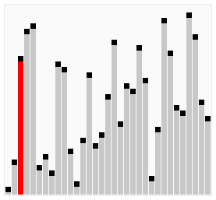
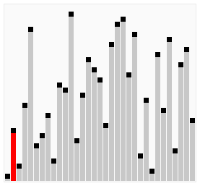
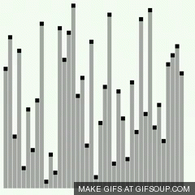
Sorting
Bubble sort
Selection sort
Insertion sort

Slide 12
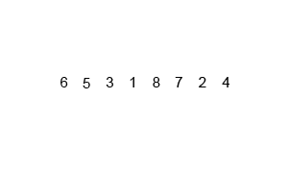
Merge Sort

Slide 13
Compare different sorting algorithms
Using Big O notation.
Big-O notation is a way of ranking about how much time it takes for an algorithm to execute
How many operations will be done when the program is executed?

Slide 14
Big-O
Big-O of a function f(n) is O(f(n)).
Using the Big-O on a function throws away everything but the largest power of n.
The idea behind this is to make analysis simpler.
For example, O(n² + n) = O(n²).
O(2n) = O(n).
O(19) = O(1).

Slide 15
Big-O
We use Big-O to classify the runtime growth rate of algorithms (how fast an algorithm is depending on the size of its input).
In the best case, bubblesort visit each element 1 time. It is O(n)
In the worst case, bubblesort visit each element n times. It is O(n²).
In the average case, bubblesort visit each element n/2 times. It is O(n²).
Hence, we can say bubblesort is O(n²).
Mergesort visits each element log₂ (n) times.
Hence, mergesort is O(n*log₂ (n)).

Slide 16
Hierarchy of runtimes
Big-O | Name | Speed | Computations
O(1) | Constant runtime | Very fast, does not depend on size of input. | Very few, does not depend on size of input
O(log(n)) | Logarithmic runtime | Very fast. | Few, depends only a little bit on size of input
O(n) | Linear runtime | Fast. | Some, depending linearly on size of input
O(n*log(n)) | n*log(n) runtime | Acceptable. | Depends more on size of input
O(n²) | Quadratic runtime | Slow. | A lot, depending on size of input. If n doubles, runtime quadruples.
O(n³), O(n⁴), ... | Polynomial runtime | Very slow. | Way too many computations, not very scalable.
O(2^{n}) | Exponential runtime | Intractable (worst). | Ridiculous amount of computations, cannot scale.

Slide 17
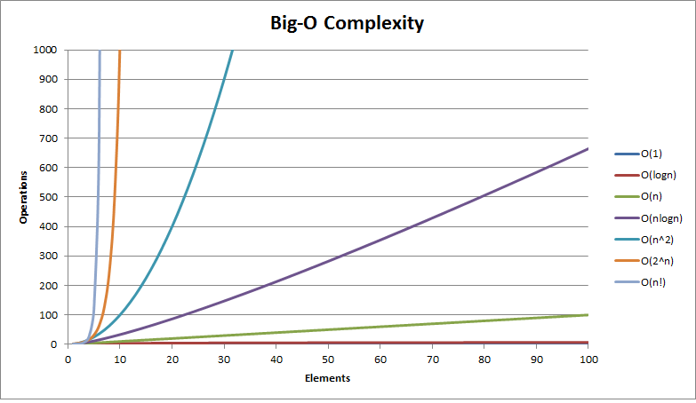
Hierarchy of runtimes
Hierarchy of runtimes (lower is faster / more scalable and better).
From http://bigocheatsheet.com/img/big-o-complexity.png.

Slide 18
Practice
What is the time complexity for searching an element from an array?
O(n)
What is the time complexity for searching an element from a sorted array?
O(log₂ (n)) at best
What is the time complexity to get the median of an array?
O(nlog₂ (n))
What is the time complexity to get the median of a sorted array?
O(1)
What is the time complexity to get the median of two arrays?
O((m+n)log₂(m+n))
What is the time complexity to get the median of two sorted arrays?
O((m+n)log₂(m+n)) -> O(m+n) -> O(log₂(m+n))

