Slide 1

Local Discriminative Distance Metrics and Their Real World Applications
Yang Mu, Wei Ding
University of Massachusetts Boston
2013 IEEE International Conference on Data Mining, Dallas, Texas, Dec. 7
PhD Forum

Slide 2
Large-scale Data Analysis framework
IEEE TKDE in submitting
ICAMPAM (1), 2013
ICAMPAM (2), 2013
IJCNN, 2011
KSEM, 2011
ACM TIST, 2011
IEEE TSMC-B, 2011
Neurocomputing, 2010
Cognitive Computation, 2009
Feature selection
Distance learning
Feature extraction
Classification
IEEE TKDE in submitting
PR 2013
ICDM PhD forum, 2013
IJCNN, 2011
IEEE TSMC-B, 2011
Neurocomputing, 2010
Cognitive Computation, 2009
KDD 2013
ICDM 2013
Representation
Linear time
Structure
Separability
Discrimination
Online algorithm
Pairwise constraints
Performance

Slide 3
Feature extraction
Feature selection
Distance learning
Classification
Representation
Discrimination

Slide 4
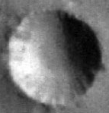


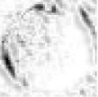
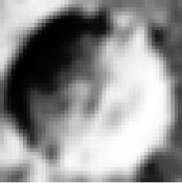
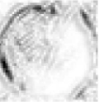
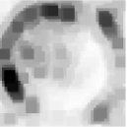
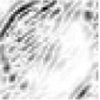
Mars impact crater data
Max operation
within S1 band
Max operation
within C1 map
Linear summation
Input crater image
C1 map pool over
scales within band
C1 map pool over
local neighborhood
Two S1 maps in one band
W. Ding, T. Stepinski:, Y. Mu: Sub-Kilometer Crater Discovery with Boosting and Transfer Learning. ACM TIST 2(4): 39 (2011):
Y. Mu, W. Ding, D. Tao, T. Stepinski: Biologically inspired model for crater detection. IJCNN (2011)

Slide 5
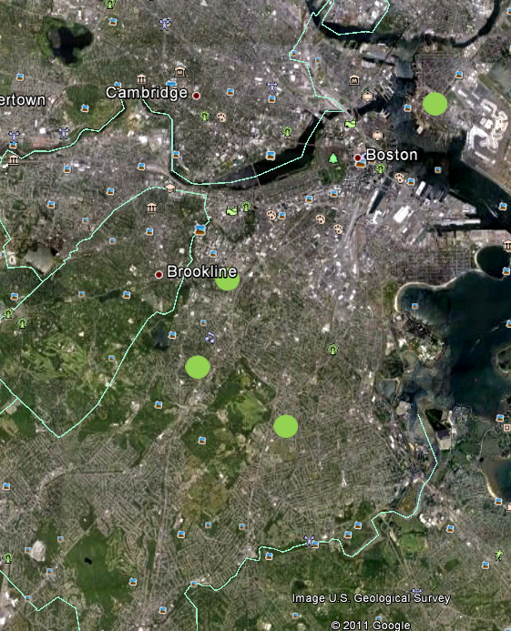

  Crime data
  Spatial influence
  Temporal influence
  The influence of other criminal events
  Other criminal events may influence the residential burglaries: construction permits, foreclosure, mayor hotline inputs, motor vehicle larceny, social events, and offender data
Crimes will be never spatially isolated (broken window theory)
Time series patterns obey the social Disorganization theories
…

Slide 6
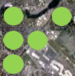
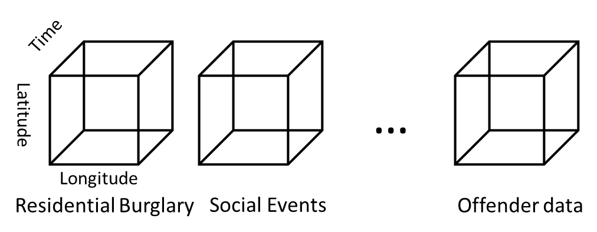

An example of residential burglary in a fourth-order tensor
Original structure
Feature representation
Vector feature
1 | 0 | 1
1 | 1 | 0
1 | 0 | 0
[1, 0, 1, 1, 1, 0, 1, 0, 0]
Geometry structure is destroyed
Tensor feature
[Residential Burglary, Social Events,…, Offender data]
…
…
…
…
Y. Mu, W. Ding, M. Morabito, D. Tao: Empirical Discriminative Tensor Analysis for Crime Forecasting. KSEM 2011

Slide 7
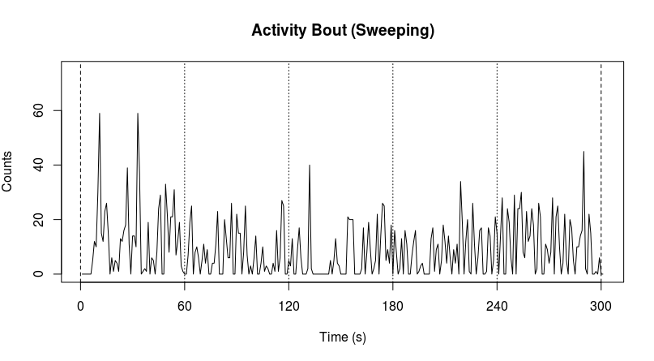
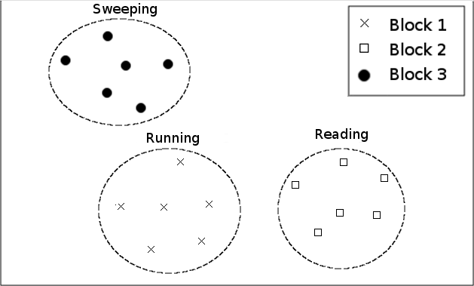
Accelerometer data
Feature vectors
One activity has multiple feature vectors,
we proposed the block feature representation for each activity.
Y. Mu, H. Lo, K. Amaral, W. Ding, S. Crouter: Discriminative Accelerometer Patterns in Children Physical Activities, ICAMPAM, 2013
K. Amaral, Y. Mu, H. Lo, W. Ding, S. Crouter: Two-Tiered Machine Learning Model for Estimating Energy Expenditure in Children, ICAMPAM, 2013
Y. Mu, H. Lo, W. Ding, K. Amaral, S. Crouter: Bipart: Learning Block Structure for Activity Detection, IEEE TKDE submitted

Slide 8
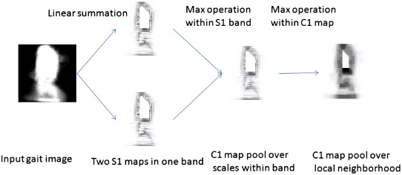
Other feature extraction works
Y. Mu, D. Tao: Biologically inspired feature manifold for gait recognition. Neurocomputing 73(4-6): 895-902 (2010)
B. Xie, Y. Mu, M. Song, D. Tao: Random Projection Tree and Multiview Embedding for Large-Scale Image Retrieval. ICONIP (2) 2010: 641-649
Y. Mu, D. Tao, X. Li, F. Murtagh: Biologically Inspired Tensor Features. Cognitive Computation 1(4): 327-341 (2009)

Slide 9
Feature extraction
Feature selection
Distance learning
Classification
Linear time
Online algorithm

Slide 10
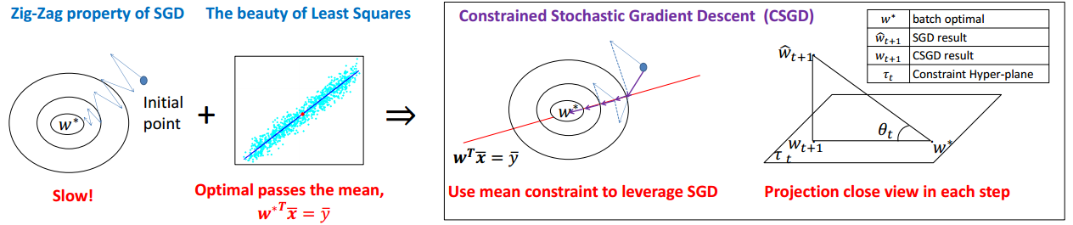
Online feature selection methods
Lasso
Group lasso
Elastic net
and etc.
Common issue
Least squares loss optimization
We proposed a fast least square loss optimization approach, which benefits all least square based algorithms
Y. Mu, W. Ding, T. Zhou, D. Tao: Constrained stochastic gradient descent for large-scale least squares problem. KDD 2013
K. Yu, X. Wu, Z. Zhang, Y. Mu, H. Wang, W. Ding: Markov blanket feature selection with non-faithful data distributions. ICDM 2013

Slide 11
Feature extraction
Feature selection
Distance learning
Classification
Structure
Pairwise constraints

Slide 12
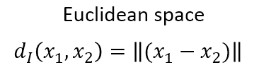
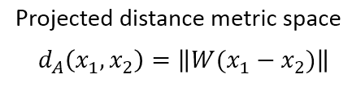
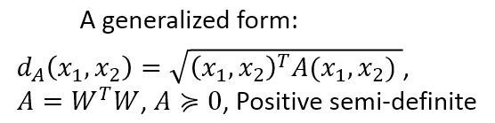
Why not use Euclidean space?
Why am I close to
that guy?

Slide 13
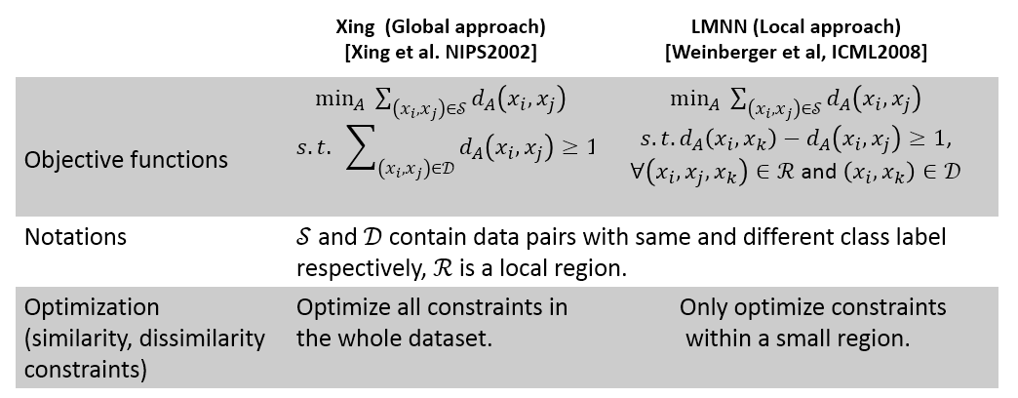
Representative state-of-the-art methods

Slide 14
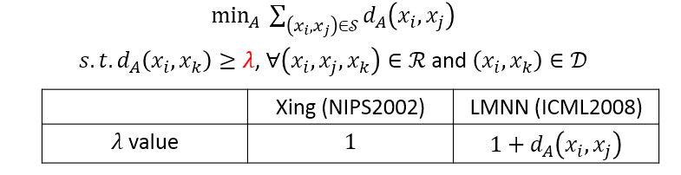
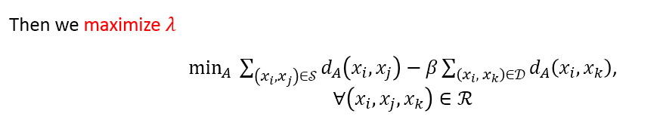
Our approach (i)
A generalized form
Y. Mu, W. Ding, D. Tao: Local discriminative distance metrics ensemble learning. Pattern Recognition 46(8): 2013
Y. Mu, W. Ding: Local Discriminative Distance Metrics and Their Real World Applications. ICDM PhD forum, 2013

Slide 15






Can the Goals be Satisfied?
local region 2 with right shadowed craters
Non-Crater
Non-Crater
Projection directions conflict
Projection direction
local region 1 with left shadowed craters
  Optimization issue (constraints will be compromised)

Slide 16
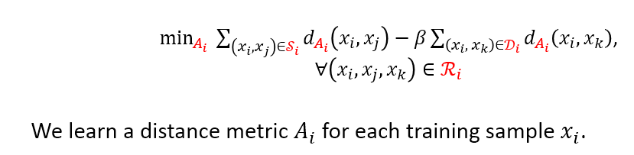
Our approach (ii)
Comments:
The summation is not taken over i. n distance metrics in total for n training samples.
The distance between different class samples are maximized.
Y. Mu, W. Ding, D. Tao: Local discriminative distance metrics ensemble learning. Pattern Recognition 46(8): 2013
Y. Mu, W. Ding: Local Discriminative Distance Metrics and Their Real World Applications. ICDM PhD forum, 2013

Slide 17
Feature extraction
Feature selection
Distance learning
Classification
Separability
Performance

Slide 18
VC Dimension Issues
In classification problem, distance metric serves for classifiers
  Most classifiers have limited VC dimension.
  For example: linear classifier in 2-dimensional space has VC dimension 3.
Fail
  Therefore, a good distance metric does not mean a good classification result

Slide 19
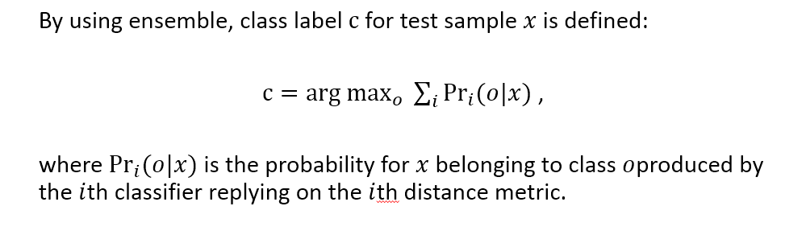
Our approach (iii)
We have n distance metrics for n training samples.
By training classifiers on each distance metric, we will have n classifiers.
This is similar to K-Nearest Neighbor classifier which has infinite VC-dimensions

Slide 20
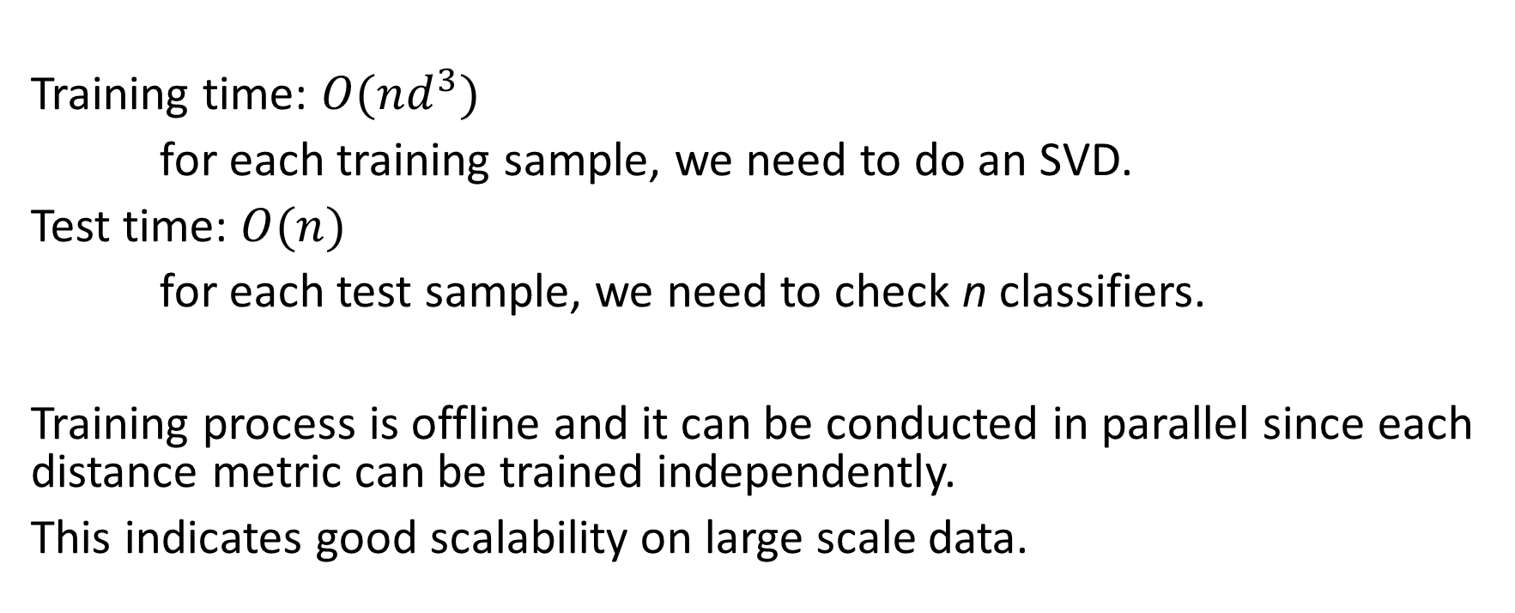
Complexity analysis
Training time: $O(nd^{3})$
for each training sample, we need to do an SVD.
Test time: $O(n)$
for each test sample, we need to check n classifiers.
Training process is offline and it can be conducted in parallel since each distance metric can be trained independently.
This indicates good scalability on large scale data.

Slide 21
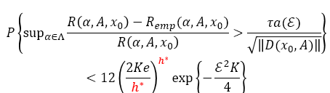
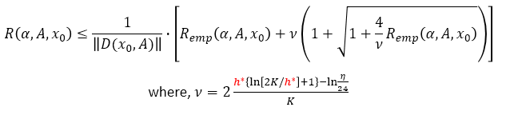

Theoretical analysis
The convergence rate to the generalized error for each distance metric (with VC dimension)
The error bound for each local classifier (with VC dimension)
The error bound for classifiers ensemble (without VC dimension)
Detail proof please refer to:
Y. Mu, W. Ding, D. Tao: Local discriminative distance metrics ensemble learning. Pattern Recognition 46(8): 2013
Y. Mu, W. Ding: Local Discriminative Distance Metrics and Their Real World Applications. ICDM, PhD forum 2013

Slide 22
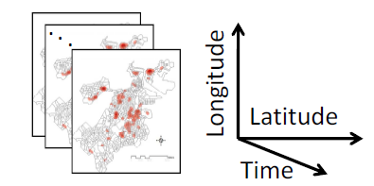
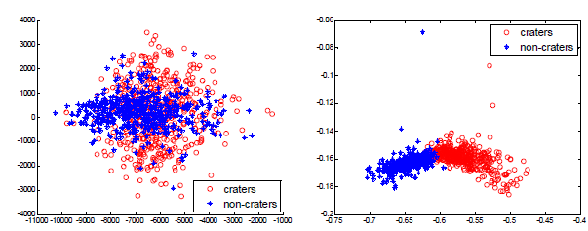
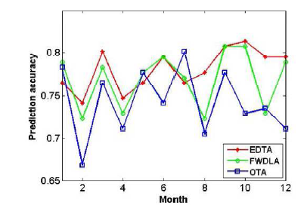
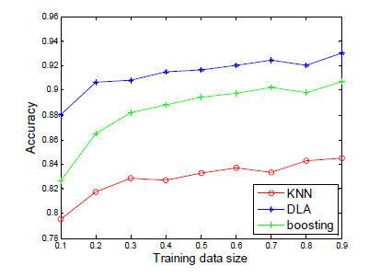
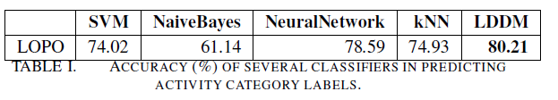
New crater feature under
proposed distance metric
Proposed
method
Crime prediction
Crater detection
Accelerometer based activity recognition

Slide 23



